Slide 1



National Audit Project 8:
Major Complications of Regional Anaesthesia and Perioperative Spinal Cord and Nerve Injury
in the UK and Republic of Ireland

Slide 2
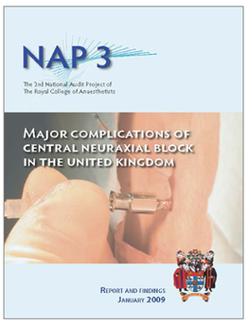
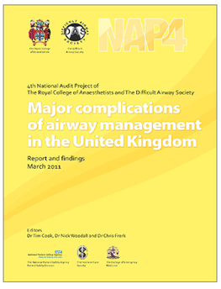
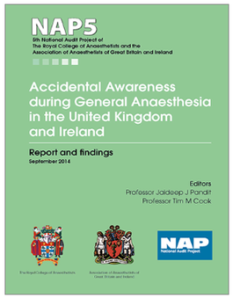
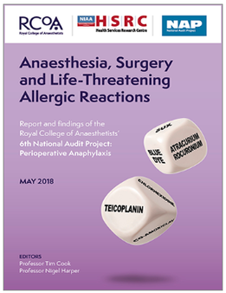
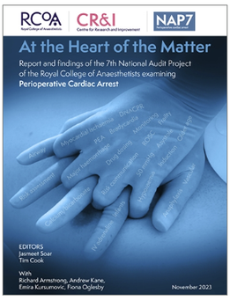
NAP8 - Background
National Audit Projects - since 2009
  Serious but rare events
  Important to patients and anaesthetists
  Incompletely studied by incidence or nature
  Not suitable for study by other methodologies

Slide 3
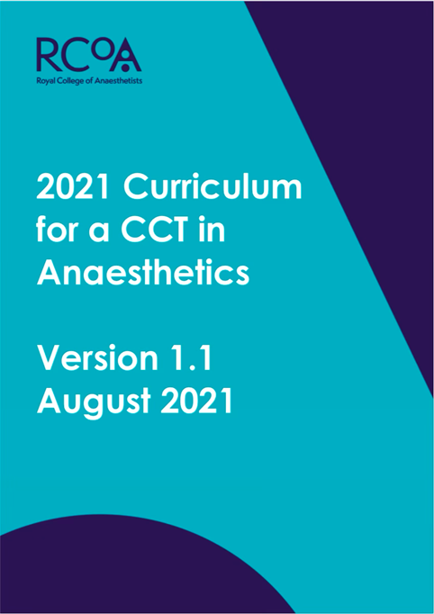
NAP8 - Background
Regional Anaesthesia (RA)
  Increase in use of RA techniques over last 10 years [1,2]
  More prominent role in RCoA 2021 Curriculum
  NAP7: ∼14% of all non-obstetric anaesthetic procedures involved a peripheral nerve block (PNB) [3]

Slide 4
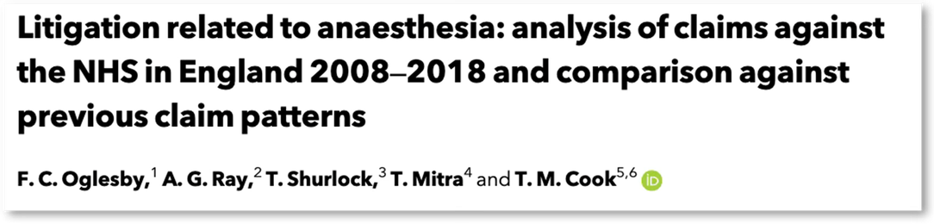

NAP8 - Background
Regional Anaesthesia (RA)
  RA is most common reason for NHS litigation in anaesthesia-related claims [4]
  Claims due to peripheral nerve blocks have doubled in 10 years
  Need for accurate data on risk, complications and harm to inform consent discussions [5]

Slide 5
NAP8 - Background
Central Neuraxial Blocks (CNB)
  NAP3 (2009): Major Complications of CNB [6]
  NAP7 (2024): Change in surgical population - older, frailer, more co-morbid [3]
  Advent of DOACs - change in risk profile for RA techniques
  Need to re-evaluate risk and close NAP3 loop

Slide 6
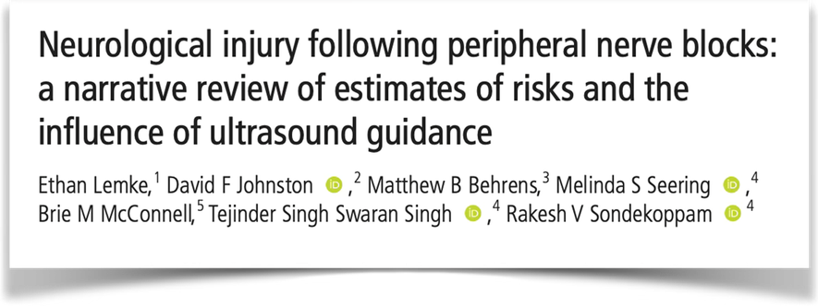
NAP8 - Background
Peripheral Nerve Blocks (PNB)
  Permanent nerve injury approximately 1 in 3000?
• Inadequate duration of follow up in some studies
• Inadequate investigation to determine if definitely secondary to PNB

Slide 7
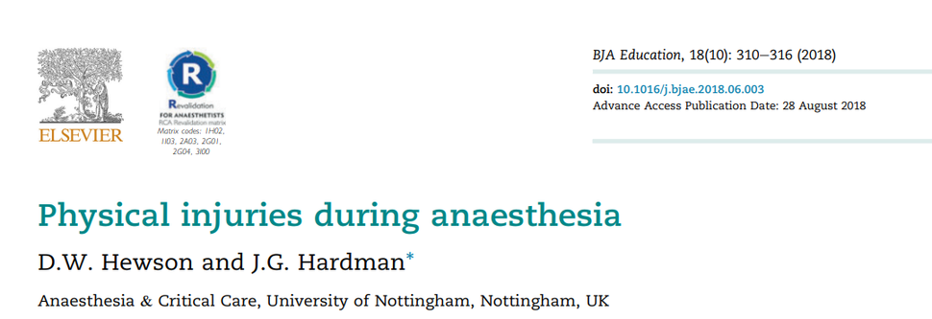
NAP8 - Background
Perioperative Nerve Injury
Unrelated to PNB or direct surgical injury - position/compression-related
  Ulnar injury 1:215-385
  Peroneal injury 1:4600
  Brachial plexus injury 1:2000
Dated evidence/Under-reporting - incidence unclear

Slide 8
NAP8 - Background
Spinal Cord Injury
Unrelated to direct surgical injury
  Incidence - High risk cardiothoracic procedures ~1.5% [7]
  Unclear incidence in non-cardiovascular procedures - case report only
  Potentially devastating sequelae

Slide 9
NAP8 Scope

Slide 10
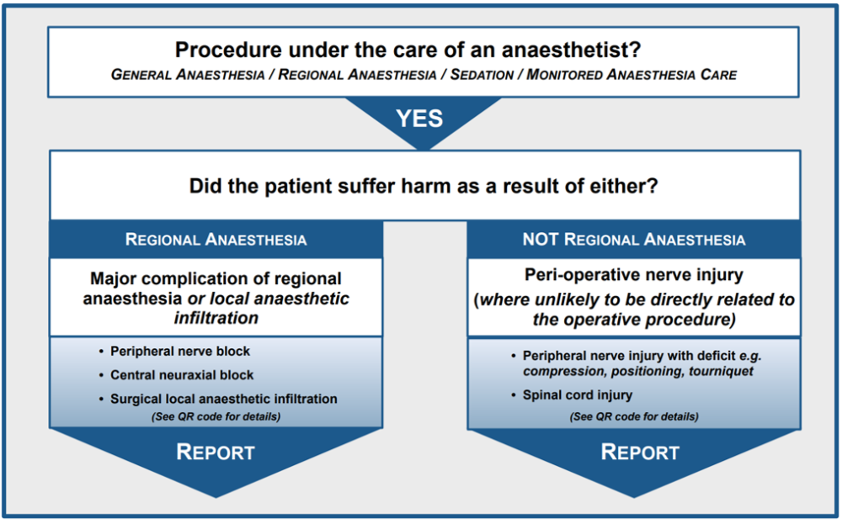
NAP8 Inclusion Criteria

Slide 11
NAP8 Inclusion Criteria
Under the care of an anaesthetist:
Any procedure conducted under general anaesthesia, regional anaesthesia/analgesia, local anaesthesia or monitored anaesthesia care with an anaesthetist or physician assistant in anaesthesia present
NHS and Independent Sector

Slide 12

NAP8 Complications
Regional Anaesthesia
PNB Only
CNB Only
Wrong route drug error​
Local anaesthetic systemic toxicity (LAST)​
Pneumothorax​
Cardiac arrest directly due to regional anaesthesia​
Infection at site of regional anaesthesia​
Anaphylaxis​
Visceral or other organ injury​
Wrong site block
Phrenic nerve palsy
Haemorrhage
Peripheral nerve injury due to PNB
Other
High/total/complete spinal
Respiratory failure
Vertebral canal haematoma
Vertebral canal abscess
Infective meningitis
Adhesive arachnoiditis
Nerve injury after CNB
Other
Spinal cord injury unrelated to direct surgical injury
Peripheral nerve injury unrelated to PNB/CNB/direct surgical injury
If in doubt
REPORT
Not RA
Related

Slide 13

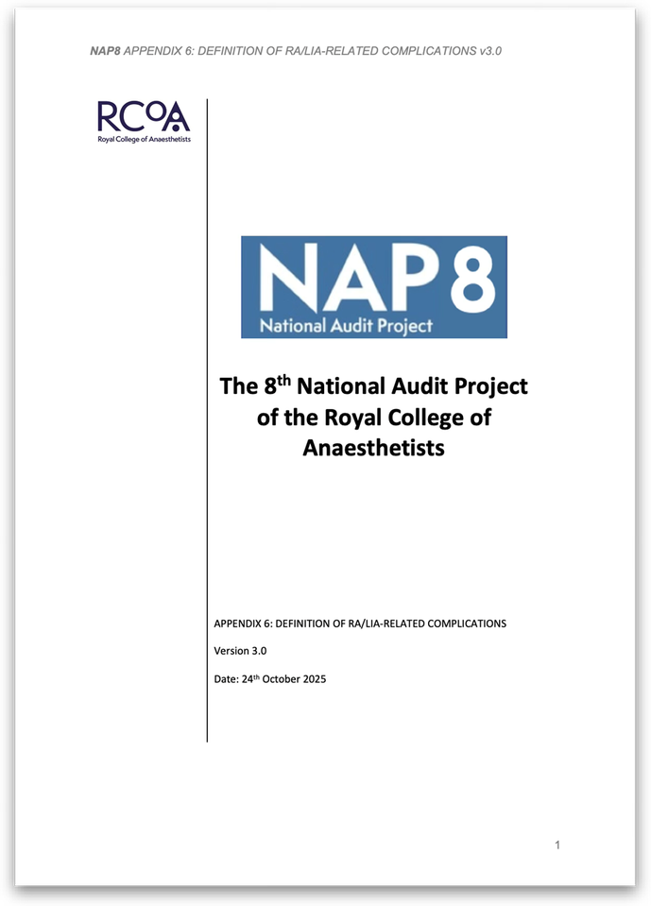
NAP8 Complications
If in doubt
REPORT

Slide 14
NAP8 Exclusion Criteria
· Sedation or anaesthesia in critical care not involving regional anaesthesia
· Critical care procedures except for regional anaesthetic/analgesic procedures
· Intra or interhospital transfers
· Any blocks performed outwith care of anaesthetist/physician assistant in anaesthesia (e.g. emergency physicians)

Slide 15
NAP8 - Structure
Baseline Surveys
Activity Survey
Case Registry
At the start of/prior to NAP8:
December 2025 to mid 2026
Individual survey:
  All anaesthetists and physician assistants in anaesthesia
  Personal experience and current practice of regional anaesthesia and peri-operative nerve or spinal cord injury
Local Coordinator Survey:
  Departmental structure and processes
During NAP8:
8th - 21st June 2026
7-day activity survey of all sites in the UK and Republic of Ireland
Randomised over a 2-week period
To estimate denominator data
One year:
Starting 18th May 2026 for 12 months
Please report all cases that meet inclusion criteria to your local coordinator
Follow up for 6 months post complication or until resolved
Complete detailed case review form
All cases reviewed by multidisciplinary NAP8 panel

Slide 16

NAP8 - Structure
Baseline Surveys
Activity Survey
Case Registry
ALL REPORTING IS ANONYMOUS AND CONFIDENTIAL
At the start of/prior to NAP8:
December 2025 to mid 2026
Individual survey:
  All anaesthetists and physician assistants in anaesthesia
  Personal experience and current practice of regional anaesthesia and peri-operative nerve or spinal cord injury
Local Coordinator Survey:
  Departmental structure and processes
During NAP8:
8th - 21st June 2026
7-day activity survey of all sites in the UK and Republic of Ireland
Randomised over a 2-week period
To estimate denominator data
One year:
Starting 20th April 2026 for 12 months
Please report all cases that meet inclusion criteria to your local coordinator
Follow up for 6 months post complication or until resolved
Complete detailed case review form
All cases reviewed by multidisciplinary NAP8 panel

Slide 17
Baseline Surveys
Individual Baseline Survey
10-15 minutes (SmartSurvey – smartphone quicker than a computer)
Link distributed by local coordinator (LC)
Certificates of completion available from LC with completion code
Departmental Survey
One per site
Launched: 1st December 2025

Slide 18
Case Registry
One year case registry period
Additional 6 months after the one year to allow follow up of any nerve injuries Further 2 months for database entry
Report any case to local coordinator in first instance
LC will also liaise with other colleagues to collect eligible cases
NO ADDITIONAL FOLLOW-UP REQUIRED BEYOND USUAL PROCEDURE
Launch: 18th May 2026

Slide 19
Activity Survey
7 consecutive day snapshot of anaesthetic activity in UK and ROI
Individual SmartSurvey form for each case
Completed by anaesthetist or physician assistant in anaesthesia
Launch: 8-21st June 2026

Slide 20


Independent Sector
Potentially lots of orthopaedics and RA
Abbreviated activity survey - quicker to complete
If complication from Independent Sector presents to NHS please liaise with Independent Sector anaesthetist to avoid double counting

Slide 21
Associate Local Coordinator Scheme
For Residents, Specialty and
Locally Employed Doctors
Hands-on role assisting LC with NAP delivery
Discuss with your LC for more information

Slide 22
Thank you for your time and for helping with NAP8!
Questions?

Slide 23
References
  Konijn, A. ∙ Aldecoa, C. ∙ Benhamou. Regional anaesthesia practices: insights from a European survey Eur J Anaesth Int Care. 2023; 2, e0026
  Gabriel, R.A. ∙ Ilfeld, B.M. Use of regional anesthesia for outpatient surgery within the United States: a prevalence study using a nationwide database Anesth Analg. 2018; 126:2078-2084
  Patient characteristics, anaesthetic workload and techniques in the UK: an analysis from the 7th National Audit Project (NAP7) activity survey. Anaesthesia. 2023; 78:701-711
  Oglesby, F.C. ∙ Ray, A.G. ∙ Shurlock, T. et al. Litigation related to anaesthesia: analysis of claims against the NHS in England 2008–2018 and comparison against previous claim patterns. Anaesthesia. 2022; 77:527-537
  Lewis, O. ∙ Lloyd, J. ∙ Ferry, J. et al. Regional anaesthesia research priorities: a Regional Anaesthesia UK (RA-UK) priority setting partnership involving patients, carers and healthcare professionals. Anaesthesia. 2025; 80:170-178
  Major complications of central neuraxial block: report on the Third National Audit Project of the Royal College of Anaesthetists. Br J Anaesth. 2009; 102:179-190
  Mousa A.Y., Morcos R., Broce M., Bates M.C., Abu Rahma A.F. New Preoperative Spinal Cord Ischemia Risk Stratification Model for Patients Undergoing Thoracic Endovascular Aortic Repair. Vasc Endovascular Surg. 2020;54(6):487-496.

