Slide 1

Lifelong Learning 2024 survey results summary

Slide 2
Participation rate 2022 vs 2024
2024:
Survey one had 783 respondents
Survey two had 308 respondents
2022:
Survey one had 679 respondents
Survey two has 331 respondents
Comparison:
Survey One: Participation increased by approximately 15.31% from 2022 to 2024.
Survey Two: Participation decreased by approximately 6.95% from 2022 to 2024.

Slide 3
What do you like most about the LLP?
"Everything all in one place"​
"Logbook is easy to use and clear"​
"Fairly self-intuitive"​
"Easy to navigate"​
"Clean interface"​
"Ease of use on a variety of devices"​
"Useful for keeping logbook for appraisal and logging CPD"​
"Getting a CPD summary"​
"Centralised repository that can be accessed by tutors and ARCP panel"​
"Recent logbook changes have meant filling in cases is easier and quicker"​
"The new logbook function that allows you to duplicate logs"​
"Creating SLEs is generally straightforward"​
"Forms are relatively free text so can be modified to situation"

Slide 4
What do you like least about the LLP? ​
Clunky User Interface: Users find the logbook and overall interface cumbersome, with too many clicks required to navigate through forms and submissions. There is a call for a more intuitive design.​
Lack of Mobile Access: Many respondents emphasized the absence of a mobile app, making it difficult to log activities on the go. Users expressed frustration about needing to use the desktop version exclusively.​
Bugs and Glitches: Frequent glitches, such as forms not saving, random log-outs, and errors in form submissions, were reported. Users expressed frustration over the unreliability of the system.​
Inefficient Linking of Assessments: The process of linking assessments to the curriculum is seen as tedious and time-consuming. There is a desire for functionality that allows multiple capabilities to be linked simultaneously without refreshing the page.​
Limited Range of Procedures: Users reported that the logbook lacks a comprehensive list of procedures, forcing them to input "other" for many common operations. This inadequacy complicates the logging process.​
Lack of Support for ACCS Trainees: ACCS trainees highlighted that the platform does not cater well to their specific needs, noting missing forms and the need for manual entry of important documentation that should be integrated into the system.​

Slide 5
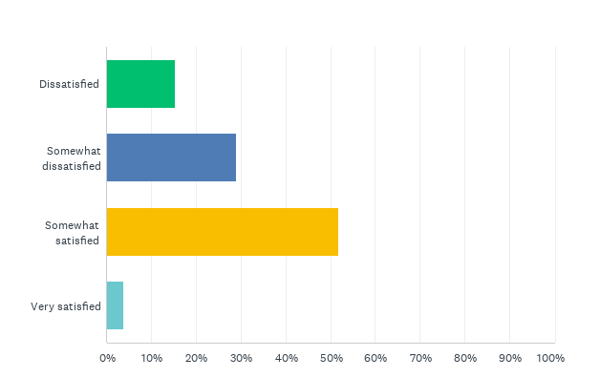
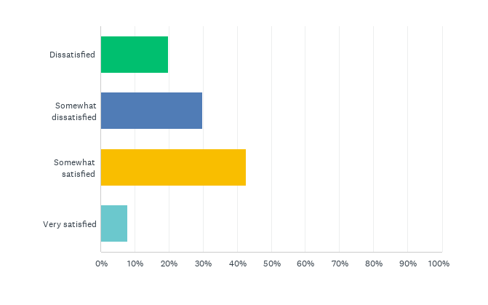
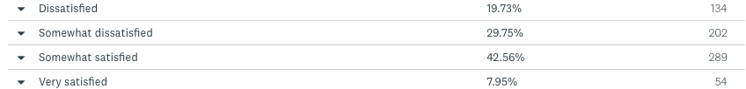
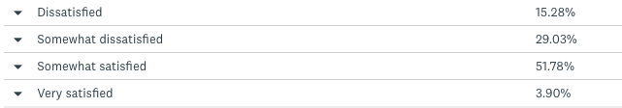
How satisfied are you with the LLP?
2022
2024
55.68% were satisfied with LLP In 2024 compared to 50.51% in 2022. 5% increase

Slide 6
When thinking about other logbooks you may have used, how does the LLP compare?
Poorly / Clunky: Many respondents described the LLP logbook as difficult to use, clunky, and cumbersome. They often found it time-consuming and less user-friendly compared to other logbooks or systems they had used.
N/A / Haven't used other logbooks: A significant portion of respondents indicated they haven't used other logbooks or systems, making it challenging for them to provide a comparative evaluation.
Better / Easier to use: Some respondents found the LLP logbook to be better or easier to use compared to other logbooks, appreciating its integration with the LLP and certain functionalities, despite recognizing areas where it could be improved.

Slide 7
If you could improve three things with the LLP what would they be?
Develop an App: Create a dedicated mobile app for better access and functionality, including offline use and notifications.
Improve Logbook Features: Enhance logbook capabilities with better filtering, search options, and integration with the curriculum.
Better Reminders and Notifications: Implement a reminder system for tasks and assessments, and provide notifications for updates.
Enhanced Progress Tracking: Add features for summarizing progress, tracking entrustment levels, and generating detailed reports.
Integration with Other Systems: Improve links between different portfolios and integrate additional functionalities like document storage and automated logging.

Slide 8
In summary
55.68% were satisfied with LLP compared to 50.51% in 2022. 5% increase
68.92% responded to using the logbook in 2024 compared to 80.19% in 2022. That is a reduction of 11.27%
In 2022, 35.83% were satisfied with the logbook compared to 32.54% in 2024.
63.3% found it easy to use the ESSR whilst only 61.83% in 2024.
38.46% in 2022 found it easy to use the MTR compared to 61.68% in 2024. Increase of 23.22%
76% found it easy to use the MSF in 2022 compared to 86.58% in 2024. Nearly 11% increase

Slide 9
Any questions?

