Slide 1


Presentation title on two lines Name Title
NAP7: an overview

Slide 2
Preface
NAP7 runs to 560 pages
There are 39 chapters
In 100 slides we over only a superficial overview – please read the report

Slide 3

NAPs
NAP3 Permanent harm from spinal
1 in 3000
1 in 120,000
1 in 12,000
1 in 19,000
1 in 50,000
NAP4 Anaesthesia airway death
?
NAP5 Awareness
NAP6 Life threatening anaphylaxis
Periop cardiac arrest

Slide 4
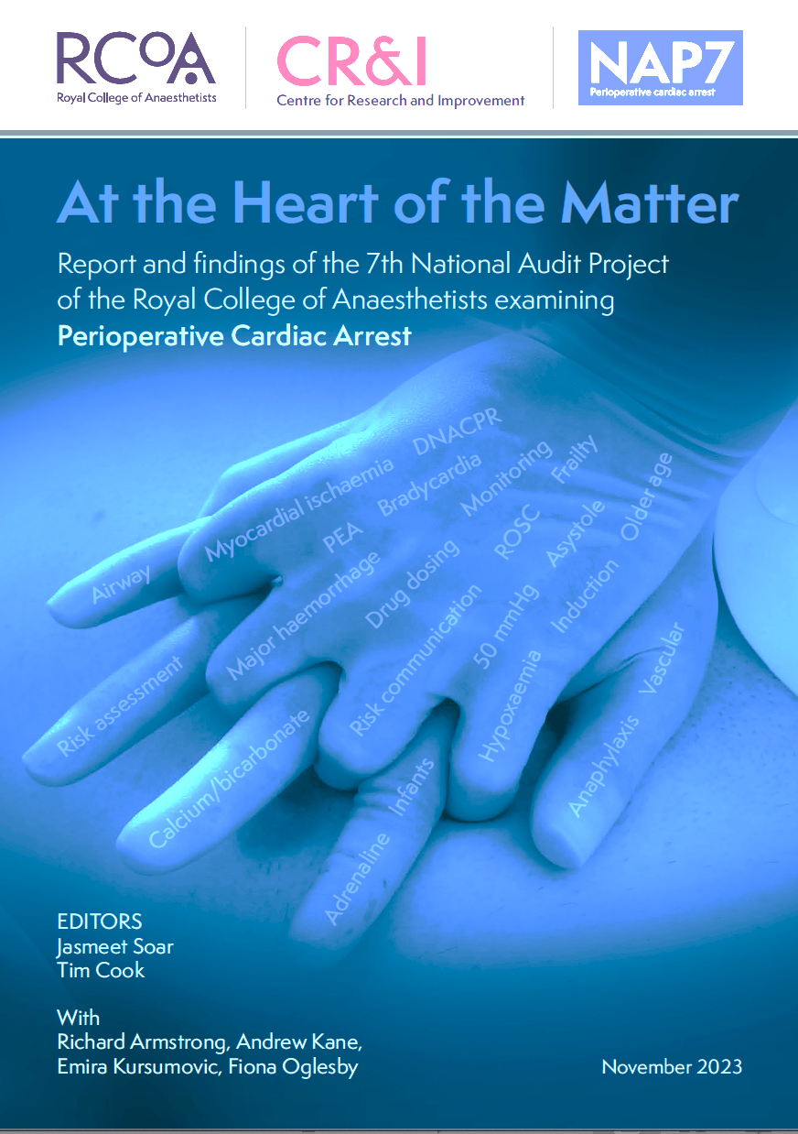

Slide 5


https://www.rcoa.ac.uk/nap7-perioperative-cardiac-arrest
Google
NAP7 RCoA
Main 1/Main 2
Airway/Breathing
Obstetric
Anaphylaxis
Frailty
Obesity
Vascular
DNACPR discussions
Regional
Anaesthetic associates
Controversies

Slide 6
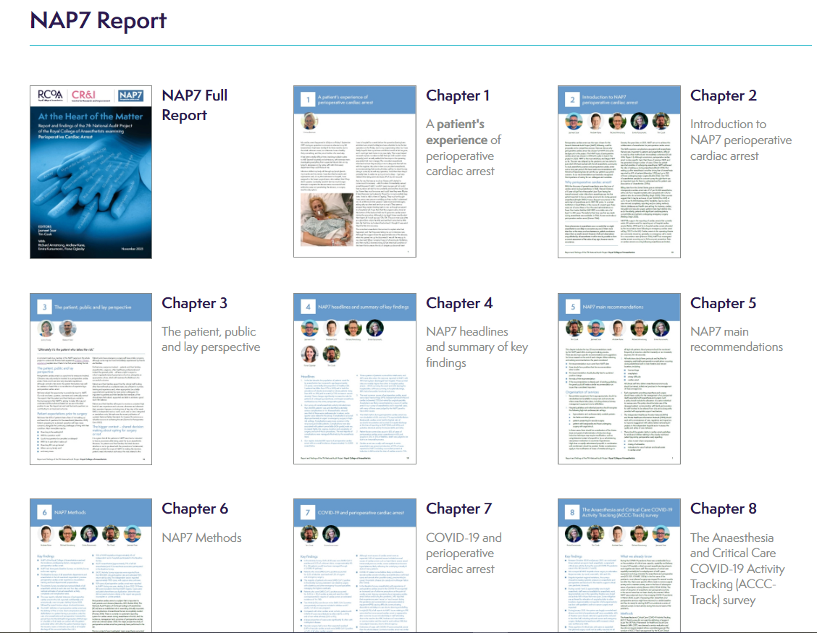
Google
NAP7 Report
https://www.rcoa.ac.uk/nap7-perioperative-cardiac-arrest

Slide 7

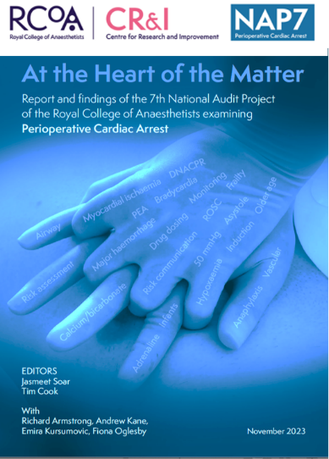
National Audit Projects

Slide 8
National Audit Projects
RARE
COMPLICATIONS
IMPORTANT TO PATIENTS
IMPORTANT TO ANAESTHESTISTS
NOT FULLY DEFINED
NO BETTER METHODOLOGY

Slide 9


NAP7 Perioperative Cardiac Arrest

Slide 10

Patient fear of anaesthesia complications
1000 surveyed (89.4% returns)
Fear of death was greatest concern
Fear of death
major surgery 46%
moderate 38%
minor 25%
Older people – lesser fear of death
Burkle CM et al. Acta Anaesthesiol Scand. 2014;58:1249-57.

Slide 11
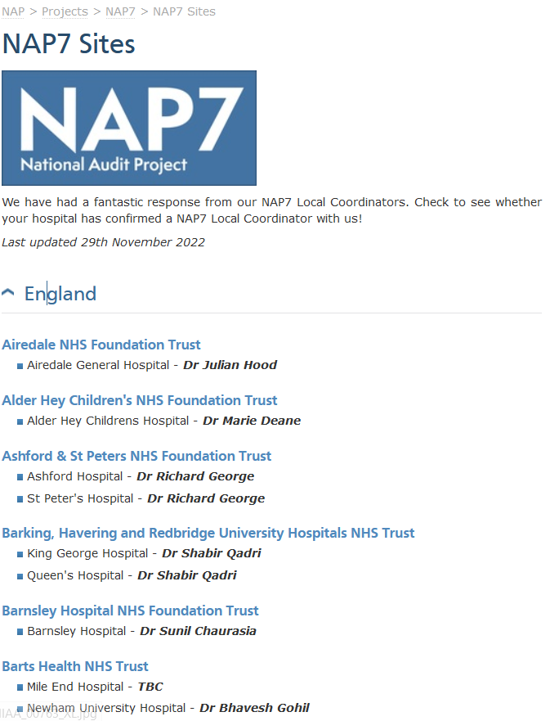


COLLABORATION
ALL UK
ANAESTHETISTS

Slide 12















NAP7 – Stakeholders
Notes:
The steering panel represent various stakeholders relevant to NAP7
Need to add surgeons
Rcoa admin, HSRC director
Lay comittee

Slide 13

NAP7 Core Team
Jas Soar
Emira Kursumovic
Andrew Kane
Richard Armstrong
Tim Cook
Fiona Oglesby
January 2020
Notes:
One thing Professor Gillies was well known for was generating future talent and 7 eminent profs of anaesthesia were nurture in his dept.
NAP projects are a team effort
Prof Tim Cook – who is College director of NAPs
1st time we have NAP7 fellows
Drs Andrw kane, Richard Armstrong Emira Kursumovic and Fiona Oglesby
i am sure they will all do very well

Slide 14
Methods
2018-20
Launch May 2020……til March 2020

Slide 15

Methods
2018-20
Launch May 2020……til March 2020
2021-2023
All virtual
All change
All the same

Slide 16




NAP7 – three parts
BASELINE
SURVEY
At start of NAP7
Personal experiences of perioperative cardiac arrest
ACTIVITY
SURVEY
During NAP7
4-day activity survey of all sites
‘Denominator data’
CASE
REPORTING
1 year
Detailed case review form with panel review
‘Numerator data’
Kane et al., Anaesthesia 2022; 77: 1376-1385,
Notes:
Local Coordinator:
Departmental structures & processes
All anaesthetists:
Personal experiences of perioperative cardiac arrest
Report all cases that meet inclusion criteria to Local Coordinator
Complete detailed case review form
Cases reviewed by NAP7 Panel
Autumn 2021
4-day activity survey of all sites
To estimate denominator data

Slide 17

NAP7 inclusion criteria
Yes
Did the patient have >5 chest compressions and/or defibrillation?
Yes
Were they having a procedure under the care of an anaesthetist?
No
Do NOT
report
No
Case likely included
Notes:
From WHO check in to 24 post surgery from handover toannother clinician or discharge home

Slide 18
Pre-procedure location
Theatre
Recovery / Ward / PACU / Critical Care
Radiology
Delivery room
Home
Other areas
WHO Checklist or Hands-on contact
Handover
Home or 24 hours
Post handover
NAP7 INCLUSION PERIOD
Time
Notes:
Known knowns, known unknowns and unknown unknowns – recognise our blind spots

Slide 19
Pre-procedure location
Theatre
Recovery / Ward / PACU / Critical Care
Radiology
Delivery room
Home
Other areas
WHO Checklist or Hands-on contact
Handover
Home or 24 hours
Post handover
NAP7 ACTIVITY
Time
Notes:
Known knowns, known unknowns and unknown unknowns – recognise our blind spots

Slide 20
NAP7 – three parts
BASELINE
SURVEY
At start of NAP7
What we do & know.
Personal experiences of perioperative cardiac arrest
ACTIVITY
SURVEY
During NAP7
CASE
REPORTING
1 year
10,746 responses
Kane et al., Anaesthesia 2022; 77: 1376-1385
Notes:
Local Coordinator:
Departmental structures & processes
All anaesthetists:
Personal experiences of perioperative cardiac arrest
Report all cases that meet inclusion criteria to Local Coordinator
Complete detailed case review form
Cases reviewed by NAP7 Panel
Autumn 2021
4-day activity survey of all sites
To estimate denominator data

Slide 21
NAP7 – three parts
BASELINE
SURVEY
At start of NAP7
What we do & know.
Personal experiences of perioperative cardiac arrest
ACTIVITY
SURVEY
During NAP7
4-day activity survey of all sites
‘Denominator data’
CASE
REPORTING
1 year
‘Numerator data’
10,746 responses
26,000 cases
Kane et al., Anaesthesia 2022; 77: 1376-1385
Notes:
Local Coordinator:
Departmental structures & processes
All anaesthetists:
Personal experiences of perioperative cardiac arrest
Report all cases that meet inclusion criteria to Local Coordinator
Complete detailed case review form
Cases reviewed by NAP7 Panel
Autumn 2021
4-day activity survey of all sites
To estimate denominator data

Slide 22
NAP7 – three parts
BASELINE
SURVEY
At start of NAP7
What we do & know.
Personal experiences of perioperative cardiac arrest
ACTIVITY
SURVEY
During NAP7
4-day activity survey of all sites
‘Denominator data’
CASE
REPORTING
1 year
Detailed case review form with panel review
‘Numerator data’
10,746 responses
26,000 cases
881 cases
Kane et al., Anaesthesia 2022; 77: 1376-1385
Notes:
Local Coordinator:
Departmental structures & processes
All anaesthetists:
Personal experiences of perioperative cardiac arrest
Report all cases that meet inclusion criteria to Local Coordinator
Complete detailed case review form
Cases reviewed by NAP7 Panel
Autumn 2021
4-day activity survey of all sites
To estimate denominator data

Slide 23
NAP – three parts
BASELINE
SURVEY
At start of NAP
What we do & know.
Personal experiences of perioperative cardiac arrest
ACTIVITY
SURVEY
During NAP
4-day activity survey of all sites
‘Denominator data’
CASE
REPORTING
1 year
Detailed case review form with panel review
‘Numerator data’
10,746 responses
26,000 cases
881 cases
Kane et al., Anaesthesia 2022; 77: 1376-1385
Notes:
Local Coordinator:
Departmental structures & processes
All anaesthetists:
Personal experiences of perioperative cardiac arrest
Report all cases that meet inclusion criteria to Local Coordinator
Complete detailed case review form
Cases reviewed by NAP7 Panel
Autumn 2021
4-day activity survey of all sites
To estimate denominator data

Slide 24
NAP7: 4 countries of UK, 392 hospitals
Baseline survey. 11,000 anaesthetists, 79% of hospitals,
Activity survey. 24 177 cases
Year long registry 881 cases reviewed in detail
ACCC –Track Tracking the impact of COVID-19 on UK anaesthesia/ICU

Slide 25
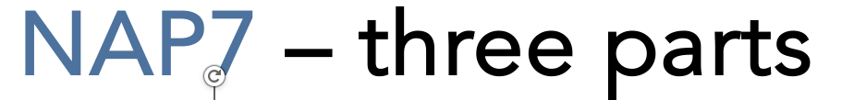
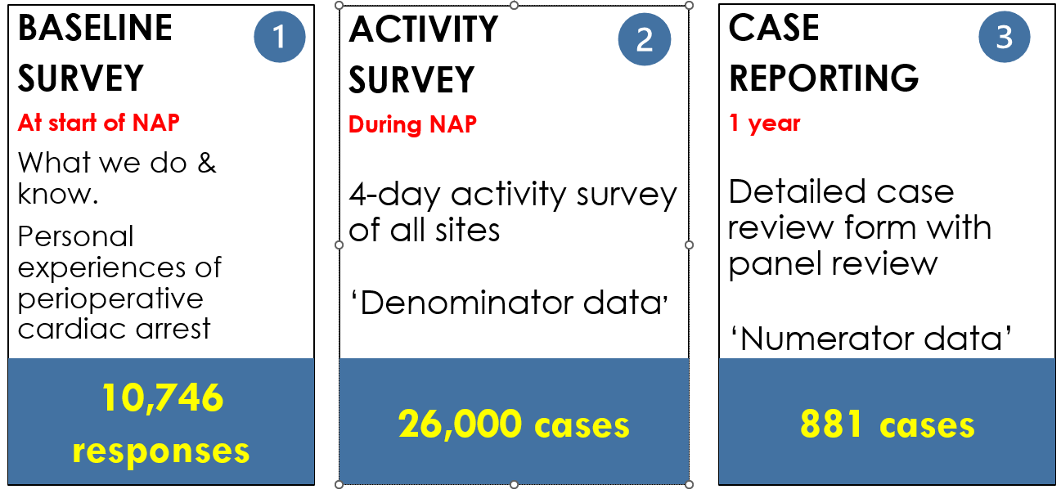
four
PHASE ZERO
ACCC TRACK
COVID study

Slide 26
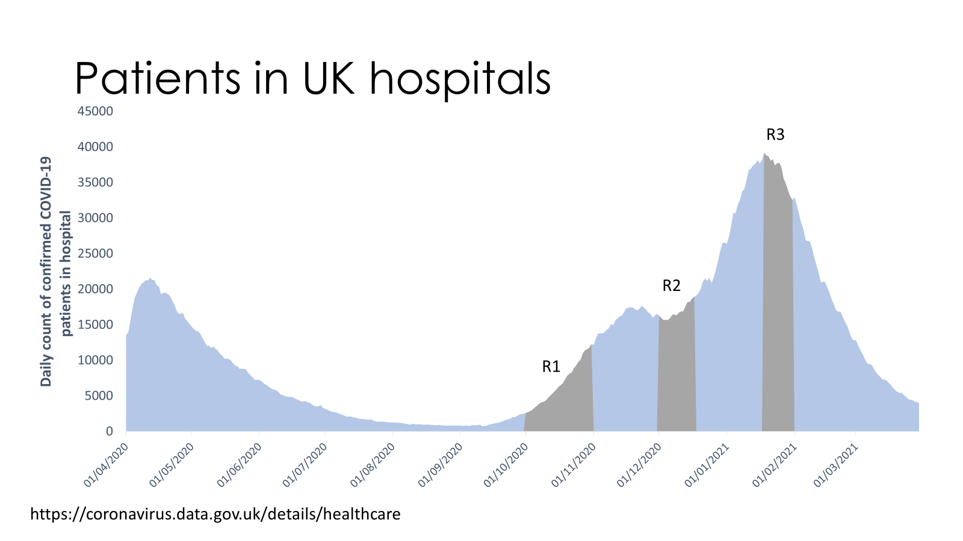
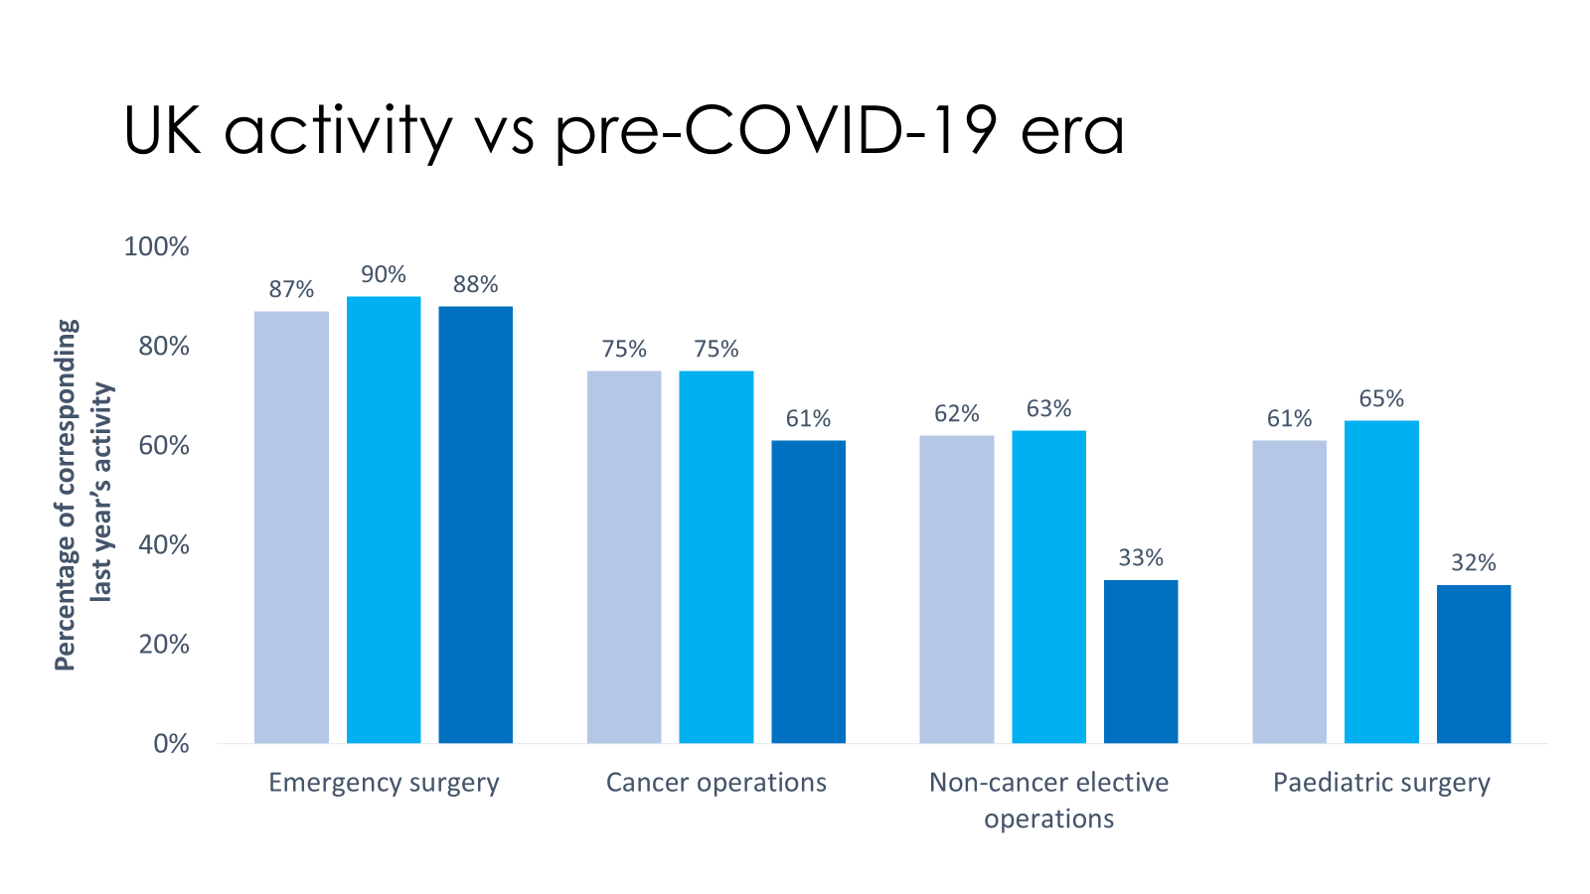
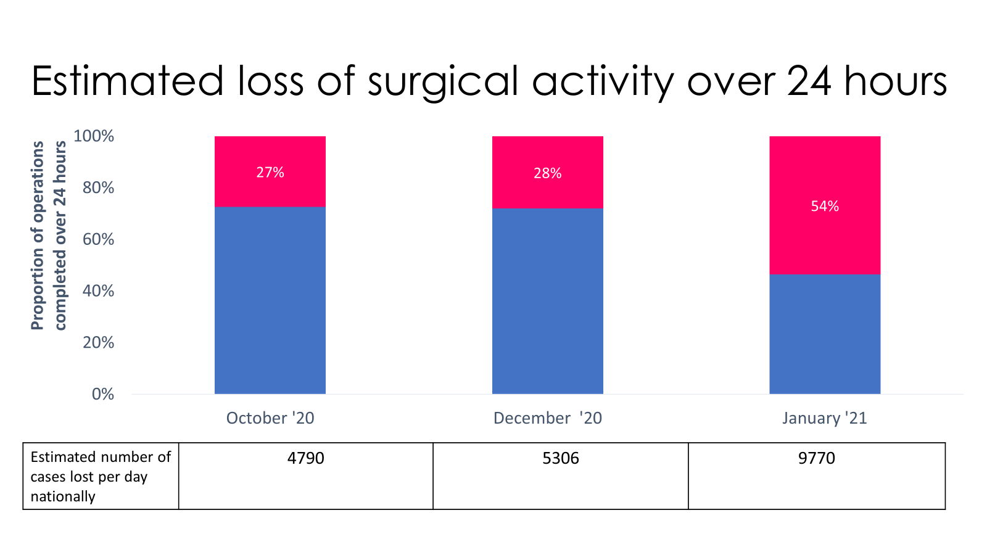
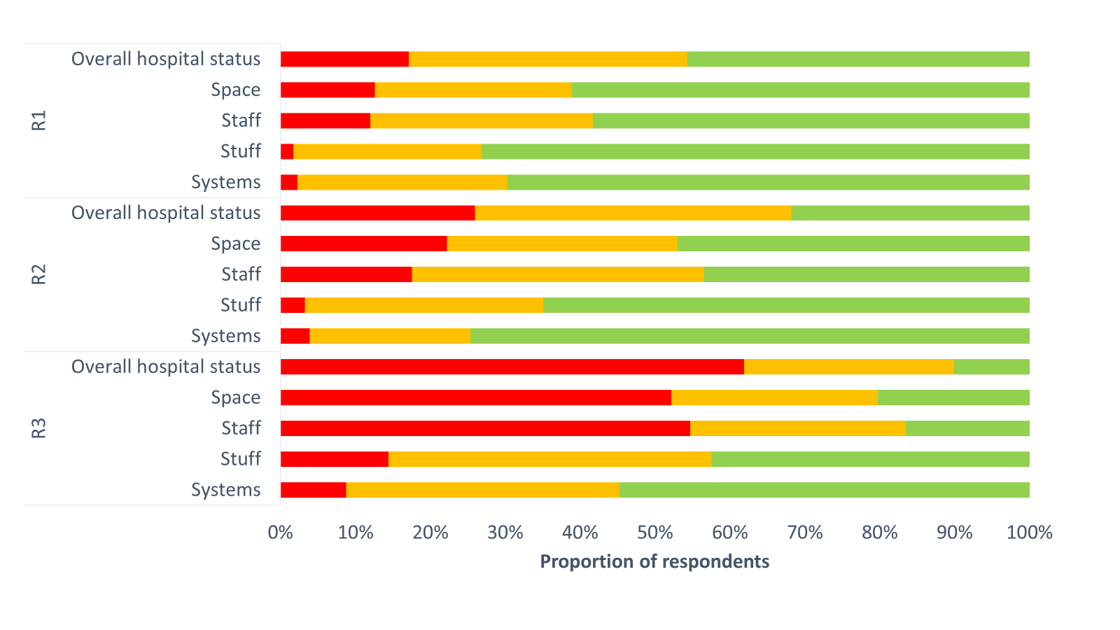

Slide 27
Baseline survey 385 hospitals (76%) -what we do -preparedness 10,746 individual anaesthetists/AAs (70%) -preparedness -beliefs -experiences

Slide 28
Anaesthetists and other staff providing anaesthesia care
Notes:
N=197

Slide 29
Anaesthetists and other staff providing anaesthesia care
Notes:
N=197

Slide 30
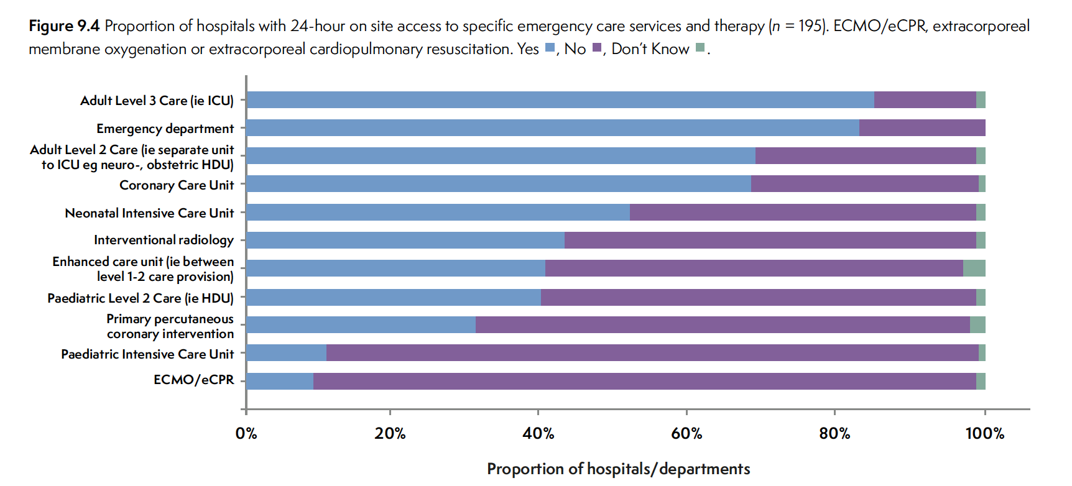
What can/do UK hospitals do?
Notes:
N=197

Slide 31
What can/do UK hospitals do?
Notes:
N=197

Slide 32
86% of hospitals have no PICU Stabilisation of critically ill children prior to retrieval – who is responsible?
Notes:
N=144
Overall paeds specialist 22.9%

Slide 33
Default location for induction of anaesthesia

Slide 34
90% hospitals do remote site anaesthesia - top 10 locations
Notes:
N=197

Slide 35
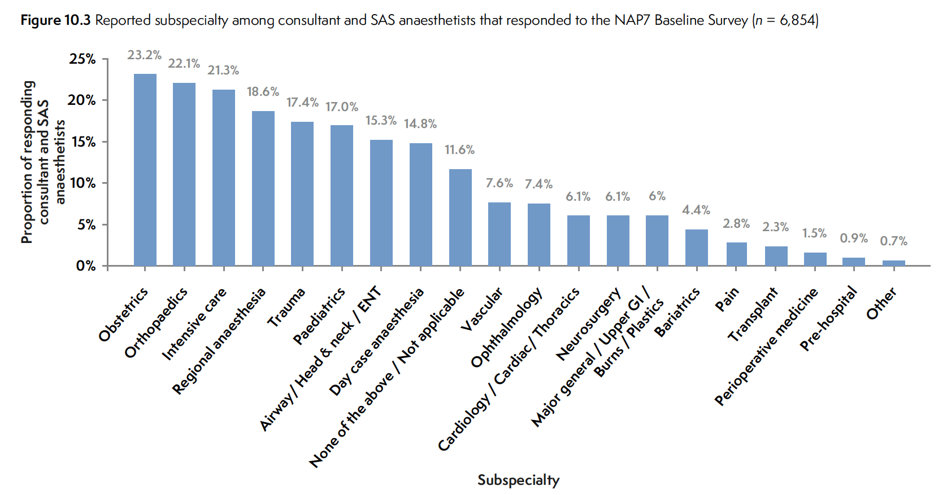

Specialties

Slide 36
Access to emergency equipment

Slide 37
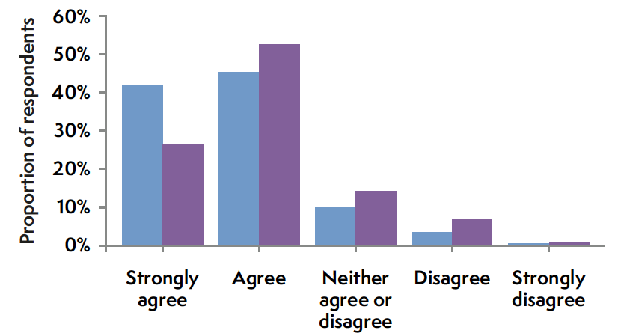
I am confident in managing perioperative cardiac arrest
males > females

Slide 38
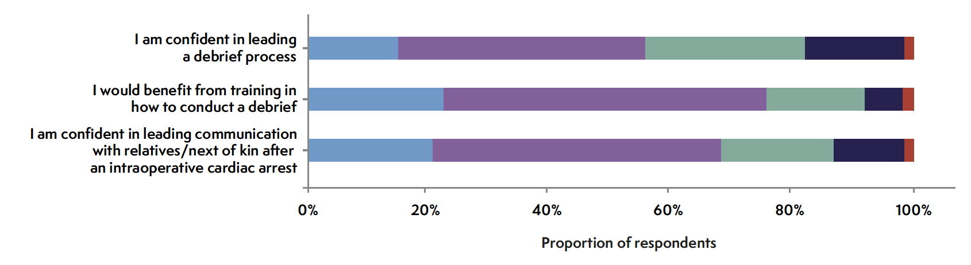
Confidence: after a cardiac arrest - MUCH lower

Slide 39
Top 10 causes of (last) arrest
Top 3 causes:
Major haemorrhage
Anaphylaxis
Cardiac ischaemia
Notes:
1% or more

Slide 40
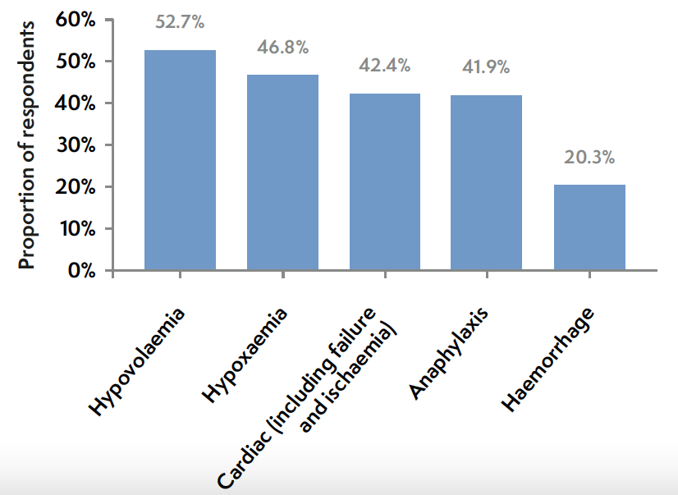
What do anaesthetists think is commonest cause of cardiac arrest?
N=10,746

Slide 41
Baseline - 38% - 80% hot - 20% cold
Debriefs
Registry - 53% - 20% cold
Cold debrief = 8-10%
of periop cardiac arrests

Slide 42
Impact on patient care delivery
Impact on wellbeing

Slide 43
Impact on patient care delivery
Impact on wellbeing

Slide 44
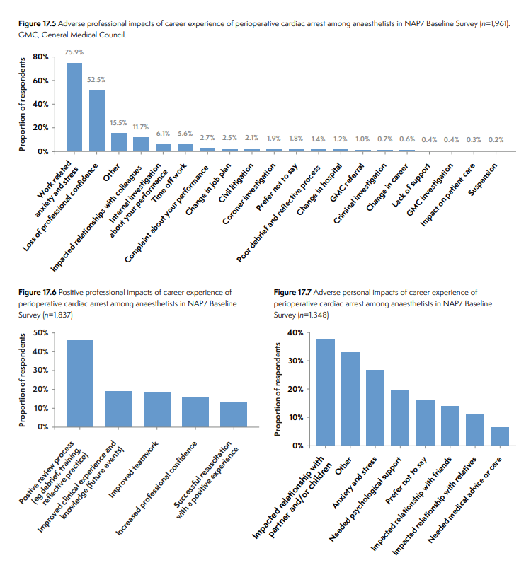
Adverse impacts (n =1961)

Slide 45
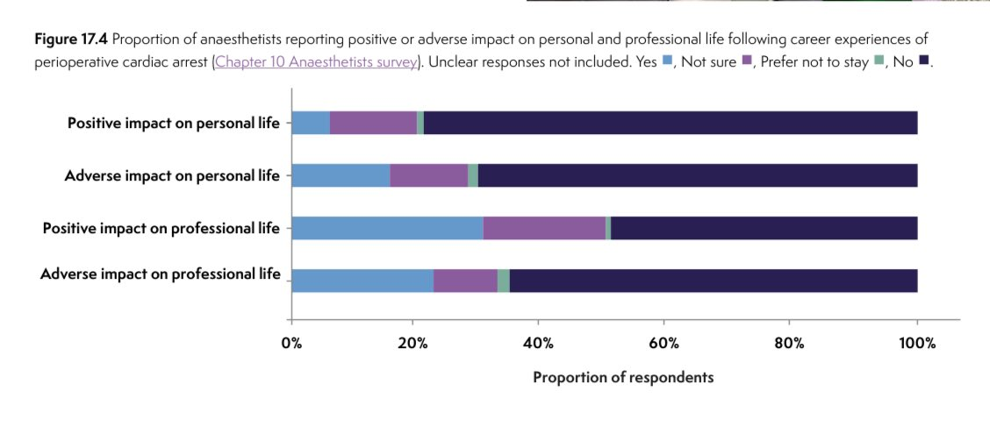
Attending perioperative cardiac arrest – career impact

Slide 46
Attending perioperative cardiac arrest – career impact

Slide 47
Positive (1817) / adverse (1348) personal impact

Slide 48


Slide 49
Activity survey 26,000 cases

Slide 50


Age
↑1.4%
↑0.7%
↓0.8%
50.5y to 52.8y
↑2.3y
Each 1 yr = 10% increase in actuarial mortality
↓1.2%
↑0.5%
↔
↔
Proportion of population
↓0.8%
↓0.6%
↑0.8%
↔
Age (y)

Slide 51
Age
↑1.4%
↑0.7%
↓0.8%
50.5y to 52.8y
↑2.3y
Each 1 yr = 10% increase in actuarial mortality
↓1.2%
↑0.5%
↔
↔
Proportion of population
↓0.8%
↓0.6%
↑0.8%
↔
Age (y)

Slide 52
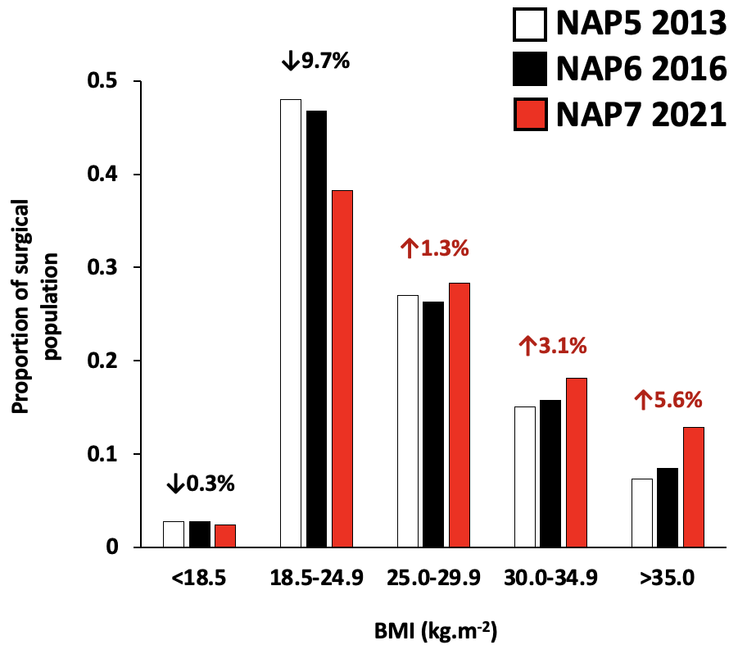

Obesity
Normal → Overweight
Proportion of surgical population
Adult non-obstetrics
↓0.3%

Slide 53




Comorbidity
ASA 2 ↑5%
Burden of comorbidity in the surgical population is increasing
Proportion of whole activity survey population
ASA 1 ↓14%
ASA 3 ↑6%
ASA 4 ↑1%
ASA 5 ↔

Slide 54

Comorbidity and age (Activity Survey 20,000)
Age 56-65 Age >85
Hypertension 57% 73%
Moderate respiratory disease 14% 20%
Diabetes mellitus 15% 14%
Atrial fibrillation 4% 29%
Cerebrovascular disease 3% 18%
Dementia 0% 21%
CKD 3–4 3% 24%

Slide 55
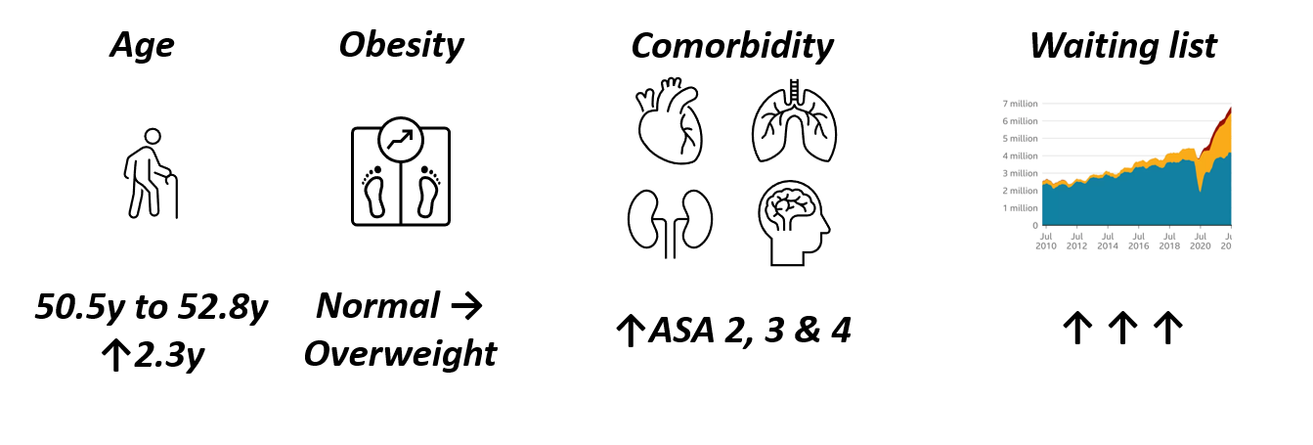
Trends
ACTIVITY SURVEY

Slide 56
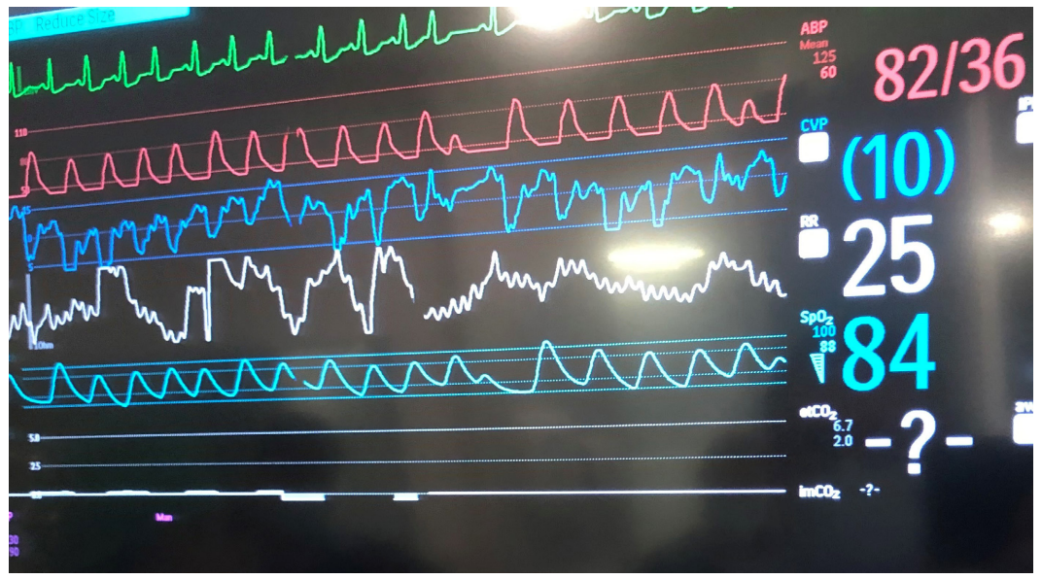
COMPLICATIONS

Slide 57
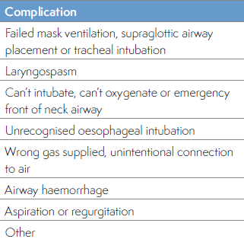
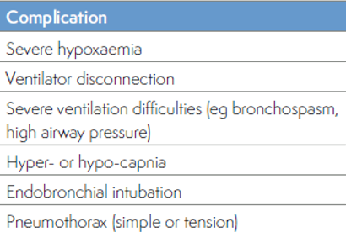
Activity Survey –complications 24,000 cases
AIRWAY
BREATHING

Slide 58
5.6% 1 in 18 cases cared for by a medically trained anaesthetist
Complications that might lead to a cardiac arrest

Slide 59
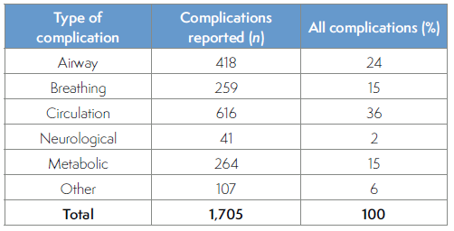
Activity Survey – complications

Slide 60
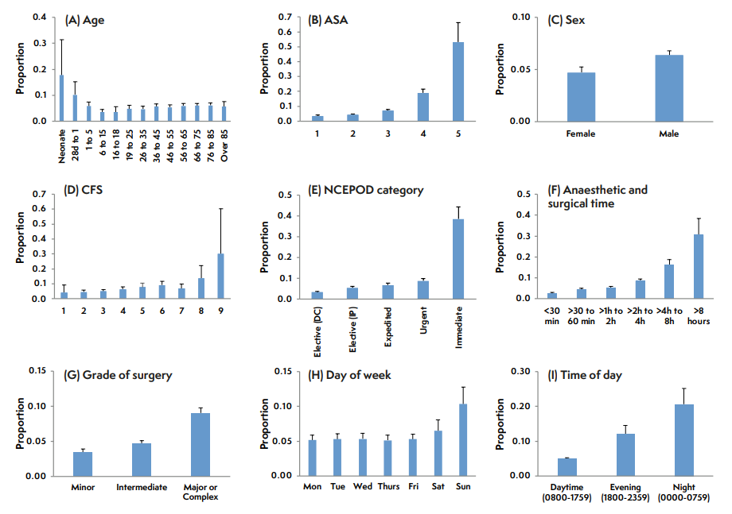

Slide 61
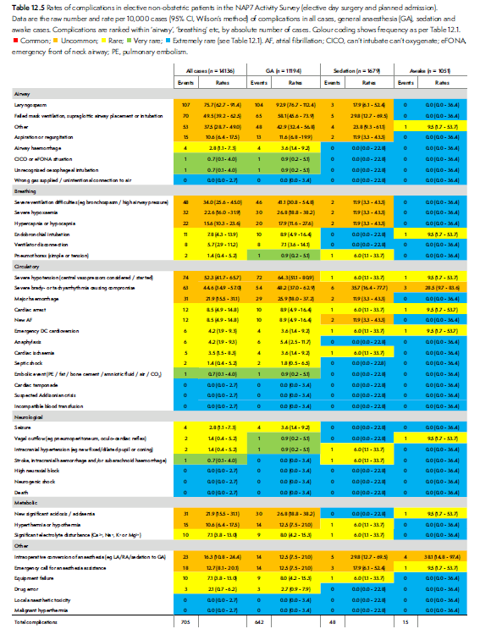
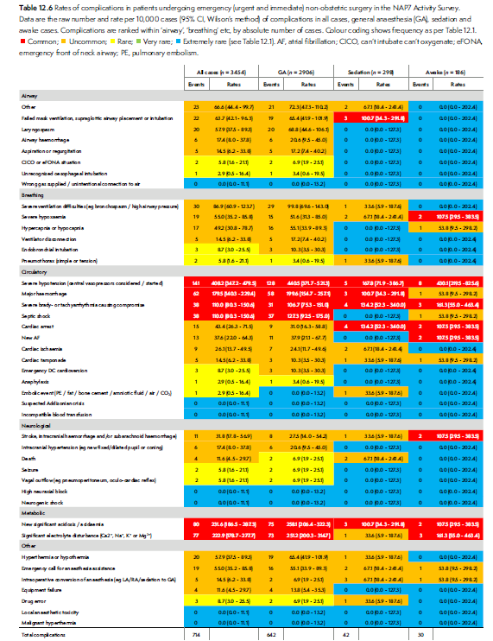

Slide 62
A + B complications
Airway
2nd most common complication,
Incidence 1.7%
22% of all complications
most common
-laryngospasm: 38%
-airway failure 30%
-aspiration 6.4%
CICO/eFONA
1 in 8370
(95%CI 1 in 2,296 - 30,519).
Breathing
4th most common complication
Incidence 1.1%
14% of all complications.
most common
-severe ventilation difficulty 37%
-hyper- or hypocapnia 24%
-hypoxaemia 23%

Slide 63
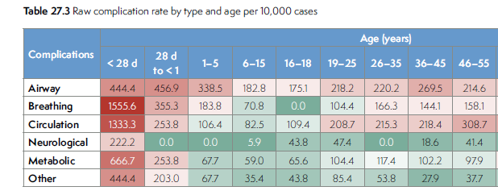
4.5%
ABC – airway, breathing children!
16%
1-2%

Slide 64
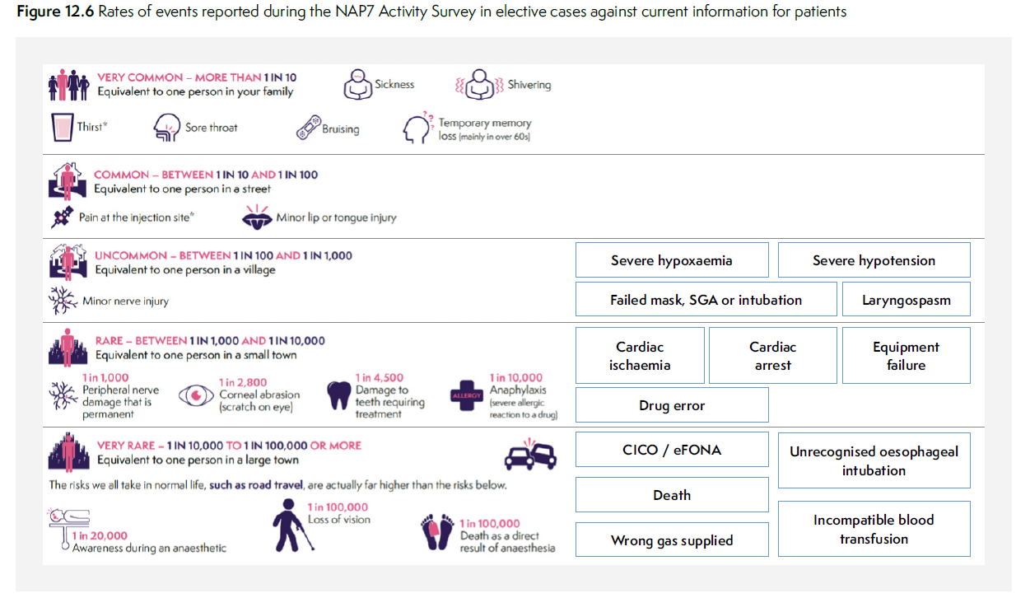

Slide 65
Year long registry 881 cases

Slide 66
Overall incidence
1 in 3,076
3 in 10,000
(95% CI 3.0-3.5)

Slide 67
NAPs
1 in 50,000
1 in 120,000
1 in 12,000
1 in 19,000
1 in 3000
NAP3 Permanent harm from spinal
NAP4 Anaesthesia airway death
NAP5 Awareness
NAP6 Life threatening anaphylaxis
Periop cardiac arrest

Slide 68
Incidence* by (low risk) patient group
 | Cardiac arrest 1 in… | Early death (no ROSC) 1 in…
All cases | 3,000 | 13,000
ASA 1 | 11,000 | 132,000
ASA 1-2 | 8,000 | 95,000
Elective cases | 7,000 | 94,000
*to nearest 1,000

Slide 69
Incidence* by (high risk) patient group
 | Cardiac arrest 1 in… | Early death (no ROSC) 1 in…
All cases | 3,000 | 13,000
Older & frailer (>65 & CFS ≥5) | 1200 | 3300
Much older (≥85) | 1300 | 3600
Much frailer (CFS 7-8) | 1300 | 3800
*to nearest 1,000

Slide 70
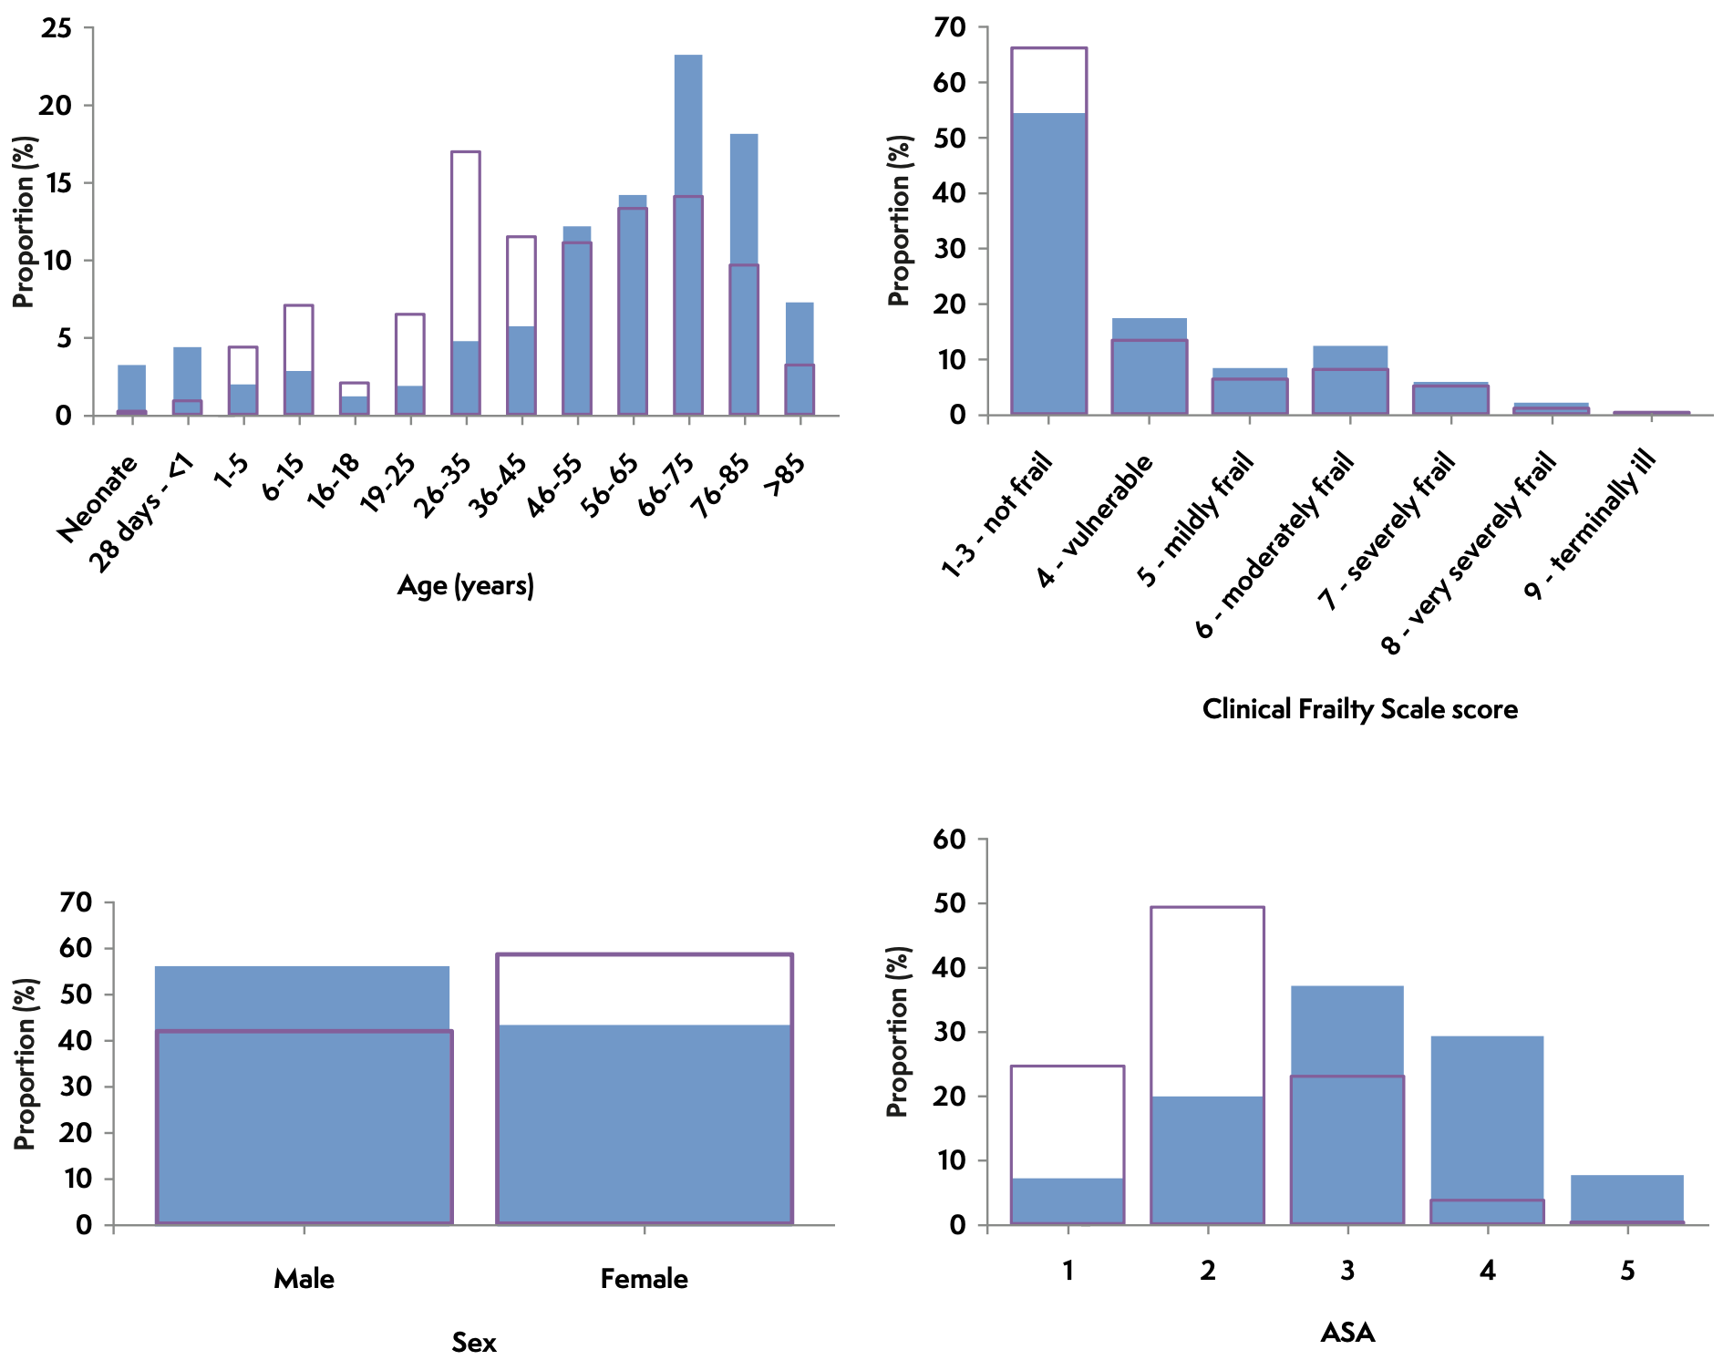
Notes:
56% male
Median age 60.5 years (IQR 40.5-80.5)
Bimodal distribution: >65 and neonates
ASA physical status grade
27% 1-2
37% 3
37% 4-5

Slide 71
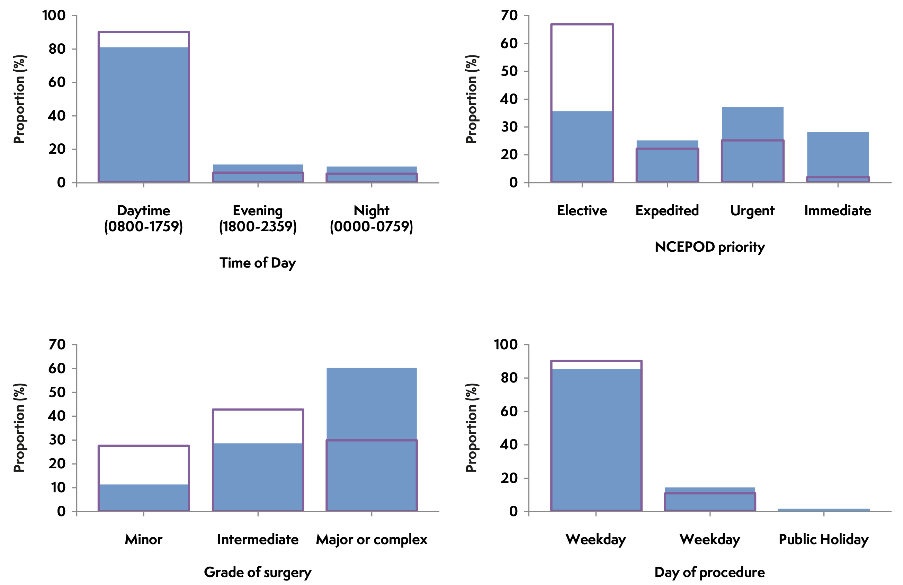

Notes:
71% non-elective (vs 36%)
60% major or complex (vs 28%)
Elective:
Gynaecology
Urology
Orthopaedics
Non-elective:
Orthopaedic trauma
Lower GI
Vascular

Slide 72
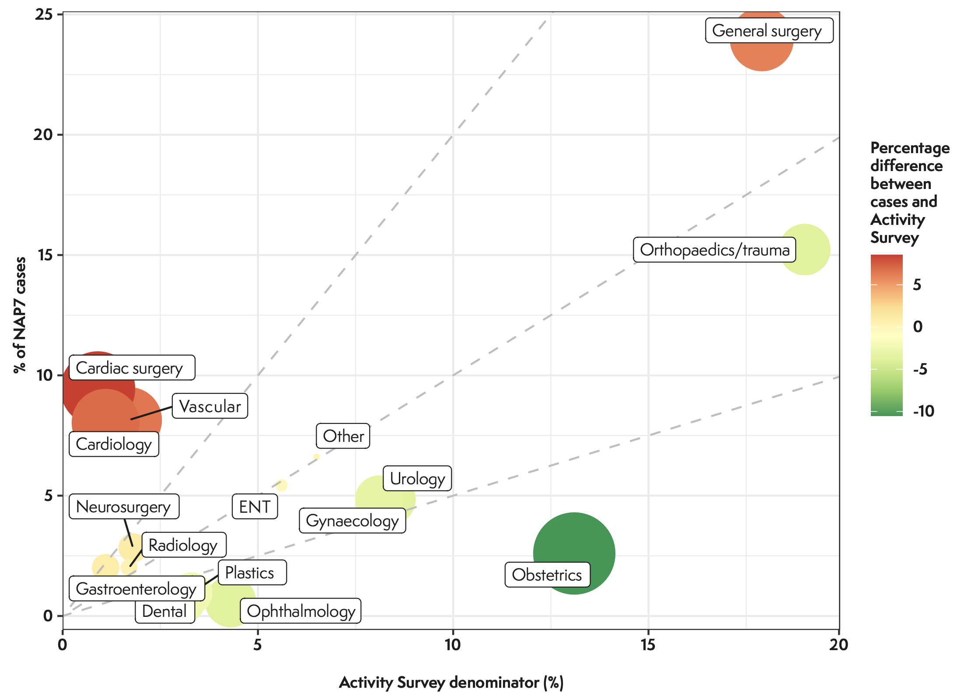
Notes:
Cardiac surgery
Cardiology
Vascular
General surgery

Slide 73
Location
51% in theatre in main theatre suite
11% anaesthetic rooms
12% critical care areas
6% cardiac cath lab
32
39
37

Slide 74
Senior staff: at induction of registry cases
86% Consultant
6% SAS or post-CCT/CESR
75% Consultant overnight

Slide 75
Cardiac arrest process
25
82% non-shockable rhythm
52% PEA
79% adrenaline
17% defibrillated
CPR in <1 minute in 78%
Notes:
67% less than 10 minutes duration

Slide 76
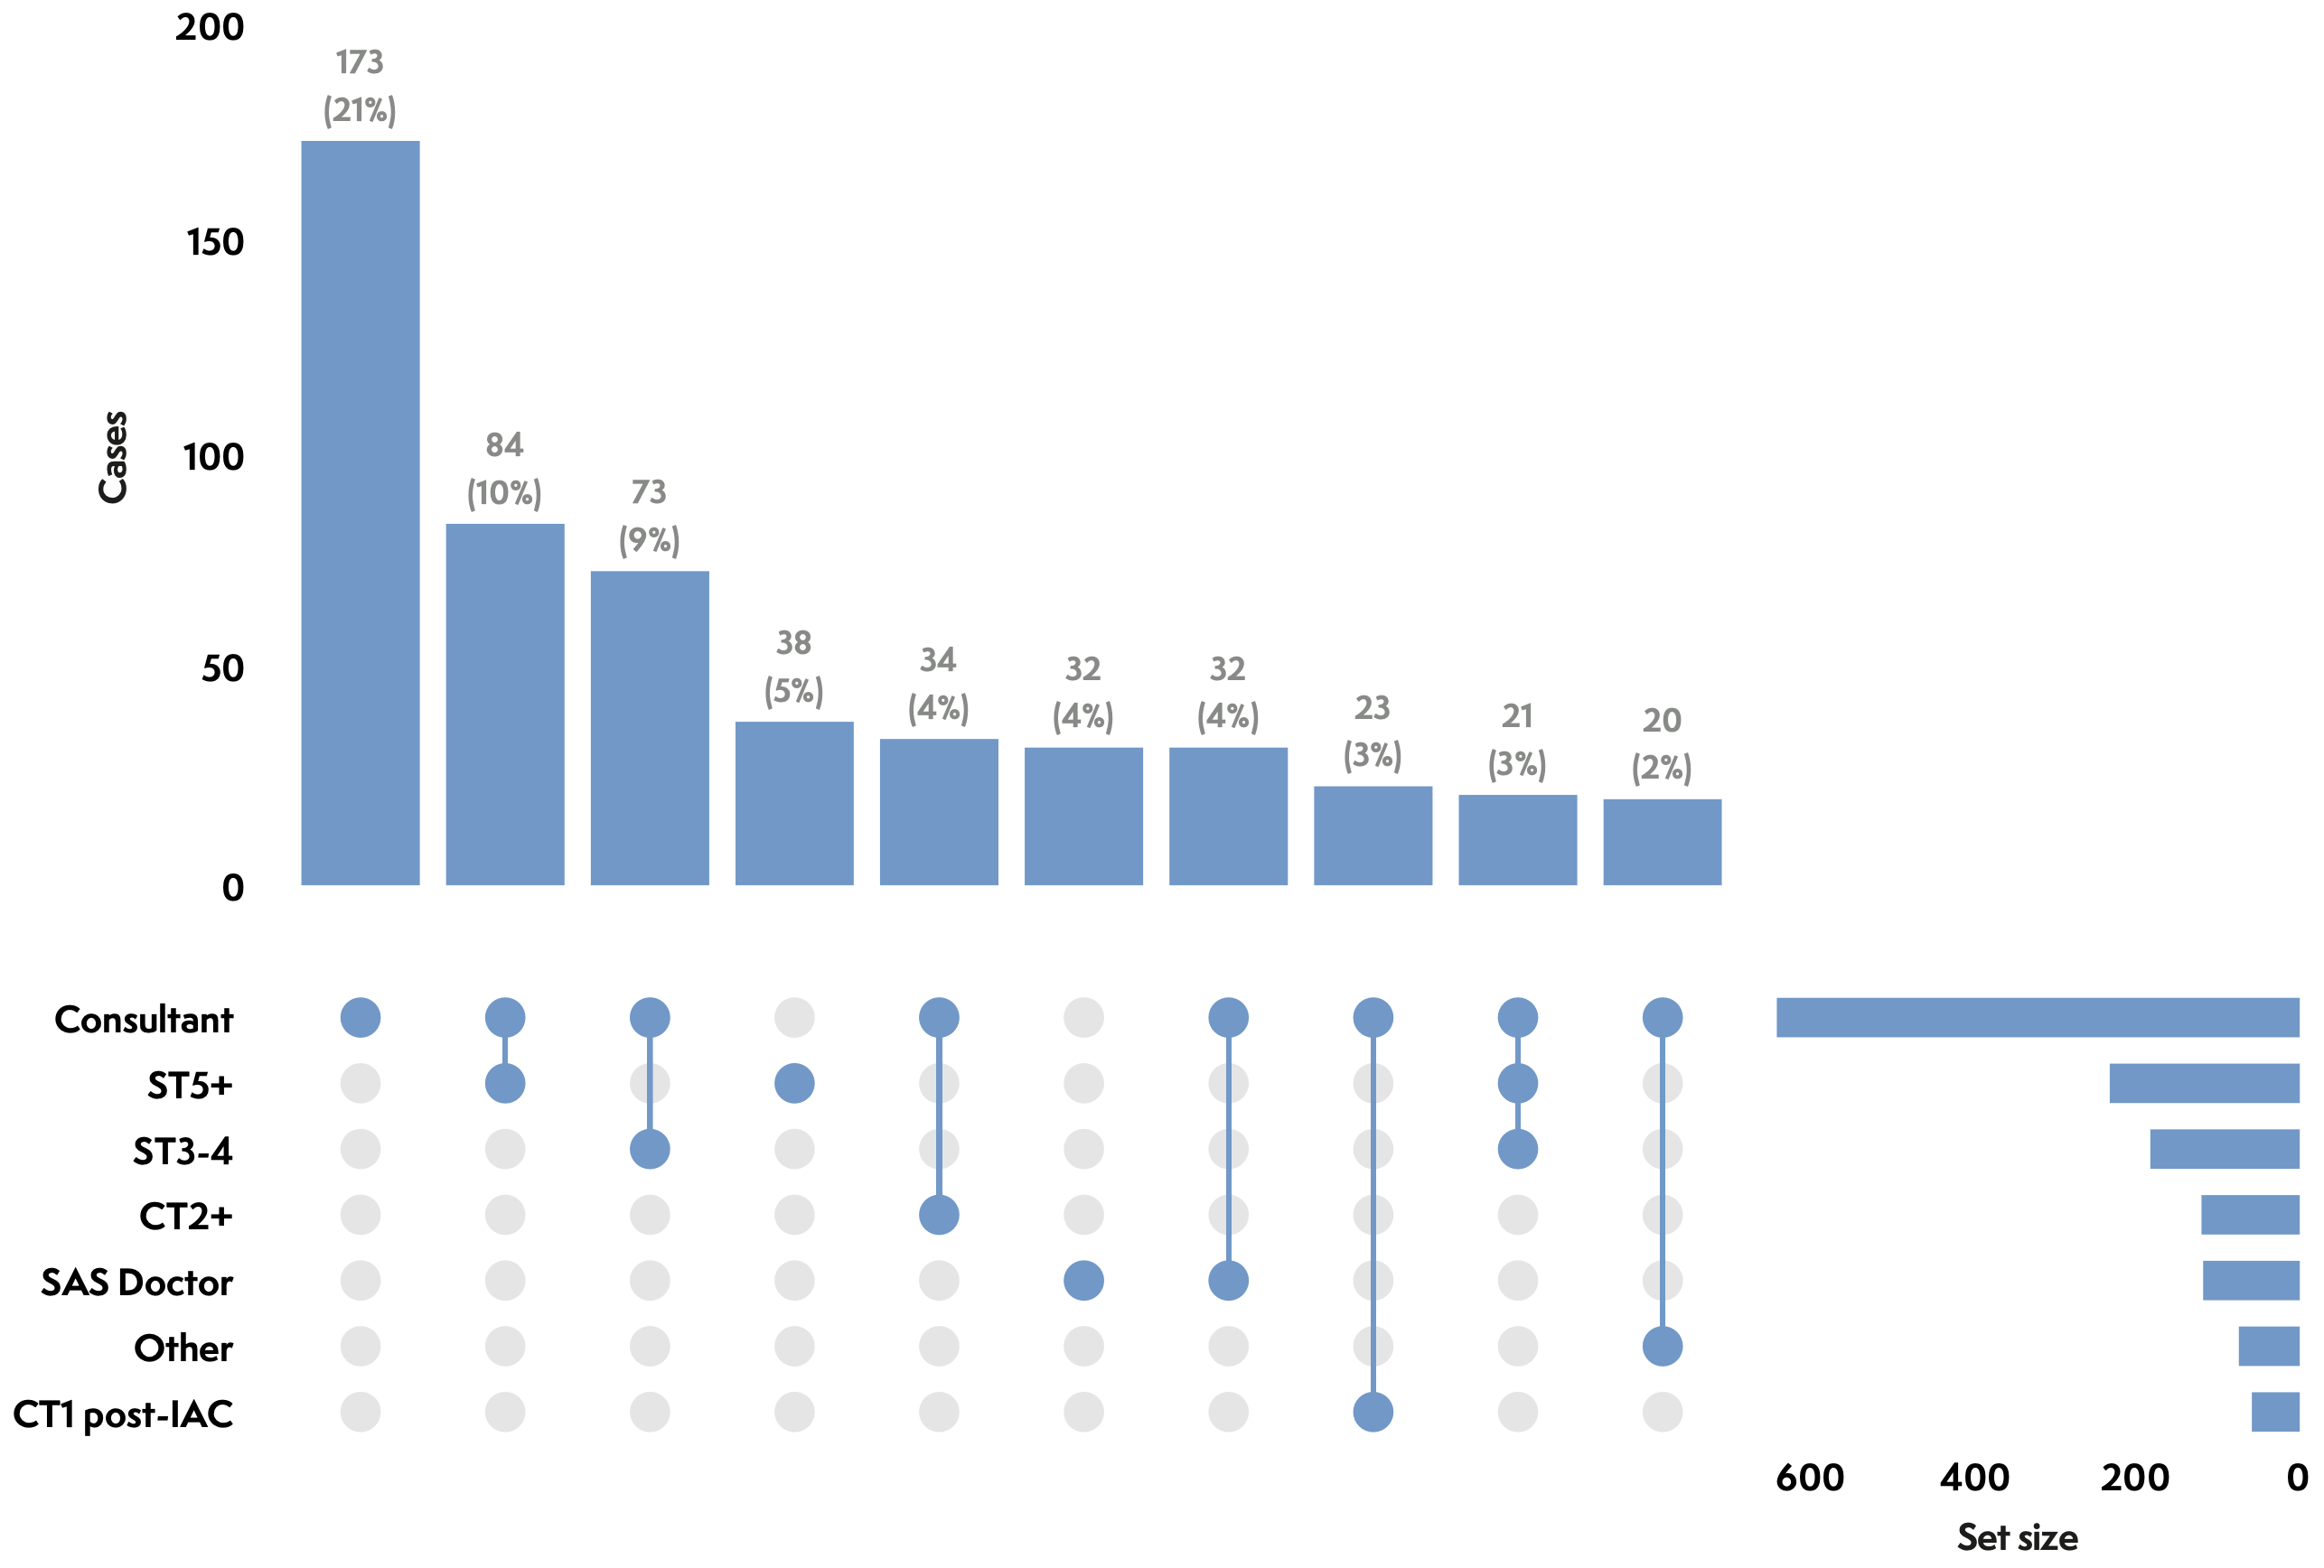
At time of arrest

Slide 77
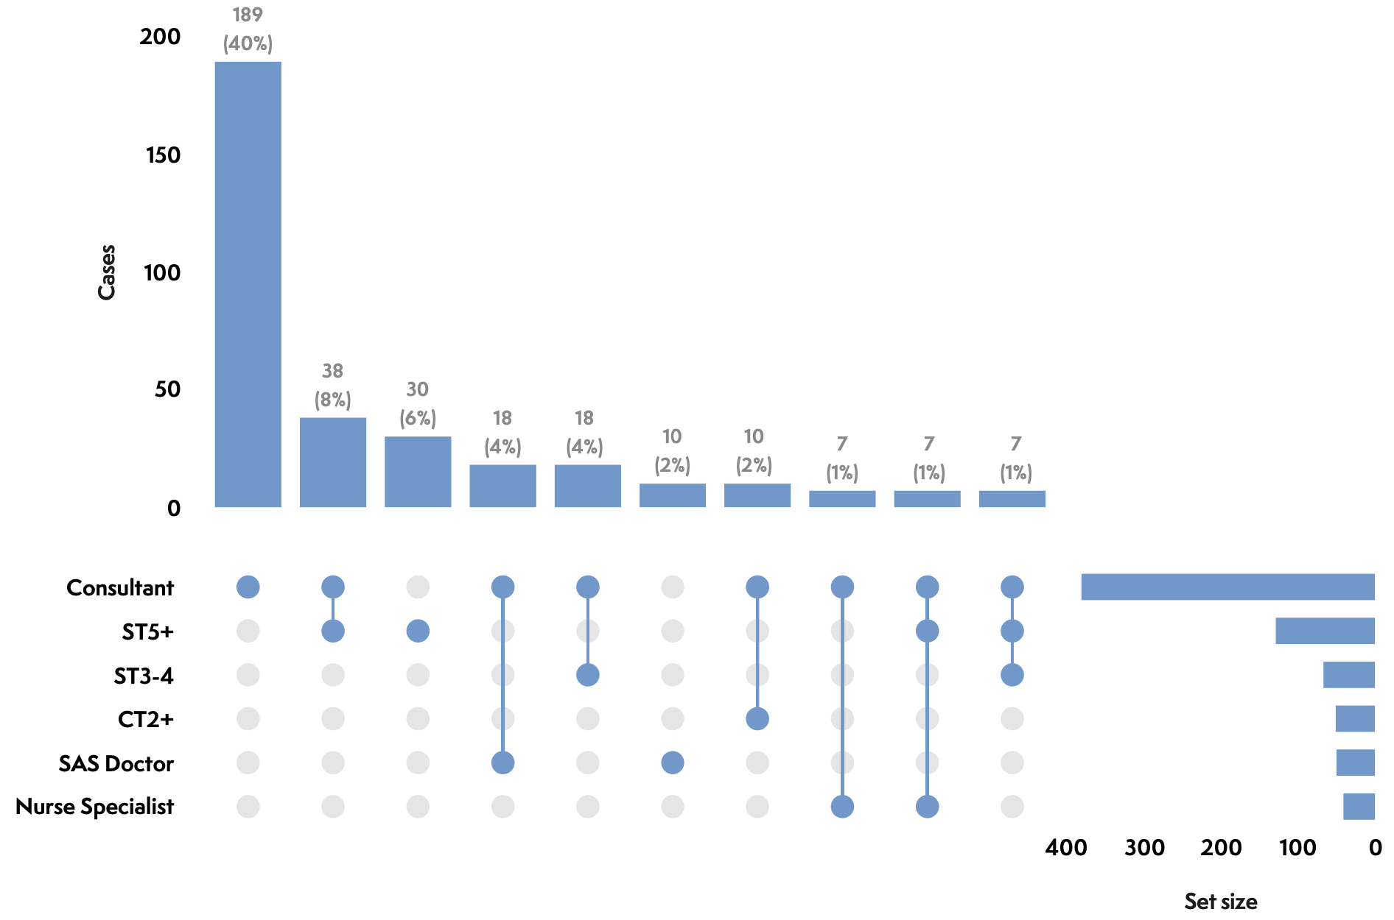
Who came to help

Slide 78
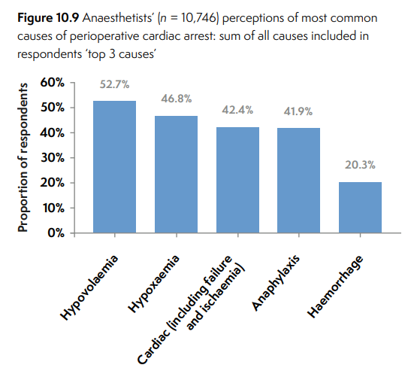
Anaesthetists ‘top 3 causes’ of perioperative cardiac arrest summed (baseline)
Hypovolaemia (52%)
Hypoxaemia (46%)
Cardiac ischaemia (42%)
Anaphylaxis 42%
Haemorrhage 20%

Slide 79
Baseline: causes of (last attended) perioperative cardiac arrest (n= 4,639) [top 10]
Top 3 causes:
Major haemorrhage
Anaphylaxis
Cardiac ischaemia
Notes:
1% or more

Slide 80
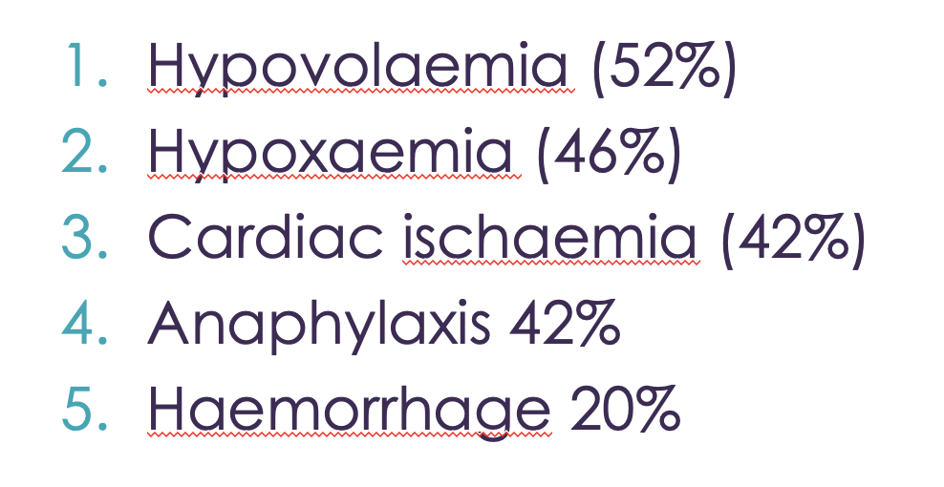
Specific causes - actual
Major haemorrhage (17%)
Bradyarrhythmia (9%)
Cardiac ischaemia (7%)
Anaphylaxis overestimated (survey, registry)

Slide 81
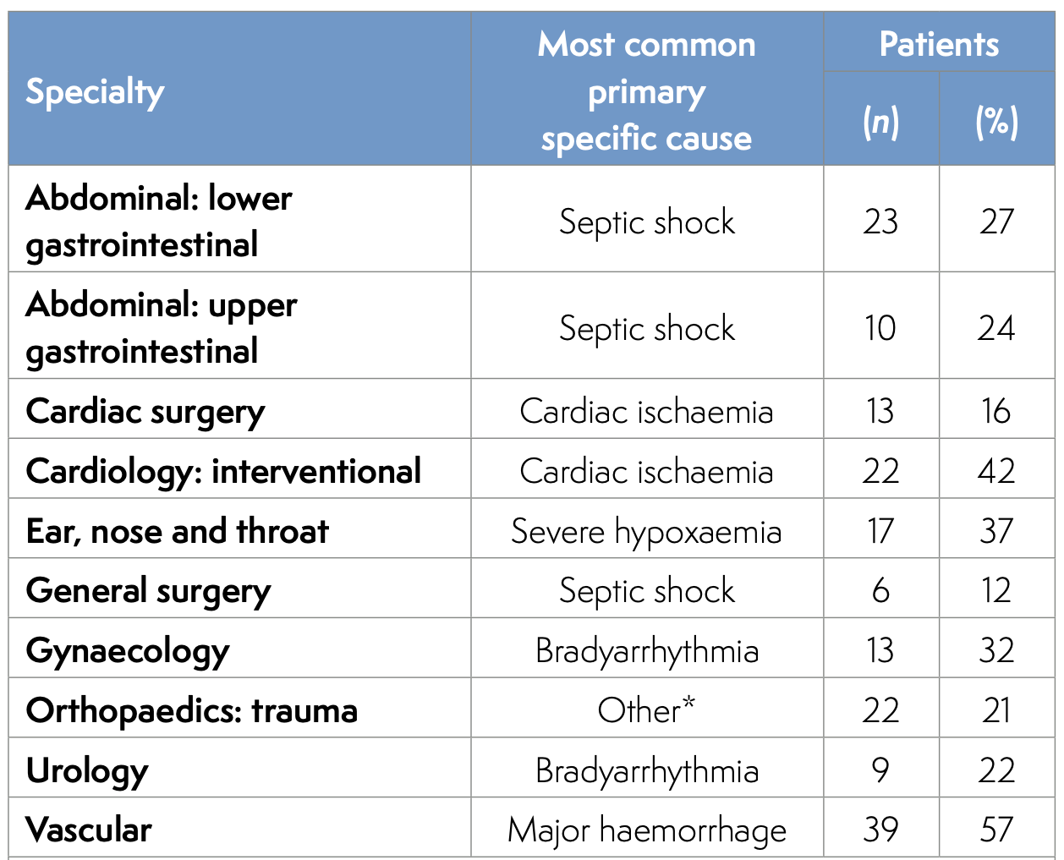
Cause by specialty

Slide 82
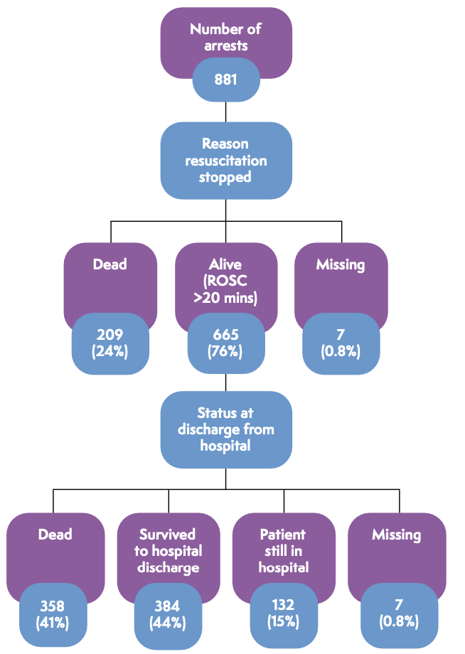
Outcomes
ROSC 75%
Alive at report 59%
mRS <3 88%
Notes:
75% survived initial event
59% alive at time of reporting to NAP7
52% survival at hospital discharge
Varied with age, specialty, priority, cause, duration, arrest rhythm

Slide 83
Outcomes
ROSC 75%
Alive at report 59%
mRS <3 88%
Other IHCA
- 50% ROSC
- 23% leave hospital
OOHCA
- 8% leave hospital
Notes:
75% survived initial event
59% alive at time of reporting to NAP7
52% survival at hospital discharge
Varied with age, specialty, priority, cause, duration, arrest rhythm

Slide 84
Severity of harm
50% moderate
12% severe
38% death (31% inexorable process)
88% of survivors favourable functional outcome

Slide 85
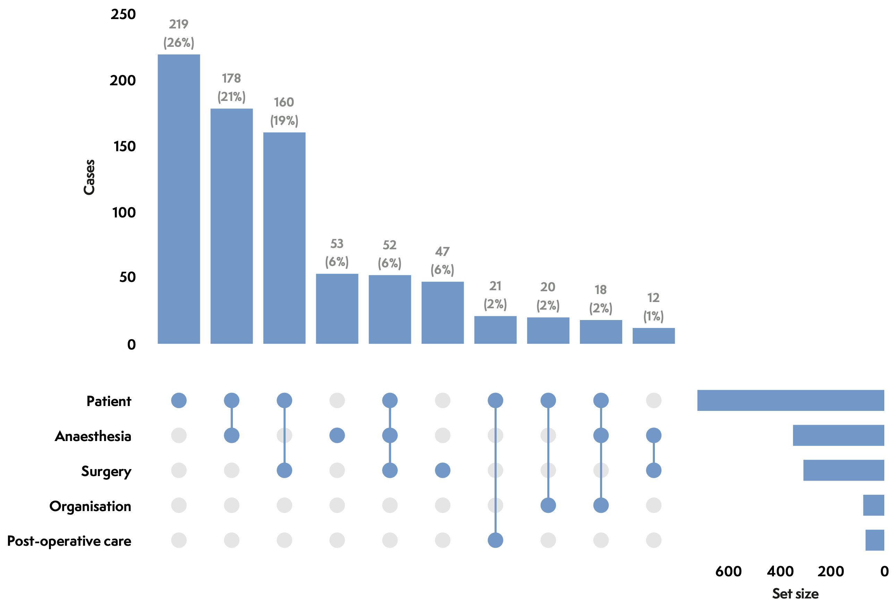
Key cause(s) of cardiac arrest
Patient 82%
Anaesthesia 40%
Surgery 35%
Notes:
Patient factors a key cause in 82%
Anaesthesia most commonly highlighted in adult elective cases

Slide 86
Key cause(s) of cardiac arrest
 | Patient | Anaesthesia | Surgery
All | 82% | 35% | 30%
Vascular | 88% | 33% | 30%
Obstetrics | 54% | 68% | 29%
Notes:
Patient factors a key cause in 82%
Anaesthesia most commonly highlighted in adult elective cases

Slide 87
Quality of care
Generally good – most poor care before cardiac arrest
 | Good | Good & poor | Poor | Unclear
Before | 48% | 21% | 11% | 20%
During | 80% | 7% | 2% | 11%
After | 80% | 5% | 1% | 14%
Overall | 53% | 28% | 2% | 17%

Slide 88
Quality of care
Generally good – most poor care before cardiac arrest
 | Good | Good & poor | Poor | Unclear
Before | 48% | 21% | 11% | 20%
During | 80% | 7% | 2% | 11%
After | 80% | 5% | 1% | 14%
Overall | 53% | 28% | 2% | 17%
76%: care good
32%: elements of poor care before cardiac arrest

Slide 89
Key cause differs from quality of care
Key causes | Patient | Anaesthesia | Surgery
All | 82% | 35% | 30%
Vascular | 88% | 33% | 30%
Obstetrics | 54% | 68% | 29%
Patient 82%
Anaesthesia 40%
Surgery 35%
Quality of care | Poor before | Elements of poor overall | Poor overall
All | 11% | 31% | 2%
Vascular | 10% | 34% | 0%
Obstetrics | 18% | 25% | 0%
Notes:
Patient factors a key cause in 82%
Anaesthesia most commonly highlighted in adult elective cases

Slide 90

Themes

Slide 91
Areas of interest?
Good stuff
Frailer and older
The very young
Adrenaline dosing
Triggers for CPR
Calcium and bicarbonate
DNACPR

Slide 92
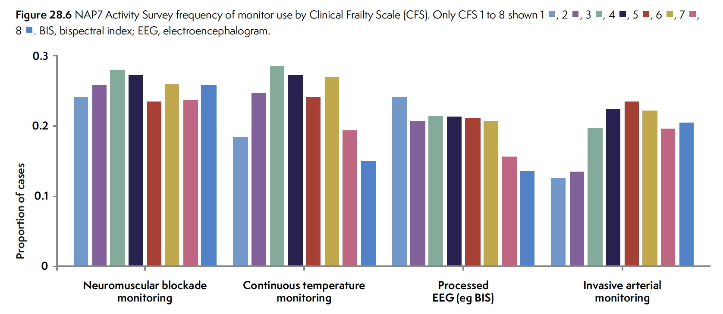

Frailty and monitoring

Slide 93
Areas of concern?
Risk scoring & risk recognition
Communication of risk
Assessment vs action
Drug choice
Drug dosing
Anaesthesia location
Monitoring

Slide 94



Must read chapters

Slide 95
Recommendations
Managing risk and DNACPR decision
Triggers for CPR, use of Ca and bicarb
Departmental preparedness
Caring for staff
Monitoring gaps
Risk scoring, coms, decision making
Improving care in high risk groups
Bespoke periop guidance
Risk scoring for clinical care
Independent sector transparency and engagement
Paeds awareness and planning
SOPs and training for predicatable causes
Dosing of adrenaline
Matching monitoring to risk

Slide 96
NAP7 key recommendations
National
Organisational
Individual

Slide 97
Examples of key chapters groups and key chapters

Slide 98
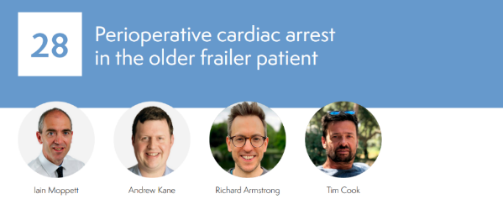
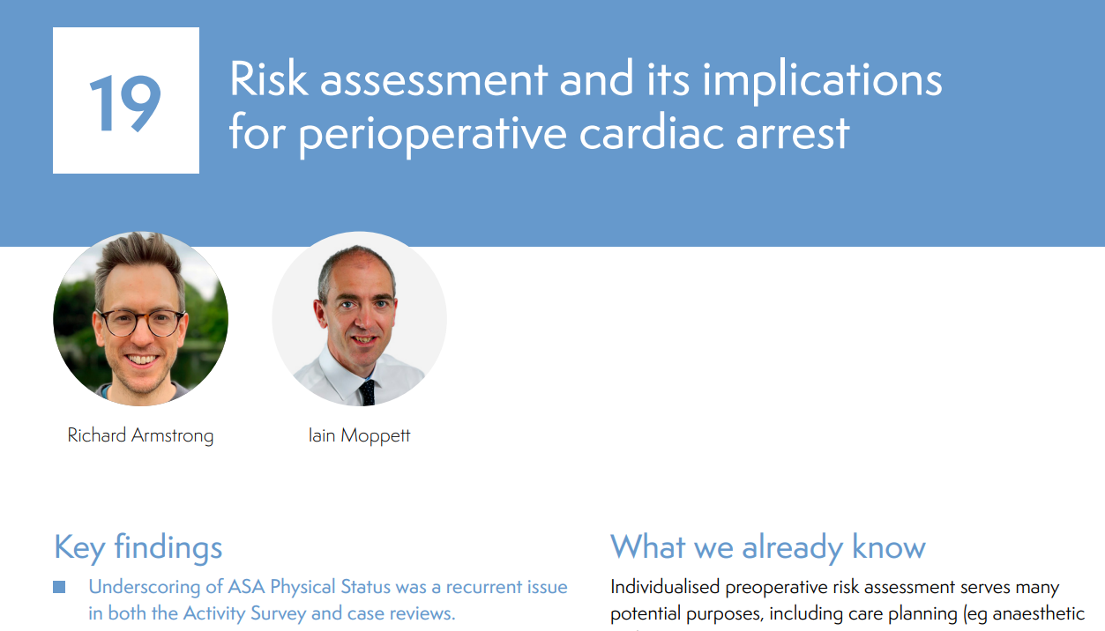


Key frailty group chapters

Slide 99
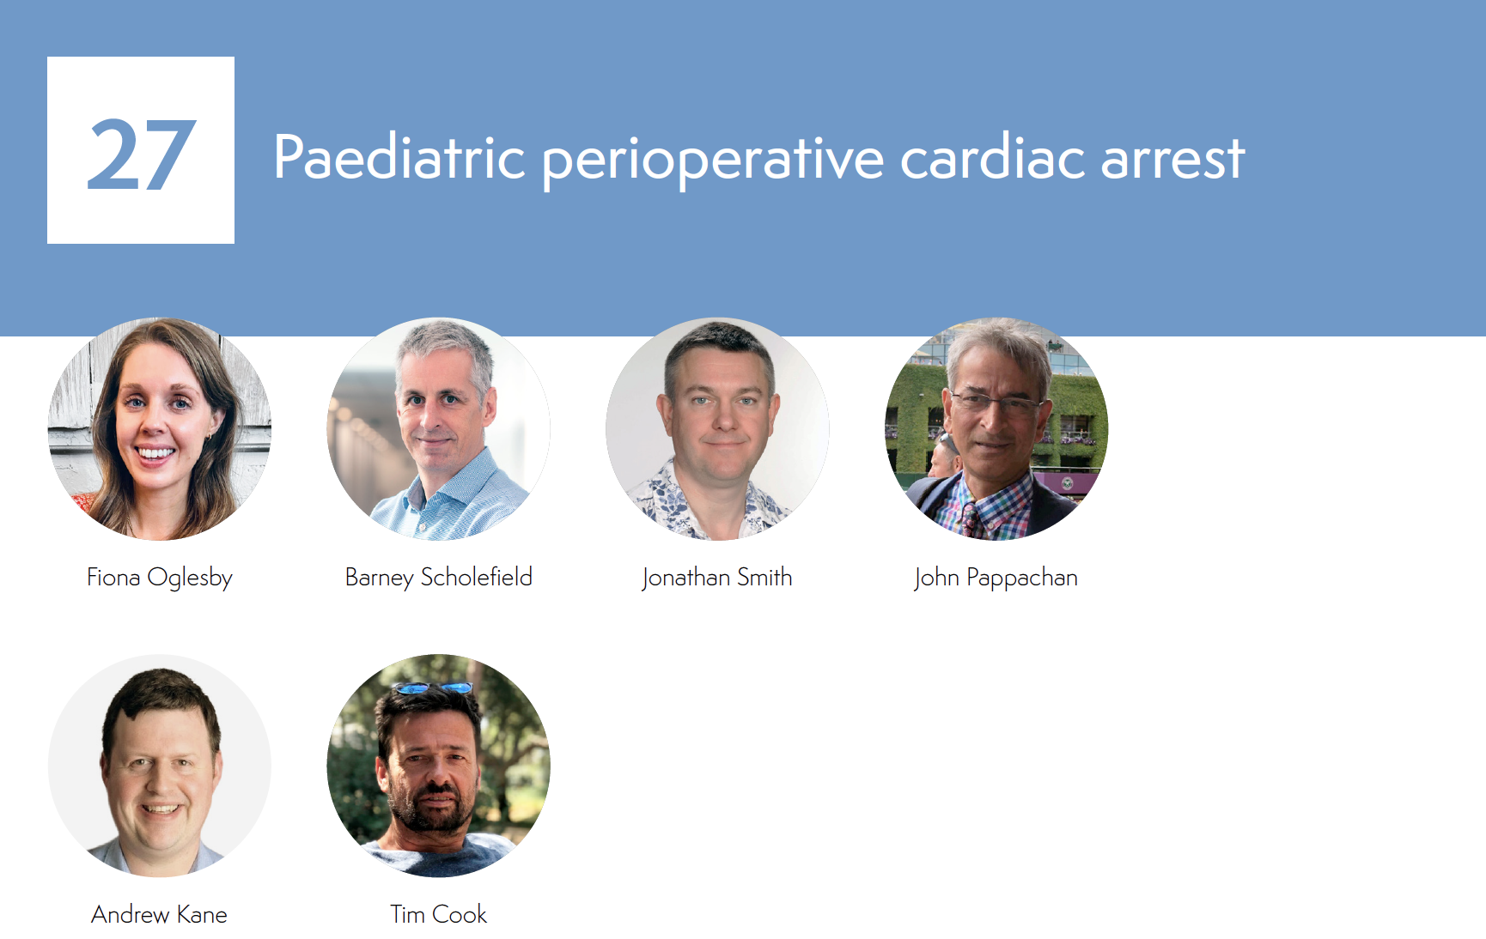

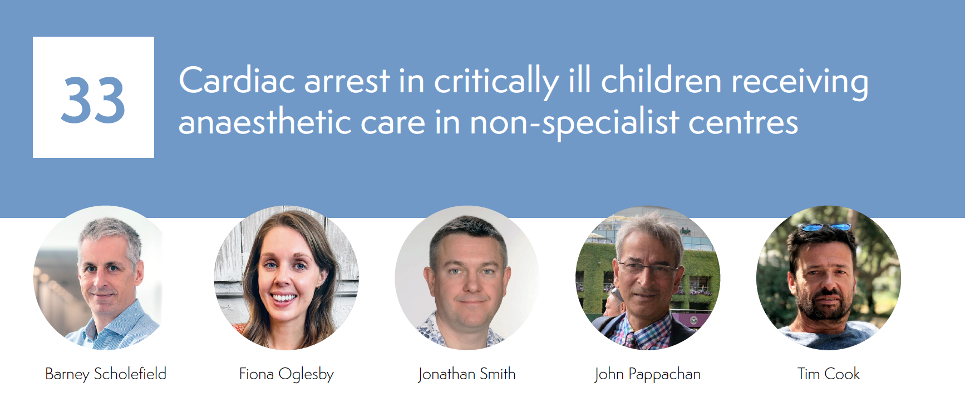
Key paediatric group chapters

Slide 101
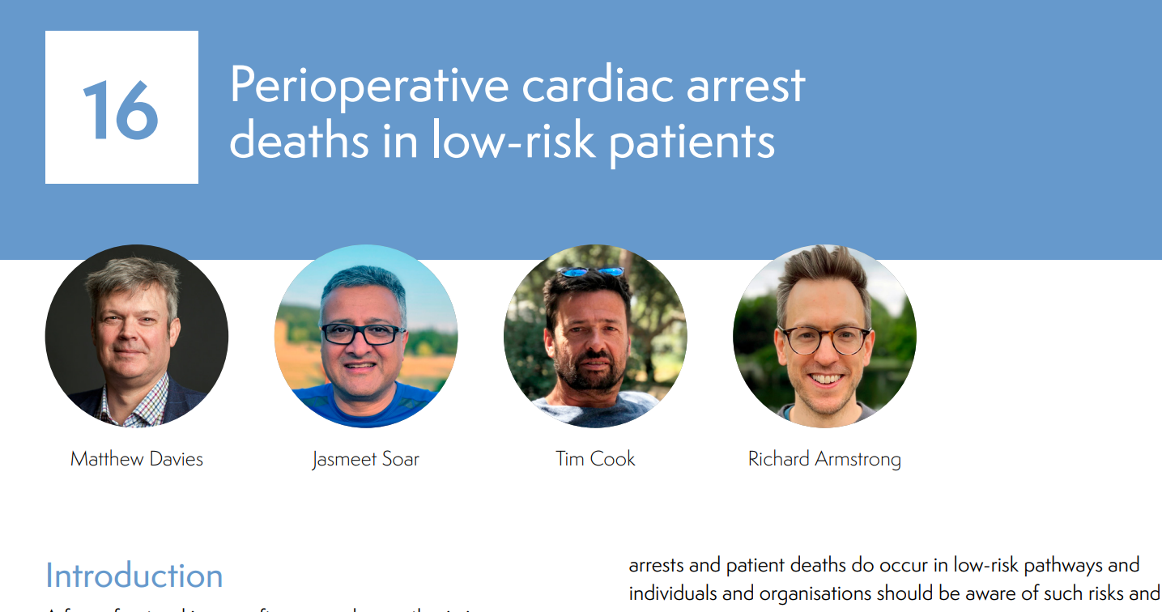

Slide 102


Slide 103
Summary
There’s a lot in it
It goes a long way beyond periop cardiac arrest
The devil is in the detail
Recommendations focus on areas of practice improvement
Read what is relevant to your practice

Slide 104
Thank you
@NAPs_RCoA
Any questions?

Slide 105

https://rcoa.ac.uk/news/nap8-complications-regional-anaesthesia

