Slide 1



Investigations:
The NAP6 Data
Prof. William Egner
Consultant Immunologist

Slide 2
Guidelines used
BSACI
B1 Drug allergy centre with expertise/high throughput
B2 Able to investigate all potential causes
B3 Dedicated drug allergy clinic
B4.1 Skin testing
B4.1 Drug challenge where necessary
B5 Identify the cause and recommend safe future use.
B6 Detailed report to referrer+GP; short report to patient
B7 Anaesthetist— report to MHRA
B8.1 Identify the cause of the reaction
B8.2 Identify drugs likely to be safe for future anaesthesia
B8.3 Written report to referring consultant, GP and surgeon
B8.4 Provide patient with a brief “to whom it may concern” letter
B8.5 Provide patient with an “alert” and specific wording
B8.6 Report to MHRA
B9 Clinic nurse with specialist allergy experience
NICE CG183
N1 written information
N1.1 Allergic or non-allergic reaction
N1.2 Drug name and a description of their reaction
N1.3 Investigations used
N1.4 Drugs or drug classes to avoid in future
N1.5 Safe alternative drugs to use
N2.1 structured written info. to patient
AAGBI
MHRA reporting

Slide 3
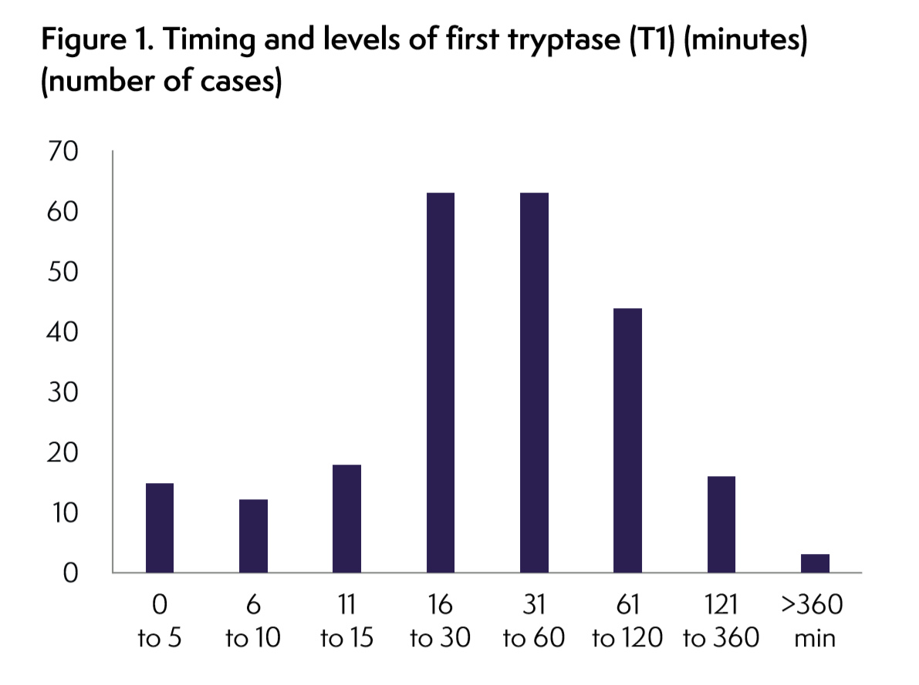
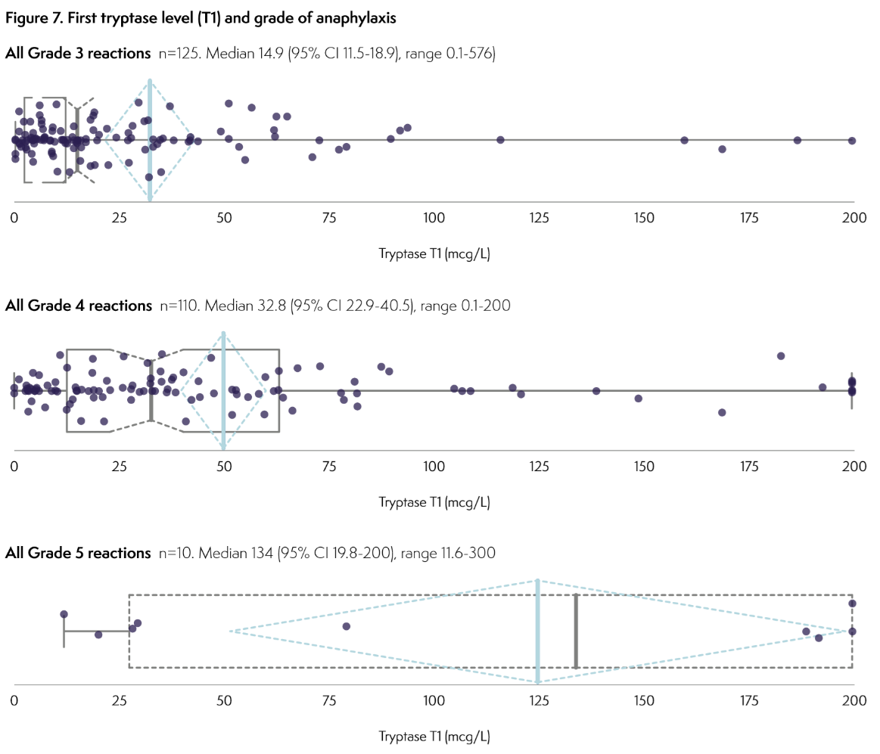
Tryptase: take it early
At least three MCT samples available in 67%, two in 19% and one in 8%

Slide 4
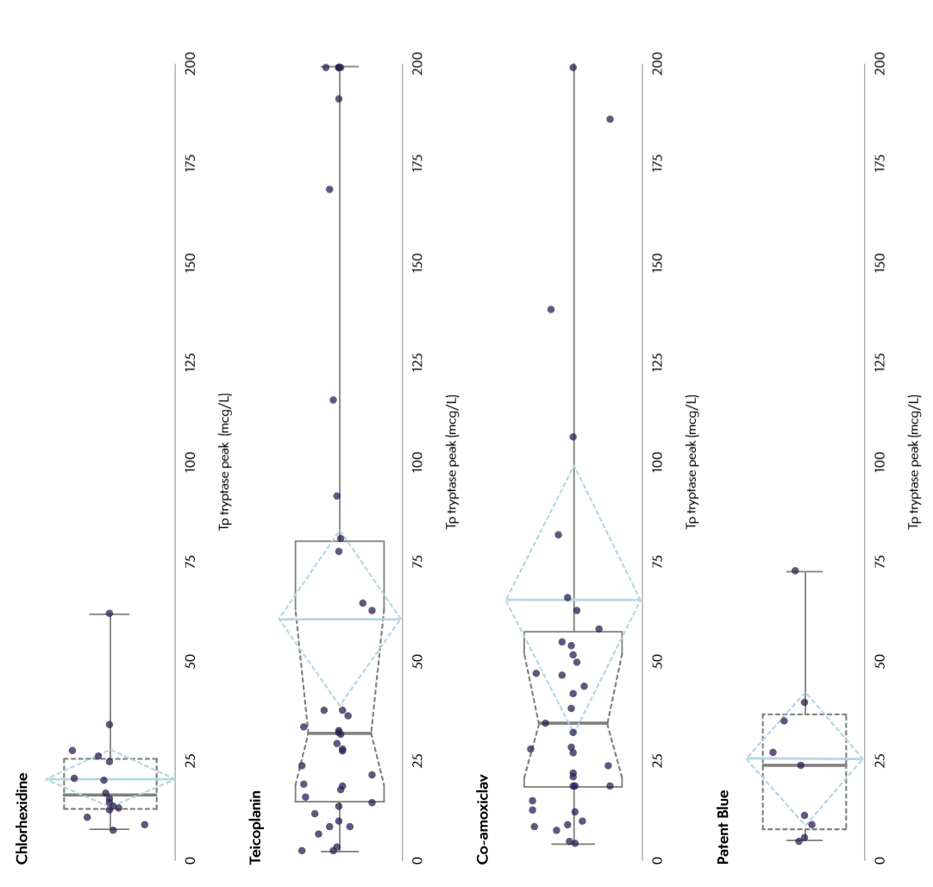
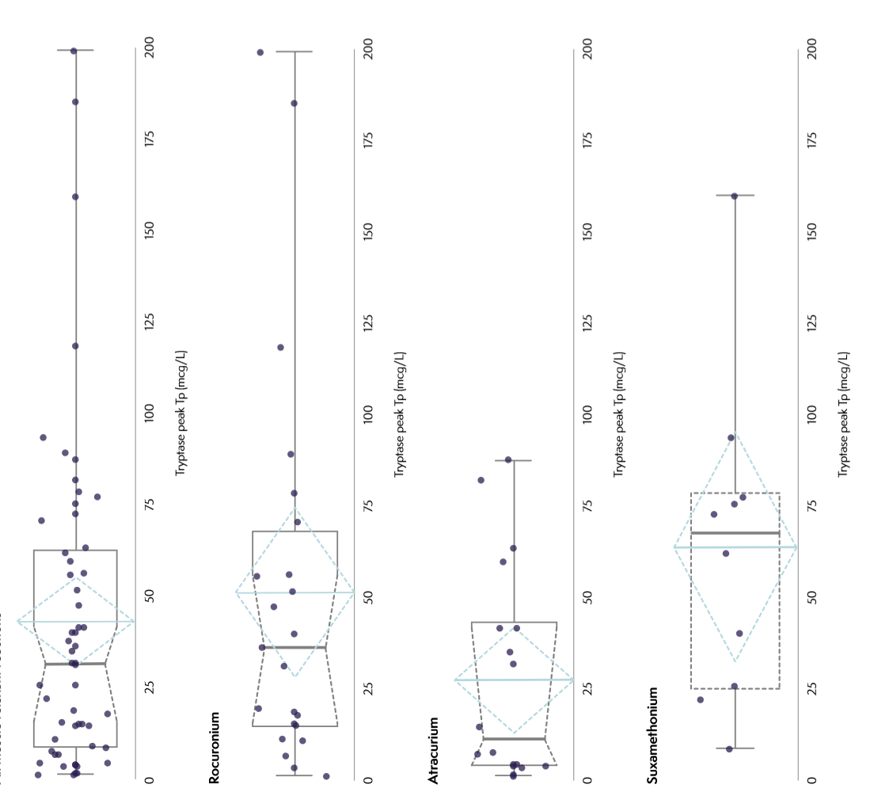
Tryptase Vs. Trigger

Slide 5
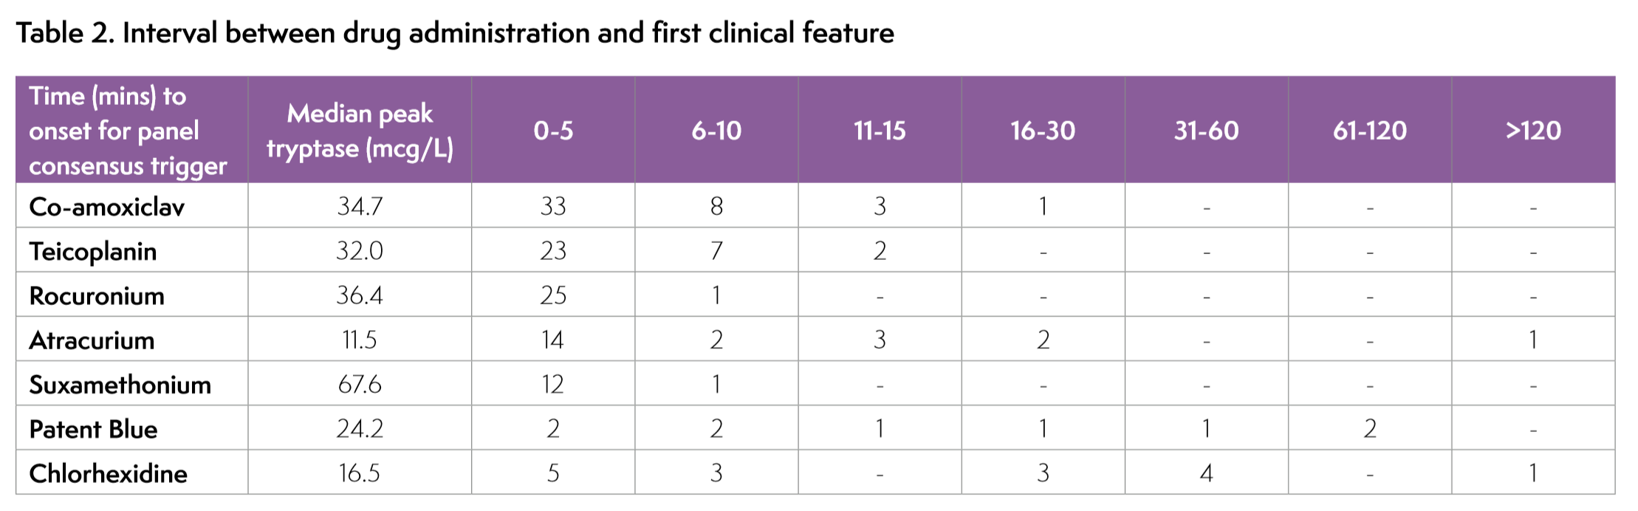
Some triggers slower onset/lower tryptases

Slide 6
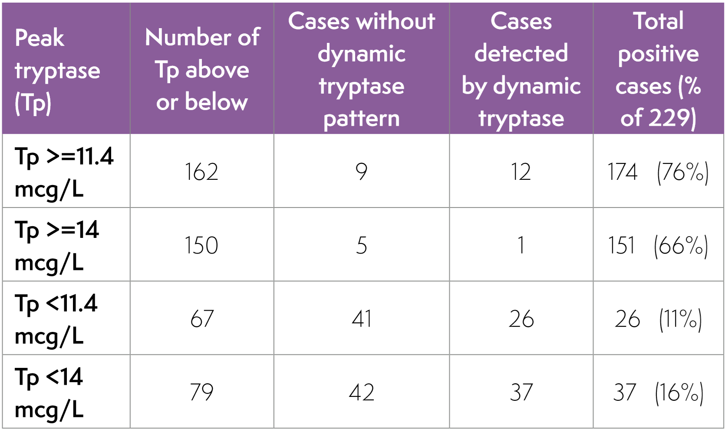

Use dynamic tryptase!

Slide 7
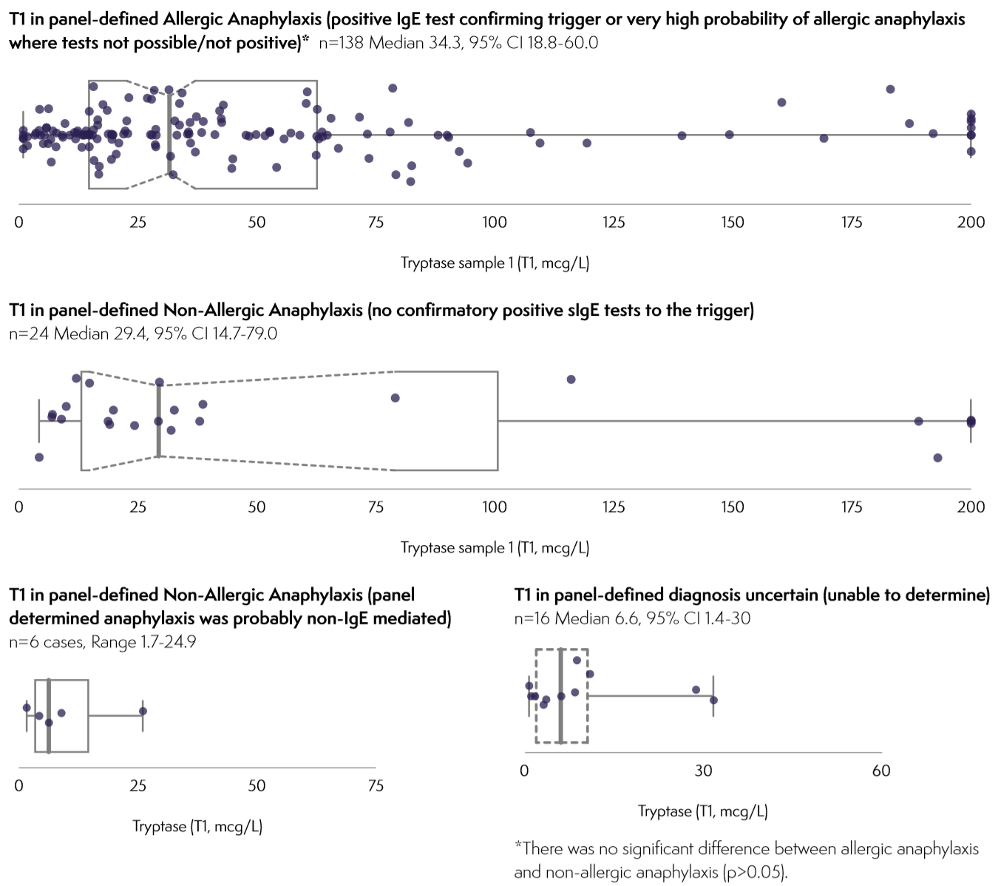

But negative tests do not make a reaction “non-allergic”
Presence of sIgE is found in most cases

Slide 8
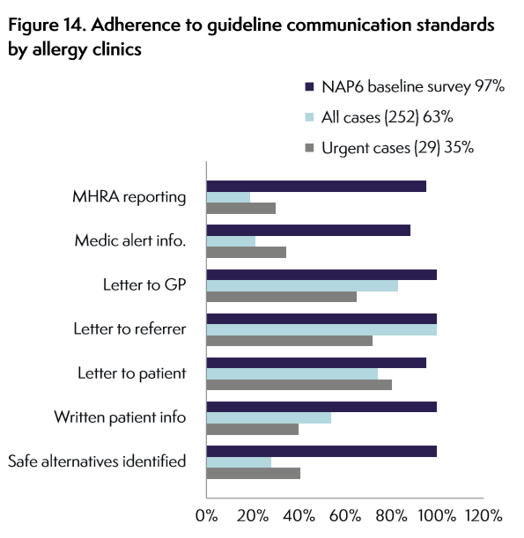


Communication
Could do (much)
better

Slide 9
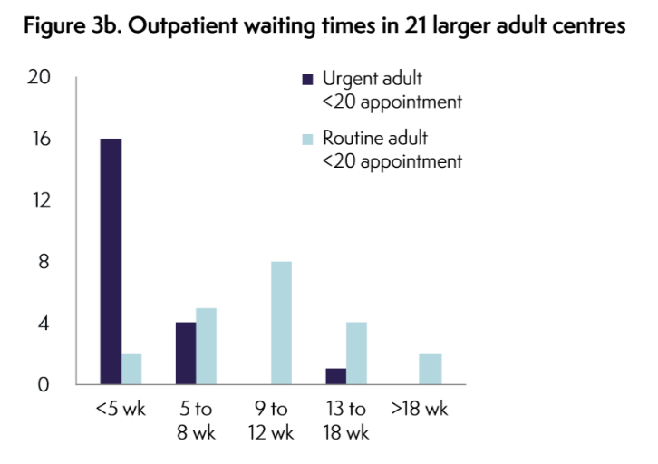
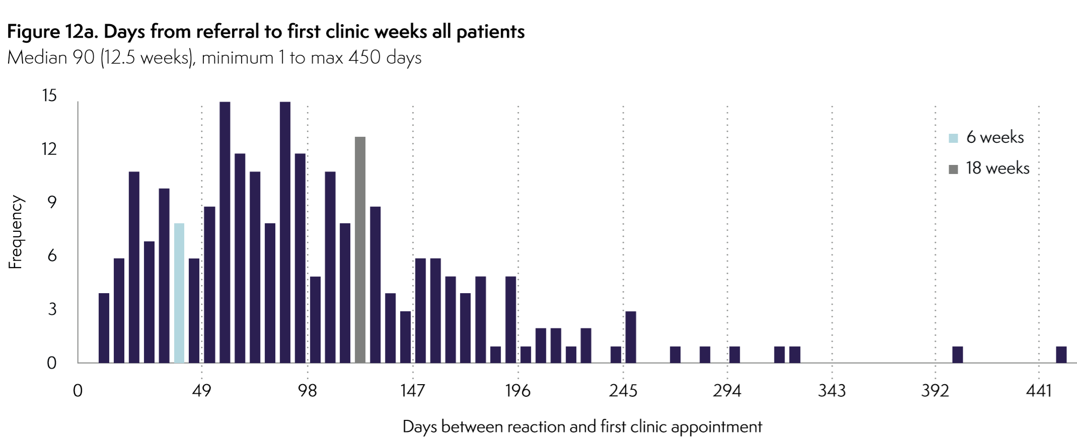
Delay in clinic assessments
A bit worse than predicted by baseline survey -
Not good

Slide 10
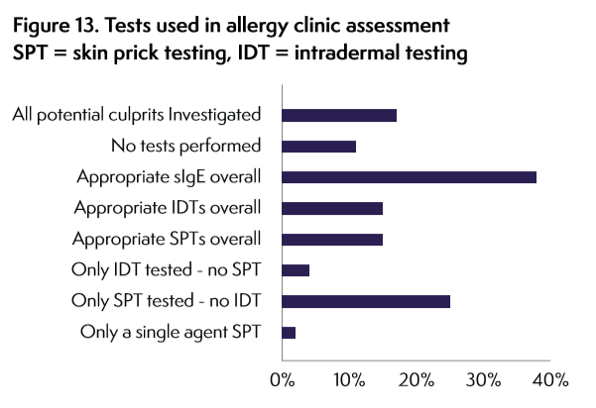
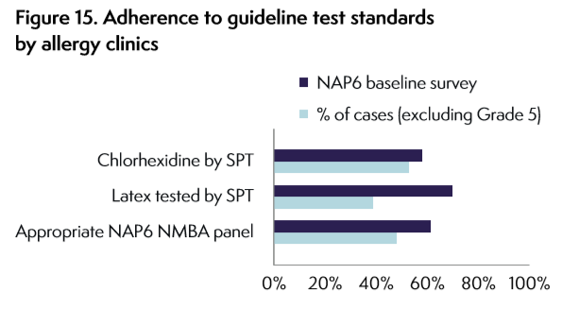

Testing
Baseline correct = confirmed to be suboptimal

Slide 11
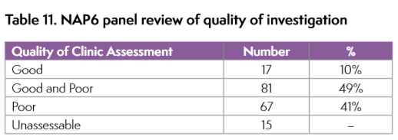
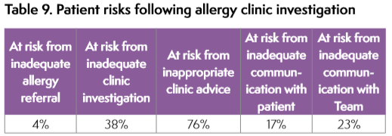
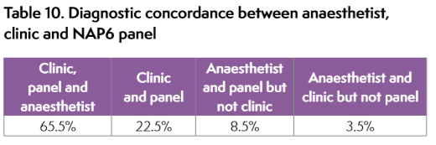

Quality – room for improvement

Slide 12
Key findings
Earlier samples gave higher MCT levels which rapidly fell within 30 minutes
Median first MCT levels rose with reaction grade - MCT level did not correlate with severity of clinical features individually
The dynamic-tryptase algorithm [(baseline tryptase x1.2) +2 mcg/L] increased yield by 16%.
Clinic investigations adhered fully to AAGBI guidance in 32% and to BSACI guidance in 17%
  most non-adherence was through
    failing to test for all potential culprit agents
    poor communication
More data on the predictive values of different modes of testing using standardised methods are required for all triggers

Slide 13
Key findings
Improved access/timeliness of assessments; ideal of 6–8 weeks post-reaction
Improved communication of diagnosis and clear safe instructions for future safe anaesthesia
anaesthetists in clinic to achieve this
All potential culprits tested by all relevant test modalities (SPT, IDT, sIgE and where appropriate challenge testing
Better standardised clinic reports should be developed, to include
  drugs identified
  type of reaction
  drugs to avoid
  safe alternatives
  tests used
  communication of results: to anaesthetists, general practitioners and patients

Slide 14


What did clinics do well?
Timely assessment
Comprehensive assessments
Achieving Diagnosis
Communication with health care professionals
Avoidance advice
Early access for urgent cases
MHRA reporting

Slide 15
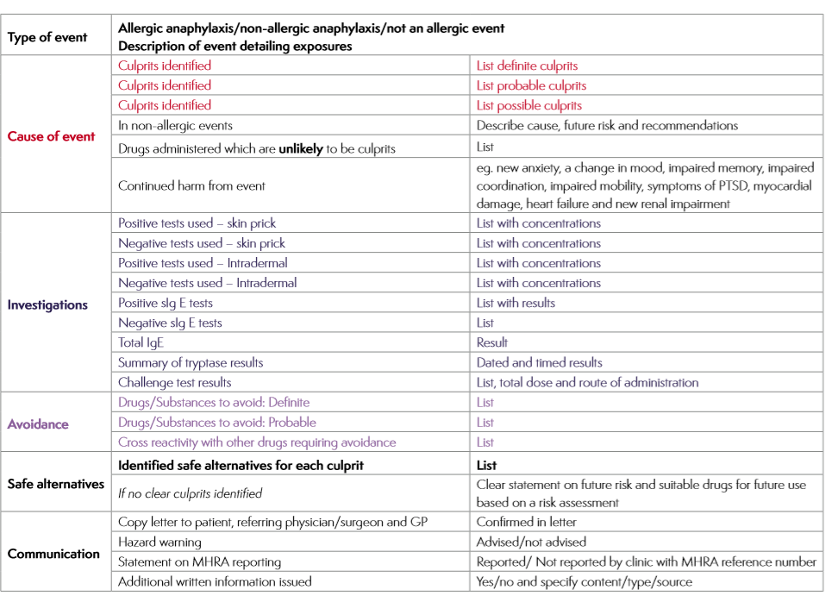
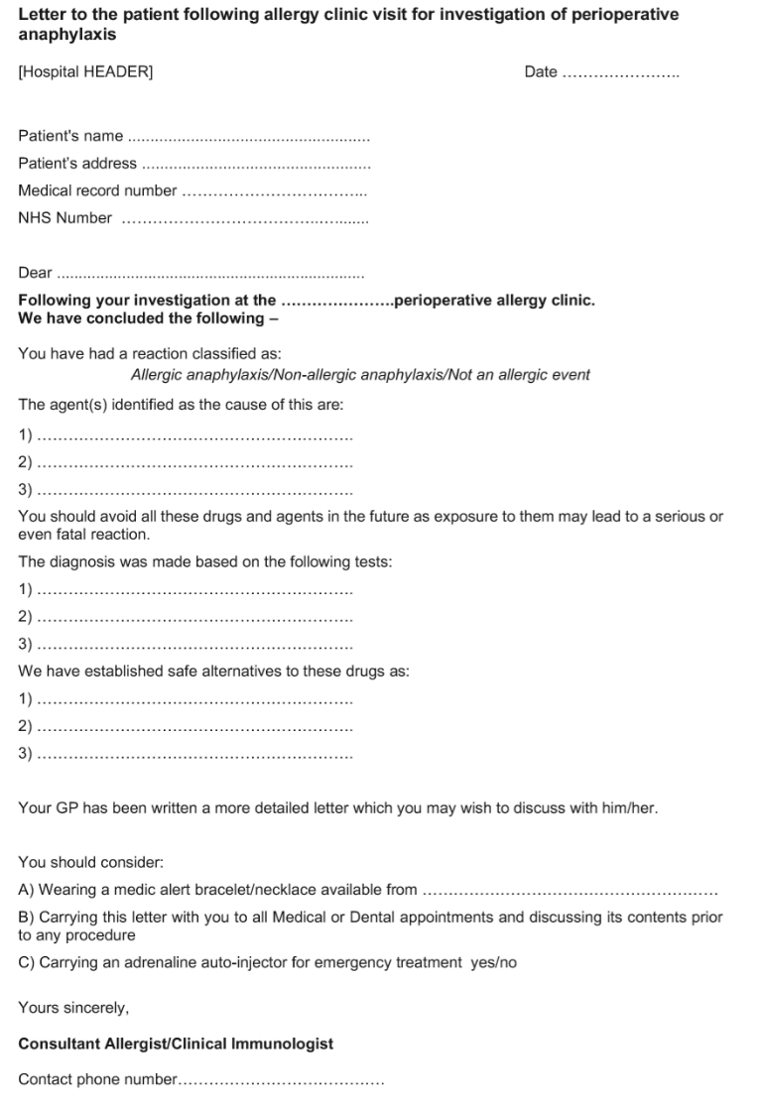
NAP6 Letter Template

Slide 16
Thank you

