Slide 1



Immediate
Management
Prof Nigel Harper
Clinical Lead, NAP6

Slide 2
What we already know
Adrenaline is the mainstay of treatment
Patients taking beta-blockers may be adrenaline-resistant (glucagon is more effective)
Other vasoactive drugs may be effective
  Metaraminol
  Noradrenaline
  Vasopressin
Large volumes of IV fluids should be administered
ALS protocol should be followed in cardiac arrest
Steroids generally accepted to be beneficial
Antihistamines may improve urticaria/swelling

Slide 3
What we already know - adrenaline
Not the usual first drug for ‘usual’ anaesthesia-induced hypotension
Beneficial alpha and beta agonist properties
Early administration important
Guidelines recommend IV and IM routes
AAGBI: 50 mcg repeated as necessary
ANZAAG: 100 mcg → 100-200 mcg every 2 mins → infusion after 3rd bolus
Reluctance to give adrenaline noted in a Danish study

Slide 4
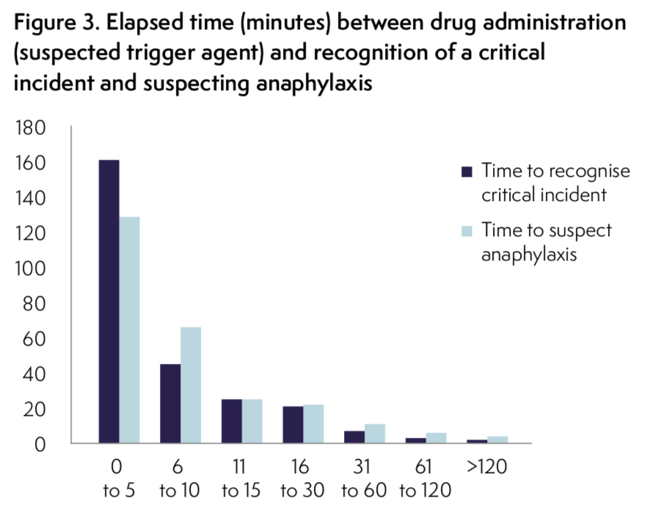
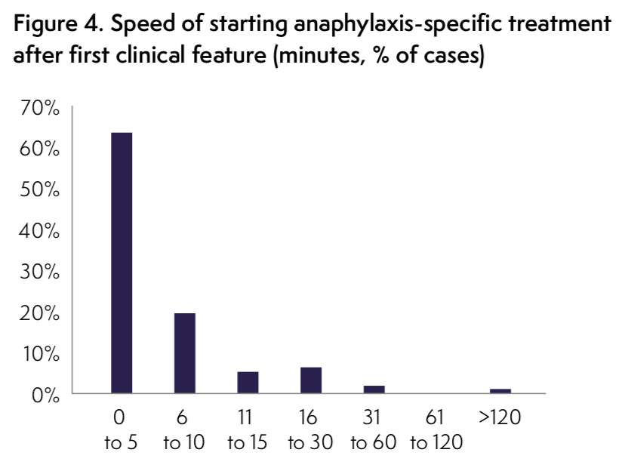
Recognition and starting specific treatment

Slide 5
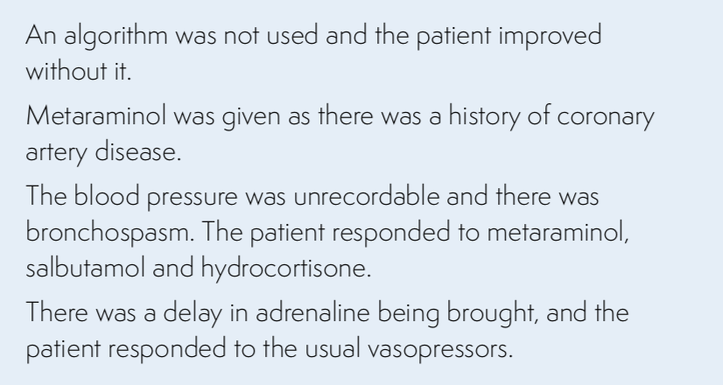
Administration of adrenaline
Adrenaline not administered in 17.7% of cases
Not given when indicated (omitted or late) in 19.4% of cases
IV infusion in 31% of cases
IM route in 14%, and both in 6% of cases
Median dose
  Grade 3: 200 mcg
  Grade 4: 500 mcg
  Grade 5: 4 mg

Slide 6
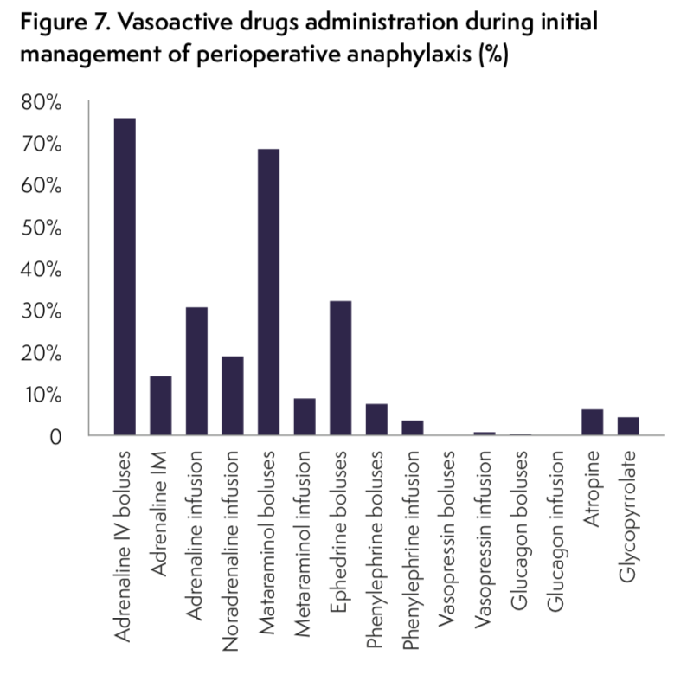
Other vasoactive drugs
Metaraminol given (usually first) in 69% of cases
Noradrenaline infusion administered in 19%
Phenylephrine administered mainly in obstetric cases
Two patients received vasopressin
18% of patients were taking a beta-blocker but only one received glucagon

Slide 7
Steroids and antihistamines
Hydrocortisone given in only 83% of cases
Dexamethasone given after the event in 16%
  Dexamethasone given as an antiemetic in 60% of all GAs
  7.5mg equivalent to hydrocortisone 200mg
Chlorphenamine given in 74% of cases and ranitidine in 5.3%
  Associated with increased probability of no harm (OR = 2.2) & decreased probability of moderate/severe harm (OR = 0.41) (univariate logistic regression - patient factors and resuscitation drugs)
  BUT chlorphenamine was strongly associated with good clinical management (P<0.005)

Slide 8
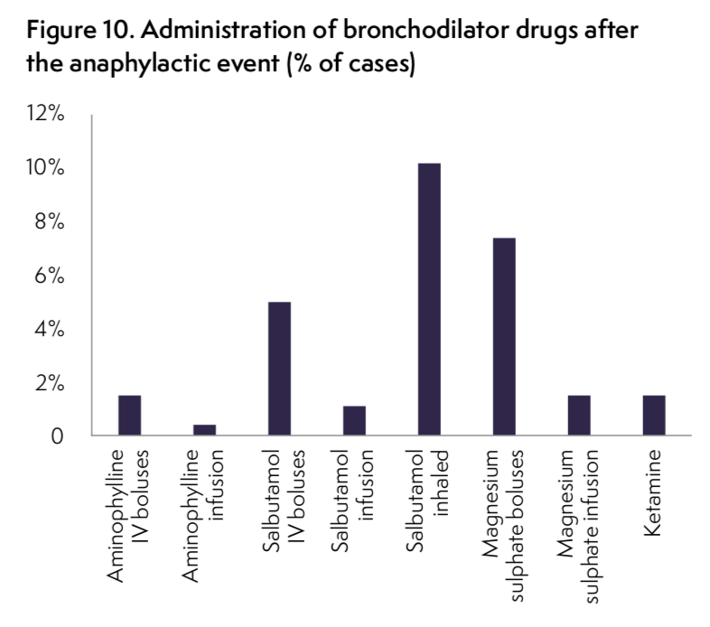
Bronchodilator Drugs
Bronchospasm present in almost half
Specific bronchodilator used in only ¼
Inhaled salbutamol administered in 10.2%
Magnesium sulphate given in 7.4% - may exacerbate hypotension
IV salbutamol boluses administered in 4.2%
Ketamine and aminophylline used in a few cases

Slide 9
Is sugammadex effective in rocuronium-anaphylaxis?
Sugammadex was administered during the first six hours following the event in 19 (7.1%) cases (median dose 300 mg, range 150– 1200 mg). The suspected trigger agent was rocuronium in nine cases, and was the actual culprit in seven
When sugammadex was given in rocuronium-anaphylaxis no additional treatment was started in 57%, but further vasopressors or bronchodilators were needed in 43%
A similar proportion was seen in non-rocuronium anaphylaxis
Compatible with results reported by Platt (2015)

Slide 10
Intravenous Fluids
Vital for restoring circulating blood volume and cardiac filling
98% received IV crystalloid in the 1st hour
9% received IV colloid
IV Fluid management inappropriate in 19% (usually not enough given)
  first hour: median 1L
  subsequent 2 hours: median 1L
  hours 3 to 5: median 0.5L
AAGBI guidelines: ‘Administer saline 0.9% … at a high rate… (large volumes may be required).’
ANZAAG guidelines ‘… repeated fluid boluses of 20mls/kg may be required.’

Slide 11
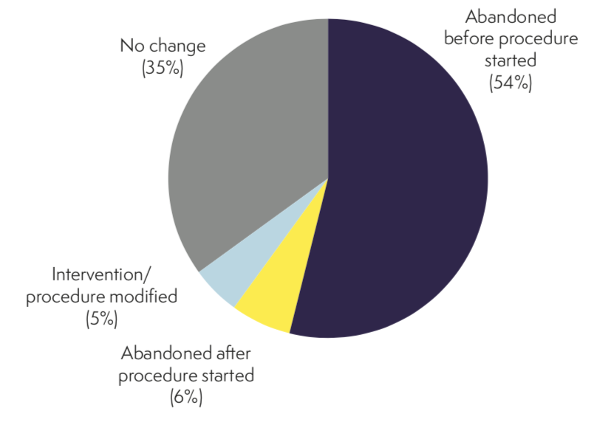
Outcome of intervention/surgery
Procedure unchanged in 35%
Procedure not abandoned in 11 cases where it would have been appropriate
Patients were more likely to require critical care if surgery had been started
In 14% of abandoned cases, it was decided not to re-schedule surgery
Median unplanned hospital stay 1 day (range 0 to 150 days)
54% transferred to critical care
  Level 3: median1 day (1 to 9 days)
  Level 2: median 1 day (1 to 25 days)
  estimated cost for the entire cohort £438,102

Slide 12
Recommendations – immediate management
Adrenaline is the primary treatment and should be administered immediately anaphylaxis is suspected. In the perioperative setting this will usually be IV
A rapid IV crystalloid (not colloid) fluid challenge of 20 ml/kg should be given immediately. This should be repeated several times if necessary
Administration of IV vasopressin 2 Units, repeated as necessary, should be considered when hypotension is refractory
In patients taking beta- blockers, early administration of IV glucagon 1 mg should be considered, repeated as necessary
Perioperative anaphylaxis guidelines and/or a management algorithm should be immediately available
Anaesthesia anaphylaxis treatment packs should be immediately available

Slide 13
Thank You

