Slide 1



NAP6 Allergen Survey
Perioperative drug exposure
Susana Marinho
Consultant Allergist & Honorary Senior Lecturer
British Society for Allergy and Clinical Immunology

Slide 2
The Allergen Survey: perioperative drug exposure
Current perioperative drug and allergen exposure in the UK
Comprehensive details
Denominator data
Interpretation of reports of perioperative anaphylaxis to NAP6

Slide 3


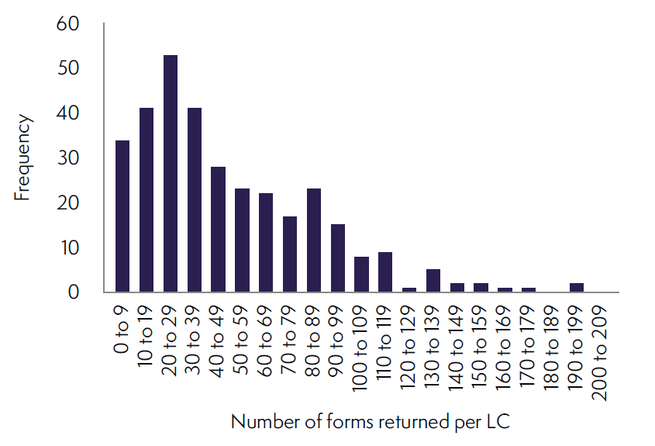
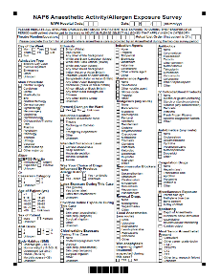

The Allergen Survey: perioperative drug exposure
Caseload
356 sites approached
342 sites took part
Scaling factor
15,942 forms returned
3,126,067 estimated annual caseload
Notes:
Scaling factor 196.09
Number of weeks in the year
It is not possible to multiply the weekly caseload by 52 due to bank holidays where activity will be reduced. Assuming activity on a bank holiday is similar to a weekend day the ‘effective’ number of weeks can be calculated. For 2016 the number of weeks used as a scaling factor to estimate annual activity was 50.6:
There were 366 days in 2016 (leap year), and 52.28 weeks (366/7 = 52.29).
Using the number of weekdays, a scaling a factor x, and y as the number of ‘effective’ weeks in 2016: 5/7 * x = 52.29 and 253/366 * x = y
Therefore x = 7 * 52.29/5 = y * 366/253
And y = (7 * 52.28 * 253) / (5 * 366) = 50.6
Multiplication factor
Number of returns in a week = number of returned forms *3.5
Number of returns in a year (2016) = returned forms * 3.5 * 50.6
Estimated annual caseload = (returned forms * 3.5 * 50.6) / (proportion of interpretable forms * proportion of hospitals responding * individual site capture rate).
Multiplication factor = (3.5 * 50.6) / (0.98 * 0.96 * 0.96) = 196.09

Slide 4
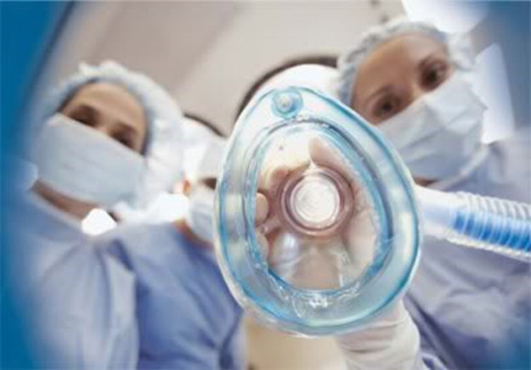
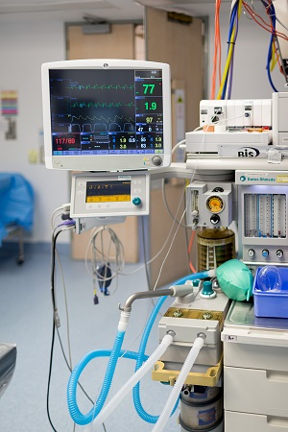
The Allergen Survey: perioperative drug exposure
Intended consciousness level
Intended consciousness level | Number of forms | Estimated annual caseload | %
General anaesthesia | 12,213 | 2,394,847 | 76.6
Deep sedation | 290 | 56,866 | 1.8
Moderate sedation | 542 | 106,281 | 3.4
Minimal sedation | 485 | 95,104 | 3.0
Awake | 2,256 | 442,379 | 14.2
Unknown | 156 | 30,590 | 1.0
Total | 15,942 | 3,126,067 | 100.0
Notes:
Sedation – 8.2% - 258,250 cases

Slide 5
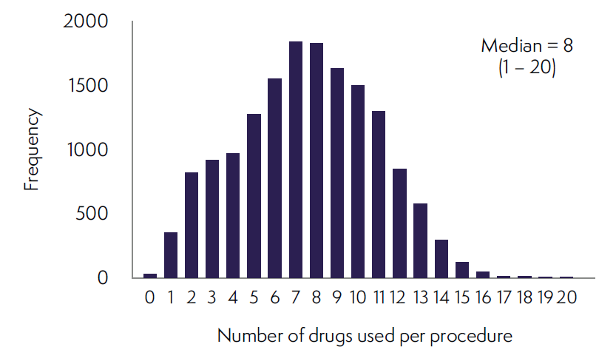
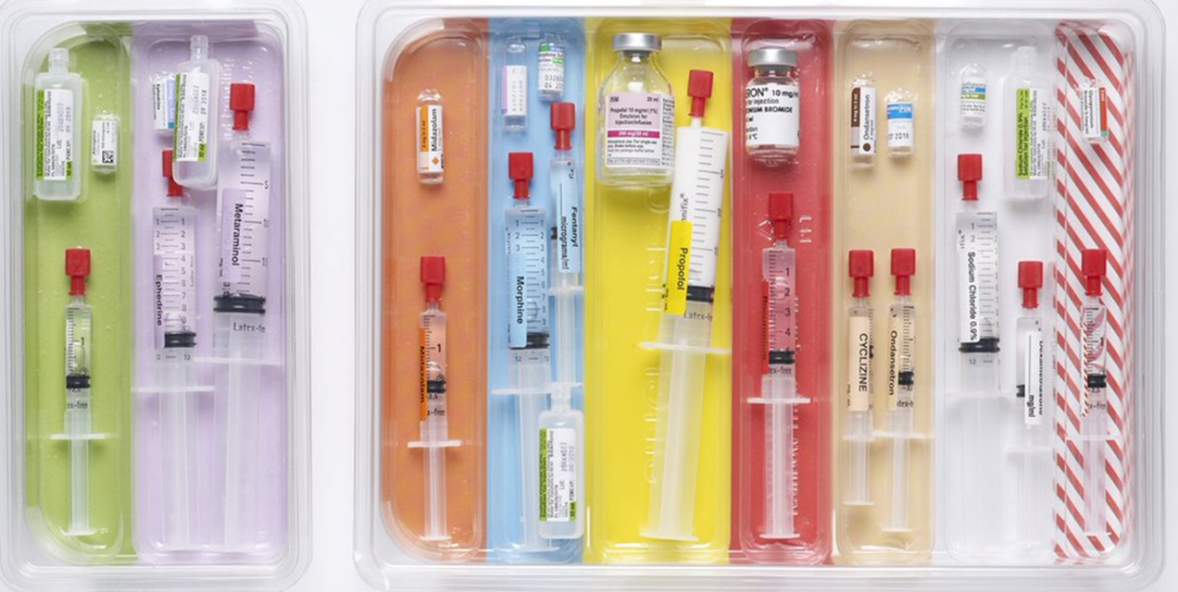
The Allergen Survey: perioperative drug exposure
Number of drugs used per procedure

Slide 6
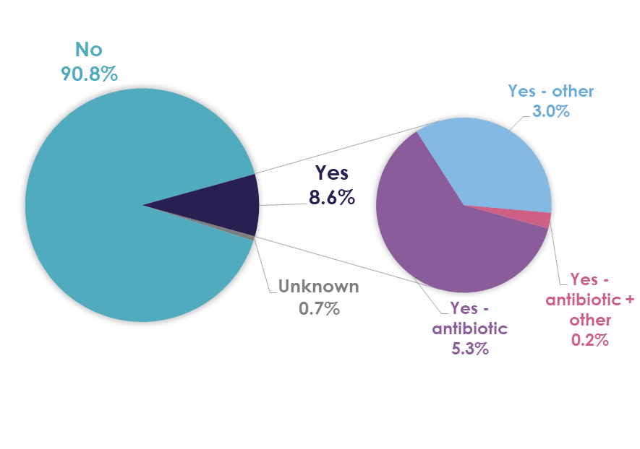
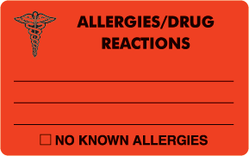
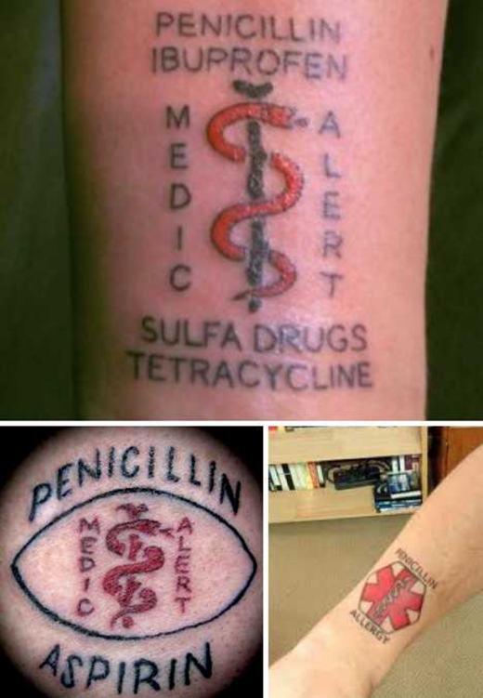
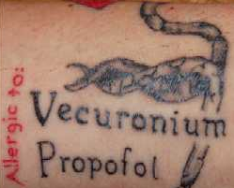
The Allergen Survey: perioperative drug exposure
Previous allergy history and choice of drugs

Slide 7
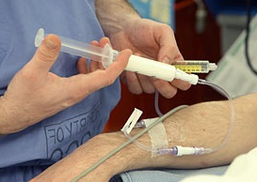
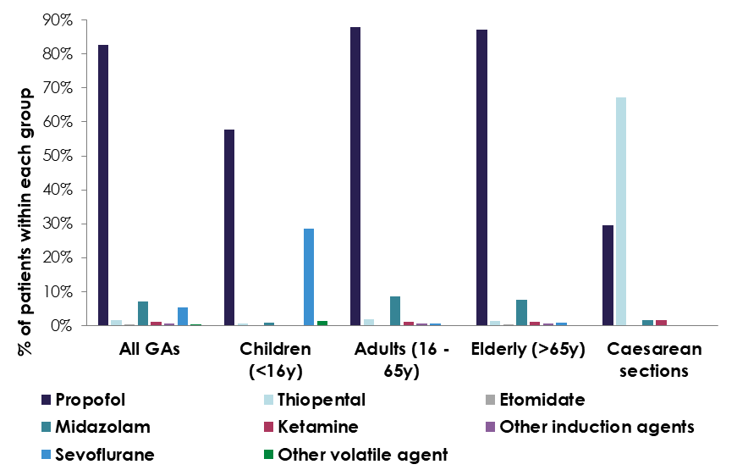
Induction agents
Use in all GA + sedation cases
Use in GAs by age group
and in Cæsarean-sections
Induction Drug | Number exposed in activity survey | Estimated annual exposure | % of cases having at least 1 agent | % of total drug group usage (sum of all; total > total no of cases)
At least 1 used | 13,019 | 2,552,896 | 100.0% | -
Propofol | 11,682 | 2,290,723 | 89.7% | 74.7%
Thiopental | 215 | 42,159 | 1.7% | 1.4%
Etomidate | 36 | 7,059 | 0.3% | 0.2%
Midazolam | 1,515 | 297,076 | 11.6% | 9.7%
Ketamine | 198 | 38,826 | 1.5% | 1.3%
Sevoflurane | 1,662 | 325,902 | 12.8% | 10.6%
Other volatile agent | 166 | 32,551 | 1.3% | 1.1%
Other induction agents | 156 | 30,590 | 1.2% | 1.0%
Notes:
Propofol – the dominant induction agent 90.4% (most widely used in all groups)
Was used more often in C-sections than in NAP5

Slide 8
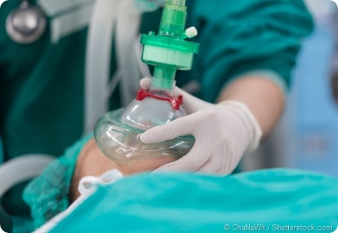
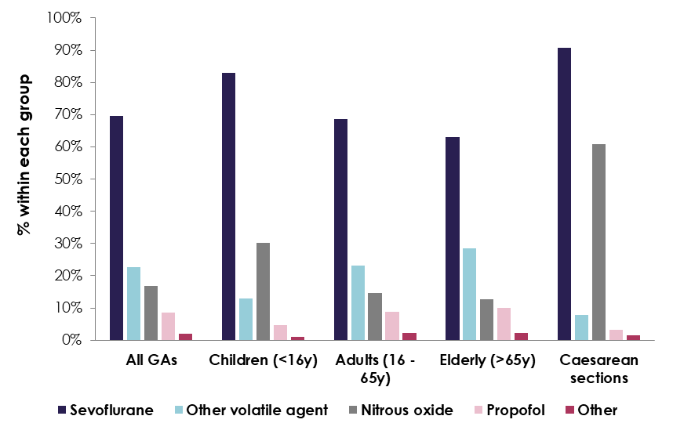
Maintenance agents
Use in GAs
Use by age group
and in Cæsarean-sections
Maintenance Drug | Number exposed in activity survey | Estimated annual exposure | % of cases having at least 1 maintenance agent
At least one maintenance agent used | 11,921 | 2,337,589 | 100.0%
Sevoflurane | 8,499 | 1,666,569 | 71.3%
Other volatile agent | 2,773 | 543,758 | 23.3%
Nitrous oxide | 2,041 | 400,220 | 17.1%
Propofol | 1,032 | 202,365 | 8.7%
Other | 249 | 48,826 | 2.1%
Notes:
Sevoflurane – main MA used across all age groups and specialties
Induction and maintenance exclusively with sevo – 2.8% of GAs: 14.5% of paeds and 0.4% of adult GAs
Nitrous Oxide use (17% of cases) use has fallen by 30% since NAP5
NO used mostly during GA in orthopaedics/trauma, general surgery and ENT – perhaps associated with increased numbers of paeds cases in these specialties
NO may have become less popular after the publication of the ENIGMA study; however, ENIGMA II dispelled safety concerns, incl in the elderly population

Slide 9
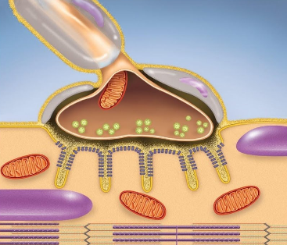
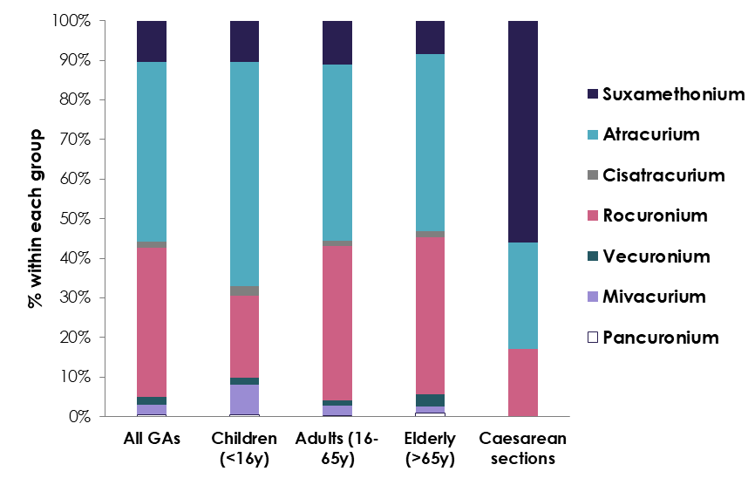
Neuromuscular blocking agents - NMBAs
Use of NMBAs (GAs)
Use by age group
and in Cæsarean-sections
Drug | Number exposed in activity survey | Estimated annual exposure | % of all GAs | % of NMBA use | % of total NMBA usage (sum of all; total > total no of cases)
At least 1 NMBA used | 5,760 | 1,129,478 | 47.2% | 100.0% | -
Suxamethonium | 643 | 126,086 | 5.3% | 11.2% | 10.3%
Atracurium | 2,828 | 554,543 | 23.2% | 49.1% | 45.4%
Cisatracurium | 95 | 18,629 | 0.8% | 1.6% | 1.5%
Mivacurium | 157 | 30,786 | 1.3% | 2.7% | 2.5%
Rocuronium | 2,341 | 459,047 | 19.2% | 40.6% | 37.6%
Vecuronium | 124 | 24,315 | 1.0% | 2.2% | 2.0%
Pancuronium | 36 | 7,059 | 0.3% | 0.6% | 0.6%
Notes:
NMBAs were used in 47.2% of GA cases – use has remained stable since 2013
Main agents were atracurium and rocuronium
Suxamethonium use has fallen slightly, both overall (5.3% vs. 13% of casesin which an NMBA was used), and during c-sections (81% vs 92%)
Of NMBA use – 88.8% received non-dep only, 4% sux only and 7.2% both sux and non-dep NMBAs
The distribution of NMBas was not captured in NAP5

Slide 10
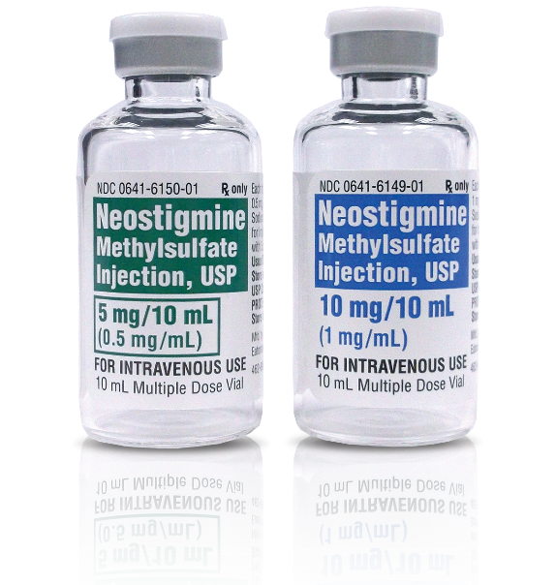
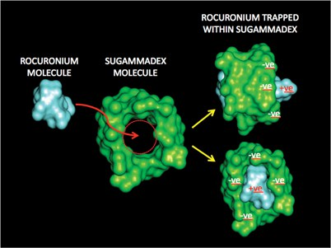
Reversal drugs
Use of reversal drugs (GAs)
Drug | Number exposed in activity survey | Estimated annual exposure | % of all GAs | % of NMBA use | % of total drug group usage (sum of all; total > total no of cases)
At least 1 reversal drug used | 3,598 | 705,532 | 29.5% | 62.5% | % of all reversal drug use
Neostigmine | 3,307 | 648,470 | 27.1% | 57.4% | 90.3%
Sugammadex | 327 | 64,121 | 2.7% | 5.7% | 8.9%
Other | 27 | 5,294 | 0.2% | 0.5% | 0.7%
Notes:
Use of reversal agents is overall unchanged since 2013, but use of sugammadex has increased 4-fold – soon to come off patent, so further increase anticipated
Overall – static nature of NMBA use, the persistent underuse of reversal agents, and the underwhelming use of NM monitoring (reported in activity survey), indicates no evidence of improvement in practice since increased vigilance in this area was recommended in NAP5 and described as mandatory in AAGBI minimum standards for monitoring

Slide 11
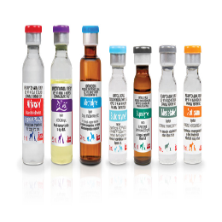
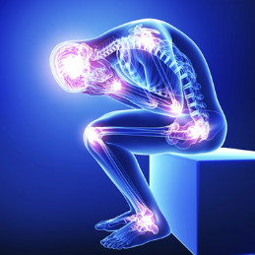
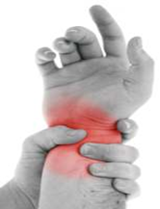
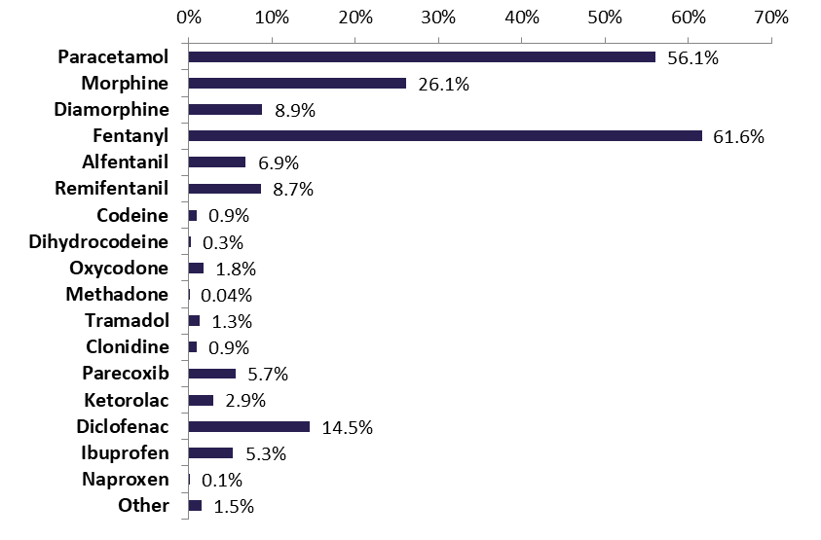
Analgesic drugs
Overall use
Used in 88.2% of all cases
and in 99.8% of GAs
Estimated annual caseload: 2,755,849
Opioids: 82.5% 2,577,603
Paracetamol: 56.1% 1,752,849
NSAIDs: 28.3% 884,170
Notes:
Opioids – 3.6 million opioid drugs administered, with fentanyl and morphine the dominant drugs
Used in virtually all GA cases
increasing concerns re dependence potential
Data useful – to directly inform practice but to monitor usage changes over time

Slide 12
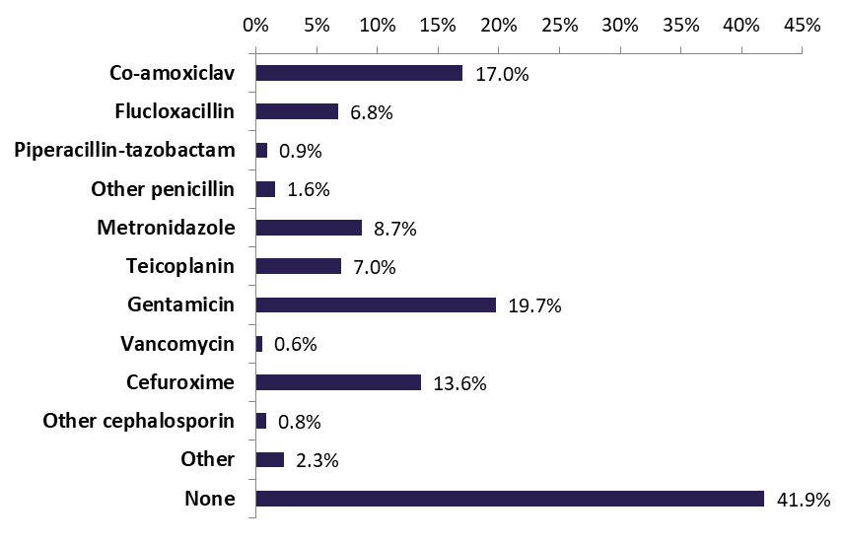
Antibiotics
Use in all procedures
Used in 57.2% of all cases
Estimated annual caseload: 1,787,360
Gentamicin: 19.7% 616,899
Co-amoxiclav: 17.0% 535,580
Cefuroxime: 13.6% 424,143

Slide 13

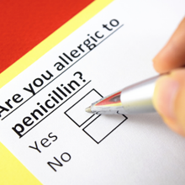
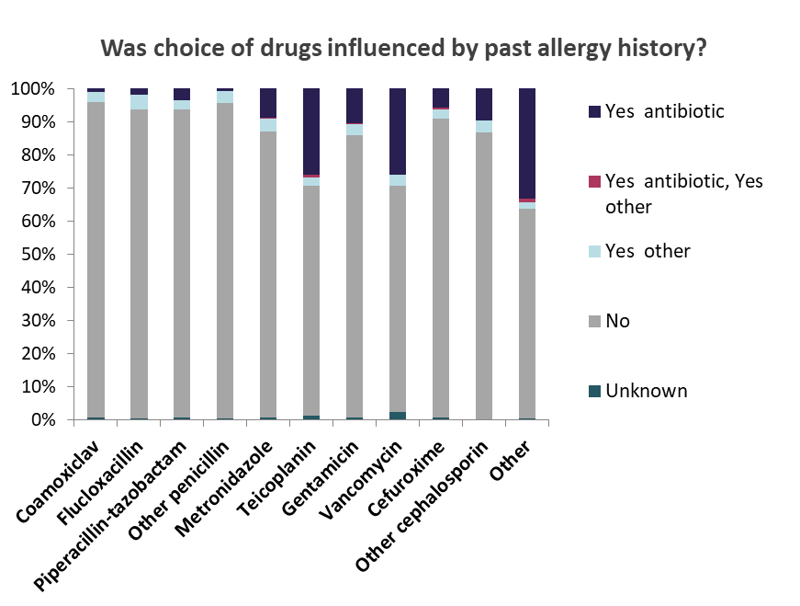
Antibiotics
Overall use
Choice of antibiotics
and past allergy history
Drug | Number exposed in activity survey | Estimated annual exposure | % of all cases | % of all cases receiving antibiotic | % of total antibiotic usage (Σ of all; total > total no of cases)
At least 1 antibiotic used | 9,115 | 1,787,360 | 57.2% | - | -
Co-amoxiclav | 2,716 | 532,580 | 17.0% | 29.8% | 21.6%
Flucloxacillin | 1,081 | 211,973 | 6.8% | 11.9% | 8.6%
Piperacillin-tazobactam | 144 | 28,237 | 0.9% | 1.6% | 1.1%
Other penicillin | 248 | 48,630 | 1.6% | 2.7% | 2.0%
Metronidazole | 1,388 | 272,173 | 8.7% | 15.2% | 11.0%
Teicoplanin | 1,120 | 219,621 | 7.0% | 12.3% | 8.9%
Gentamicin | 3,146 | 616,899 | 19.7% | 34.5% | 25.0%
Vancomycin | 90 | 17,648 | 0.6% | 1.0% | 0.7%
Cefuroxime | 2,163 | 424,143 | 13.6% | 23.7% | 17.2%
Other cephalosporin | 135 | 26,472 | 0.8% | 1.5% | 1.1%
Other | 364 | 71,377 | 2.3% | 4.0% | 2.9%
Notes:
Co-amoxiclav – the most commonly used antibiotic – 21.6% of all antibiotic uses
When co-amoxiclav was used, the choice of antibiotic was rarely affected by drug allergy (5.8%)
Teicoplanin – 8.9% of all antibiotic administrations
Mainly used in orthopaedics and trauma (17.5% of all cases receiving this drug), general surgery (16.9%) and gynaecology (10.8%).
In 25.6% of cases receiving this antibiotic, its choice was determined by previous history of antibiotic allergy.
Antibiotics
Current threat of increasing ab resistance
Our data provide detailed info on ab use – more than ½ of procedures and ~2 million administrations pa
Antibiotic stewardship
The choice of drugs administered was reported to be influenced by allergy history in almost 10% of cases
A hx of ab allergy influenced choice of teicoplanin or vancomycin in > ¼ of cases when either of these abs were used
We did not collect info on the specific ab hx – likely penicillin dominant – these drugs common substitutes and pen allergy reported in ~10% of gen pop and ~20% of inpatients
Morte than 90% of patients with hx of pen allergy are deemed not allergic when investigated
Growing body of evidence has shown that use of second-line (often more expensive) antibiotics has significant public health implications and increased healthcare costs with increased duration of Rx and hospital stay; also lead tp higher rates of antibiotic resistance and infections, incl MRSA, C diff, VRE (vanco res enterococcus)
Our data provide additional evidence of use of 2nd-line abs, especially teic, driven by drug allergy hx, adding further strength to calls from the international community for robust programmes to tackle the problem of inaccurate labels of antibiotic allergy – improving antibiotic stewardship

Slide 14
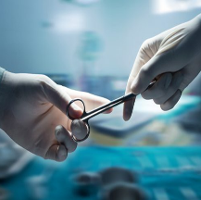
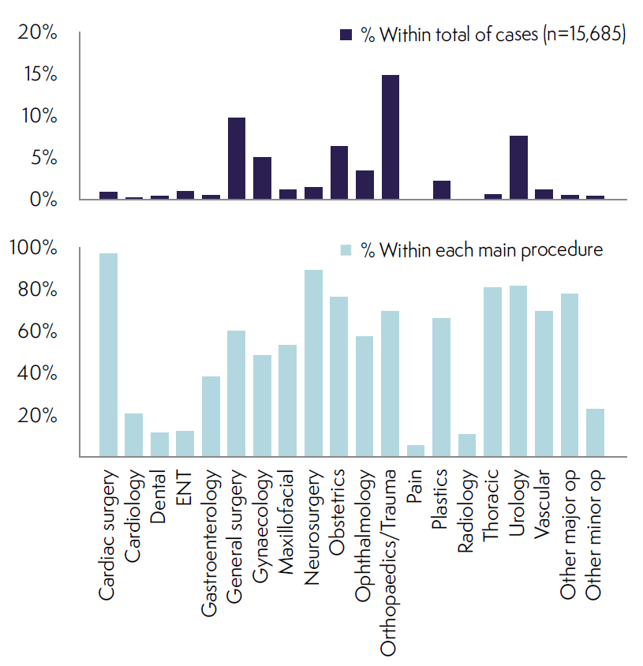
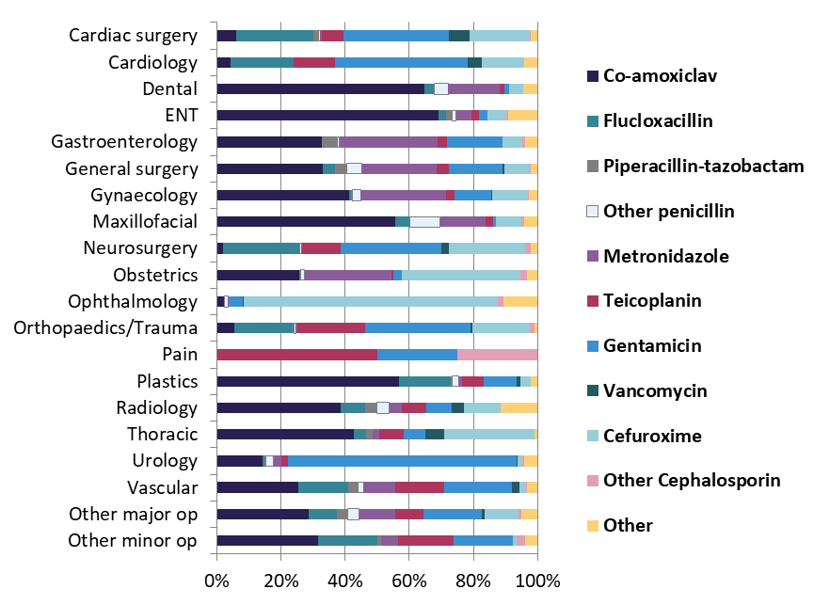
Antibiotics
Use by specialty
Individual antibiotic use
by specialty
Notes:
Orthopaedics/trauma and general surgery are the main specialties using antibiotics but cardiac and neurosurgery, urology and thoracic surgery are the specialties with the greatest proportion of cases receiving an antibiotic
The wide distribution of abs used might perhaps hint at a lack of consistent application of best practice, but this would require further investigation

Slide 15
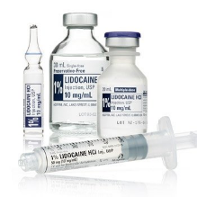
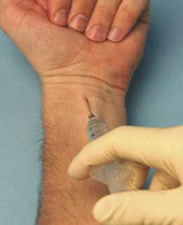
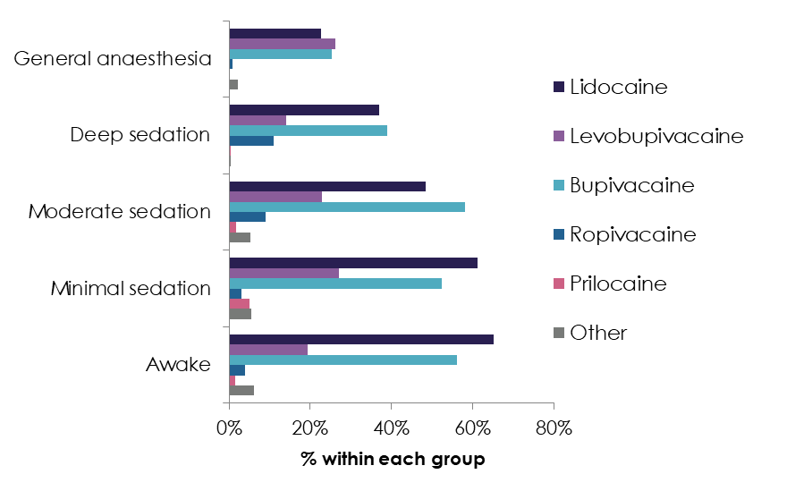
Local anaesthetics
Overall use
Use by intended conscious level
Drug | Number exposed in activity survey | Estimated annual exposure | % of all cases | % of all cases receiving LA | % of total LA usage (Σ of all; total > total no of cases)
At least 1 local anaesthetic used | 11,831 | 2,319,941 | 74.2% | - | -
Lidocaine | 4,951 | 970,842 | 31.1% | 41.8% | 33.3%
Bupivacaine | 5,092 | 998,490 | 31.9% | 43.0% | 34.2%
Levobupivacaine | 3,954 | 775,340 | 24.8% | 33.4% | 26.6%
Ropivacaine | 302 | 59,219 | 1.9% | 2.6% | 2.0%
Prilocaine | 103 | 20,197 | 0.6% | 0.9% | 0.7%
Other | 469 | 91,966 | 2.9% | 4.0% | 3.2%
Notes:
Local anaesthetics
Widespread use – in ¾ of all cases
Distribution of drugs used indicates that local and regional anaesthetic techniques were used in ¾ of cases and suggest that the most suitable cases are receiving neuraxial, peripheral nerve block or local anaesthesia infiltration; the 1st 2 associated with improved patient reported satisfaction

Slide 16
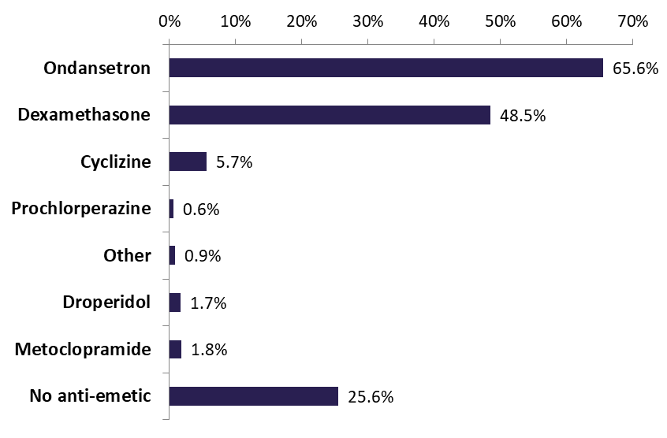
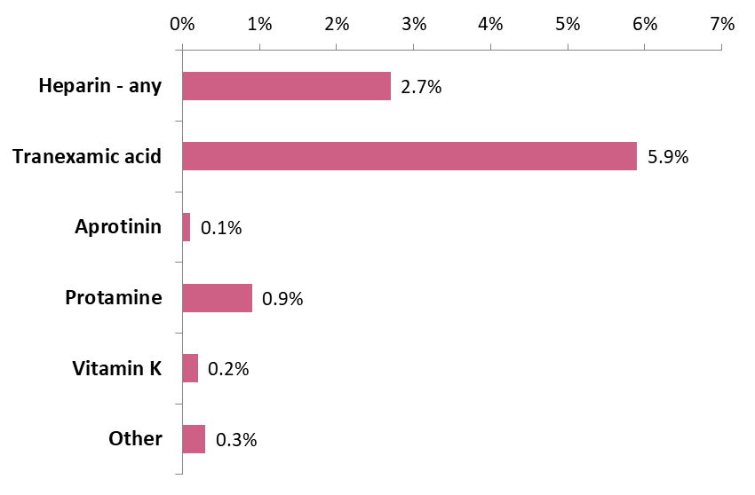
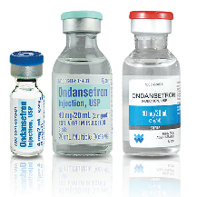
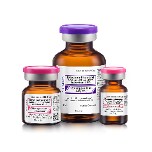
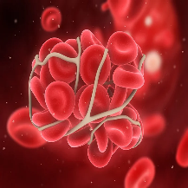
Anti-emetics and drugs affecting coagulation
Anti-emetics
- used in 73.1% of all cases (2,285,429 pa)
Drugs affecting coagulation
- Used in 8.3% of all cases (258,643 pa)
Notes:
Anti-emetics
GA – use of anti-emetics was higher
Ondansetron 78.3%
Dexamethasone 60.4%
Ond & dexa used in combination in 53.1% of all GA cases

Slide 17
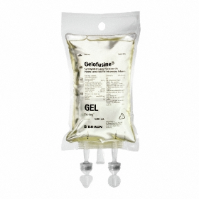
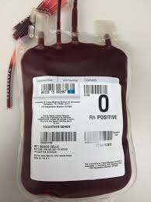
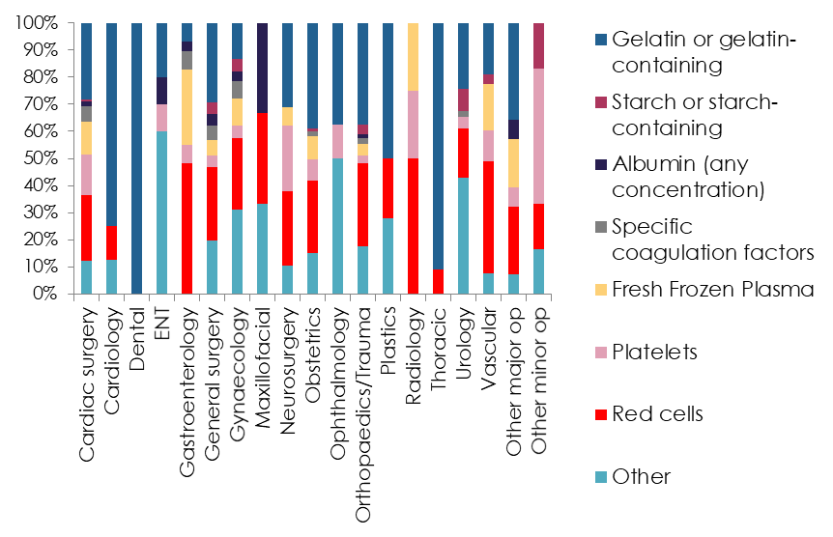
Intravenous colloids and blood products
Overall use
Use by specialty
Drug/substance | Number exposed in activity survey | Estimated annual exposure | % of all cases
At least 1 IV colloid/blood product used | 668 | 130,988 | 4.2%
Gelatin or gelatin-containing | 266 | 52,160 | 1.7%
Starch or starch-containing | 26 | 5,098 | 0.2%
Albumin (any concentration) | 18 | 3,530 | 0.1%
Red cells | 242 | 47,454 | 1.5%
Platelets | 68 | 13,334 | 0.4%
Fresh frozen plasma | 74 | 14,511 | 0.5%
Specific coagulation factors | 28 | 5,491 | 0.2%
Other | 156 | 30,590 | 1.0%
Notes:
Blood products were used in ~3% of all cases
Synthetic colloids in <2% - starch in only 1 in 600 cases
Starch
~1 in 600 cases; no particular pattern but use did include emergency cases and patients ASA grade 3-4
The 26 admin came from 17 sites – clustered use?
EMA 2018 recommended suspension from sale

Slide 18
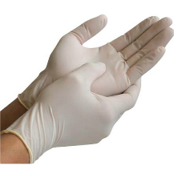
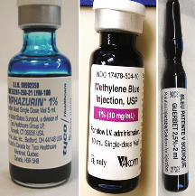
Latex exposure & Miscellaneous drugs/substances
Latex exposure
Miscellaneous drugs/substances
Latex exposure | Number exposed in activity survey | Estimated annual exposure | % of all cases | % of all cases exposed to latex | % of total latex exposure (Σ of all; total > total no of cases)
Exposure - at least 1 route | 11,119 | 2,180,325 | 69.7% | - | -
Gloves | 10,244 | 2,008,746 | 64.3% | 92.1% | 88.0%
Other | 1,397 | 273,938 | 8.8% | 12.6% | 12.0%
Drug/substance | Number exposed in activity survey | Estimated annual exposure | % of all cases
Patent blue dye | 315 | 61,768 | 2.0%
Methylene blue dye | 139 | 27,257 | 0.9%
Bone cement | 407 | 79,809 | 2.6%
X-Ray contrast | 274 | 53,729 | 1.7%
Notes:
Latex
Specialty with the highest rate of exposure was cardiac surgery (94.8%) and the lowest was psychiatry (30.8%)
Latex-free reported for only 1/5 of cases

Slide 19
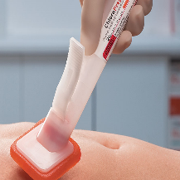
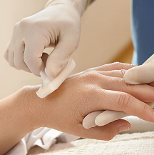
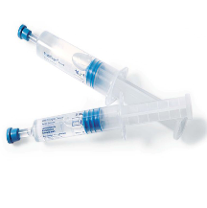
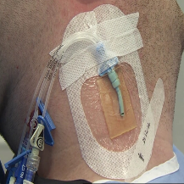
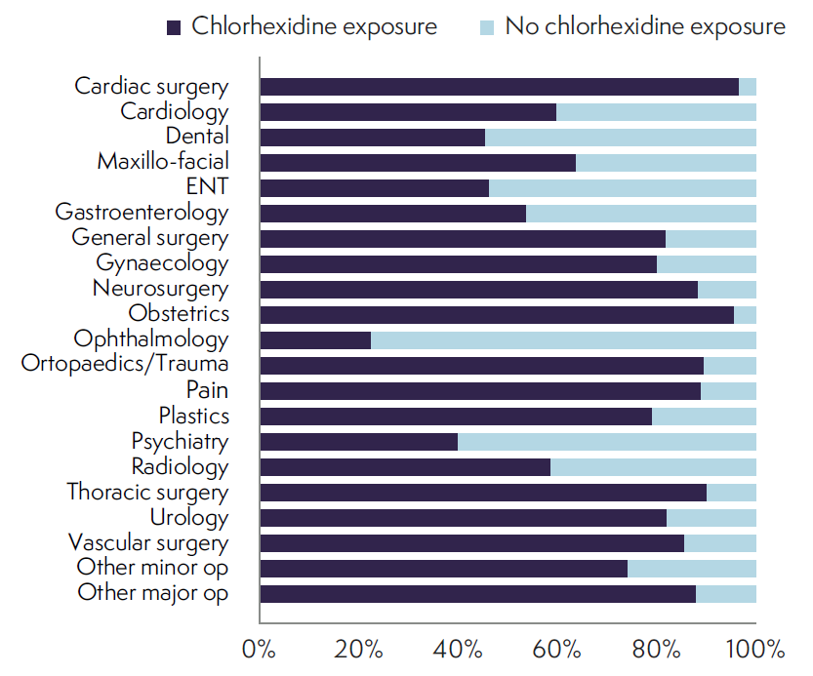
Antiseptics – chlorhexidine
Overall exposure
Exposure by specialty
Chlorhexidine exposure | Number exposed in activity survey | Estimated annual exposure | % of all cases | % of all cases exposed | % of all chlorhexidine exposure (Σ of all; total > total no of cases)
Exposure - at least 1 route | 11,722 | 2,298,567 | 73.5% | - | -
Coated/impregnated CVC | 93 | 18,236 | 0.6% | 0.8% | 0.6%
Urethral | 532 | 104,320 | 3.3% | 4.5% | 3.3%
Skin Prep - anaesthetist | 8,232 | 1,614,213 | 51.6% | 70.2% | 50.9%
Skin Prep - surgeon | 7,120 | 1,396,161 | 44.7% | 60.7% | 44.0%
Surgical irrigation | 95 | 18,629 | 0.6% | 0.8% | 0.6%
Other | 101 | 19,805 | 0.6% | 0.9% | 0.6%
Notes:
Unknown – 0.9%
No exposure reported – 23.6%
Chlorhexidine
Widely used antiseptic - ubiquitous
Increasingly reported as an emerging cause of allergy and perioperative anaphylaxis in particular
Use appears to be under-recognised in the healthcare sector
Potential to cause allergic reactions appears under-estimated by HCWs
National guidelines (e.g. NICE CG 74) recommend use of CHG to prevent surgical site infections and many local hospital guidelines advocate the use of CHG prior to cannulation
We suspect that our data may reflect under-reporting due to nder-recognition of CHG exposure – e.g. due to lack of awareness of its presence in many antiseptic alcohol wipes, urethal lubricants and CVCs

Slide 20
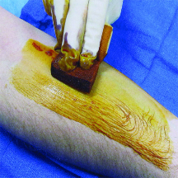
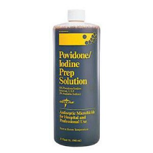
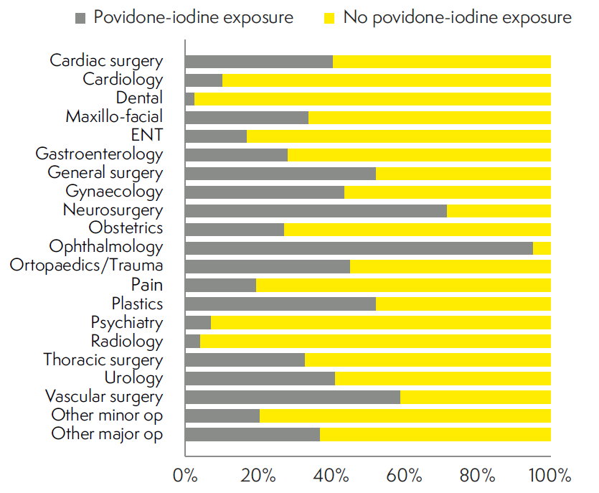
Antiseptics – povidone-iodine
Overall exposure
Exposure by specialty
Povidone-iodine exposure | Number exposed in activity survey | Estimated annual exposure | % of all cases | % of all cases exposed | % of all p-i exposure (Σ of all; total > total no of cases)
Exposure - at least 1 route | 6,382 | 1,251,446 | 40.0% | - | -
Skin prep anaesthetist | 1,047 | 205,306 | 6.6% | 16.4% | 14.6%
Skin prep surgeon | 5,852 | 1,147,519 | 36.7% | 91.7% | 81.3%
Surgical irrigation | 137 | 26,864 | 0.9% | 2.1% | 1.9%
Other | 159 | 31,178 | 1.0% | 2.5% | 2.2%
Notes:
Unknown – 1.3%
No exposure reported – 54.6%
Unsurprising to find p=i in ~2/5 of all cases and exp is mostly via skin prep by the surgeon

Slide 21
The NAP6 Allergen Survey: perioperative drug exposure
Extensive national survey of anaesthetic practice
Detailed data on drug use and allergen exposure in perioperative care
Used as denominator in the NAP6 analysis of reports of perioperative anaphylaxis
Provides new and significant insights into many aspects of perioperative practice
Notes:
This survey
provides unique, detailed insight into drug/substance exposure during anaesthetic activity and drug use in the UK
Provides considerably greater detail on use of analgesics, antibiotics, LAs, anti-emetics, iv colloids and blood products, and other substances, such as latex, antiseptics, radiocontrast media, dyes and bone cement – comprehensive and, to the best of our knowledge, previously unavailable data.

Slide 22

Any questions?

