Slide 1



Activity
Survey
Harriet Kemp
Research & Audit Federation of Trainees

Slide 2
Aims
Up-to-date denominator data
Changes in practice since NAP5 (2013)
Working patterns in anaesthesia
  Anaesthetic-specific
  Day of the week

Slide 3
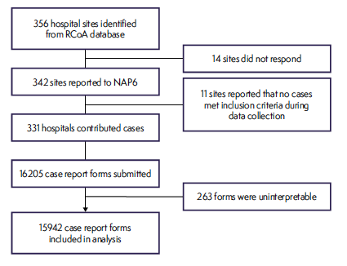
Response
Scaling factor
Annual caseload =
  3,126,067
58.7% female

Slide 4
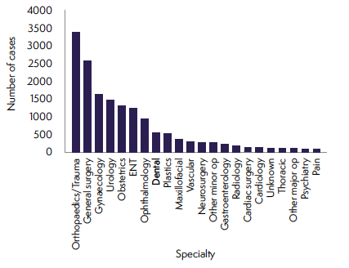
Specialty of main procedure

Slide 5
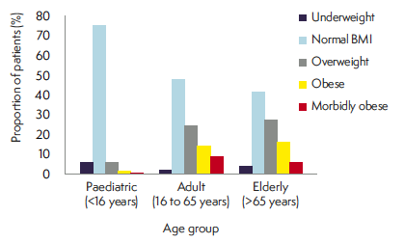
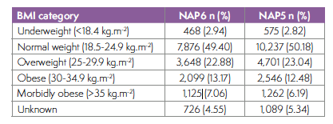
Obesity

Slide 6
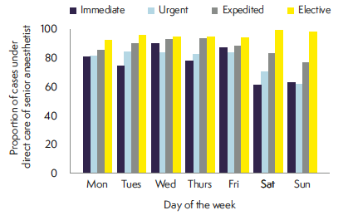
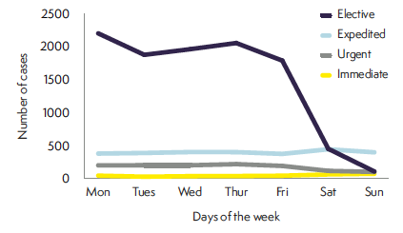
Day of week by urgency

Slide 7
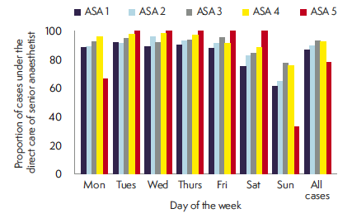
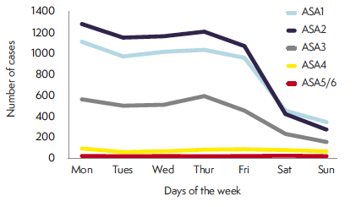
Day of the week by ASA grade

Slide 8
Workload by specialty
Highest proportion of specialty workload at weekend
  Obstetrics (30.5%)
  Orthopaedics/Trauma (13.7%)
  General Surgery (13.1%)
Highest proportion of overall weekend workload
  Orthopaedics/Trauma (23.4%)
  Obstetrics (20.4%)
  General surgery (17.2%)

Slide 9
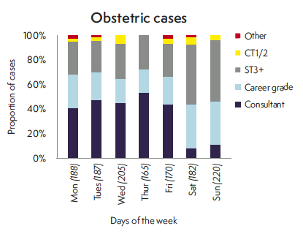
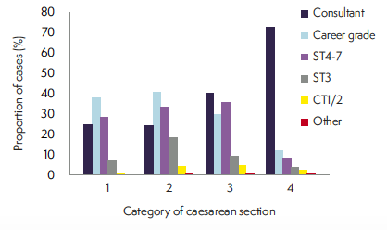
Obstetrics

Slide 10
Location of induction
Induction (GAs)
  77.3% in anaesthetics room
  18.8% in theatre
  No change since NAP5
Theatre induction
  Obstetrics (92.3%)
  Thoracic (35.8%)
  Dental (34.7%)

Slide 11
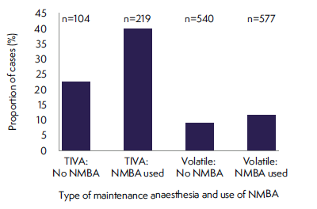
Depth of anaesthesia monitoring
12% of all GA cases
Most frequent use
  Cardiac (42.9%)
NAP5

Slide 12
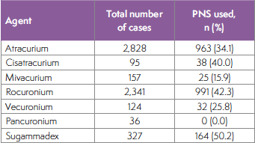
Neuromuscular monitoring
GA cases with NMBA
  36.7% Peripheral Nerve
  Stimulator
  2.8% quantitative monitoring
64.6% reversal agent

Slide 13
Conclusions
Increasing elective weekend working
Direct senior involvement in high proportion of emergency cases but fewer at weekend than during the week
Increasing use of DOA monitoring
No increase in NM monitoring

Slide 14
Thank You

