Slide 1



Allergy Clinic Perceptions:
The NAP6 Baseline survey
Prof. William Egner
Consultant Immunologist

Slide 2
Guidelines used
BSACI
B1 Drug allergy centre with expertise/high throughput
B2 Able to investigate all potential causes
B3 Dedicated drug allergy clinic
B4.1 Skin testing
B4.1 Drug challenge where necessary
B5 Identify the cause and recommend safe future use.
B6 Detailed report to referrer+GP; short report to patient
B7 Anaesthetist— report to MHRA
B8.1 Identify the cause of the reaction
B8.2 Identify drugs likely to be safe for future anaesthesia
B8.3 Written report to referring consultant, GP and surgeon
B8.4 Provide patient with a brief “to whom it may concern” letter
B8.5 Provide patient with an “alert” and specific wording
B8.6 Report to MHRA
B9 Clinic nurse with specialist allergy experience
NICE CG183
N1 written information
N1.1 Allergic or non-allergic reaction
N1.2 Drug name and a description of their reaction
N1.3 Investigations used
N1.4 Drugs or drug classes to avoid in future
N1.5 Safe alternative drugs to use
N2.1 structured written info. to patient
AAGBI
MHRA reporting

Slide 3
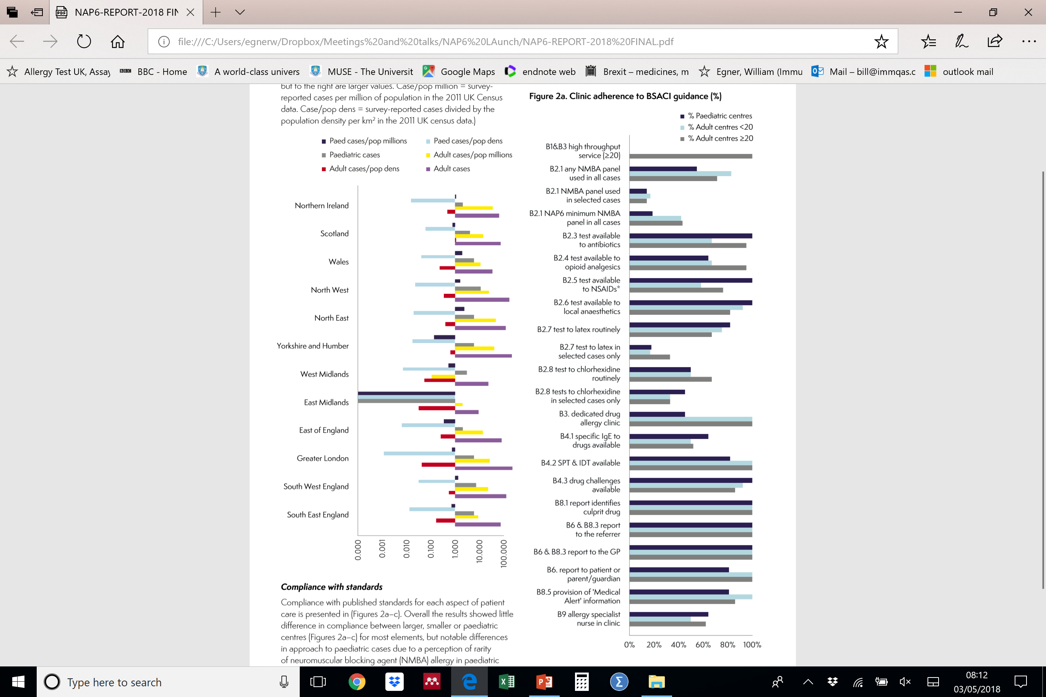
Where are the
Specialist
PoA clinics?

Slide 4


Adherence to BSACI Guidance

Slide 5
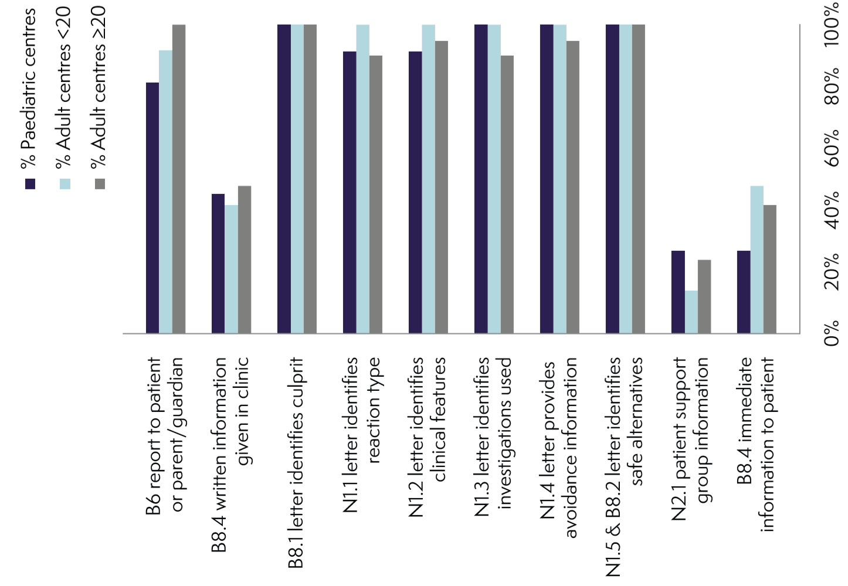



communication

Slide 6
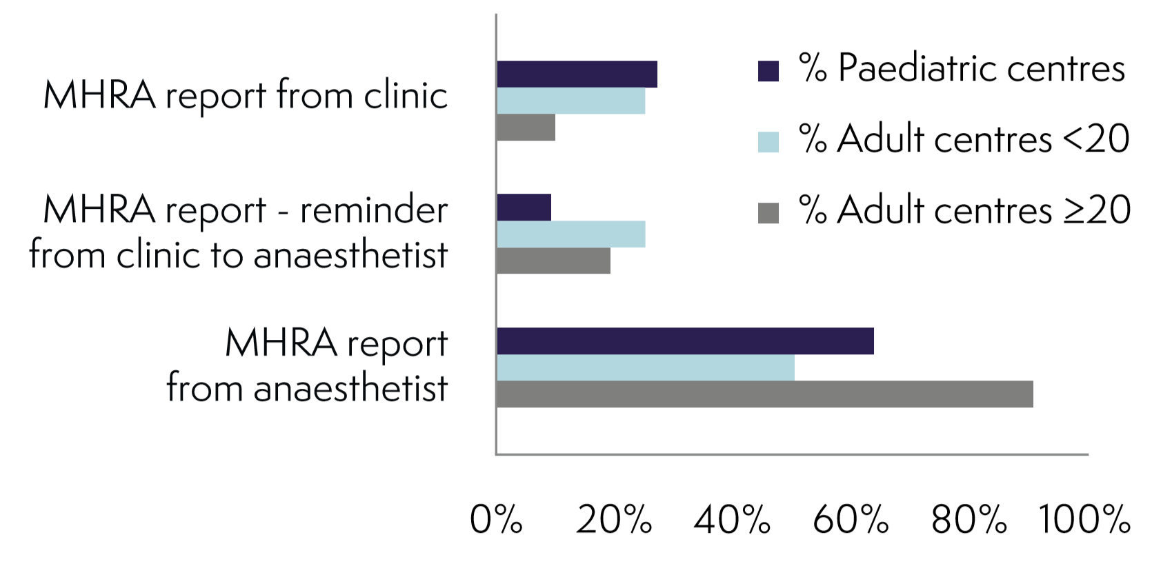


MHRA Reporting

Slide 7
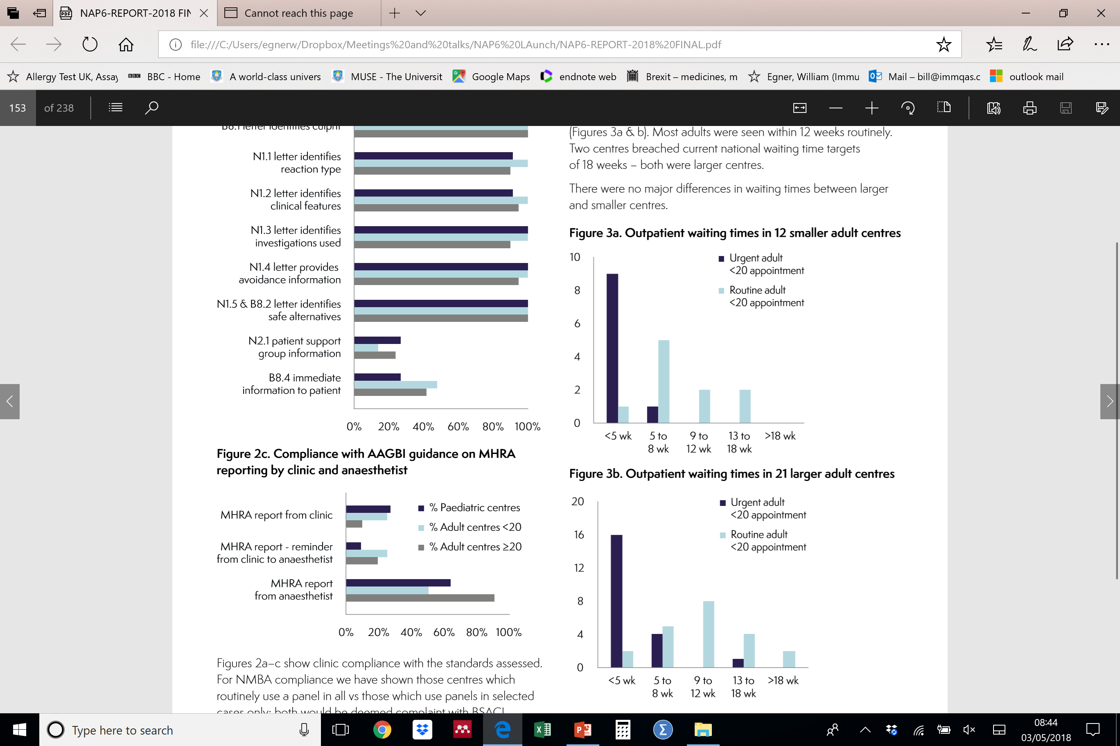


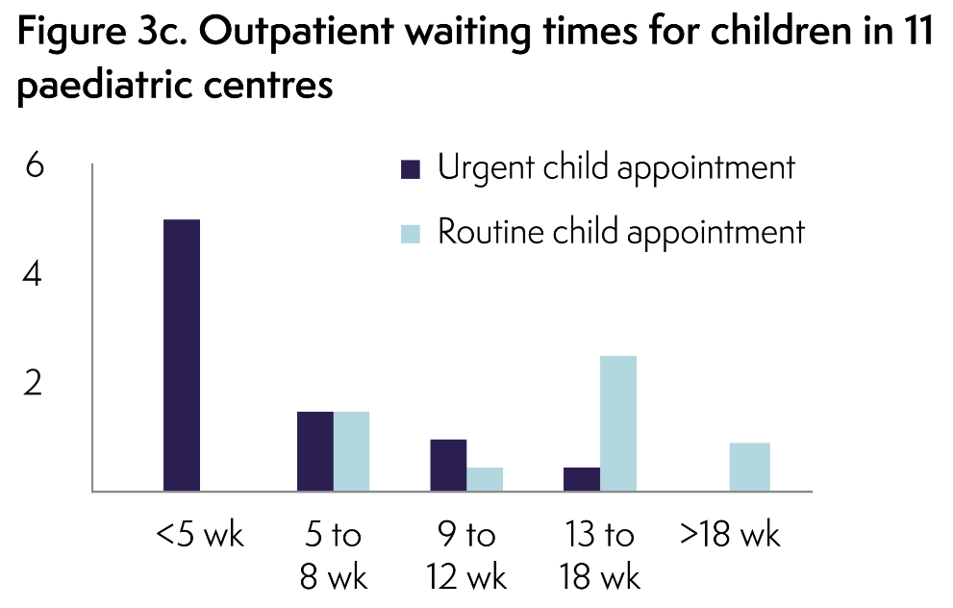
Delay in clinic assessments

Slide 8
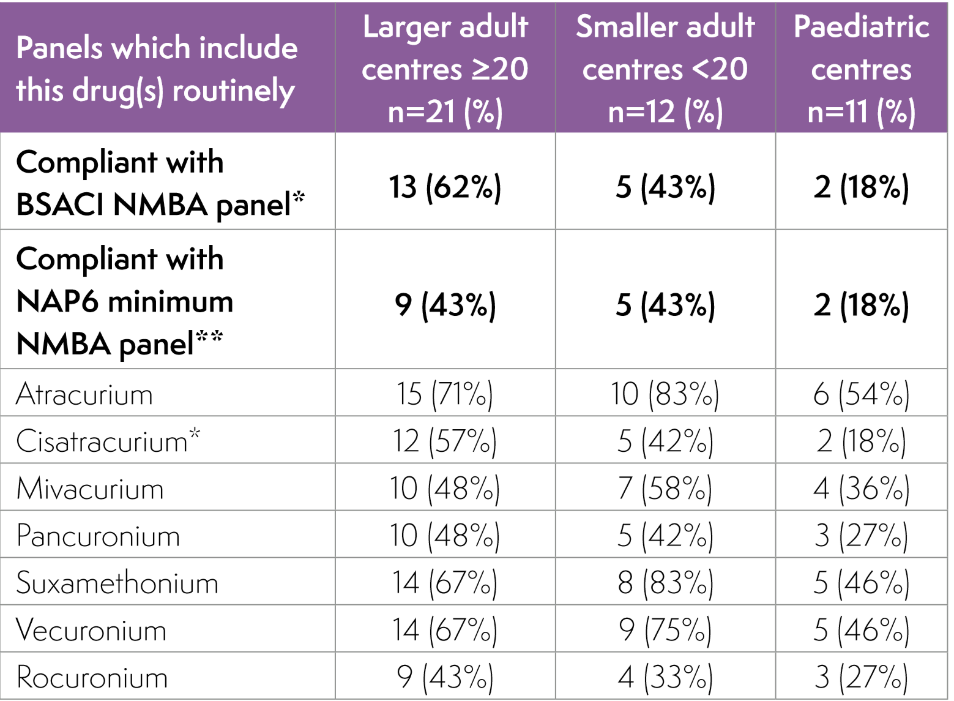
NMBA testing

Slide 9
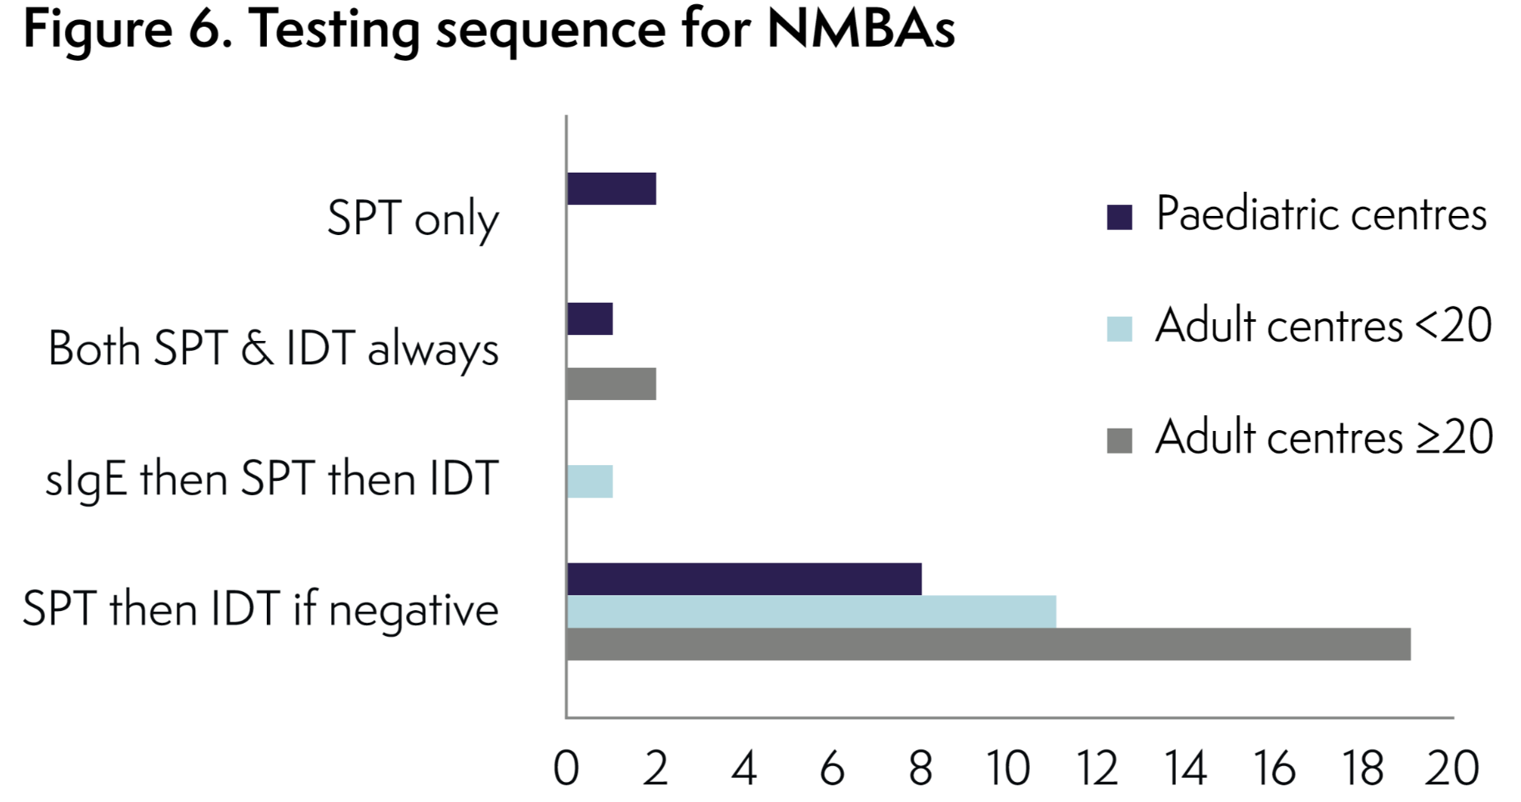
Tests used

Slide 10

What did they believe they do well?
Comprehensive assessments
Achieving Diagnosis
Communication with health care professionals
Avoidance advice
Early access for urgent cases

Slide 11
Where was there room for improvement?
Communication
  Reaction and investigation details
Testing – chlorhexidine, NMBA and latex
Waiting times for clinic
MHRA reporting

Slide 12
Thank you

