Slide 1



Anaesthetists’
Perceptions
Harriet Kemp
Research & Audit Federation of Trainees

Slide 2
Aims
Assess baseline practice
  Management
  Referral
  Reporting
Explore experience of previous cases
Identify risk perceptions of causative agents

Slide 3
Response
11,104 (77%) anaesthetists
341 (96%) hospitals
1734 cases primary anaesthetist in 2014-15
49% confirmed
2% fatalities

Slide 4
Departmental Systems
87% immediate access to guidelines
37% ‘anaphylaxis treatment pack’
82% knowledge of where to refer
35% departmental lead

Slide 5
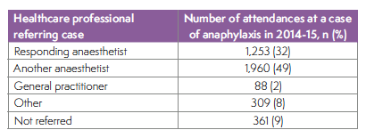
Referral & Reporting
47% reported via local critical incident
14% reported to the MHRA

Slide 6
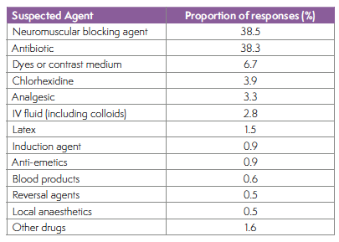
Suspected causative agents
Did perception of risk reflect the actual risk rate?

Slide 7
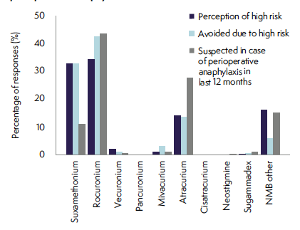
NMBAs
Suxamethonium:
  ‘High risk’
  Low number of cases
Atracurium
  ‘Lower risk’
  High number of cases

Slide 8
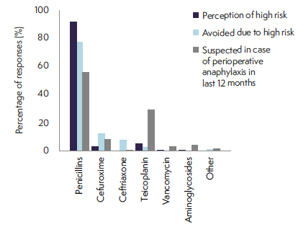
Antibiotics
Teicoplanin
  ‘Low risk’
  Proportionally high number of cases
Test dose
  32% routine use
  4.7% observed reaction to test does

Slide 9
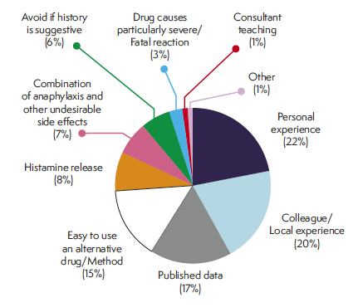
Reasons for avoidance

Slide 10
Career Experience
76% had career experience of perioperative anaphylaxis
Median of 2 cases per respondent ≈ 1:7.25 years
4% reported a death ≈ 1: 311 years

Slide 11
Conclusions
Largest survey on this topic
Majority not reported to national databases
Some not referred for investigation
Mismatch of risk perception and actual risk?
NMBA and antibiotics perceived as highest risk
NB Limitation of retrospective incidences

Slide 12
Thank You

