Slide 1



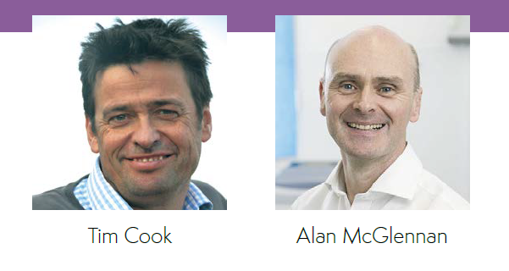
NAP6 – the independent/private sector m
Tim Cook
Director of NAP program
Consultant Anaesthesia/Intensive Care, Bath

Slide 2
Chapter 23 – The independent sector

Slide 3
What we know already
45% of independent sector patients are NHS-funded (CHPI 2017)
  >50% in 25% of private hospitals)
Orthopaedics is 25% of private surgery (CMA 2014)
  1 in 5 of all NHS hip and knee replacements (Nuffield trust 2015)
Smaller, isolated, competitive
Lack of departmental structure in many private hospitals
Lone wolf anaesthetists vs anaesthetic group practices

Slide 4
Efforts
No previous NAP included independent sector
Private hospitals identified –
  List provided by Association of Independent Healthcare Organisations based on Lang & Buisson data
Written to x4 – RCoA president
  May 2015, June 2015, Sept 2015, Dec 2015
Deadlines delayed x3

Slide 5
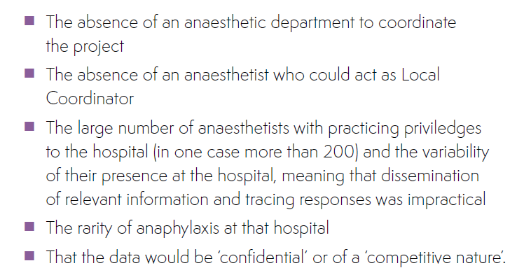
Barriers to engagement

Slide 6
Numbers
304 hospitals contacted
41 agreed to take part (13% vs 100%)
33 took part in organisational survey (11% vs 91%)
DECISION
Independent sector not included for main data collection quantitative analysis
No baseline survey, no activity survey

Slide 7
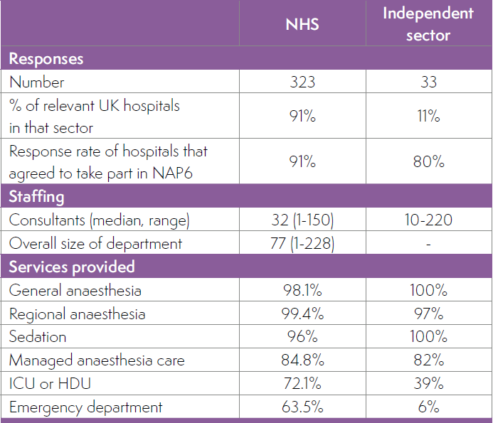
Numbers
Organisational
comparison

Slide 8
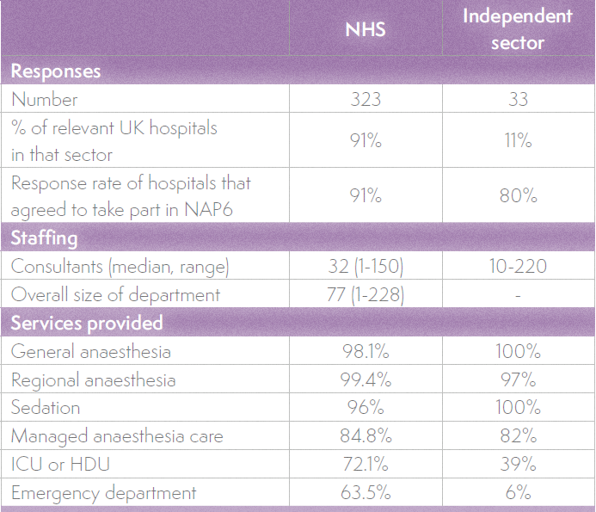
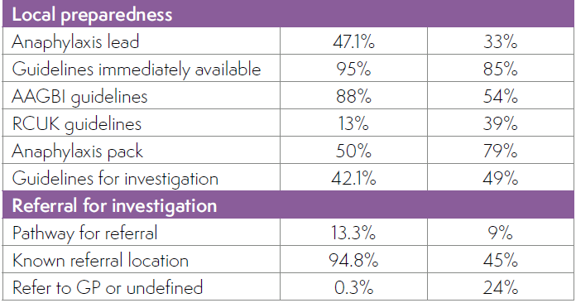
Numbers
Organisational
comparison

Slide 9
Case reporting - involvement
 | NHS | Independent sector
Hospitals | 356 (100%) | 41 (13%)
All monthly returns | 84% | 39%
Overall return rate | 94% | 70%

Slide 10
Cases in independent sector
7 requests to report
  2 complete,
  5 part A only

Slide 11
Of the 7 cases
4 aged 66-77
5 orthopaedics
All ASA 2-3
5 had antibiotics
4 had NMBAs
Grades
  4 grade 4 (<50mmHg)
  3 grade 3

Slide 12
Of the 7 cases
Surgery
  2 completed
  1 modified
  4 abandoned
3 to ICU
  1 on site
  2 another hospital
All referred
None reported to MHRA
3 used anaphylaxis pack
6 used guidelines
5 did not call for assistance
  1 nursing staff
  1 an other anaesthetist
0 - CPR for BP <50mmHg

Slide 13
Comment
Anaphylaxis is
  Unpredictable
  Life-threatening
  Infrequent
  …. but predictable enough to require preparation
  Independent sector patients are likely to be exposed to top three culprits (antibiotics, NMBAs, chlorhexidine)

Slide 14
Comment
Anaphylaxis treatment requires
  expert, timely, co-ordinated resuscitation
  teamworking
  typically needs critical care for up to 48 hours
  referral for investigation and follow-up
  reporting

Slide 15
Challenges for the independent sector
Engagement
Governance
  Ensuring training
  Communication by organisation
  Teamworking
  Lack of Anaesthetic departments
    Protocols and SOPs
    M&M
  Crisis management experience

Slide 16
Challenges for the independent sector
Engagement
Governance
  Ensuring training
  Communication by organisation
  Teamworking
  Anaesthetic departments
    Protocols and SOPs
    M&M
  Crisis management experience
Drugs
  Vasopressors
  Glucagon
  Vasopressin
Critical care
Transfer
Referral
Reporting and follow-up

Slide 17
Recommendations

Slide 18
Recommendations

Slide 19
Recommendations

Slide 20
Recommendations

Slide 21
Summary
First attempt to engage independent sector
Poor engagement
Inevitable that anaphylaxis will occur in independent sector
NAP6 has been unable to characterise how those cases are typically managed
NAP6 has identified significant challenges for independent sector for ensuring safety in this (and other) critical situations.

