Slide 1



Methods m
Tim Cook
Director of NAP program
Consultant Anaesthesia/Intensive Care, Bath

Slide 2
5 phases
Baseline survey of anaesthetists perspectives/experiences
Baseline survey of allergy clinic organisation
Baseline organisational survey (NHS/IS*)
Year long registry (NHS/IS) Numerator
Allergen/activity registry Denominator
*IS=independent sector

Slide 3
5 phases
Baseline survey of anaesthetists perspectives/experiences
  11,000 anaesthetists
Baseline survey of allergy clinic organisation
Baseline organisational survey (NHS/IS)
Year long registry (NHS/IS) Numerator
  All NHS hospitals
Allergen/activity registry Denominator
  96%

Slide 4
Set up
Local reporter
  Consultant anaesthetist
  Every participating hospital
  Heartbeat of the project

Slide 5
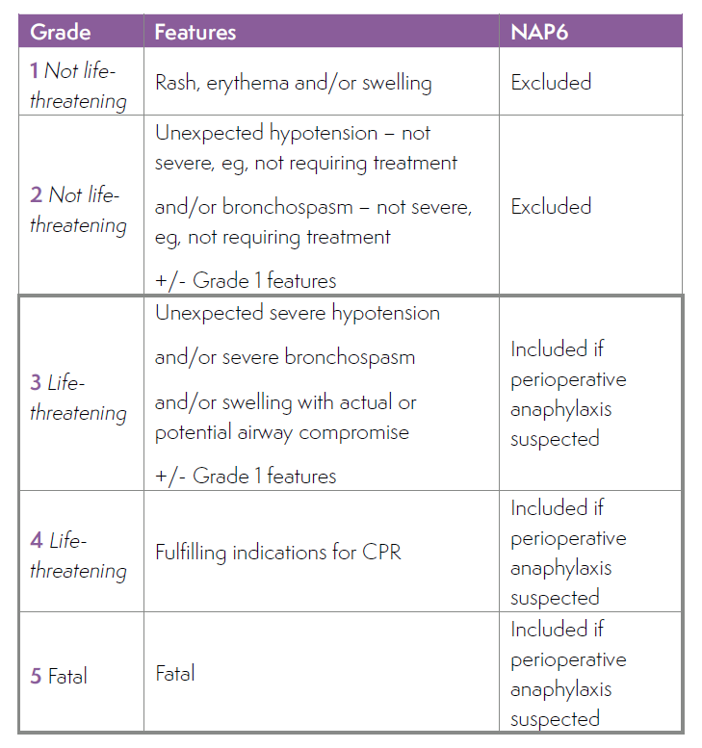
Inclusion
Peri-operative
  any case involving an anaesthetist and a procedure

Slide 6
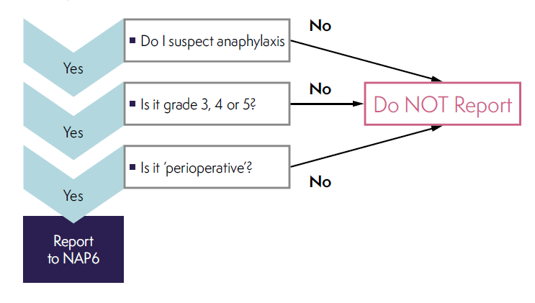
Inclusion

Slide 7
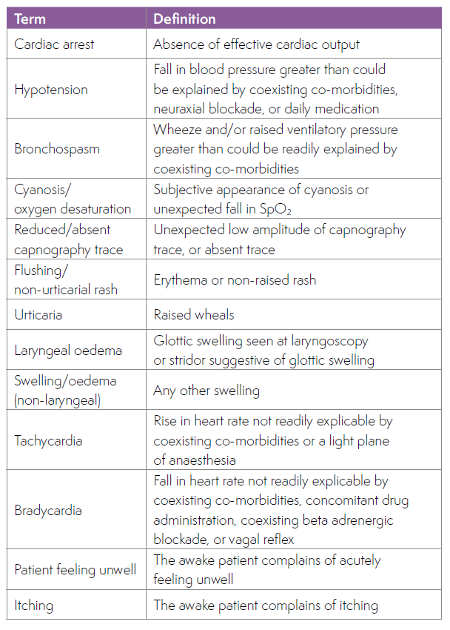

Slide 8
Reporting and the firewall
Request to report
Screening questions
Release of access code and password
Secure encrypted website
Tracking progress without content access
Final report to NH
Moderator

Slide 9
Panel
Multidisciplinary
  Allergy/clinical immunology
  Anaesthesia and subspecialties
  Critical care
  Lay members
  Allergy charities
25 members
Monthly meetings
  Organisational/planning
  Case review
  Data review
  Report writing and review

Slide 10
Review
No knowledge of
  Location
  Individuals
  Patient
Structured
Triplicate
  Anaesthetists and other team members
  Immunologists
  All together

Slide 11
Big group - moderation
Allergists
Clinical immunologists
Anaesthetist
Layperson
Allergist/Immunologist
(12-25)
Anaesthetist
Lay member
Expert groups
Allergists
Clinical immunologists
Anaesthetist
Lay member
Expert groups
Anaesthetist
Lay member
Expert groups
Allergists
Clinical immunologists

Slide 12
Outcome bias: knowledge of poor outcome leading to ‘harsh judgement’
  Caplan RA et al Effect of outcome on physician judgements of appropriateness of care. JAMA 1991; 265: 1957-60
Hindsight bias: exaggerated belief that a poor outcome would have been predicted
  Henriksen K, Kaplan H. Hindsight bias: outcome knowledge and adaptive learning. Qual Saf Health Care 2003; 122(supp) 2): ii 46-50.
‘Group think’

Slide 13
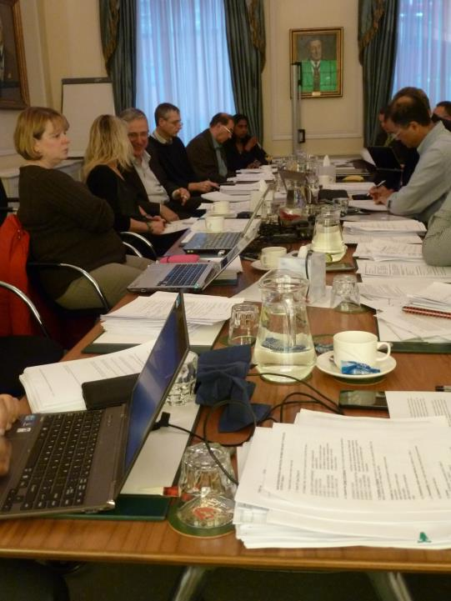

Slide 14
Structure - clinical
Part A
Immediate clinical management:
  dx, treatment
  speed, completeness
Further management
Referral
Patient outcomes
Part B
Clinic investigation
Quality of care
- Good
- Good and poor
- Poor
- Unassessable

Slide 15
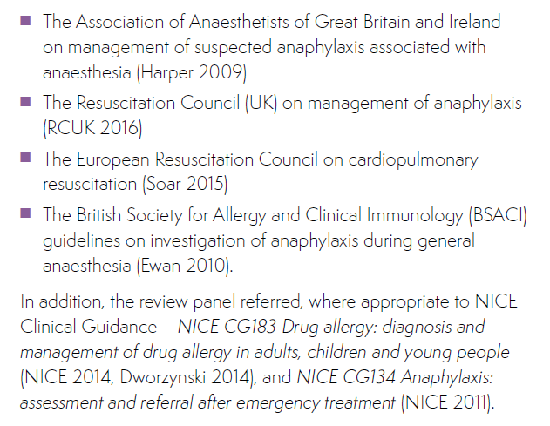
Benchmarking

Slide 16
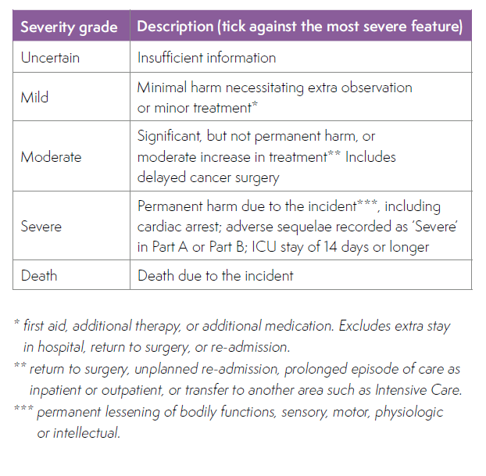
Outcomes
Physical harm
  Cardiac, cerebral, renal, respiratory
Psychological harm
  Anxiety, PTSD, mood, movement, behavioural etc
Mild/mod/severe

Slide 17
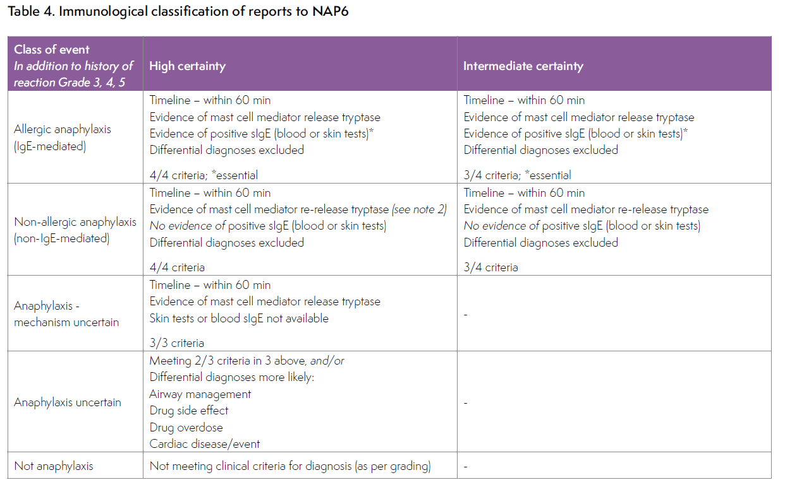
Structure - immunology

Slide 18
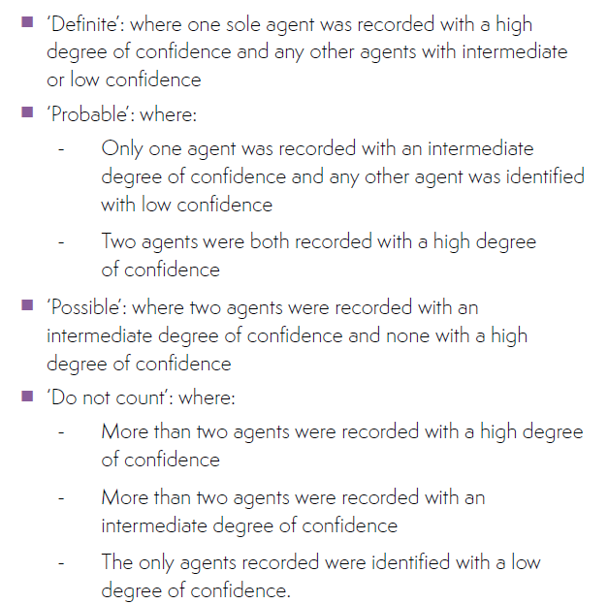
Structure – culprit identification
Step 1
  Identify high/intermediate certainty of anaphylaxis
Step 2
  Identify culprits and degree of certainty of each
Step 3
  Classify culprits

Slide 19
Structure – culprit identification
Step 1
  Identify high/intermediate certainty of anaphylaxis
Step 2
  Identify culprits and degree of certainty of each
Step 3
  Classify culprits
Definite/probable: included
Possible/do not list: excluded

Slide 20
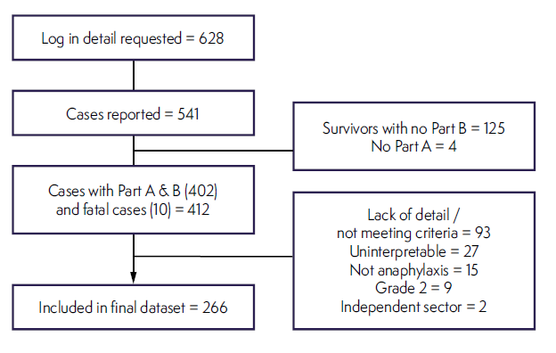
No website problems

Slide 21
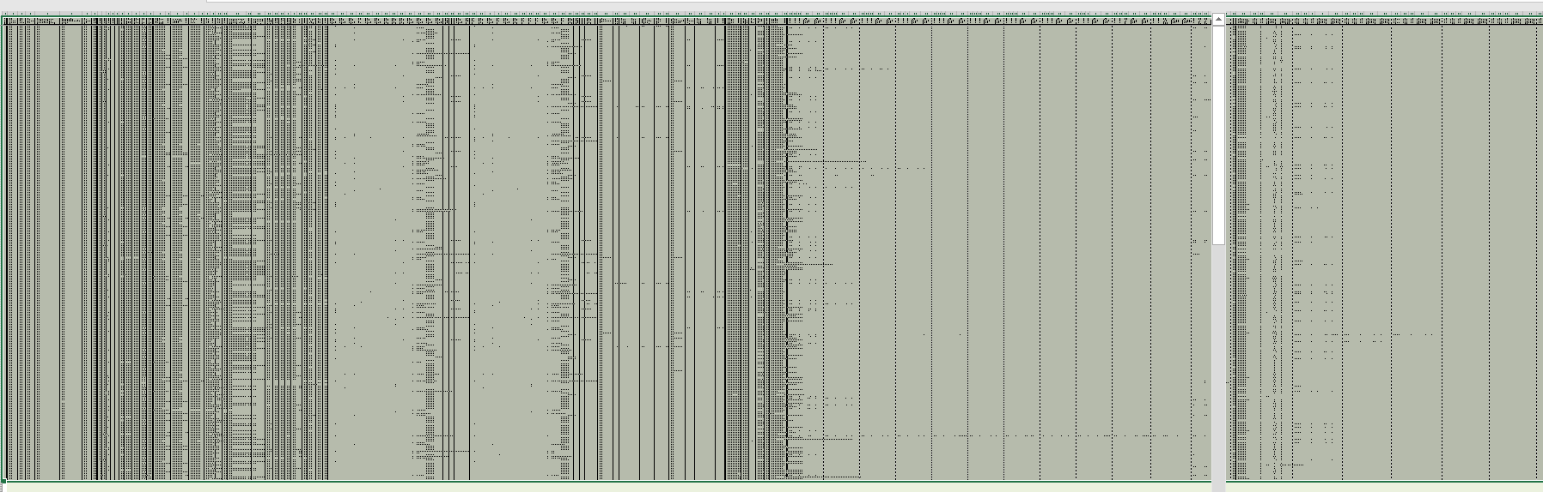
Final spreadsheet
266 x 1555
= 430,000 data points

Slide 22
Final spreadsheet
Data collection closed
- May 2017
Report written
- Feb 2018

Slide 23
