Slide 1



Overview and
Key Findings
Prof Nigel Harper
Clinical Lead, NAP6

Slide 2
What we already know
Perioperative anaphylaxis is an uncommon but hazardous accompaniment of anaesthesia and surgery
It is usually an allergic reaction to one of the many drugs administered
It can occur suddenly in any patient, regardless of allergy history or previous uneventful anaesthesia
Most previous studies have implicated muscle relaxant drugs (NMBAs) as the most common cause
Published guidelines exist on management and investigation

Slide 3
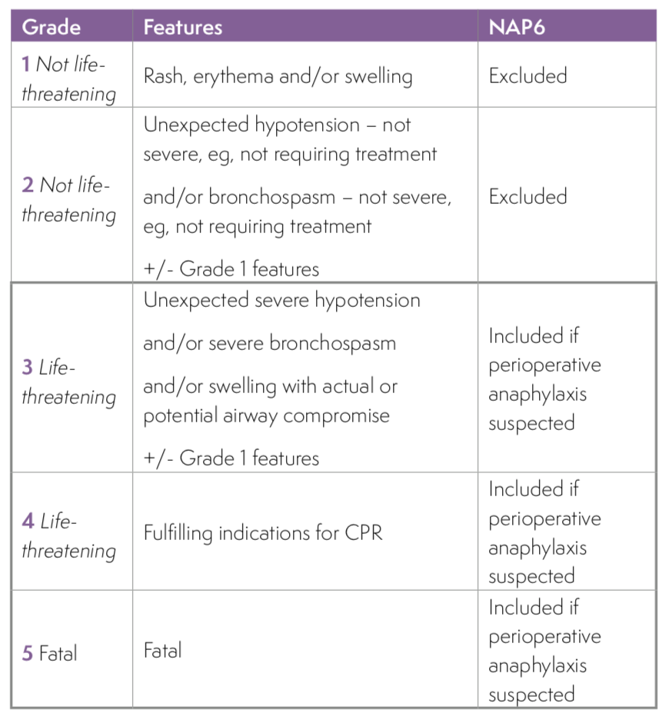
Anaphylaxis – ‘A severe, life-threatening generalised or systemic hypersensitivity reaction’
Perioperative
  general anaesthesia
  regional anaesthesia
  sedation
  managed anaesthesia care (anaesthetist monitoring only)
  under the care of an anaesthetist
  between the period of first administration of a drug (including premed) and the post-procedure transfer to the ward, or critical care

Slide 4
Aims of NAP6
What proportion of cases are referred and investigated?
How many are proven to be anaphylaxis and what are the culprits?
How well does immediate management, referral and investigation match published guidelines?
Is there a correlation between immediate management and outcomes?

Slide 5
Case Reports
Prospective
All NHS hospitals
One-year period
Anonymised
Anaesthetic practice survey
Prospective
Workload
Demographics
Anaesthetic techniques
Baseline survey
Previous experience
Referral pathways
Perceptions
Avoidance
Allergy clinic survey
Workload
Investigation pathways
Communication
Allergen survey
Prospective Anaesthetic drugs
Antibiotics
Antiseptics
1
4
3
2

Slide 6
Case Reporting
Local Coordinator in every NHS Hospital
Grade 3 – 5 anonymised cases reported on line
266 cases reviewed by a multidisciplinary panel
Part A
  Patient demographics
  Drugs administered
  Features of the reaction
  Immediate management
  Referral for investigation
  Initial outcomes
Part B
  Investigations performed and results
  Diagnosis
  Communication with patient
  Outcomes
  Reporting

Slide 7
Review Process
Multidisciplinary panel met monthly
Two-stage review to minimise bias
Guidelines for clinical management and investigation used to attribute quality measures (‘good’/’good and poor’/poor’)
  RC(UK)
  AAGBI
  BSACI
Panel identified culprit agent (where possible), probability and mechanism
Assessed outcomes and severity of adverse sequelae

Slide 8
Key Findings – Outcomes
Of the 266 cases reviewed, 40 patients experienced cardiac arrest and 10 patients died
More than half of patients required admission to critical care (70% for Level 3 care)
Poor outcomes were associated with increased age, ASA grade, obesity, beta-blocker, and/or ACE inhibitor medication
Adverse sequelae (104) included anxiety, mood and memory changes, alteration in coordination, mobility or PTSD-like symptoms
A small number of patients experienced a myocardial infarction, acute kidney injury or new shortness of breath
Fewer than a quarter of cases were reported to MHRA

Slide 9
Key Findings – Survey of anaesthetic practice
15,942 forms from 96% of hospitals : annual caseload of 3,126,067, including 2,394,874 general anaesthetics
Increases in the proportion of patients with obesity and in elective weekend working compared with 2013 data
Three quarters of 11,104 anaesthetists had seen a case of perioperative anaphylaxis (1: 7.25 years of practice)
Antibiotics used in 57.2% of cases (>3 million administrations, often combinations)
In 25% of teicoplanin or vancomycin uses, allergy history influenced drug choice
Suxamethonium and penicillins were avoided by a higher proportion of respondents than events attributed to these drugs; the converse was true for atracurium and teicoplanin

Slide 10
Key Findings – Clinical Features and Management
Anaphylaxis presented within 10 minutes of exposure to the culprit agent in 83% of cases.
Anaphylaxis caused by chlorhexidine and Patent Blue dye had a slower onset
Skin signs were uncommon in the more severe cases of anaphylaxis, sometimes only occurring after resuscitation
All patients were resuscitated by an anaesthetist of appropriate grade, and recognition of a critical event was prompt
When cardiac compressions were indicated there was delay starting them in more than half of cases.
IV fluid administration was frequently insufficient and was inappropriate in 19% of cases.

Slide 11
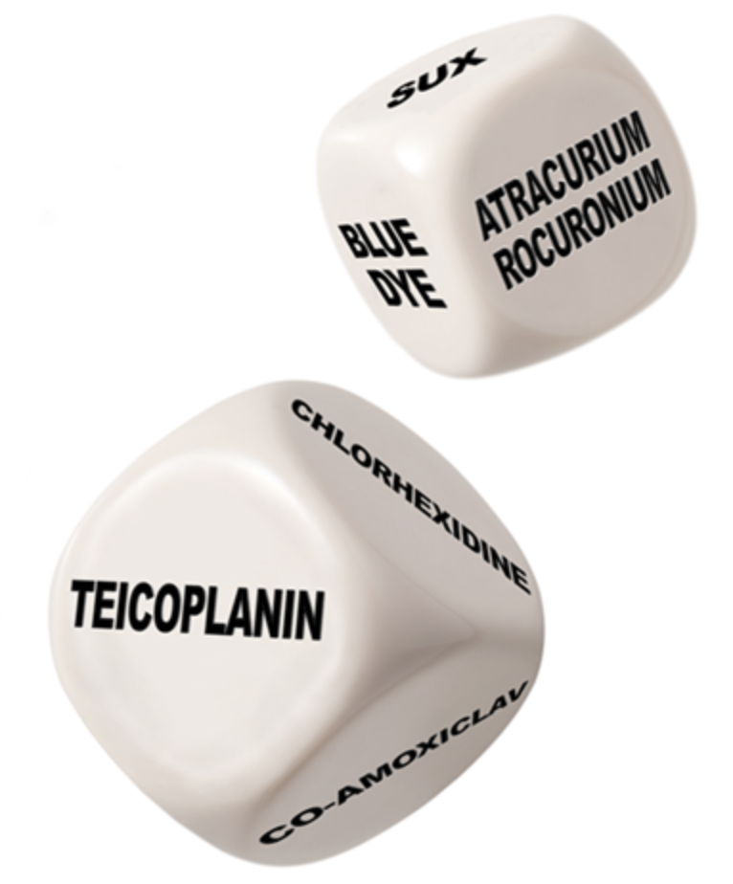
Key Findings – trigger agents and investigations
Most common trigger agents:
  1) antibiotics, 2)NMBAs, 3)chlorhexidine, 4) Patent Blue dye
Highest incidence /100,000 exposures:
  teicoplanin, 2) Patent Blue dye, 3) suxamethonium, 4) co-amoxiclav
Average clinic waiting time101 days (up to 450 days). Only16% seen within the ideal six weeks; 23% breached the national UK 18-week target for first appointments, and 7% waited longer than six months
Clinic investigations adhered fully to AAGBI guidance in 32% and to BSACI guidance in only17%, mainly failing to test for all potential culprits and providing poor communication

Slide 12
Thank You
Thank you

