Slide 1
Consent Issues Medicolegal aspects
Prof Tim Cook

Slide 3
Litigation - key points
Complaints are rare
Litigation is rarer
Deficient practice is not
NAP5 provides a rationale/defence against res ipsa loquitur

Slide 6
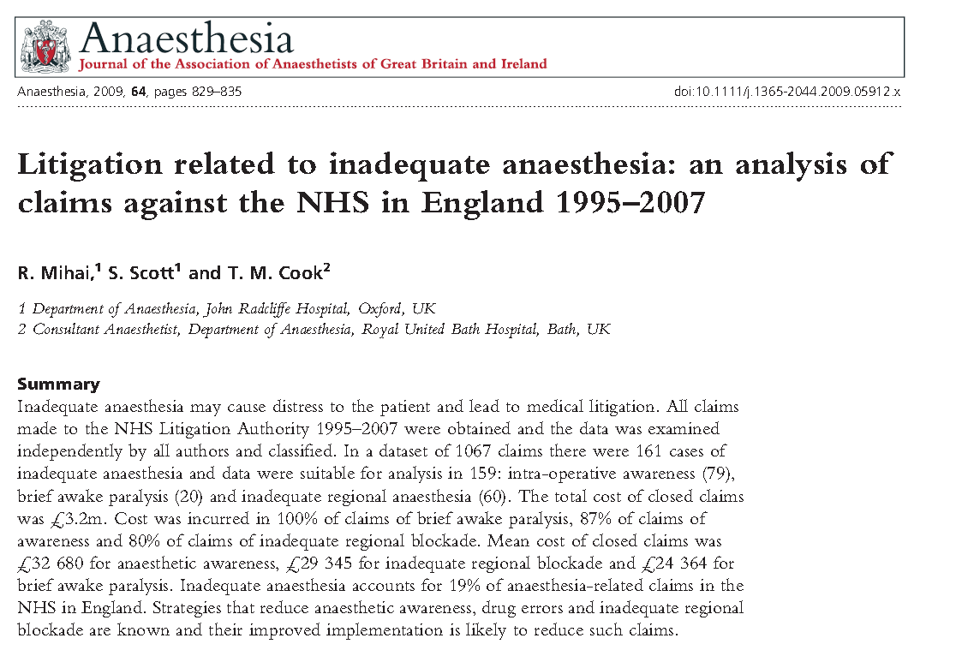

Slide 7
Anaesthesia litigation in UK: Top 5
Category | Cases | Total cost | Cost per case | Severity
Regional | 1 | 1 | 8 | 6
Obstetric | 2 | 2 | 6 | 8
Inadequate anaesthesia | 3 | 6 | 4 | 10
Dental | 4 | 12 | 13 | 11
Airway | 5 | 3 | 2 | 2
Drug error | 6 | 4 | 5 | 5
Drug allergy | 7 | 8 | 7 | 4
Respiratory | 9 | 5 | 3 | 3
CVC | 11 | 7 | 1 | 1

Slide 8
AAGA UK litigation
19% of all assessable claims
>74% female
50% obstetric (no cardiac, no trauma)
>70% psychological symptoms described
3 groups
AAGA (21% of GA claims)
awake paralysis
inadequate RA (16% of RA claims)

Slide 9
UK litigation

Slide 10
AAGA
N=79
29% obstetric
1/3 Drug error
1/3 monitoring issues
1/3 other
…difficult airways

Slide 11
Awake paralysis
N=20
Obs 35%
Wrong drug
Sux vs synto (6)
Augmentin vs STP
Wrong order

Slide 13
Complaints and litigation
NAP5
Complaint 11%
Litigation 5%
Baseline
Compliant 19%
Litigation 4%
Drug errors
Compliant 6%
Litigation 6%

Slide 14
Litigation – pre-requistites
Duty of care
Breach of duty (negligent)
Harm
Harm due to breach

Slide 15
Quality care?

Slide 18
Litigation
Res ispa loquitur

Slide 19
NAP5 and res ipsa loquitur
Not all reports of AAGA had a GA
Not all reports of AAGA were AAGA
Not all cases of AAGA led to harm
Some reports of AAGA had no apparent cause (? Any negligence/breach?)
We have no 100% reliable monitor of unconsciousness
NAP5 methodology as a method for investigating claims of AAGA

Slide 21
Key points
- What to tell patients
- When and how

Slide 25
Record of consent
Consent for anaesthesia
44% of NAP5 reports
Discussion of AAGA
2% of NAP5 reports

Slide 26
Informed consent
Communication
Risk of AAGA
Experience of AAGA
Sedation

Slide 28
Informed consent
Risk of AAGA
To tell all patients?
NAP5 1 in 19,000 vs Brice 1 in 600
Specific circumstances
Obstetrics
Obese/ predicted difficult airway
RSI
Obesity
ASA4
Awake extubation

Slide 30
Paternalism vs information
Tell everyone with NMB?

Slide 31
Informed consent
Experience of AAGA
Brief vs long
Timing
+/- distressing
Inability to move
Inability to communicate
+/- pain
Important to relate afterwards

Slide 32
Consent and sedation
20% of NAP5 ‘AAGA’ cases were after sedation
>80% of cases preventable with better communication
Sequelae…..

Slide 33
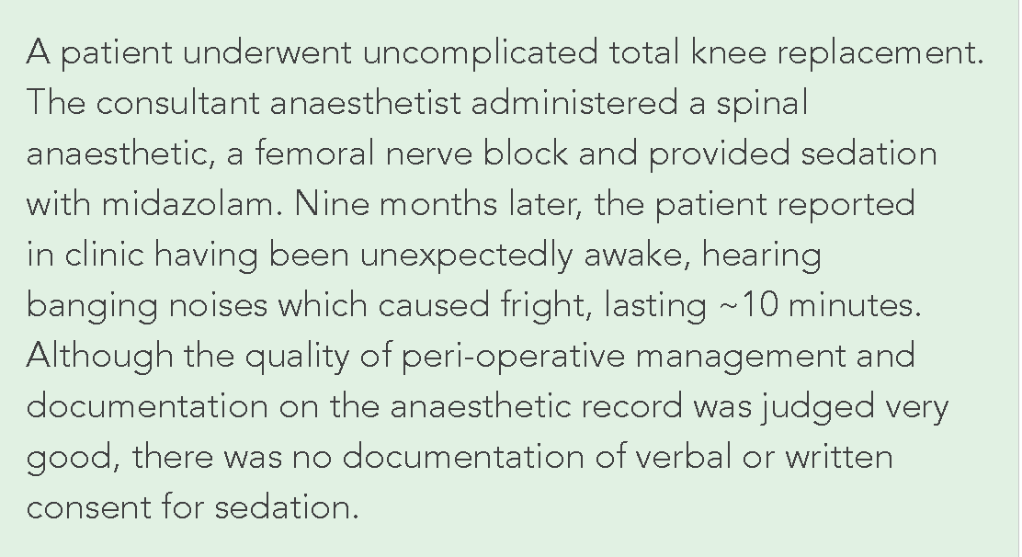

Slide 34
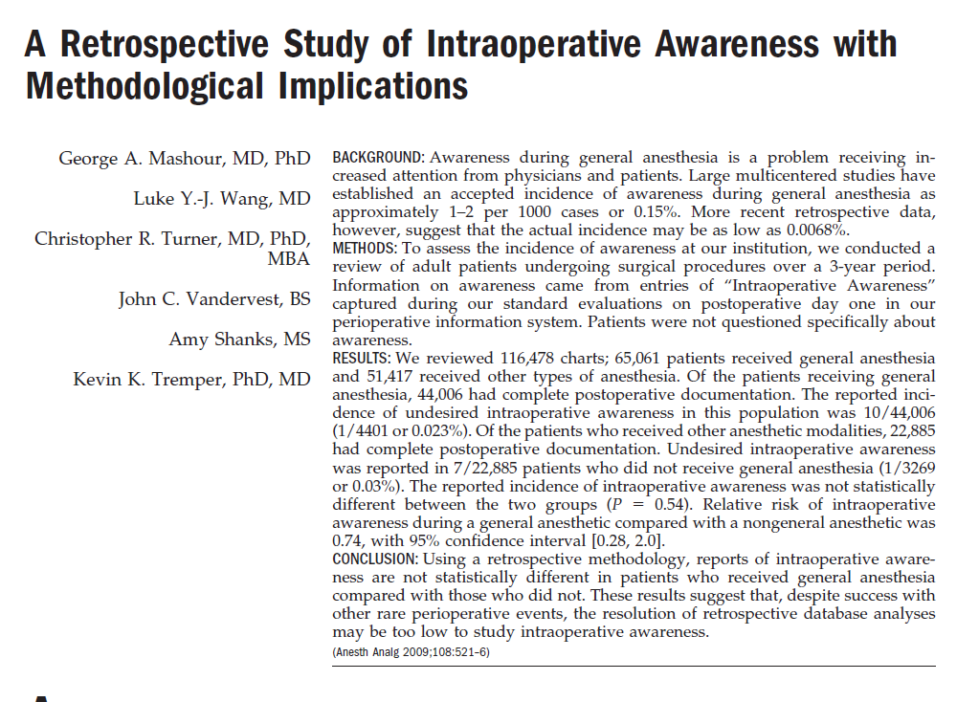
Anesth Analg 2009; 108:521-6.

Slide 35
Anesth Analg 2009; 108:521-6.
Chart review
65,061 GA vs 51,417 non-GA.
Patients ‘were asked if they experienced any problems related to anaesthesia’
Report of AAGA
GA 1/4401 (0.023%).
Non-GA 1/3269 (0.03%).
P = 0.54 (n/s)
RR of AAGA GA vs non-GA 0.74 (0.28-2.0).

Slide 36
Anesth Analg 2009; 108:521-6.
Chart review x116,478
65,061 GA vs 51,417 non-GA.
Postoperative documentation GA 44,006, non-GA 22,885
Patients ‘were asked if they experienced any problems related to anaesthesia’
Report of AAGA
GA 10/44,006 (1/4401 or 0.023%).
Non-GA 7/22,885 (1/3269 or 0.03%).
n/s
P = 0.54,
RR of AAGA GA vs non-GA 0.74 0.28-2.0.
Interpretations
1 General anaesthesia is ineffective
2 Patients understanding of GA vs non-GA is such that difficult to interpret
3 The interaction of experience, memory formation and memory recall interacting with the altered stages of anaesthesia, emergence and recovery make patient experiences difficult to interpret

Slide 37
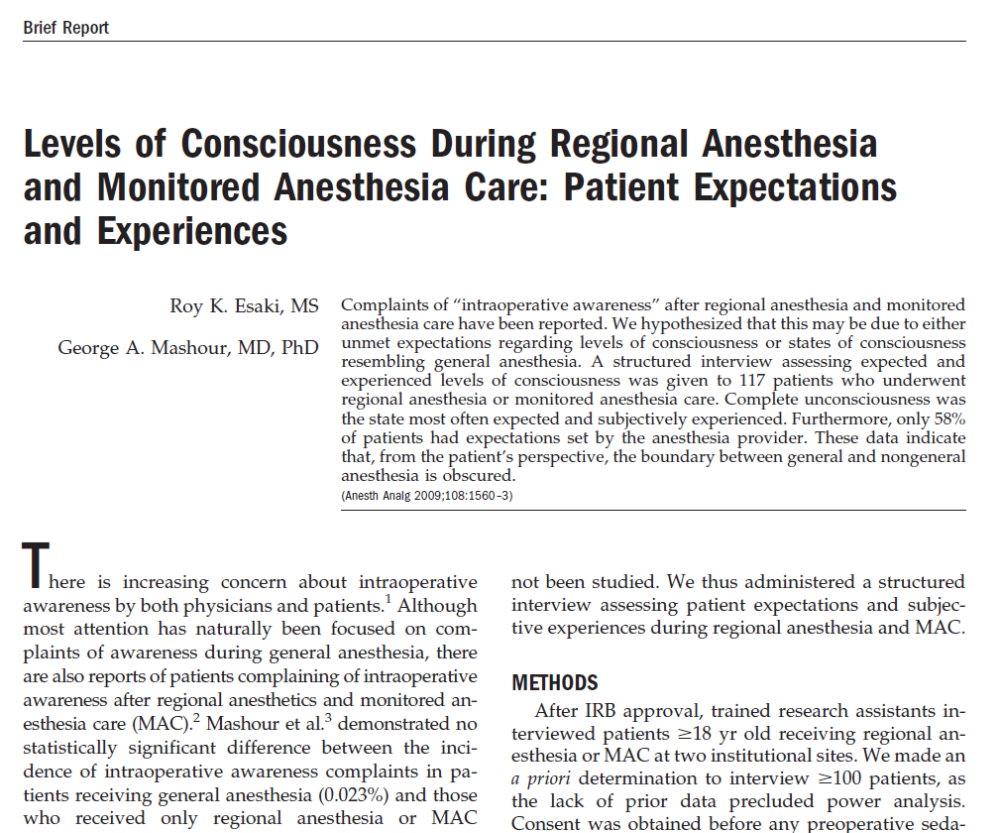
Anesth Analg. 2009;108:1560-3.

Slide 38
117 patients
RA or MAC
structured interview assessing expected and experienced levels of consciousness
“Complete unconsciousness was the state most often expected and subjectively experienced”.
Only 58% had expectations set by the anesthesia provider.
……from the patient's perspective, the boundary between general and non-general anesthesia is obscured.

Slide 39
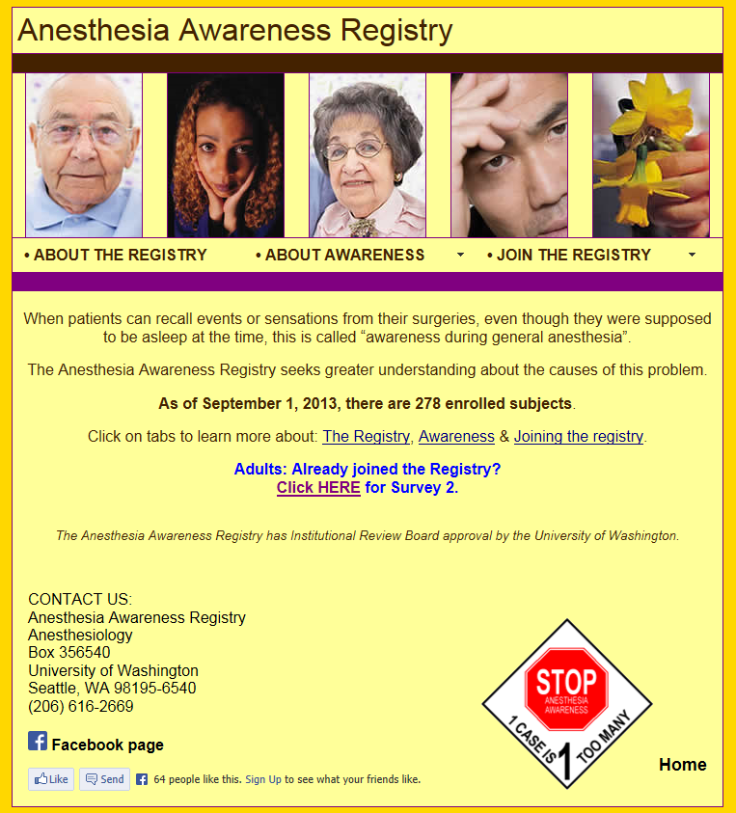
ASA
ASA Anaesthesia
Awareness survey
2007-present
Self reporting
N= 250
http://depts.washington.edu/awaredb/

Slide 40
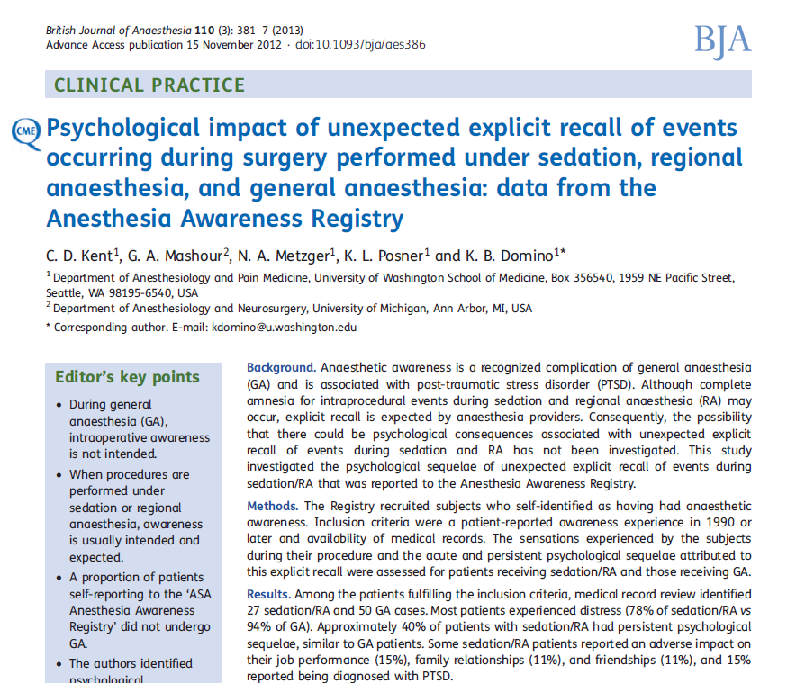
1/3 of patient did not have GA
Outcome similar whether GA or RA/sedation

Slide 41
Informed consent
Sedation
Altered level of consciousness
Reduction/alteration in perception
Variable amnesia
NOT general anaesthesia
Document agreed aims

Slide 43
The Sury table

