Slide 1
Human factors and AAGA
Prof Tim Cook

Slide 4
Key points
NAP likely underestimates HF
HF was highly prevalent in NAP5 cases
Institutional HF was notable – but so was individual HF
Investigation of cases of AAGA (including drug errors) should include an HF analysis

Slide 6
What is HF?
Ergonomics
Encompassing all those factors that can influence people and their behaviour. In a work context, HF are the environment, organisational and job factors and individual characteristics which influence behaviour

Slide 8
HF on the agenda 2013

Slide 11
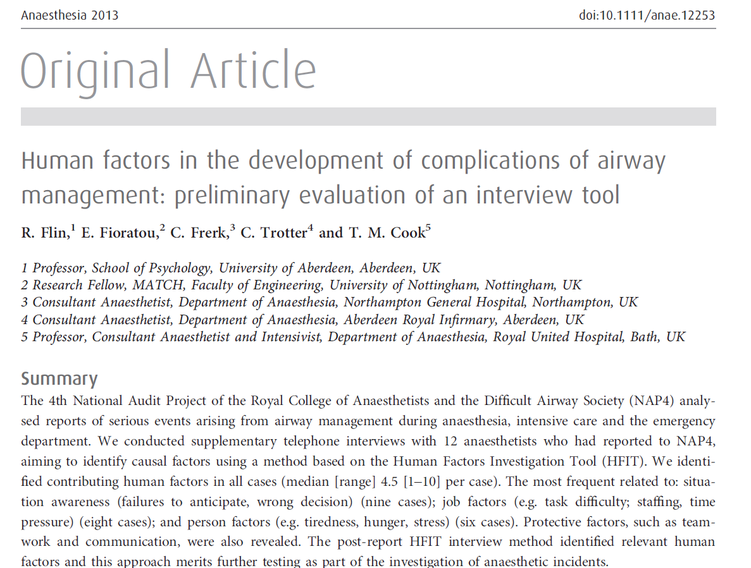
NAP and HF detection: wrong methodology

Slide 12
Poor methodology
NAP4 report
40% of reports included HF contribution
25% of this subset (10%) major contributor to poor outcome
Poor judgement commonest
Flin et al
Telephone interviews with reporters to NAP4
100% of interviews identified HF contribution
Median 4.5 (1-10 per case)
Commonest; situation awareness: job factors; person awareness

Slide 13
Poor methodology
Flin et al
100% of interviews identified HF contribution
Median 4.5 (1-10 per case)
Commonest;
situation awareness (9) (failure to anticipate, wrong decision)
job factors (8) (task difficulty, staffing, time pressure)
person awareness (6) (tiredness, hunger, stress)

Slide 14
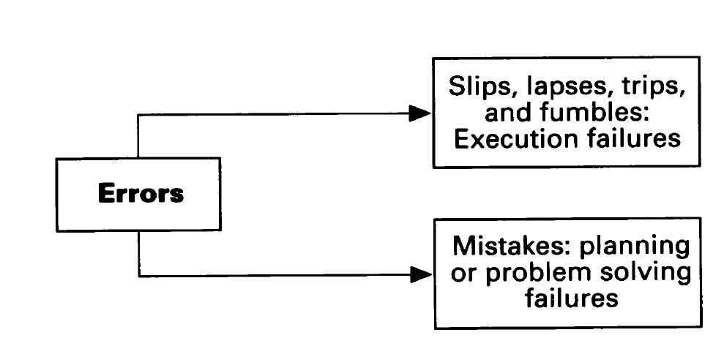
Classifications 1 Reason

Slide 15
Classifications 1 - Reason

Slide 16
Classification 1 - Reason
‘active failures of healthcare professionals’
(slips, lapses, mistakes and violations)
‘latent organisational failures’
(those circumstances that provide the conditions under which active errors are more likely to lead to patient harm, by defeating barriers in place to prevent this). to the final outcome

Slide 17
Classifications 1 - Reason
Routine violations – cutting corners
Optimising violations – furthering personal goals
Necessary violations – made unavoidably to achieve tasks

Slide 18
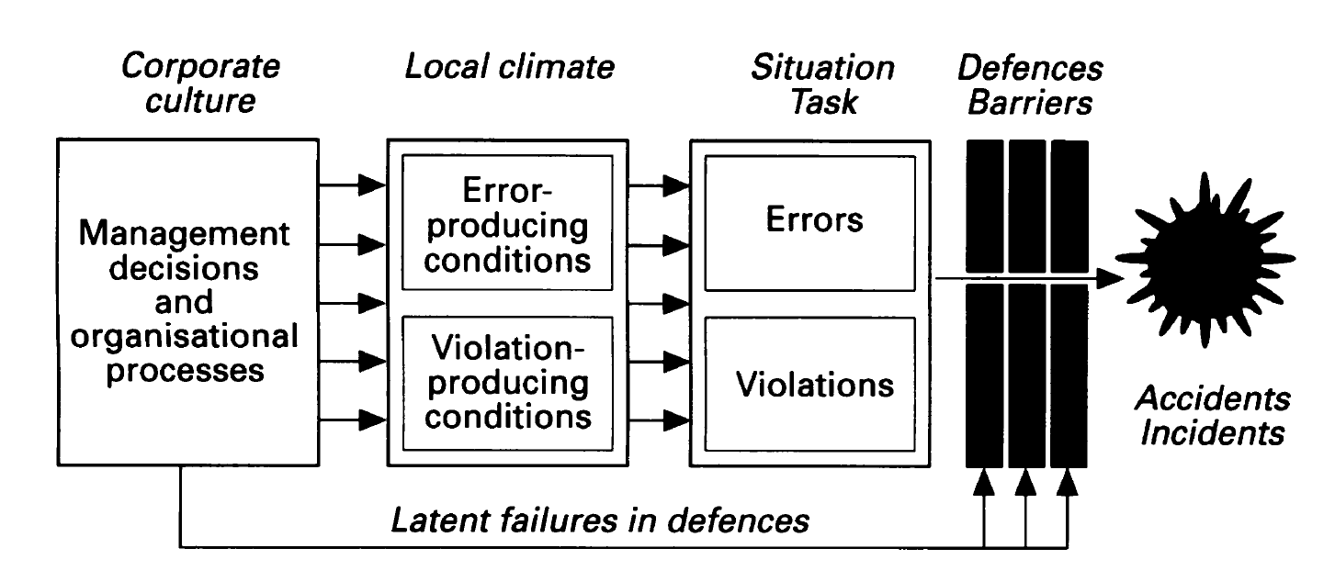
Classifications 1 Reason

Slide 19
Classifications 2 HFIT

Slide 20
Classifications 2: HFIT

Slide 21
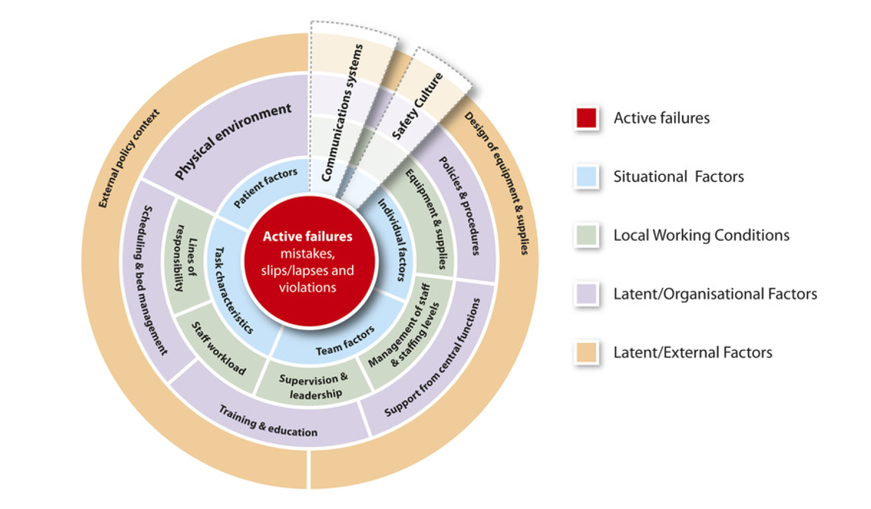
Classification 3 - Lawton

Slide 22
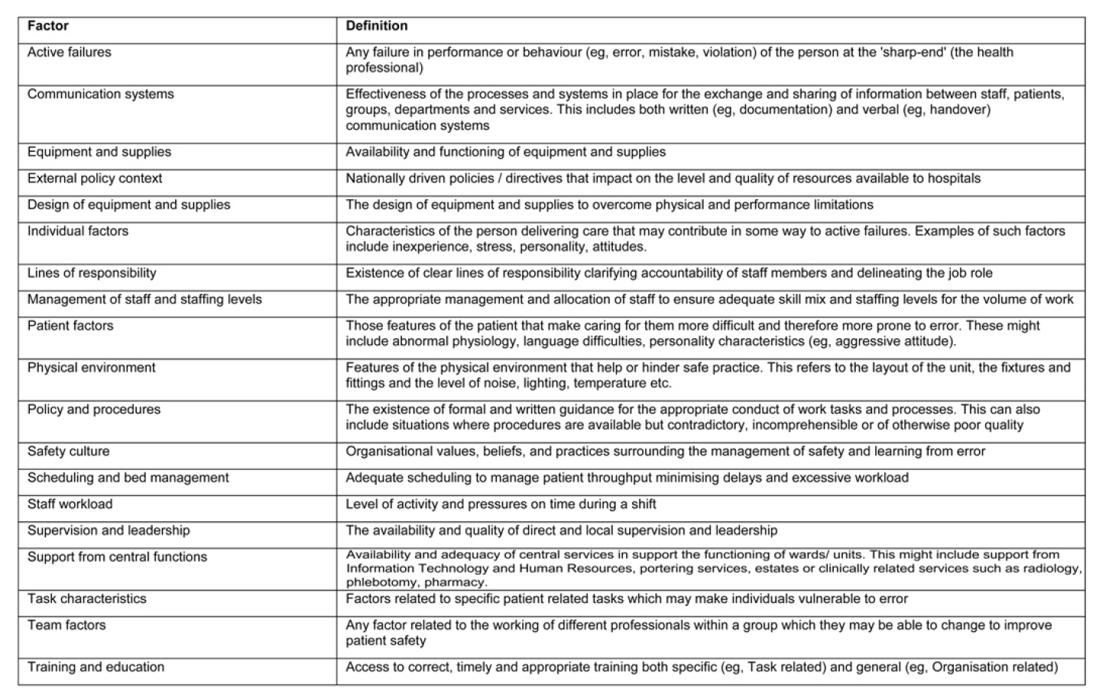

Slide 23
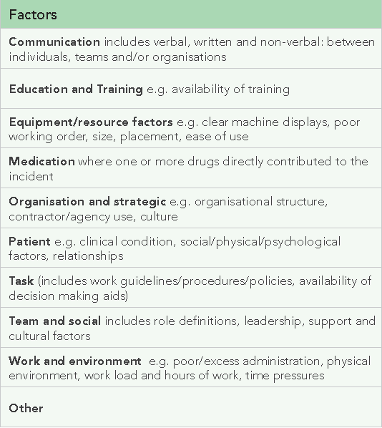
Classification 4 – NPSA

Slide 24
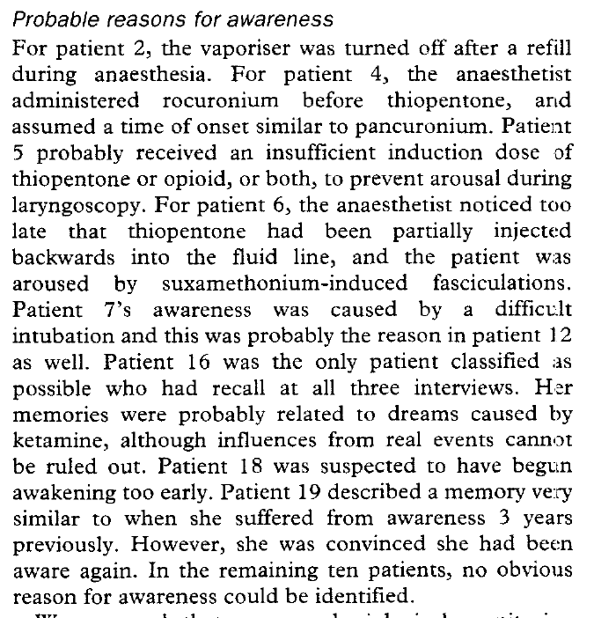
AAGA and HF: Literature

Slide 25
Literature
Vapouriser turned off after refill
Rocuronium before STP (and assumed onset ≈panc)
Inadequate does of induction or opioid
STP allowed to run up IV line and sux given before anaesthesia
5&6. Difficult intubation
Emerged too early
2/19 uncertain
10/19 no cause found

Slide 26
Literature
Vapouriser turned off after refill
Rocuronium before STP (and assumed onset ≈panc)
Inadequate does of induction or opioid
STP allowed to run up IV line and sux given before anaesthesia
5&6. Difficult intubation
Emerged too early
2/19 uncertain
10/19 no cause found
41%

Slide 27
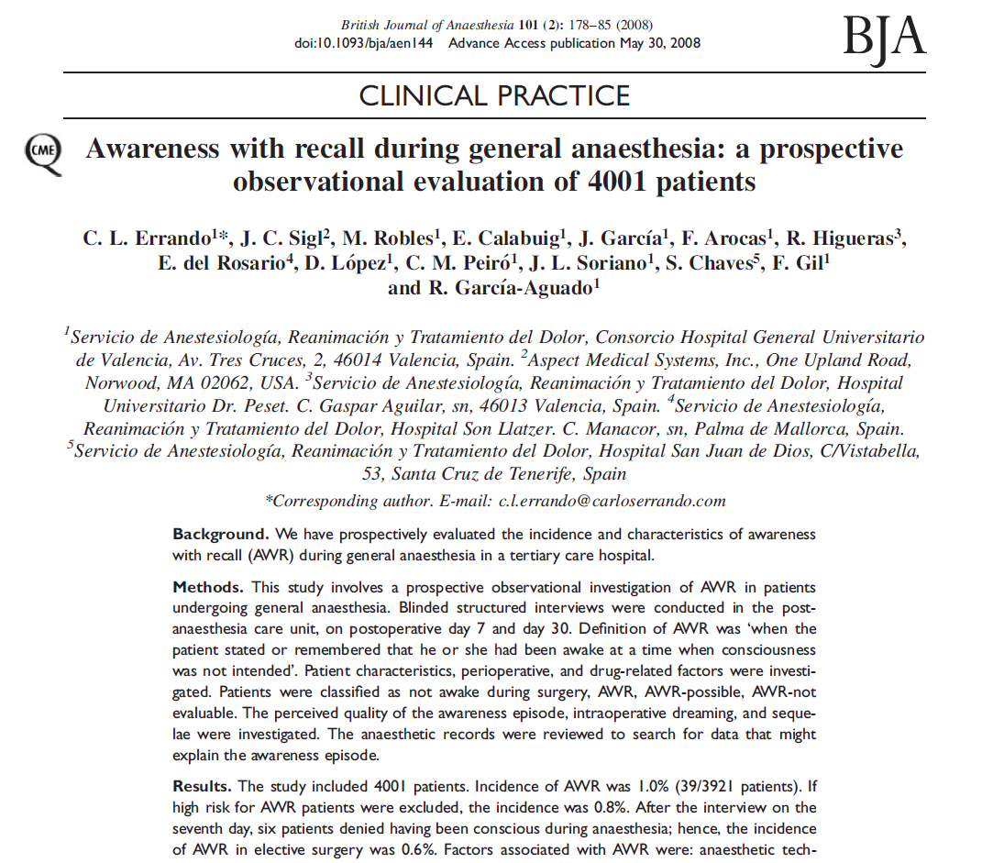
Literature

Slide 28
Literature
22 cases…..
15 cases could be attributed to human error.
…..absolute or relative hypnotic drug dosage errors
3 difficult intubations
19 out of 22 cases were considered avoidable.
2 cases of equipment failure
5 cases no cause identified

Slide 29
Literature
22 cases…..
15 cases could be attributed to human error.
…..absolute or relative hypnotic drug dosage errors
3 difficult intubations
19 out of 22 cases were considered avoidable.
2 cases of equipment failure
5 cases no cause identified
68%

Slide 30
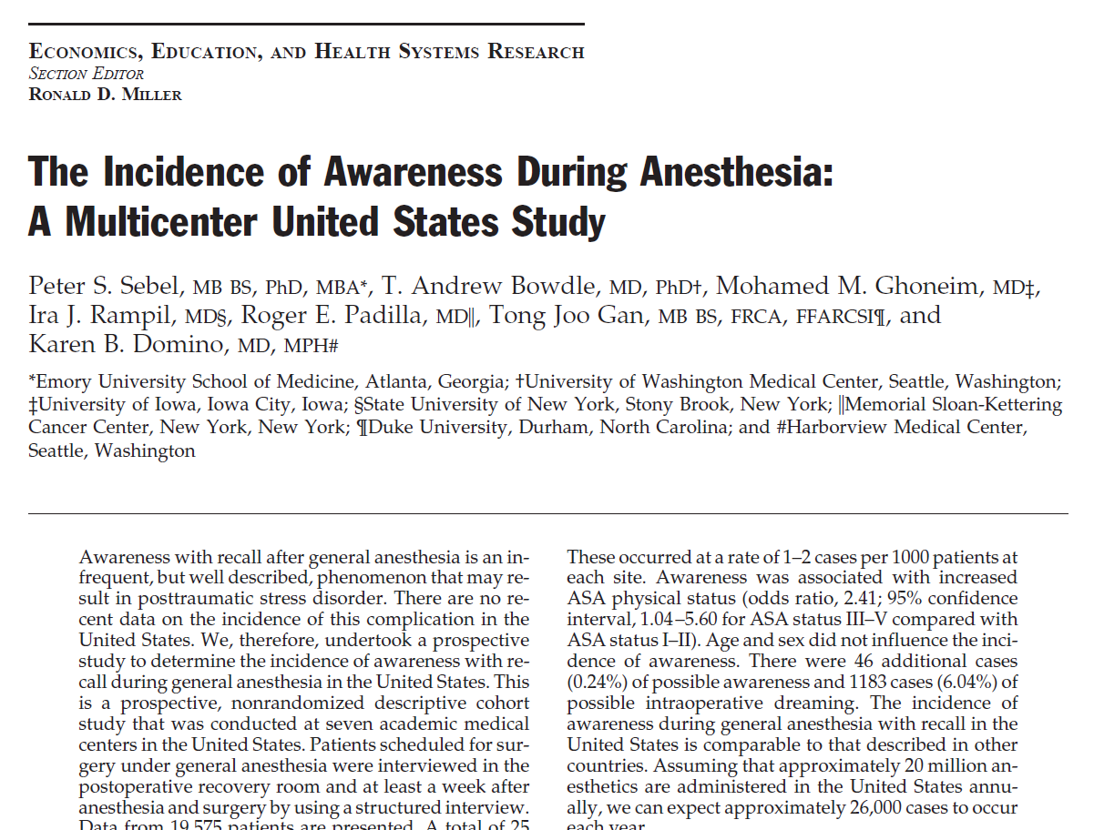

Slide 31
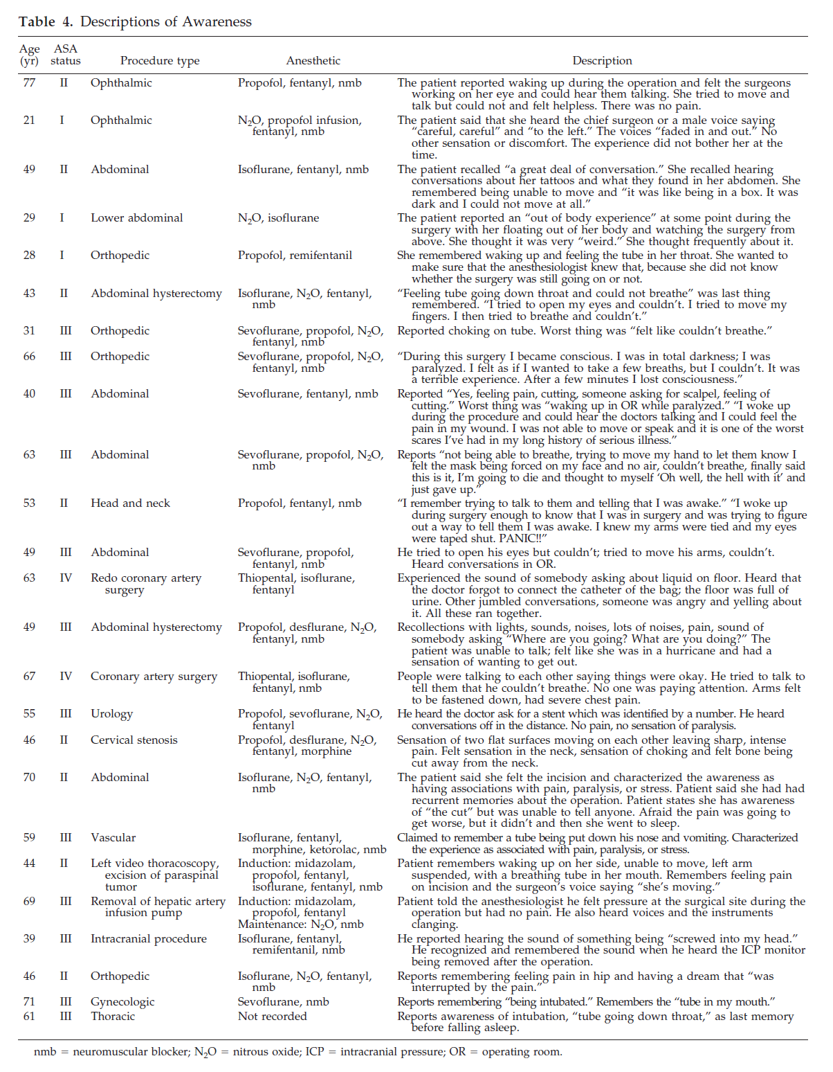

Slide 32
25 cases…..
No ‘causes offered’

Slide 33
25 cases…..
No ‘causes offered’
0%?
X%?

Slide 34
RCTs of AAGA/BIS etc
……………HF never mentioned

Slide 37
Mind the gap

Slide 38
Mind the gap

Slide 40
Induction - HF

Slide 41
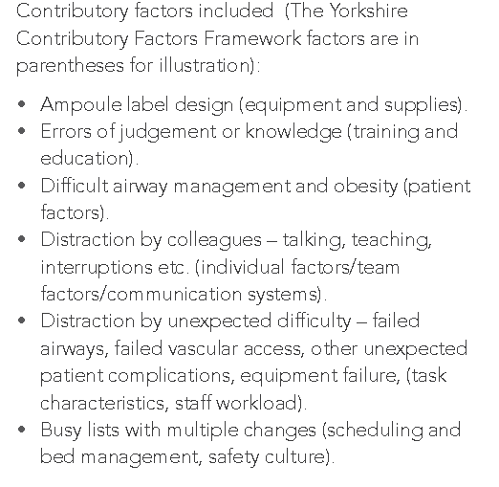
Induction - HF

Slide 42
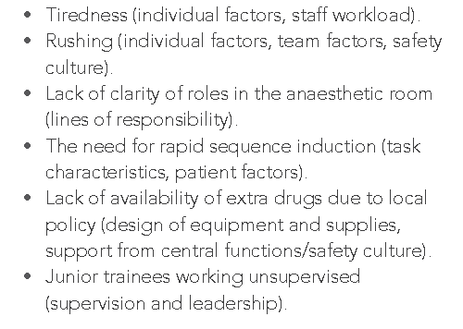
Induction - HF

Slide 44
Slips and lapses……

Slide 45
Slips and lapses……
Latent factors in 100%

Slide 46
Maintenance and emergence

Slide 47
Monitoring and emergence

Slide 48
Monitoring and emergence
88% of emergence cases were judged preventable

Slide 49
LCs’ reports of HF

Slide 50
Do you ever rush?

Slide 51
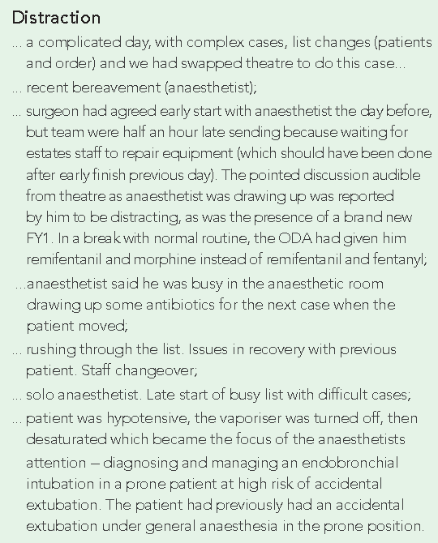
LCs’ reports of HF

Slide 54
…when AAGA occurred HF sometimes contributed to poor quality care during or afterwards…….

Slide 56
HF solutions?
Better environment
Better planning
Checklists
Better kit –drug ampoules
Technology
Scanning drugs
Single touch timed pauses of gas delivery
Servo control of ETAG
DOA ??
Better communication

Slide 58
