Slide 1
Depth of Anaesthesia Monitoring
Professor Jaideep J Pandit
Clinical Lead, NAP5

Slide 2
Background
A ‘hot topic’
How do we know a paralysed patient is also conscious?
If we directly access the brain, we may know

Slide 3
An open question:
B-Aware trial (2004)
5-fold reduction in AAGA with BIS
0.9% → 0.16%
B-Unaware trial
No change with BIS
0.2% each
BAG-RECALL trial
AAGA higher (NS) in BIS!
0.24% vs 0.07%

Slide 4
NICE
Despite uncertainties: NICE Diagnostic Guidance 2013
DOAs = ‘ an option’ (??) in ‘high risk’ (???)
No guidance on usage or interpretation
Aim for value <60…but which is worse
BIS 85 for 10 sec or 62 for 30 min?

Slide 5
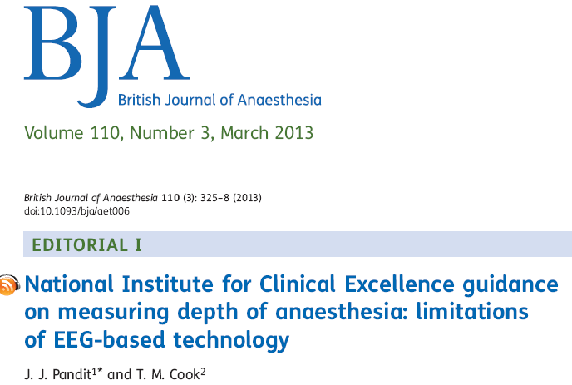
These and other issues discussed:

Slide 6
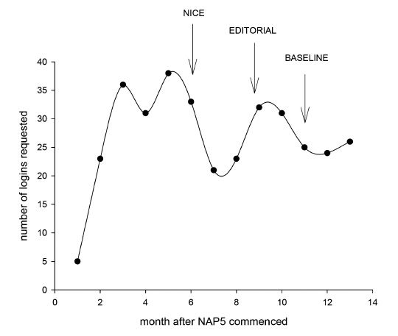
NAP5 Results: DOAs
NICE did not influence reporting

Slide 7
Headline figures: don’t tell whole story
DOAs in Activity Survey = 2.8%
DOAs in AAGA cohort = 4.3%
…over-representation in AAGAs ! (by ~50%)
Cannot be a ‘risk’ to use DOAs?
→ need to look at data more closely

Slide 8
Hazard ratios of anaesthetic techniques
TIVA + NBD presents most risk (3 -4 x)

Slide 9
Ratio of use of DOAs Activity Survey vs AAGA cases
Selective use in certain modes of anaesthesia
Greater use in TIVA+NBD – and greatest apparent benefit here too

Slide 10
Extra benefit of DOA?
Of the 6 AAGA cases with DOA only 1 was distressed
impact of AAGA milder with DOA use?
Trials focussing on TIVA + NMB and on impact on patients may show most benefit for DOAs

Slide 11
Caution with DOAs (1)
Titrating agent dosing to DOA output, even to very low agent levels
Elderly pt, cardiac surgery, BIS < 60 but ETAG titrated to 0.4 MAC to achieve this – AAGA with distress during positioning
Elderly pt, abdo surgery, BIS kept <55 but ETAG titrated to 0.4 MAC; AAGA with pain but no distress

Slide 12
Caution (2)
If DOA used, and its output high, then this is compelling evidence that AAGA occurred, despite no other pointers
Pt made a complaint of AAGA after ortho surgery (with other complaints). Account vague but BIS briefly 65 after incision (~45 otherwise)

Slide 13
Caution (3)
The majority of AAGA cases arise at induction or soon after, before (or at) start of surgery
Are DOA monitors used then?
If so, then should same thresholds apply (ie, <60)?
Note: also time when minimum MAC alarms least useful

Slide 14
Recommendations
We need to be familiar with existing DOAs
Including IFT
Need for pragmatic protocols for how to use and respond to DOA outputs, integrating with other information
DOAs likely most useful when NMBs used in highest risk categories (eg, TIVA)
Logically should be used from very start of/before induction END

