Slide 1
Neuromuscular Blockade
Dr Wouter Jonker
Consultant Anaesthetist
Sligo Regional Hospital, Ireland

Slide 2
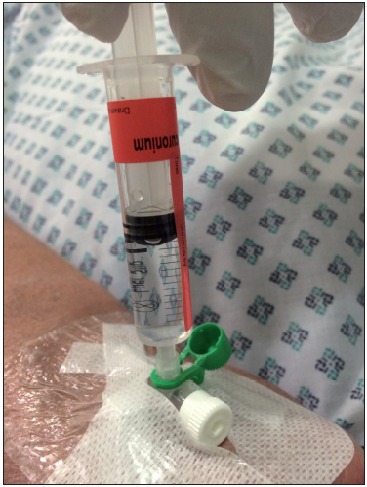
Aim:
Demonstrate the relation between AAGA and the use of neuromuscular blocking (NMB) drugs.
How NMB affects patient’s experiences of intra-operative events.
Notes:
(NMB) are administered during general anaesthesia to block the transmission of signals between motor nerve endings and skeletal muscles.

Slide 3
Indication may be to either:
  facilitate laryngoscopy and tracheal intubation, ventilation or for surgical requirements.
But
NMB removes the capacity of a patient to move in response to unpleasant stimuli during general anaesthesia.
Notes:
This movement could be used as one of the indicators of depth of anaesthesia, which our next speaker will discuss.
The association between NMB and AAGA isn’t new

Slide 4
Ghoneim & Block (1992)
  Avoid neuromuscular blockade wherever possible and if used, avoid complete paralysis.
Sandin et al., 2000
  NMBs predispose to AAGA and to the adverse effects of AAGA when it occurs
  Incidence of AAGA
    with NMB was 0.18% vs 0.1% with no NMB
Notes:
Methods for avoiding AAGA in induction phase of anaesthesia

Slide 5
B-Aware (Myles et al., 2004)
  predominantly studied patients in whom NMBs were administered.
Other large trials (B-Unaware/ BAG-RECALL; Avidan 2008 & 2011)
  have not explicitly recorded NMB as a risk factor

Slide 6
NAP5 Results
NMB is dramatically over-represented in the cohort of AAGA reports in NAP5
NMB used in 46% of all general anaesthetics.
  Anaesthesia Activity Survey (Sury et al., 2014)
93%(131) of NAP5 Class A and B cases received a NMB

Slide 7
Notes:
All of the ICU and all but one of the Class G cases
The sparseness of results makes formal statistical comparison impossible between the cohort that received no NMB vs those that did
In 3 Class A and 1 Class G resulted in rather vague symptomatology and none of the patients reported pain or paralysis and modified NPSA scores varied widely
7 possible cases without NMB even vaguer (Probable vs Possible classification)
A comparison is possible of longer term psychological outcomes between those patients in the Certain/ probable category who received NMBs (Table 19.1) and those patients in whom there were syringe swaps or drug errors.

Slide 8
Notes:
median score for the NMB class A was ‘low’ with ‘severe’ being a relatively infrequent consequence, but for the Syringe swap/drug error class, the median score was ‘moderate’, with ‘no impact’ being less common.
Highlight greater psychological morbidity in unmodified ‘awake paralysis’

Slide 9
Distress at the time of the episode was reported
  In 51% of all reports where NMBs were used
  in 61% when paralysis was also experienced
  in 77% when both paralysis and pain were experienced.
Notes:
Distress as pointed out earlier today appears to be an important factor in determining longer term adverse effects.
More patient felt distress when the experience of AAGA was associated with feeling paralysis.
The relationship between the degree of reversal of NMB and the likely degree of distress can be illustrated in Fig 10.2

Slide 10
Notes:
Fig 10.2
A report of incomplete reversal at emergence illustrates this

Slide 11
Notes:
Incomplete reversal of emergence.
AAGA, at emergence, was generally caused by mistimed or mismanaged NMB, failure to monitor the effects of NMB and failure to consider idiosyncratic responses to single doses of NMBs. These were discussed earlier today.

Slide 12
Residual paralysis is an under appreciated problem after anaesthesia
  Baillard et al. (2000), Murphy et al. (2008) and Di Marco et al. (2010)
Best practice revolves around coupling information from a nerve stimulator with the use of reversal agent
Baillard et al. (2005) showed that a programme of education could reduce residual curarisation from 62% to 3.5%.

Slide 13
Nerve stimulator
  Monitor of ‘motor capacity’
  Only used in minority (38%) of cases where non depolarising block was used (Sury et. al, 2014)
Failure to use a nerve stimulator was judged causal or contributory in half of the reports.
Notes:
Because the vast majority of NAP5 reports were of unintended awareness during neuromuscular blockade it begs the question:

Slide 14
Were we studying?
Accidental awareness during general anaesthesia
or
Accidental awareness during neuromuscular blockade
Notes:
Any case in which neuromuscular blockade is used must be regarded as carrying increased risk of AAGA.

Slide 15
Notes:
Conceptually, unopposed global neuromuscular blockade is an intervention with capacity to cause great psychological harm, unless it is counteracted by general anaesthesia (as evident in syringe swap reports)
NAP5 contains reports of paralysis at induction, on transfer into theatre, during surgery, during transfer from theatre, and during recovery.
A disruption of the balance can occur at any time during anaesthesia.

Slide 16
Recommendations
Plan the use of NMB
Patients informed regarding
  Effect of NMB
  Increased risk of AAGA if NMB is used
  Awake extubation
Packaging, labeling and handling of NMB
Nerve stimulator to be considered as ‘essential’ in monitoring guidelines
Management of drug errors that lead to accidental paralysis
Notes:
12 recommendations relating to NMBs

