Slide 1
TIVA
Dr Alastair Nimmo

Slide 2
Anaesthetic maintenance technique and accidental awareness
Volatile maintenance – ETAG concentration can be measured and if alarms are turned on and set at 0.7 MAC this reduces the risk of awareness*
But two thirds of the cases of AAGA reported to NAP5 did not occur during maintenance
“Gaps” between an IV induction and volatile maintenance or between volatile maintenance in theatre and IV infusion maintenance after surgery may result in AAGA
*Avidan MS. NEJM. 2011;365:591–600.

Slide 3
Anaesthetic maintenance technique and accidental awareness
IV maintenance – ETAG concentration monitoring can’t be used to confirm delivery of anaesthetic to the patient
Monitoring of anaesthetic drug effect e.g. processed EEG monitoring such as BIS® may be used for this purpose
“Gaps” in drug delivery between induction and maintenance or between maintenance in theatre and maintenance after surgery don’t usually occur

Slide 4
Relative risk of AAGA
Some studies and reviews have concluded that the risk of accidental awareness is higher with TIVA than with maintenance with a volatile agent
Other studies and reviews have found the risk to be similar with both techniques
There probably isn’t a single answer to this question. Rather the risks will depend on the specific drugs and techniques used including typical dose ranges and monitoring techniques, and on training and experience in TIVA

Slide 5
TIVA and NAP5
NAP5 provides information on the relative frequency with which patients having volatile anaesthesia or TIVA report AAGA with current practice in the UK
The reports enable common causes of AAGA during TIVA to be identified and recommendations to be made to reduce the risk
All anaesthetists need to be skilled at administration of IV anaesthesia because volatile anaesthesia is not possible in all areas, or during transfers or during some procedures

Slide 6
TIVA – optional or required?
There were 31 reports of AAGA in patients who received IV anaesthesia for maintenance during part or all of their anaesthetic
In 19 cases (14 Class A and 5 Class B) anaesthesia was confined to the anaesthetic room & theatre and volatile maintenance could have been used
In 12 cases (9 Class A and 3 Class D) volatile anaesthesia was not an option because anaesthesia occurred or was continued outside theatre (11 cases) or a procedure on the airway made inhalational anaesthesia impractical (1 case).

Slide 7
NAP5 reports from TIVA patients
Anaesthesia started in anaesthetic room or theatre
24 Class A or B reports in patients who had anaesthesia maintained with IV anaesthesia or both volatile and IV anaesthesia
Maintenance technique | Class A | Class B
TIVA – TCI | 9 | 5
TIVA – manual infusion | 2 | 0
Intermittent propofol boluses | 1 | 0
Volatile and IV | 7 | 0

Slide 8
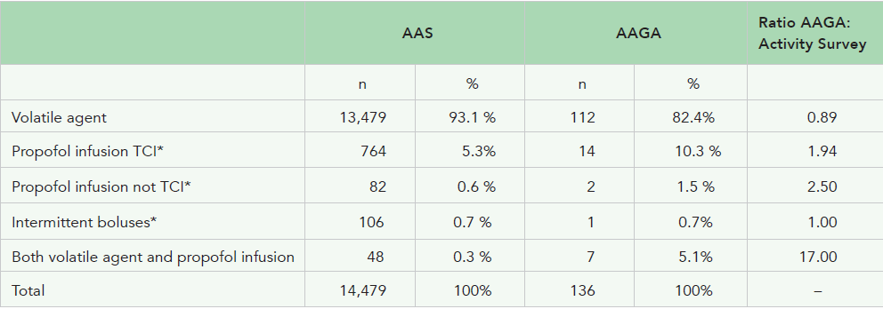
NAP5 reports from TIVA patients
Anaesthesia started in anaes room / theatre
Class A (certain or probable) & Class B (possible) AAGA reports

Slide 9
IV anaesthesia alone in theatre
12 Class A and 5 Class B reports
Details are available to examine causes / contributory factors in the Class A cases
8 of the Class A cases involved “standard” TCI anaesthesia

Slide 10
IV anaesthesia alone in theatre
8 TCI cases
4 cases in which there was failure to deliver the intended dose of propofol (2 “tissued” cannulae; 1 propofol and remi syringes swapped i.e. each put in the wrong pump; 1 propofol infusion not actually connected to IV cannula during “induction”)
2 cases in which the NMB was given and paralysis produced before loss of consciousness
2 cases in which the patients experienced awake paralysis because the NMB was still acting when they woke up after surgery

Slide 11
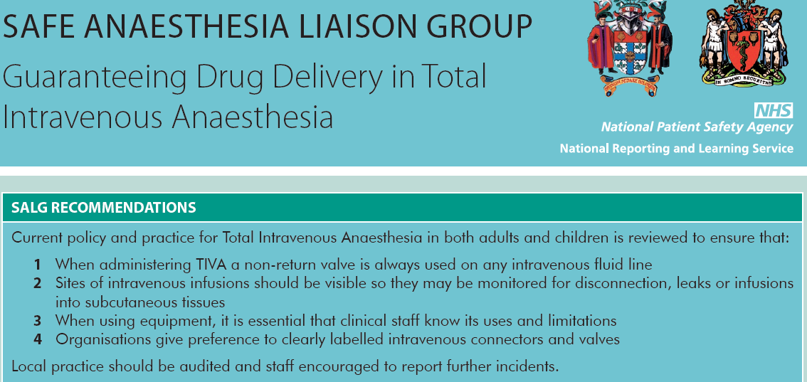

Slide 12
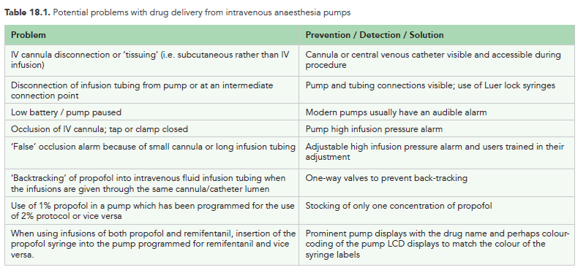

Slide 13
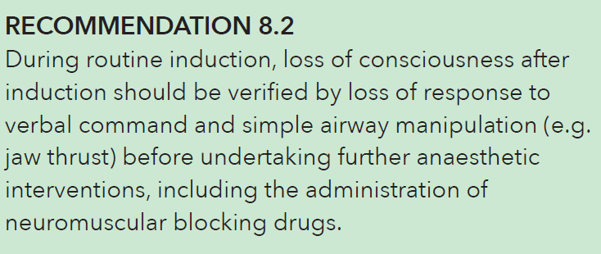
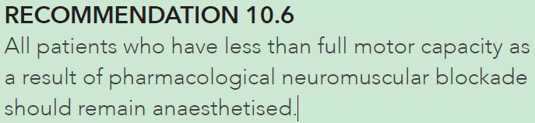
Relevant recommendations from other chapters

Slide 14
IV anaesthesia alone in theatre
4 non-TCI cases
1 cases in which propofol and remifentanil were mixed in the same syringe (?TCI for the propofol)
1 cases in which propofol and remifentanil boluses were given followed by manual infusions
1 case in which a combined spinal & epidural anaesthetic was given with a manual propofol infusion (no bolus recorded) while the patient breathed spontaneously from a “Hudson” type mask
1 case in which manual boluses of propofol were given

Slide 15
Anaesthesia induced in theatre

Slide 16
Both volatile and IV anaesthesia
2 reports involved simultaneous administration of a volatile anaesthetic and a TCI propofol infusion.
In 1 case an inhalational induction in a child was followed by maintenance with TCI propofol
In 4 cases a volatile anaesthetic was turned off after a procedure in theatre and a manual (non-TCI) propofol infusion was started for transfer to ICU or radiology or for ventilation in the recovery. In one case the cause of AAGA was thought to be a tissued IV cannula and in the other three to be inadequate doses of propofol

Slide 17
Anaesthesia induced outside theatre
4 Class A reports were of patients who received a propofol infusion for intended general anaesthesia in A&E, radiology or ICU.
3 Class D reports were similar cases of propofol infusions in A&E, radiology or ICU.
The cause of the awareness in most of these cases appeared to be propofol doses that were too low. In all cases a manual infusion was used rather than TCI. Infusion rates as low as 10 ml/h were reported and in some cases no initial bolus was given.

Slide 18
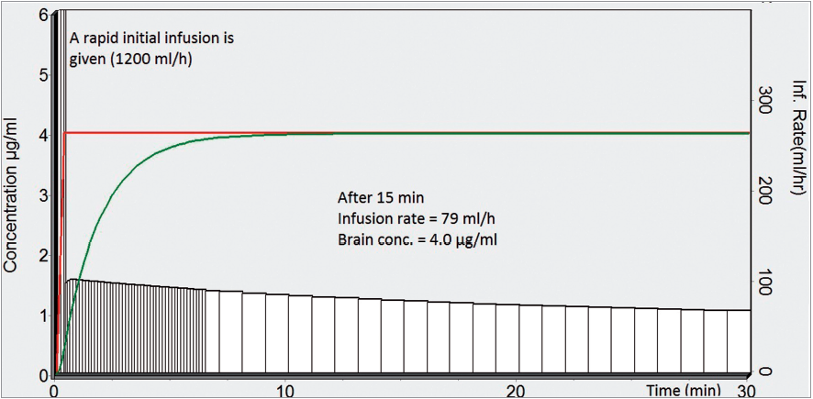
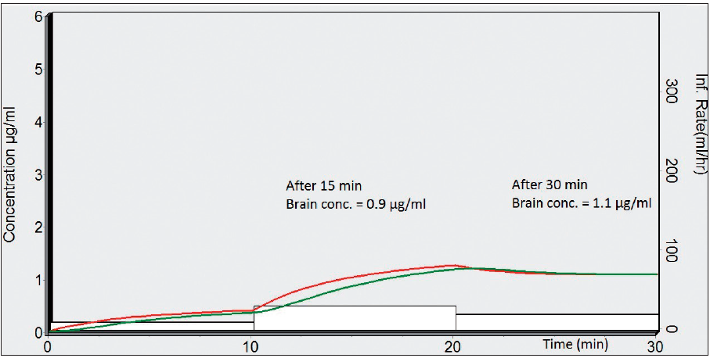
Simulations of a typical TCI propofol anaesthetic and of a manual infusion with no initial bolus
See chapter 18.
TIVAtrainer software version 9; Marsh pharmacokinetic model with a blood-brain equilibration rate constant of 0.6

Slide 19
NMB use in TIVA AAGA cases
There were only 2 Class A TIVA or combined TIVA and volatile cases in which no NMB had been given
1 case in which a CSE anaesthetic was given with a manual propofol infusion (no bolus recorded) while the patient breathed spontaneously from a “Hudson” type mask
1 case in which manual boluses of propofol were given and discontinued when the anaesthetist mistakenly thought the procedure had finished

Slide 20
Preventability
The NAP5 Case Review Panel assessed preventability in 25 of the Class A and B reports involving TIVA
19 of the cases (76 %) were considered to have been preventable
The commonest contributory factor identified was inadequate education and training

Slide 21
Learning points
TIVA was a more frequent anaesthetic technique in the reports to NAP5 than in the Activity Survey.
Changing from a volatile anaesthetic to IV anaesthesia at the end of surgery (e.g. for transfer to ICU) and anaesthesia outside the operating theatre appeared to be associated with particularly high incidence of AAGA reports.
Three quarters of the AAGA cases associated with TIVA were considered to have been preventable and the commonest contributory factor identified was inadequate education and training.

Slide 22
Learning points
The large majority of reports of AAGA associated with TIVA were from patients who had received a neuromuscular blocking drug.
TIVA in the operating theatre is usually given as a target controlled infusion. Causes of AAGA included failure to deliver the intended dose of propofol, giving an NMB before loss of consciousness and allowing the patient to waken from anaesthesia while still paralysed.
During transfer and anaesthesia outside theatre, the commonest cause of AAGA appeared to be inappropriately low doses of propofol (non-TCI).

Slide 23
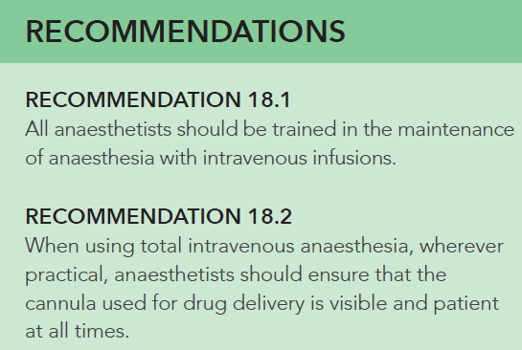

Slide 24
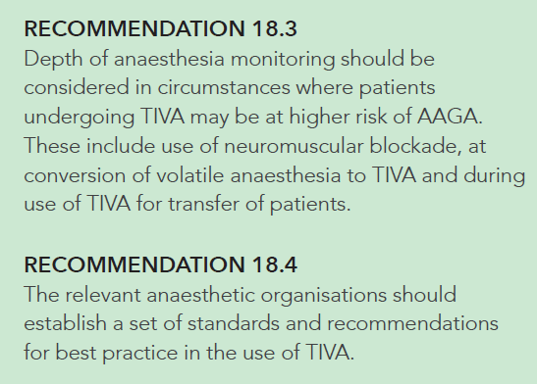

Slide 25
TIVA
Dr Alastair Nimmo

