Slide 1
AAGA in children
Mike Sury
September 2014

Slide 2
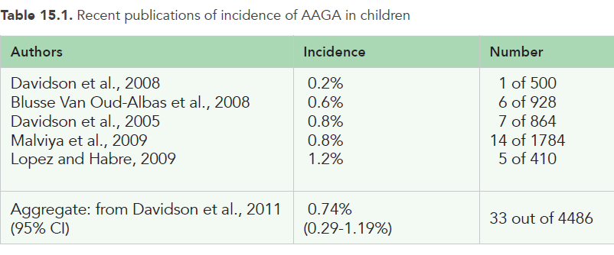

Slide 3
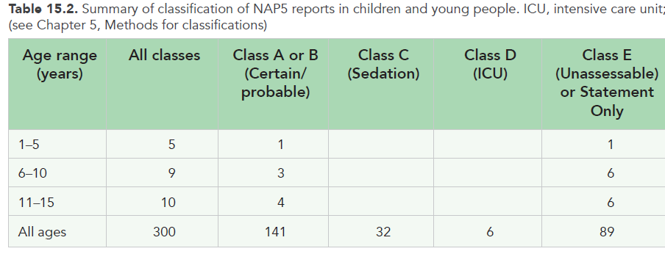

Slide 4
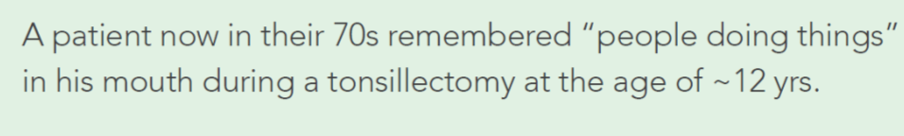
Vignettes:
Unassessable or Statement Only

Slide 5
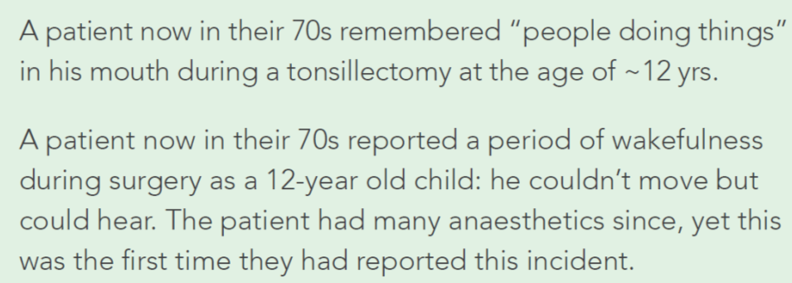
Vignettes:
Unassessable or Statement Only

Slide 6
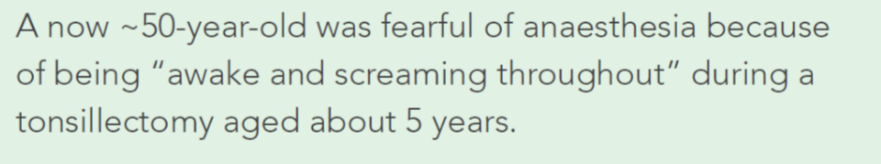
Vignettes:
Unassessable or Statement Only

Slide 7
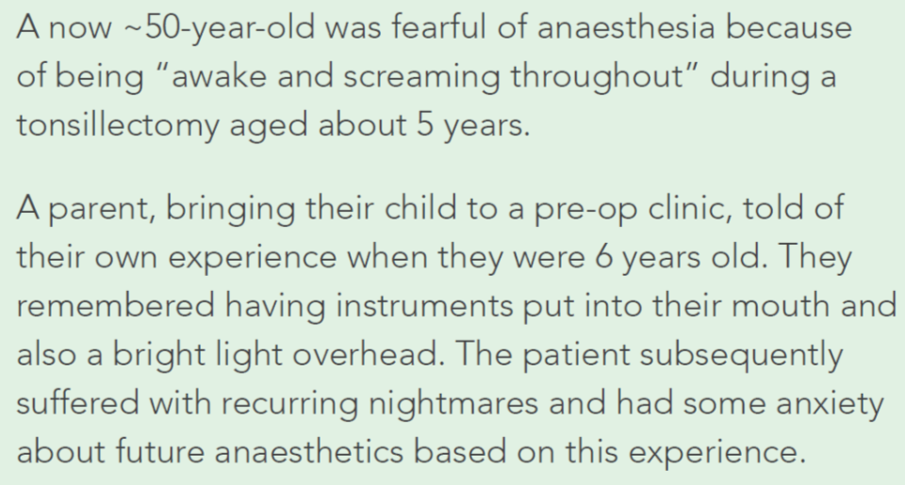
Vignettes:
Unassessable or Statement Only

Slide 8
    Reports not assessable
N = 13 (largest group), records unavailable.
Patients can recall events long ago and may not report them despite having had anaesthetics in the intervening period
  5 had general anxiety or specific fears
  6 had had AAGA during tonsillectomy.

Slide 9
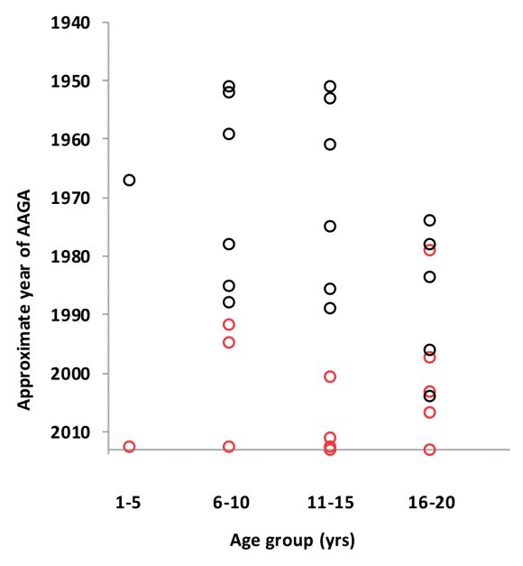

Slide 10
Two major findings
very few children themselves reported AAGA
patients can delay reporting an AAGA event that occurred as a child for many years.

Slide 11
Two major findings
very few children themselves reported AAGA
patients can delay reporting an AAGA event that occurred as a child for many years.

Slide 12
Incidence?
The NAP5 Activity Survey estimates that 488,500 general anaesthetics are administered to patients aged <16 years in the UK annually.
This yields an incidence of just ~0.002% (or ~1: 60,000).

Slide 13
Incidence?
The NAP5 Activity Survey estimates that 488,500 general anaesthetics are administered to patients aged <16 years in the UK annually.
This yields an incidence of just ~0.002%
(or ~1: 60,000).

Slide 14
? Missing reports
If 0.74% is the true rate of AAGA, there should be approximately 3,700 children per year in the UK with recall of events during general anaesthesia.
Why?
  NAP5 is a study of spontaneous reporting and did not involve direct questioning.

Slide 15
? Missing reports
If 0.74% is the true rate of AAGA, there should be approximately 3,700 children per year in the UK with recall of events during general anaesthesia.
Why?
  NAP5 is a study of spontaneous reporting and did not involve direct questioning.

Slide 16
? Missing reports
If 0.74% is the true rate of AAGA, there should be approximately 3,700 children per year in the UK with recall of events during general anaesthesia.
Why?
  NAP5 is a study of spontaneous reporting and did not involve direct questioning.

Slide 17
Why is AAGA reported less in children?
Experience not being sufficiently compelling or interpretable.
Children may lack the language or vocabulary to explain what happened.
Distress, fear and confusion may inhibit communication.
Their awareness may be difficult to separate from dreaming or nightmares.
Parents may suppress reporting.

Slide 18
Paediatric anaesthesia is different to adult anaesthesia?
In the NAP5 Activity Survey data sample, neuromuscular blockade was used less frequently in children than in adults (25% v 50%).
  the spectrum of surgical interventions is different
  adults have diseases that prevent them receiving high doses of anaesthetic to achieve immobility.

Slide 19
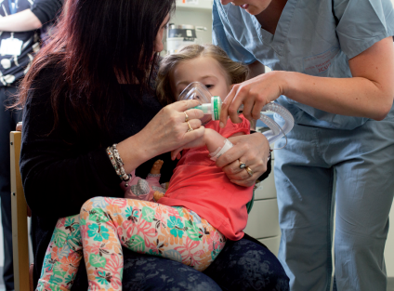
Inhalational induction

Slide 20
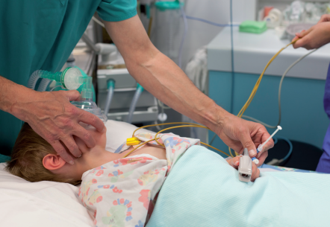
Inhalational induction

Slide 21
Recommendations
The paucity of AAGA cases involving children reported to NAP5 means it is unjustified to make specific recommendations about prevention and management of AAGA in this group.

Slide 22
4 Learning Points
Spontaneous reporting of AAGA is very rare and may be delayed until adulthood
Children’s reports can be as reliable as those from adults.
Children should be believed and treated sympathetically.
Serious long term psychological harm and anxiety states are rare, but do occur

