Slide 1
AAGA during general anaesthesia in intensive care
Dr Richard Paul

Slide 2
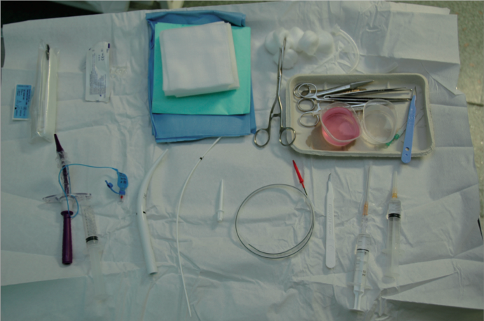
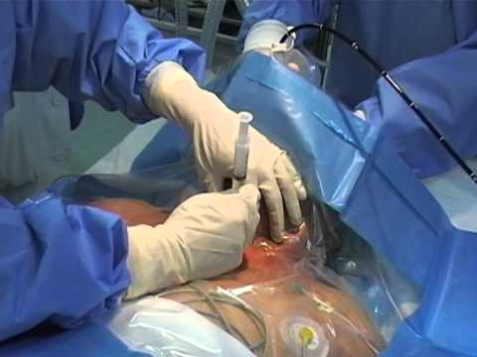
Background
Critical illness increases the complexity of anaesthesia
General anaesthesia should be expected for surgical and airway procedures
Notes:
There are multiple factors in critical illness that influence the safe conduct of anaesthesia, the most significant of which is pre-existing cardiovascular instability that could lead to severe hypotension and cardiovascular collapse on administration of a standard dose of induction agent
Furthermore, multiple organ dysfunction will alter the kinetics of most agents used, potentially potentiating and prolonging their effects
Therefore, making judgements post-hoc on the dosages of drugs that should be used in the critically ill is challenging
However, the panel felt that severely unwell patients should still receive general anaesthesia for all surgical procedures, airway interventions and transfers where awareness would lead to pain or distress
With that in mind, NAP5 examined reports of AAGA arising from critically ill patients during general anaesthesia for procedures either on the ICU, in the ED or during transfer of patients to and from the ICU.
We classed these reports as Class D or ‘ICU reports’
With rates of delirium as high as 80% in the critically ill population, we were aware of the added challenge of separating factual from distorted memories
However, after scrutiny, no reports of AAGA from the ICU were judged to be the result of either delirium, delusion or false memory

Slide 3
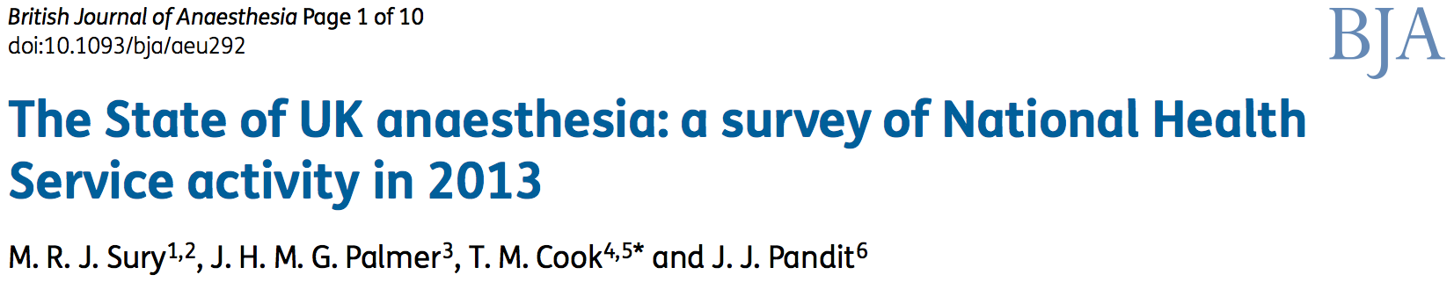
Numerical and case analysis
Comparison with UK activity survey
AAS | 29,000 / 2.77m | ≈ 1% of GA’s
NAP5 | 7 /308 | ≈ 2.3% of GA’s
Notes:
NAP5 reviewed a small number of reports involving intensive care patients
In the Activity Survey, general anaesthesia was conducted (by anaesthetists) either in the ICU or ED in 29,000 cases out of a yearly total of nearly 2.77 million general anaesthetics, or about 1% of total general anaesthetic activity
Seven ICU cases were reviewed by the NAP5 committee, approximating to 2.3% of the total number of cases reviewed

Slide 4
Numerical and case analysis
Of the 7 reviewed reports:
- all considered Grade A evidence
- 3 ICU, 2 ED, 2 transfer
- 5/7 female
- 5/7 morbidly obese (BMI 45-60)
- 4/7 consultant intensivist/anaesthetist
Notes:
Of the 7 reviewed reports, all were considered to be Grade A evidence
3 were from the direct ICU environment, 2 from the ED and 2 involved patient transfer
5 reports involved female patients and 5 morbidly obese
The most senior operator involved in 4 of the reports was either a consultant anaesthetist or intensivist, with the remainder involving a range of anaesthetic grades

Slide 5
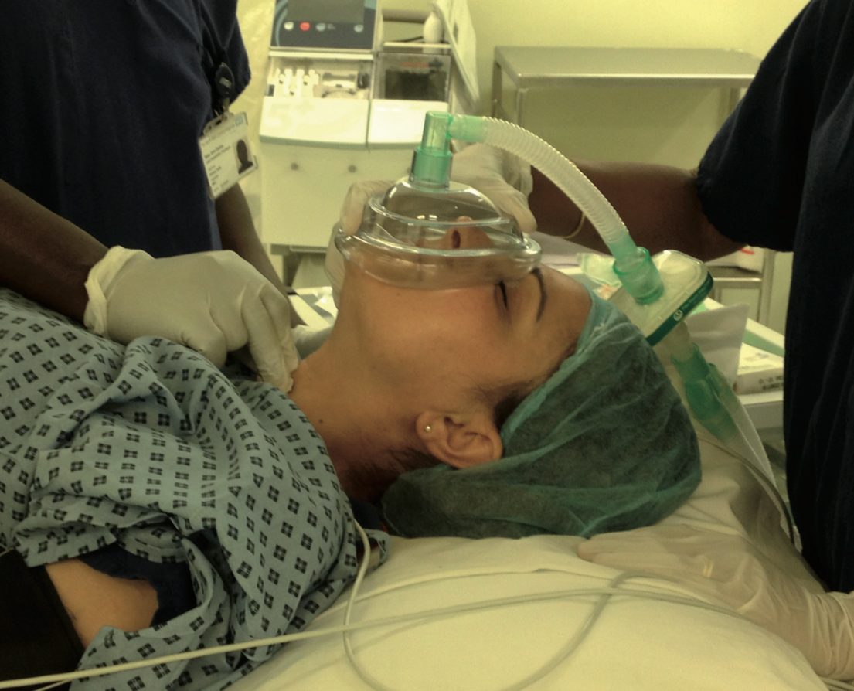
Numerical and case analysis
Of the 7 reviewed reports:
- 3 at tracheal intubation with RSI
Notes:
3 cases involved intubation with an RSI
2 were during peri-arrest scenarios and one case involved difficult intubation with multiple changes in operator
In two of the reports, the dose of propofol used for induction was 0.4 and 1.2mg/kg respectively, deemed too low for adequate anaesthesia
In the 3rd report, a peri-arrest case, no induction agent was given, however a neuromuscular blocking agent was administered as intubation was difficult due to the presence of airway reflexes. This patient appeared moribund to the clinical team but subsequently reported awareness of intubation and transfer
An example of one of these cases follows on the next slide

Slide 6
Numerical and case analysis
“ A middle-aged patient underwent tracheal intubation in the ED for management of acute severe asthma. An RSI was conducted (ketamine 20mg, propofol 30mg, suxamethonium, rocuronium). Significant hypertension was noted soon after intubation and was treated with bolus propofol prior to starting a propofol infusion. Awareness of the entire intubating process was reported following extubation.”

Slide 7
Numerical and case analysis
Of the 7 reviewed reports:
- 3 at tracheal intubation with RSI
- 4 during maintenance and transfer
Additional 3 cases involved post-op transfer
Notes:
2 cases were reported concerning the period immediately after intubation, including painful insertion of invasive monitoring lines and a patient transfer both whilst paralysis persisted
2 cases were reported during surgical interventions performed later on during patients’ ICU stays
In several of the seven cases, the time between induction agent administration and initiation of maintenance anaesthesia or sedative infusions was deemed to have been a contributing factor in the episode of AAGA
In addition to these 4 reports, a further 3 cases involved transfer of a post-operative patient to ICU
Themes amongst these 7 reports were similar:
- the use of non-TCI propofol infusions (with only one record of a propofol bolus given pre-infusion)
- the use of low infusion rates (100mg/hr)
- the use of neuromuscular blockade
An example of one of these cases is in the subsequent vignette

Slide 8
Numerical and case analysis
“A patient experienced AAGA during transfer and a procedure performed in radiology. The patient reported awareness throughout the procedure, including the painful insertion of a drain, which was described as “something exploding in my tummy.”

Slide 9
Numerical and case analysis
Of the 7 reviewed reports:
- All cases involved NM blockade
- 1 case used vasopressors
- No cases used DOA or NM monitoring
- Not all cases were judged preventable
Notes:
In all cases, neuromuscular blockade was used
In only one case was a vasopressor used to support cardiovascular stability during the episode of general anaesthesia (an intubation)
In none of the cases was a DOA monitor or nerve stimulator used
However, given the inherent difficulties in managing anaesthesia in the critically ill, the NAP5 panel judged that only 4 of the 7 cases were preventable

Slide 10
Patient experience
All patients experienced distress during AAGA
Symptoms included:
- fear, anxiety, feeling of suffocation
5 patients reported pain, paralysis and distress
5 patients reported moderate/severe degree of longer-term harm
Notes:
In terms of the effect of the episodes of AAGA on these patients:
All patients experienced paralysis and distress
With five patients reporting pain
And 5 patients reporting longer-term psychological sequelae
Interestingly, all reports came from patients receiving less than 24hrs of mechanical ventilation and all made reports very soon after extubation (the latest at 4 days)
This makes delirium and false memories (caused by prolonged illness, sedation and polypharmacy) less likely as a cause of the reports

Slide 11
Patient experience
“After reporting an episode of AAGA the patient self-discharged from ICU. The patient described the episode which occurred during intubation as “one of the worst things I have ever been through” and as “really hurting”. The patient stated “I have never been so scared in my life and I was scared during my whole stay.”
Notes:
An example of the distress experienced is as follows:

Slide 12
Incidence
Potential AAGA incidence approx. 1:4,100
Potentially higher than compared to other settings
Some caveats…
Notes:
Our data (7/308) (albeit a lower number of reports) raises the potential for a higher incidence of AAGA in the ICU compared to other healthcare settings → 1:4,100
However there are some caveats to this including:
1. The activity survey not including tracheal intubation for initiation of critical care management as an anaesthetic procedure
2. And the survey may not have captured all general anaesthesia used for patient transfers
3. And It may have been difficult to judge if a report of AAGA on the ICU related to an intervention or a period of maintenance, and so may have gone unreported

Slide 13
Learning points
Low induction agent doses with NMB contributed to AAGA
Delays in starting infusions and their low doses appear to have contributed to cases of AAGA
Use of TCI infusions (+/- opioids) may lead to more appropriate doses of drugs delivered
Use of checklists for induction & intubation
Obtundation of mental state does not guarantee absence of consciousness
Notes:
Moving on to learning points:
Low dose of induction agent, delays in starting maintenance infusions and their lose doses all appear to have contributed to cases of AAGA, particularly where NMB agents were used.
It was felt that the use of TCI infusions (TIVA lecture) on ICU could lead to more appropriate doses of anaesthetic agent being administered, albeit with an undetermined haemodynamic effect in the critically ill
It was considered that using a checklist (as described in NAP4) could reduce the risk of delays in initiating appropriate anaesthetic/sedative infusions and medication adjuncts during general anaesthesia on the ICU
It was also noted that obtundation of mental state does not guarantee absence of consciousness or retention and recall for events.
Therefore, even in patients with lowered conscious levels, care should be given to provide adequate anaesthesia for airway and surgical interventions

Slide 14
Learning points
There are valid concerns about the adverse effects of induction agents in the critically ill
Explanation and reassurance required in cases where severity of illness demands a reduction in anaesthetic agent
AAGA in ICU may not be completely avoidable
Notes:
However, there remain valid concerns about the adverse effects of standard doses of anaesthetic agents in the critically ill
In some cases, which could only be decided locally, patients may be so unwell that any alteration in haemodynamics may have a catastrophic effect
In these patients, there may be a need for a reduction in drug dosing
In these situations, we believe patients would benefit from either pre- or post- intervention explanation of the situation and risk of AAGA with reassurance and assistance as necessary
In summary, there are some potential areas, from an AAGA perspective, in which management of anaesthesia in the ICU may be improved. However, we accept that AAGA may not be completely avoidable in certain ICU circumstances without putting patients at risk of harm

Slide 15
Research possibilities
DOA monitoring in the ICU setting
The use of sympathomimetic agents for induction of anaesthesia
The role of TCI in both anaesthesia and transfer of ICU patients
Notes:
Due to the small number of cases, we stop short of making recommendations for practice in the intensive care setting.
Instead, we suggest that there may be scope for further research on
The utility of DOA monitors in ICUs
The use, on ICU, of induction agents with intrinsic sympathomimetic activity (e.g. ketamine) that better maintain CV stability
The role of propofol TCI in both induction and maintenance of anaesthesia on the ICU for both procedures and transfers

