Slide 1
Patient experiences of AAGA
Jackie Andrade
Cognition Institute
Plymouth University

Slide 2
A study of patient reports
Not all AAGA is remembered
Even light sedation prevents recall on recovery
Patients can be responsive during GA but remember nothing on recovery
From Russell (1993): 72% IFT response, 0% postoperative recall

Slide 3
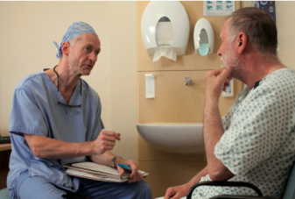
Memory for AAGA
Previous studies have tried to elicit recall by repeatedly interviewing patients using the modified Brice procedure
1-2 per 1000
1 in 3 reported > 1 week
Wide variation in patients’ experiences of AAGA
Auditory perceptions are common, as are feelings of helplessness and fear

Slide 4
How memory works
Why so few?
Why the delay?
Can we trust them?

Slide 5
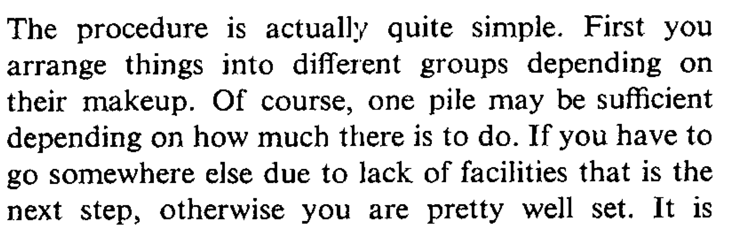
Why so few memories?
Memories are reconstructed not replayed
Need to understand the experience:
Bransford & Johnson (1972)
Need to know source of the memory (otherwise imagination or dream)
Need to have unique retrieval cues

Slide 6

Why is recall delayed?
Memories are over-written by more recent memories
Shared retrieval cues
AAGA patient regains consciousness at least twice

Slide 7
Can we trust reports of AAGA?
False memories created by inserting erroneous information
Ceci: ‘Tell me about what happened when you went to hospital’
‘Tell me about the time you heard people talking during your operation’
Reports of dreaming are different: pleasant content, unrelated to DoA, reported soon on emergence

Slide 8
NAP5 results
141 certain/probable or possible cases (1:20,000 cf 1:600 with Brice)
43% reported to another anaesthetist, 26% to anaesthetist who provided care, 15% to recovery or ward nurses
34% reported on day of AAGA, 11% day after, 52% within a week
but 25% reported after a year or more

Slide 9
Trustworthy?
Certain/probable and possible reports were supported by anaesthetic notes
Reports classed as unassessable or unlikely were typically confused about timing of peri-operative events or too sparse to interpret
Panel judged there were no malicious reports

Slide 10
Patients’ experiences
Wide variety of experiences
Only one report (‘unlikely’) of a patient interpreting dream as AAGA
Median 2 experiences
Range 0 (‘being awake’) to 8
% certain/probable and possible cases

Slide 11
Neutral reports
A patient mentioned to the surgeon overhearing a conversation between surgeons regarding the position of incision, and quoted exactly what had been discussed. The conversation had taken place in the middle of surgery, for a few seconds. The patient was interested rather than concerned.
A patient whose trachea was difficult to intubate recalled anaesthetists trying to “get the tube down and struggling” but was reassured by their care and thanked them. The patient was not distressed and thanked the anaesthetists for their care and attention.

Slide 12
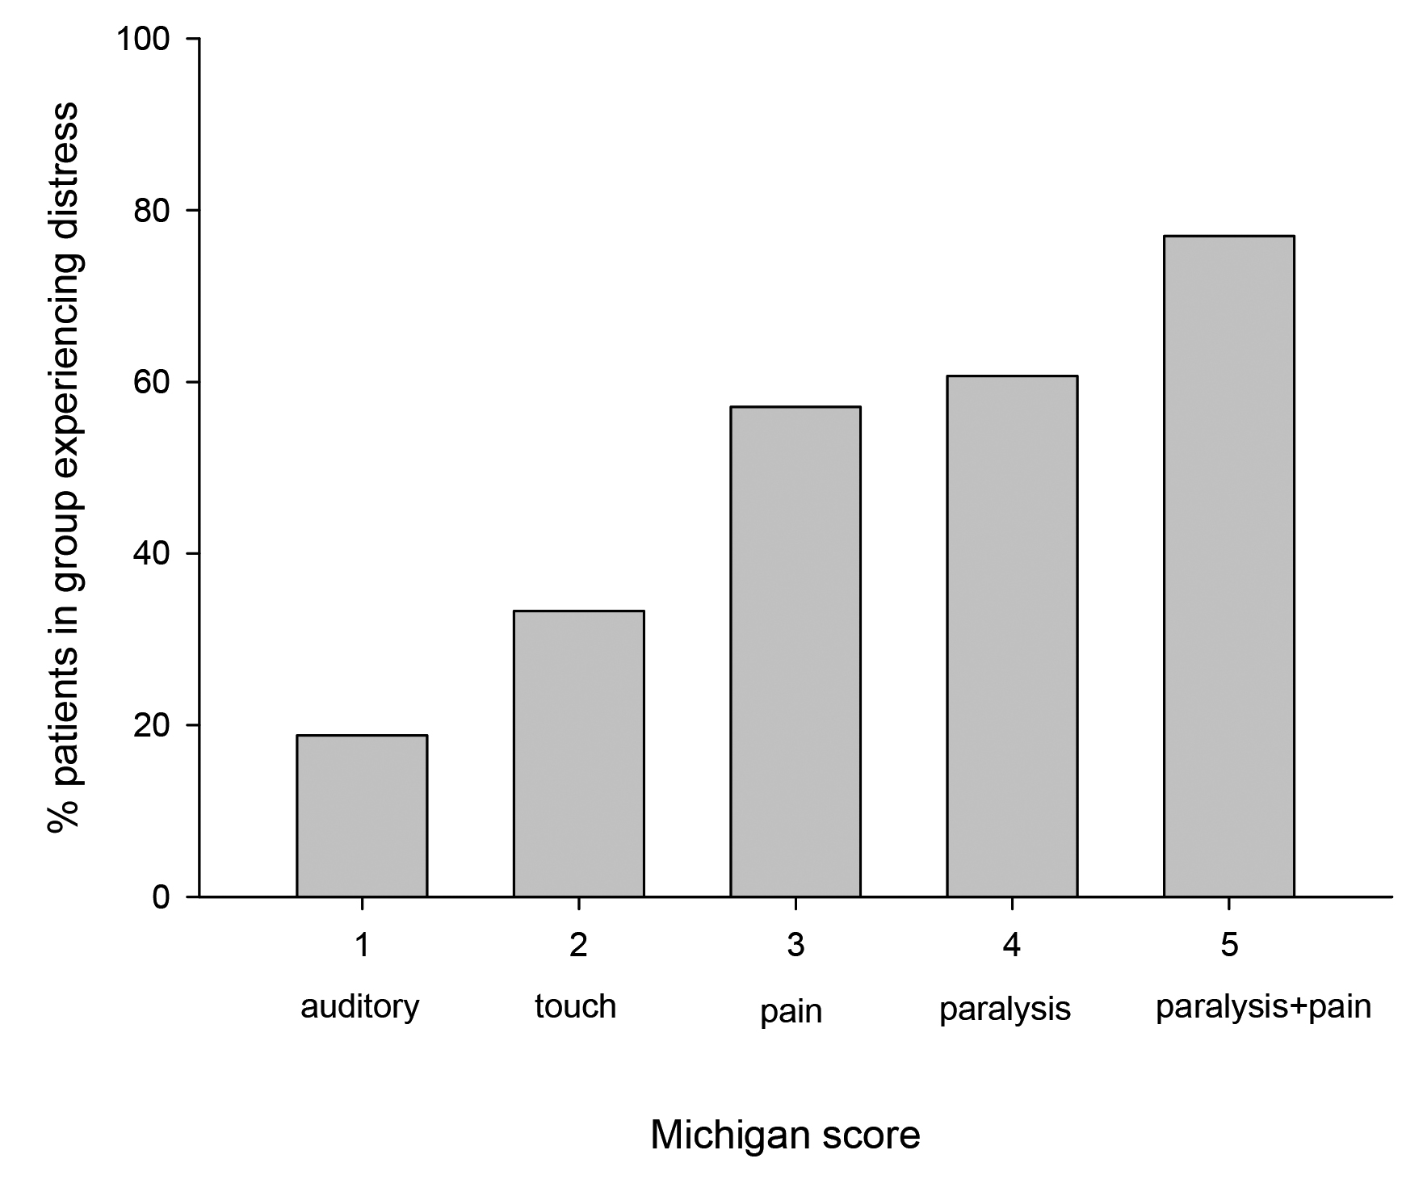
Distress
53% distress
Common in, but not restricted to, cases with pain or paralysis

Slide 13
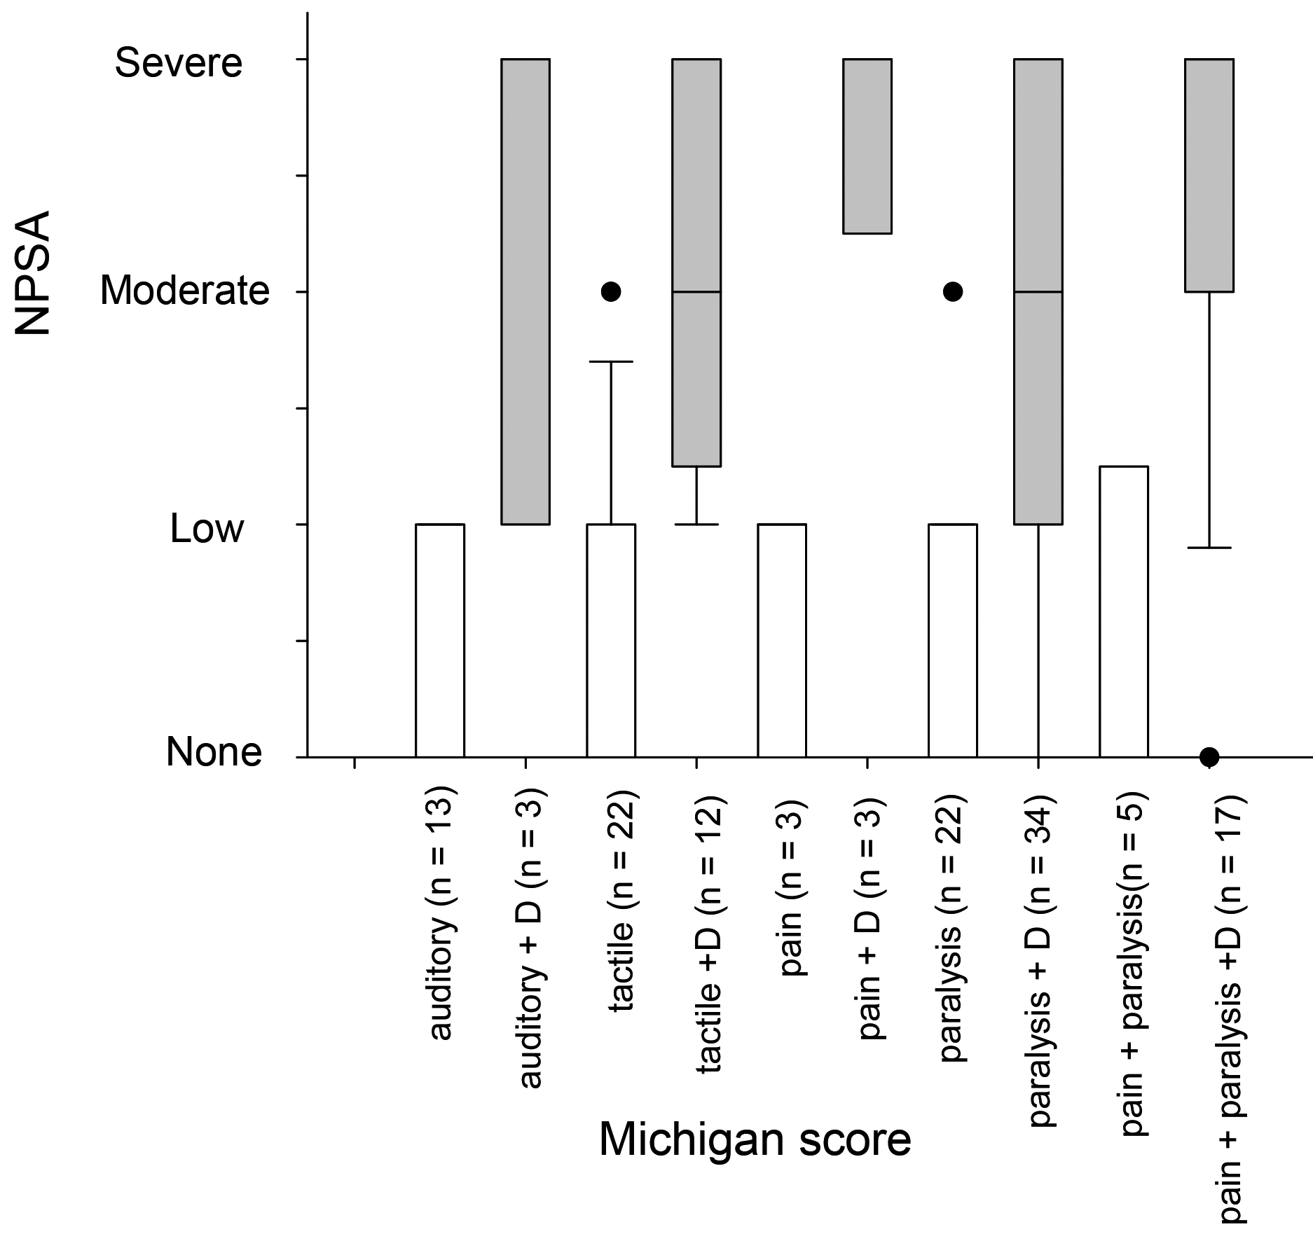
Distress
Distress during AAGA was very strongly associated with long-term psychological harm

Slide 14
Severe distress
A patient reported auditory and tactile recall of laryngoscopy and intubation and the start of surgery. The patient wanted to scream but could not move or speak.
The patient could hear everything but felt no pain, only some touch when somebody lifted their leg, and something being drawn along the leg with a pencil (as did happen), some humming, and then with no pain, an incision.

Slide 15
Duration and delay
No clear relationship between the perceived duration of AAGA and psychological impact
Brief experiences could be severely distressing
No clear relationship between reporting delay and impact
Experiences reported after a delay were no less distressing than those reported immediately

Slide 16
Understanding and reassurance
During AAGA
A patient reported hearing voices, and experiencing paralysis and abdominal pain. Wanted to ask for painkillers but could not speak. The pain was unpleasant; but the paralysis was not a great worry because the patient knew “you were supposed to be paralysed during the operation”. The patient was later not worried about having another anaesthetic.

Slide 17
Understanding and reassurance
A patient was given suxamethonium before induction inadvertently. The anaesthetist immediately recognised the error and induced anaesthesia. The patient experienced paralysis, was afraid they were dying from a stroke and had flashbacks for 2-3 days afterwards. However the patient was very reassured by the anaesthetist’s immediate explanation, "I know what’s happening and I can fix it", during the critical event and had minimal long-term sequelae.

Slide 18
Understanding and reassurance
After AAGA
A patient recalled hearing voices, seeing bright lights not being able to move or communicate and being terrified, thinking they were going to die. The patient went home and mentioned it to their family and was reassured when they all apparently had a report of awareness "…it happens to all my family – we all wake up. Please can you give me a bit more?”

Slide 19
Understanding and reassurance
After AAGA
Neuromuscular blockade was inadvertently administered without induction agent. The anaesthetist questioned the patient on recovery, who said that they had “felt and heard everything”, felt the tube going in and could not breathe, which was distressing. The anaesthetist apologised, and the patient had no adverse sequelae.

Slide 20
Research implications
Why is there a delay in reporting memories of AAGA?
  Are AAGA memories overwritten by memories of recovery?
  Are they hard to recall because partial and disconnected?
  Does it take time for patients to come to terms with their experience and feel able to discuss it?
Does repeated questioning (Brice) help patients retrieve genuine AAGA memories and allow faster intervention?
Can better psychological support mitigate impact of AAGA?

Slide 21
Recommendations
Reassure the patient during suspected AAGA
Respond promptly and sympathetically after AAGA and follow the NAP5 Psychological Support Pathway
Treat all reports of AAGA seriously, even when sparse or delayed, as they may have serious psychological impact

