Slide 1
The Baseline Surveys
Professor Jaideep J Pandit
Clinical Lead
NAP5

Slide 2
Methods
Survey
Conducted to guide main project
Conducted in 2012
All UK consultants & SAS doctors asked
about their experience of new AAGA cases during 2011
Survey co-ordinated by LCs
Published BJA & Anaesthesia 2013

Slide 3
Results
7140 consultants
5951 SAS
265 centres
82% response rate (staff)
100% response rate (centre)
Demography of dept size, yrs experience – not to be discussed here

Slide 4
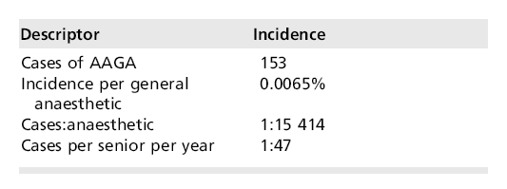
153 new AAGA cases
Using NAP4 denominator = incidence
~1: 15,000

Slide 5
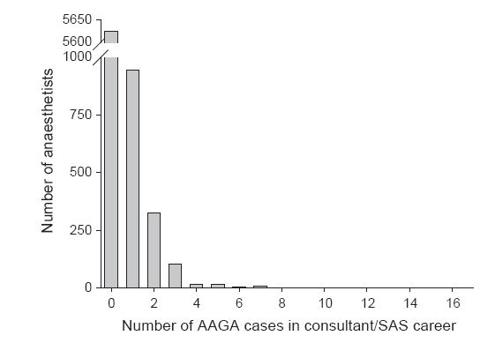
Histogram by anaesthetist in career

Slide 6
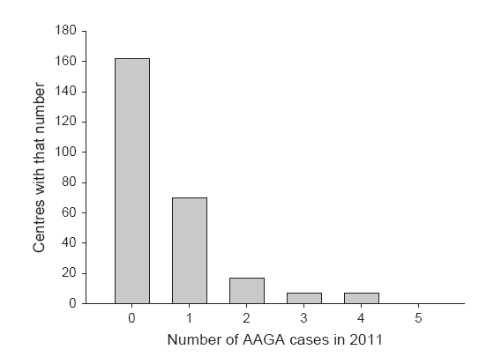
Histogram by centre for year

Slide 7
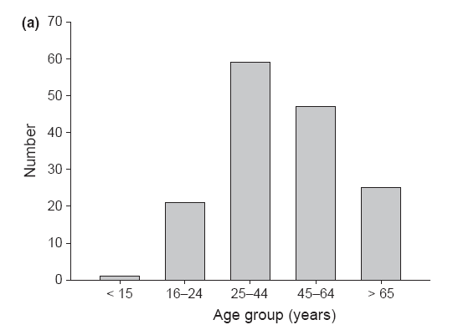
Age of AAGA cases
Most in young/middle age adults…(but no denominator)

Slide 8
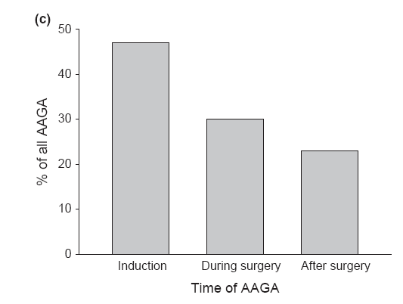
Timing of AAGA
Most in ‘dynamic’ phases of anaesthesia

Slide 9
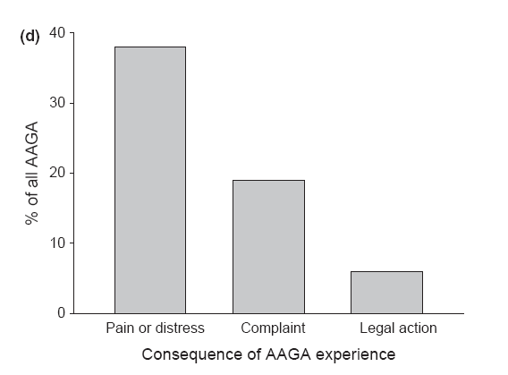
Consequence of AAGA
A minority distressed or in pain

Slide 10
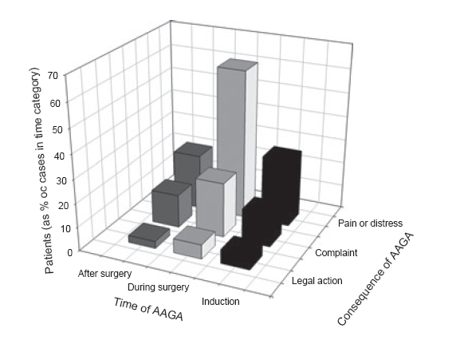
Pain/distress more likely during surgery than other phases

Slide 11
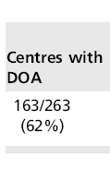
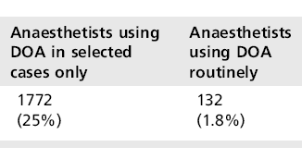
Use of DOA monitoring

Slide 12
Policies for preventing/managing AAGA
12/265 centres had any policy (4.5%)
Some were general critical incident policies; many were mini-reviews of AAGA

Slide 13
Conclusions
Baseline survey helped us plan main study
Reports of AAGA very much rarer than Brice questioning incidence (1:15,000 vs 1:600)
Most patients middle-aged
Most AAGA during induction and emergence
Pain/distress not universal (and in the minority)
Pain/distress more common with AAGA during surgery

Slide 14
Complaints or legal action very rare (<20% and <10% of AAGA cases)
Only 2/3rds centres have DOA monitor
75% of anaesthetists never use DOA
<5% centres have any relevant policies

Slide 15
Note these findings in light of main study
…will see little changed by main study; Baseline approach robust in main findings
END

