Slide 1
Summary of major findings

Slide 2
Approximately 2.9 million general anaesthetics are administered in the UK NHS each year.
Airway management
  56% SAD
  38% TT

Slide 3
Clinical themes
Poor airway assessment contributed to poor airway outcomes.
  omission,
  incomplete assessment
  failure to alter the airway management technique in response to findings at assessment.
Assessment to predict both potential airway difficulty and aspiration risk were equally important.

Slide 4
Poor planning contributed.
When potential difficulty with airway management is identified a strategy is required.
  An airway plan suggests a single approach to management of the airway.
  A strategy is a co-ordinated, logical sequence of plans, which aim to achieve good gas exchange and prevention of aspiration.

Slide 5
Failure to plan for failure.
When difficulties arose some airway management was unexpectedly difficult the response was un-structured.
All anaesthetic departments should have an explicit policy for management of difficult or failed intubation and for impossible mask ventilation and for other airway emergencies.
Individual anaesthetists should use such strategies in their daily practice.

Slide 6
Numerous cases where awake fibreoptic intubation (AFOI) was indicated but not used.
Cases suggest
  lack of skills,
  lack of confidence,
  poor judgement
  lack of suitable equipment being immediately available.
AFOI should be available and used whenever it is indicated.

Slide 7
Problems arose when difficult intubation was managed by multiple repeat attempts at intubation.
Regularly deteriorated to CICV.
It is well recognised a change of approach is required rather than repeated use of a technique that has already failed.

Slide 8
SADs were used inappropriately.
Non aspiration
  Patients who were markedly obese,
  Often managed by junior trainees,
  Aspiration
  Numerous cases during use of a first generation SAD
  In patients who had multiple risk factors
  Emergencies
  Juniors

Slide 9
SADs used to avoid tracheal intubation in patients with a recognised difficult intubation.
  Often no evidence of a back-up plan.
  If the airway is lost (e.g. due to oedema or mechanical displacement) this becomes an anaesthetic emergency.
  AFOI or FOI through a SAD before surgery may offer a lower risk alternative.

Slide 10
Head and neck surgery featured frequently in cases reported to NAP4.
These cases require careful assessment and co-ordinated planning by skilled anaesthetists and surgeons.
Excellent teamwork is required as when any part of this process fails the risk of adverse outcomes is high.

Slide 11
Management of the obstructed airway requires particular skill and co-operation between anaesthetist and surgeon.
This is best performed in a fully equipped environment with full surgical, anaesthetic and nursing support.
An operating theatre is the ideal location.
Tracheostomy under LA should be actively considered.
When surgical airway performed by a surgeon is the back-up plan preparation should be made so this is can be instantly available.

Slide 12
Complications in obese patients were twice that in the general population, this finding was even more evident in the morbidly obese.
Ignored as risk factor
particular complications
  aspiration
  SAD complications
  difficulty at tracheal intubation
  airway obstruction during emergence or recovery.
  Failure of rescue techniques
Obesity needs to be recognised as a risk factor for airway difficulty and plans modified accordingly.

Slide 13
High failure rate of emergency cannula cricothyroidotomy (60%)
  numerous mechanisms
  root cause not determined;
The technique of cannula cricothyroidotomy needs to be taught and performed to the highest standards to maximise the chances of success.
The possibility exists that it is intrinsically inferior to a surgical technique

Slide 14
Aspiration was the single commonest cause of death in anaesthesia events.
  Poor judgement
  poor assessment of risk (patient and operation)
  failure to use airway devices or techniques that would offer increased protection against aspiration.
  Several major events occurred when there were clear indications for a RSI but this was not performed.

Slide 15
Failure to correctly interpret a capnograph trace led to several oesophageal intubations going unrecognised in anaesthesia.
A flat capnograph trace indicates lack of ventilation of the lungs: the tube is either not in the trachea or the airway is completely obstructed. Active efforts should be taken to positively exclude these diagnoses. This applies equally in cardiac arrest as CPR leads to an attenuated but visible expired carbon dioxide trace.

Slide 16
One third of events occurred during emergence or recovery
  obstruction was the common cause
  POPO was described in 1 in 10 reports.
This phase of anaesthesia, particularly when the airway was difficult at intubation or there is blood in the airway, needs to be recognised as a period of increased risk and planed for.

Slide 17
The commonest cause of the events reported to NAP4, as identified by both reporters and reviewers appeared to be poor judgement. While this assessment is made with hindsight it was a consistent finding. The next most common contributory factor was education and training. Choosing the safest technique for airway management may not necessarily be the anaesthetist’s most familiar. It may be necessary to seek the assistance of colleagues with specific skills for example in regional anaesthesia or airway management.

Slide 18
In more than a third of events from all sources; during anaesthesia, in ICU and the emergency department, airway management was judged to be poor.
More often there were elements of both good and poor management. In approximately one fifth of cases airway management was judged to be exclusively good.

Slide 19
ICU and the emergency department
At least one in four major airway events reported to NAP4 was from ICU or the emergency department.
Outcome was more adverse than events in anaesthesia. Gaps in care that included:
  poor identification of at-risk patients
  poor or incomplete planning
  inadequate provision of skilled staff and equipment to
  delayed recognition of events
  failed rescue
  lack of or failure of interpretation of capnography.
  Avoidable deaths due to airway complications occur in ICU and the emergency department.

Slide 20
Failure to use capnography in ventilated patients likely contributed to more than 70% of ICU related deaths.
Increasing use of capnography on ICU is the single change with the greatest potential to prevent deaths such as those reported to NAP4.

Slide 21


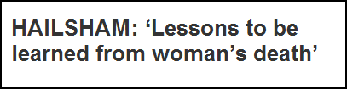
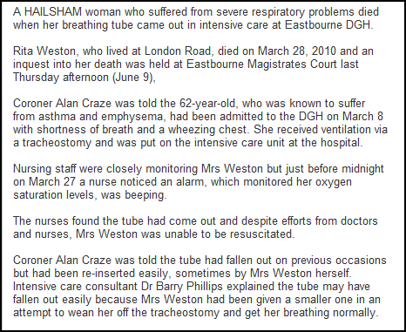

Slide 22
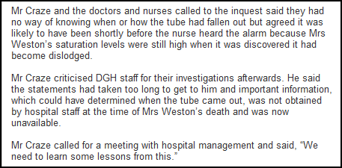

Slide 23
Displaced tracheostomy, and to a lesser extent displaced tracheal tubes, were the greatest cause of major morbidity and mortality in ICU.
Obese patients were at particular risk.
All patients on ICU should have an emergency re-intubation plan.

Slide 24
Most events in the emergency department were complications of rapid sequence induction.
This was also an area of concern in ICU.
RSI outside the operating theatre requires the same level of equipment and support as is needed during anaesthesia.
This includes capnography and access for equipment needed to manage routine and difficult airway problems.

Slide 25
Airway management is a fundamental anaesthetic responsibility and skill
Anaesthetic departments should provide leadership in developing strategies to deal with difficult airways throughout the entire organisation.

Slide 26
Interpretation of results
Many of the events and deaths reported to NAP4 were likely avoidable. Despite this finding, the incidence of serious complications associated with anaesthesia is low.
This is also true for airway management in ICU and the emergency department, though it is likely that a disproportionate number of airway events occur in these locations.
The aim of this report is that detailed attention to its contents and compliance with the recommendations will make it safer.

Slide 27
Interpretation of results
Many of the findings of NAP4 are neither surprising nor new. The breadth of the project, covering the whole of the UK for a full year, is.
NAP4 should provide impetus to changes that can further improve the safety of airway management in the UK in anaesthesia intensive care and the emergency department.
Our goal should be to reduce serious complications of airway management to zero.

Slide 28
websites
BJA full papers
  http://bja.oxfordjournals.org/content/early/2011/03/25/bja.aer058.full.pdf+html
  http://bja.oxfordjournals.org/content/early/2011/03/25/bja.aer059.full.pdf+html
RCoA full report
  http://www.rcoa.ac.uk/index.asp?PageID=1089

