Slide 1
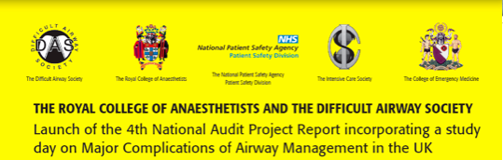
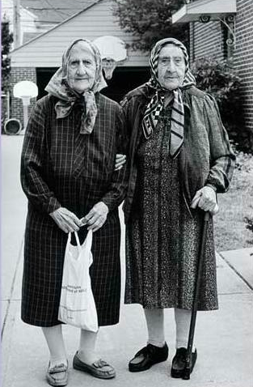


Association of Paediatric Anaesthetists of Great Britain and Ireland
Obstetrics & Paediatrics
Audrey Quinn & Ann E Black
Association of Paediatric Anaesthetists off Great Britain and Ireland
Notes:
A picture of the two of us after a particularly long day at the NAP4 panel

Slide 2

Thinking inside the box
Sub-specialties require “unique” skills in event of difficult airway
Times of standardisation and conformity
Protocols & guidelines
Helpful when faced with complex situation
Or are they?
Does this approach have limitations?
Notes:
Before I present the findings I’d like you to consider the concept of thinking inside the box which I think is what we do in subspecialties like obs & paeds

Slide 3
Aims of presentation
Obstetrics in the context of other cases
Primary findings
Key points
Notes:
In NAP4, we can stand outside our obstetric box and look at these cases in the context of the whole report.
We were able to look at how we manage obs cases differently from the non obstetric eg general surgical list.

Slide 4
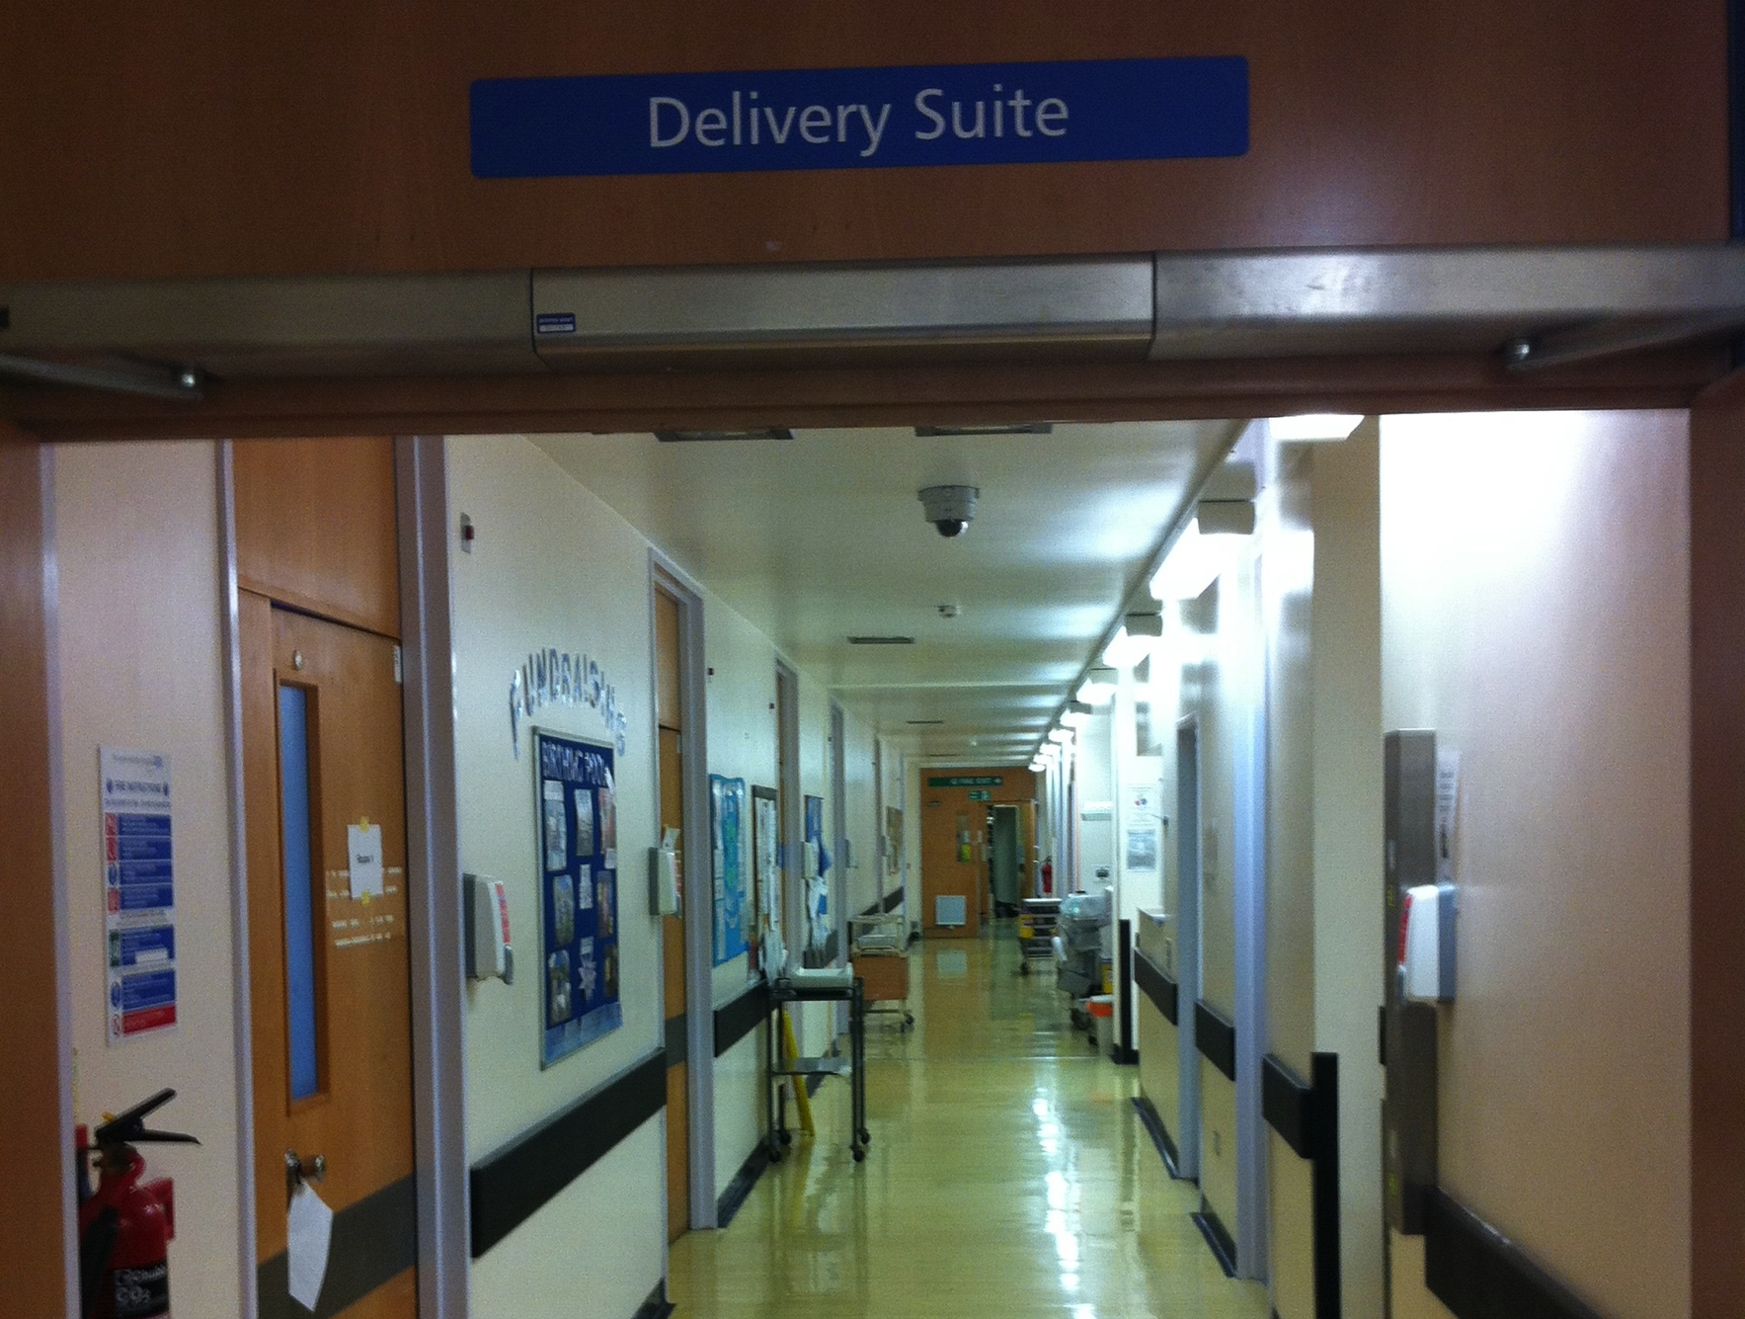
Notes:
What’s going through your mind when you’ve been called to help out here? We had 4 obstetric cases of a particularly complex nature and all made a full recovery and had live births which was great. Not possible to make robust comments but useful info. How does entering delivery suite change the anaesthetists’standard approach to a difficult airway?

Slide 5
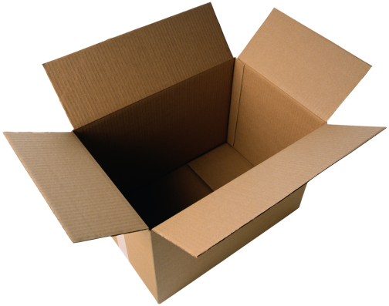
Thinking outside the box
Can we improve in obstetrics?
Alternative laryngoscope blades were not seen consistently as in non- obstetrics
In cases where a SAD was used a cLMA was always first choice. All then required an ETT.
No attempt to convert cLMA to ETT
Rescue of the airway with a cLMA failed in 50%
Rescue surgical airway also failed on one of the two cases it was attempted.
Notes:
Use of alternative laryngoscope blades were not seen consistently in the reported cases, something of a contrast to non-obstetric cases.
No SAD was converted to ETT- they were removed for repeat direct laryngoscopy or a surgical trachy was done

Slide 6
Thinking outside the obstetric box
A fibrescope was never used during GA in these patients
In one case of AFOI-this failed due to problems with “sedation and compliance”.
Midwives caring for postop patients are often not competency trained in recovery techniques
Notes:
A fibrescope was not used either to intubate directly, intubate via a SAD or to check tracheal tube placement when it was in doubt

Slide 7
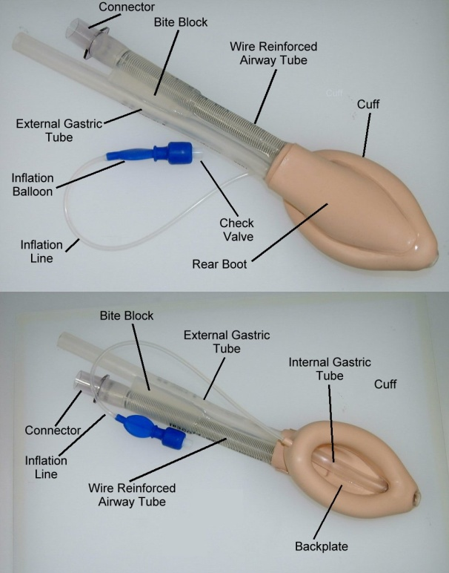
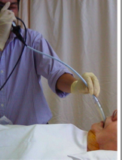
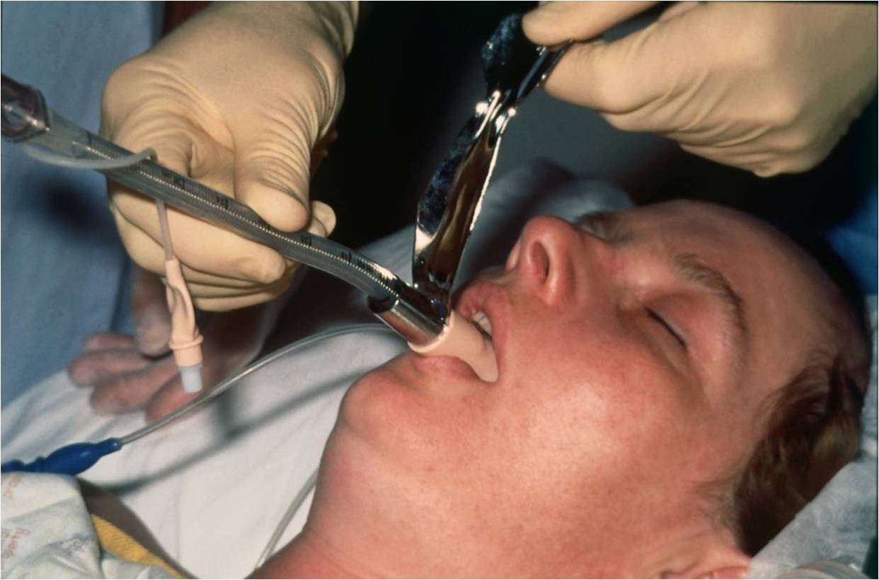

Second Generation Intubation
Notes:
The high failure rate could be explained by the fact that the obstetric patient is particularly difficult, obese, oedematous, but there the panel felt there was room for improvement. Reports are increasgly showing increased SAD use in difficult obs airways. The cLMA may be the best device but we should chose it based on our wider experience not because it’s the only one we know.- the second generation SADs that fit better and have gastric suction, and techniques to convert to endotracheal intubation using fibrescopes.
Thinking outside the box in a general surgical list we would try to try to secure the airway better.
In obstetrics the cLMA is increasingly regarded as a solution rather than interim measure in secure in protecting the airway.

Slide 8
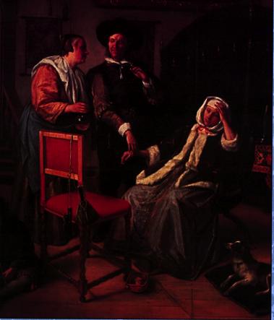
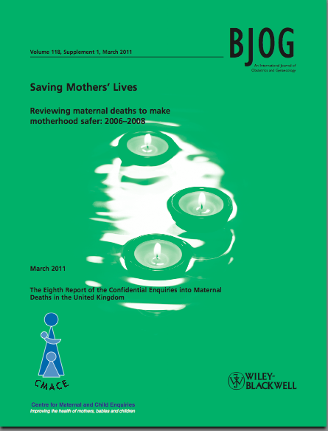
Something to be proud of
Notes:
There is no doubt our airway complications have markedly reduced over the years - 2 airway related events in recent triennial report.
But remember this reports deaths. There are still many airway problems occurring iin this group and we had 4 reports to NAP4

Slide 9
The Primary Findings- 4 Obs cases
All were acute LUSCS (consultant involved)
All were near term, 3 obese
All complex obstetric&/or medical issues
All admitted post-op to ICU
No deaths or hypoxic brain damage
ESA?: One surgical tracheostomy postop (ENT surgeon). In another patient - failed cricothyroidotomyx2
Notes:
Admitted to ICU for observation of their airway and other reasons (e.g. aspiration, controlled ventilation following massive haemorrhage).
.

Slide 10
The 4 cases
1. Woken up, failed AFOI, failed cLMA, failed cricothyroidotomy, rescued ILMA
2. Rescued by cLMA, then gastric aspiration
3. cLMA insufficient for perioperative management of complex case, ENT trachy
4. Severe bronchospasm no capnograph trace, confusing picture. ETT
Notes:
2. No Na citrate given. Eventually blind intubation with McCoy

Slide 11
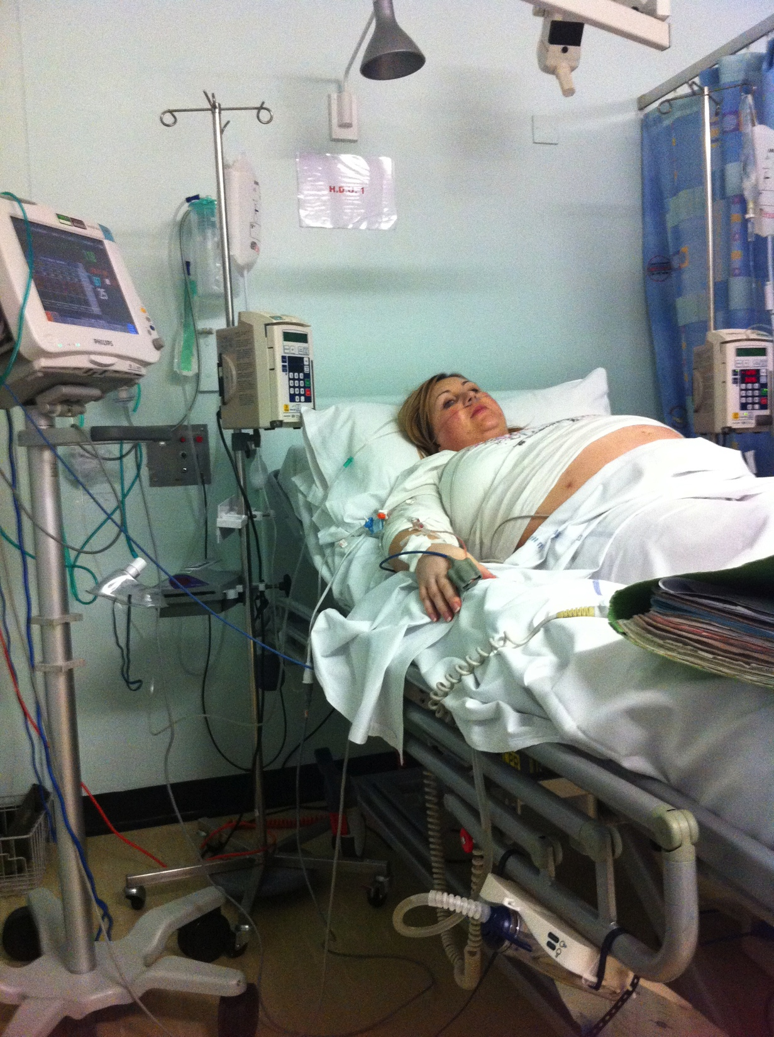
Key points
Major airway complications are rare but often complex.
Not always possible to wake
up and convert to a regional
Non-anaesthetic staff should
be aware of difficulty of cases.
Notes:
It is not always possible to wake up the patient and convert to a regional
(e.g. failed block, ongoing surgery) This should be recognised in preparing failed intubation strategies.

Slide 12
Key points
Staff in recovery of a delivery suite must be competency trained.
Consultants from other disciplines may not fully understand issues of choice of anaesthetic
Management decisions of complex patients requires close collaboration when forming initial and back-up plans.
Notes:
Skills must be regularly updated

Slide 13
Key points
Obstetric anaesthetists should be familiar and skilled with SADs for rescuing and protecting the airway +/- ETT.
A flexible fibrescope may have several roles in obstetric setting.
Anaesthetic departments should provide training, skills and equipment to deliver awake fibreoptic intubation in obstetrics
Notes:
Despite the relative infrequency of general anaesthesia obstetric anaesthetists need to maintain their airway skills including strategies to manage difficult intubation, failed intubation and CICV. Obstetric anaesthetists should be familiar and skilled with SADs for rescuing the airway: particularly those protecting from aspiration and to facilitate ventilation and or intubation.

Slide 14
“The patient had a lumbo-peritoneal shunt in situ. Prior neurosurgical advice ..labour and regional anaesthesia were contraindicated”
“It is essential to have properly trained support staff 24 h a day… reported as a problem area… in some cases vital equipment was not immediately at hand and led to delays”
“ Patient was woken up then AFOI: this failed..the patient was left to labour with midwife in the OR using entonox…for poorly understood reasons the patient suffered a cardio-respiratory arrest..”
Notes:
These quotes from the reports or chapter serve to highlight some of the principles discussed

Slide 15
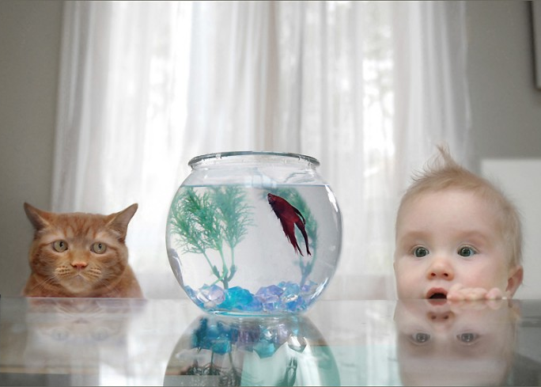
Notes:
So I hope I have given you some food for thought and pass you to Ann to summarise the paeds findings

Slide 16

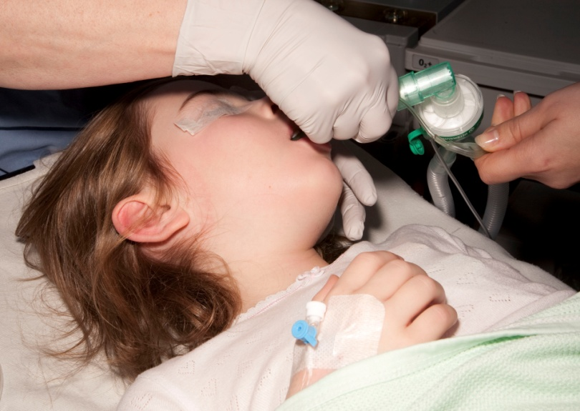
Paediatrics
What are children
Key points: What are the main differences
    Pre op airway assessment
    Monitoring
    SGD use
    Surgical airway use
Notes:
In NAP4 there was lots of discussion and shifting goal posts re age to be included, 0-16 decided on, older 16-21 had more adult pathology and management.
There are interesting differences in the management of adults and children which became apparent in NAP4.
It is worth questioning whether these are valid.
16

Slide 17
13 paediatric cases
11 cases anaesthetic (7% of anaesthetic cases), 1 ER, 1 ICU
Tracheal tube majority
1 LMA

Slide 18
Primary causes of airway difficulty related to anaesthesia:
Failed intubation 2
Blocked airway 3
Airway trauma 1
Aspiration of gastric contents 1
Tube displacement 1
Problem at extubation 3
Notes:
Mostly managed with TT
Blacked airway, secretions or blood
1 FB
One LMA-patient vomited, another vomited later with TT in situ which was displaced and got into airway difficulties
Extubation: I lost TT, obstruction,

Slide 19
Reflection:
Outcome:
9 moderate level of harm
1 no harm
3 died
Airway care:
good in 2
good and poor in 5
poor in 4
not commented on in 2.
Notes:
Views of the NAP4 panel
Deaths- one in each area-see report
Bad things can happen despite good care
Obstruction in recovery
ICU & ER patients

Slide 20
Organisational issues:
Experience of anaesthetic team
Equipment / monitoring
Recovery
Organisation of services
Human factors
Notes:
Evidence of each in NAP4
Equally relevant to surgical teams
Lots of consultant involvement in anaesthesia care, we considered that this may mean that there is less chance for trainees to have experience or even observe these difficult events.
Equipment was satisfactory, though one child came to harm when the TT was removed from the OR and another because of delay in finding a correct tube in recovery.
Monitoring was used and generally satisfactory, but some cases ETCO2 not used / misinterpreted
Recovery standards not clear, several problems in recovery, bleeding, death. Blood in the airway in three, one died.
Task fixation was an issue and in several cases repeated attempts at intubation were tried despite no success.

Slide 21
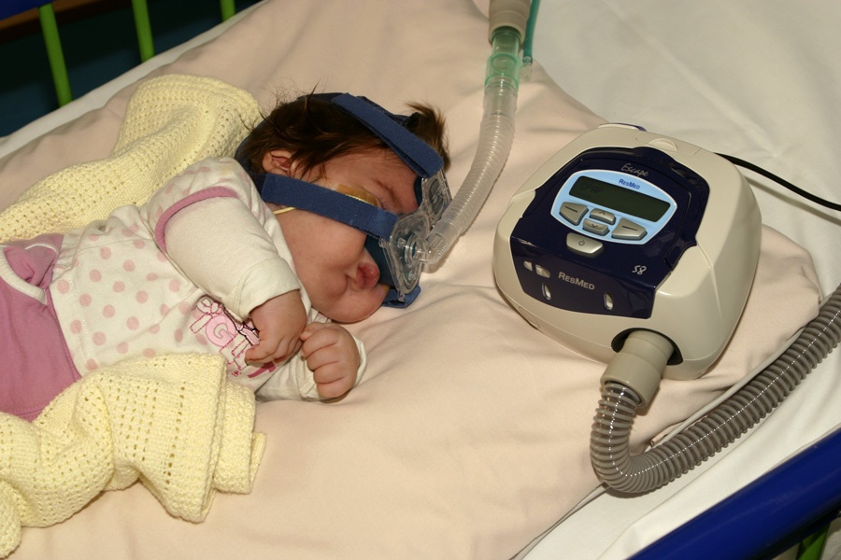
Preop airway assessment should be routine?
3/11 had an airway assessment-
Children 72% had no assessment
Adults 25-33% had no assessment
Notes:
Airway assessments brief. Tests are not validated for paediatric patients.
Two patients had anticipated airway problems noted, neither were the ones that had difficulty.
1 child was checked and did have difficulty a child with tracheal stenosis

Slide 22
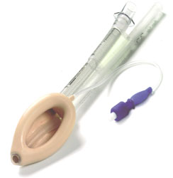
Use of SGDs > 90% =cLMA
ProSeal LMA v the Classic LMA
  Better fit
  Better VT
  Less gastric insufflation
  Higher airway leak pressure
Notes:
Index cases almost all TT
Despite evidence, newer SGDs just not used. >90% cLMA , 0.1% Proseal, and 9.9% “other”
Even in snapshot alternative SGAs rarely used. Some may feel paediatric anaes should “move with the times” ?

Slide 23
Abnormal airways: predicted difficult intubation
Tracheal stenosis
Dysmorphic baby admitted to PICU
Unpredicted difficult intubation in the apparently normal child did occur
Notes:
Predictable difficult airway usually syndromal. Very rare to have unexpected difficult airway but it does occur. Eg TS
Airway difficulty in ASA1&2 children did occur e.g. following anaesthesia for inguinal hernia
23

Slide 24
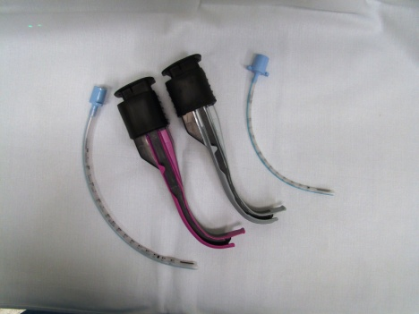
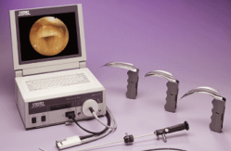
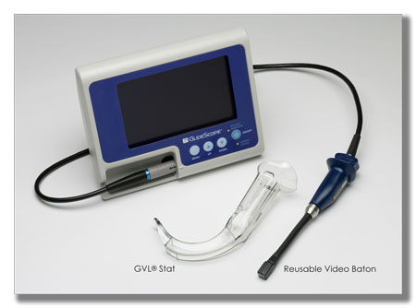
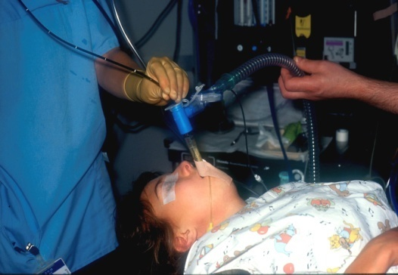
Intubation: difficult in 6. 2 died.
Direct laryngoscopy rarely an issue: 1 case in each area.
Paediatric sizes available of :
Airtraq
Intubating video laryngoscope
Glidescope
Fiberoptic scopes
Notes:
Intubation was difficult in 6. 2 died. Few cases had difficult D/L as an initial problem
Mackintosh, straight blade and occasional bougie used
Alternative laryngoscopes not used in any case.
There is little evidence based information available on airway management techniques in paediatrics.

Slide 25
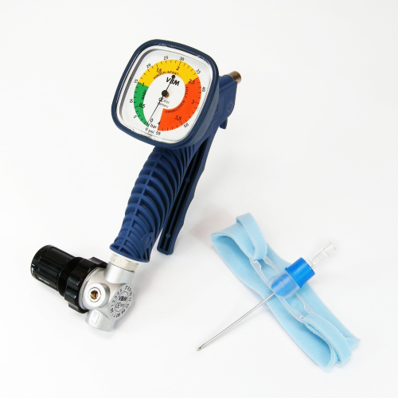
Surgical airway
CICV rare in paediatric practice
Cricothyroidotomy difficult and risky
Jet ventilation can be difficult and risky
ENT tracheostomy used more
frequently and successfully
NAP4 - ENT=4 (3)
Cric =1 (0)
Notes:
Difficult,
Brackets = success
Surgical airways used in 4 patients, two had major tracheal narrowing, one a FB in the airway.
ENT, 3 successful, 1 died during transfer for a trache
Even ENT traches can be associated with significant morbidity, one case with pneumothorax and pneumomediastinum
Anaes 1 cricothyroidotomy, not successful but intubated conventionally

Slide 26

Summary: Learning points 1
Whilst most airway difficulties are predictable, this is not always so.
More formal airway assessment would be beneficial
Monitoring at intubation is essential
Notes:
Keep an eye on them

Slide 27
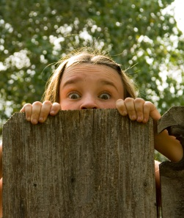
Summary: Learning points 2
Staff training for paediatric airway care and resus is essential, guidelines would be useful
Trache may be needed, get ENT help early, especially in syndromal children
Transfers are risky
Notes:
Guidelines are read,(APA & DAS) and out to consultation, which hopefully will be useful. Transfers- 3 cases of difficulty, 1 died (ICU)

