Slide 1




The Health Services Research Centre and NAP5
Mike Grocott
Director, NIAA Health Services Research Centre
Consultant in Critical Care Medicine, Southampton University Hospitals NHS Trust
Senior Lecturer, University College London

Slide 2
HSR and Anaesthesia
National Institute of Academic Anaesthesia (NIAA)
NIAA Health Services Research Centre (HSRC)
National Audit Projects (NAPs)

Slide 3
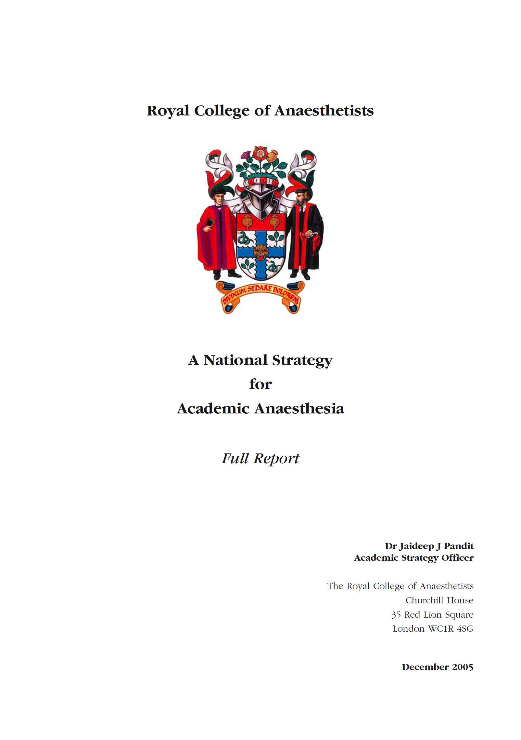

Slide 4
Decline and fall…
1940s - 1970s
UK world leading
Investigator led and initiated
Minimal bureaucracy
Core activity of consultants
1980s - 2010s
RAE and Universities
Primacy of “basic science” research
Research governance
Job market
Pandit RCoA 2005

Slide 5
Review and consultation…
EXTERNAL ADVISORS
Council of Heads of Medical Schools
Universities UK
Medical Research Council
Wellcome Trust
Department of Health
COMMENTS
No national profile
Fragmented
No strategy
Pandit RCoA 2005

Slide 6
A way forward
RECOMMENDATIONS
Institute of Academic Anaesthesia
Academic departments
Proper focus of research
Clinical training
Academic training
Medical student training
Intercalated BS/PhD
F2s
Research-active NHS consultants
Roles in research governance
Pandit RCoA 2005

Slide 7
National Institute of Academic Anaesthesia
Develop and maximise its academic profile within the healthcare profession, NHS, Universities and major research bodies
Facilitate high profile, influential research
Facilitate and support training and continuing professional education in academia
Improve patient care by promoting the translation of research into clinical practice

Slide 8
NIAA: Priorities
Engage with NIHR and DoH – PORTFOLIO RECOGNITION
Research priority setting exercise – COMPLETED 1st ROUND
Develop a national strategy - ONGOING

Slide 9
NIAA: Structure
BJA
RCoA
Specialist Societies
AAGBI
Anaesthesia
HSRC Scientific Advisory Board
NIAA Board
HSRC Executive Board
Research Training
Military Anaesthesia
Research Council
HSRC Working Groups
NIAA Grants

Slide 10

NIAA Research Council

Slide 11


Slide 12
HSRC: Background
Concept originated 2007-2009
Developed and approved by NIAA board 2008-2009
Pre-launch consultation phase 2010-2011
Launched 16th March 2011 (RCoA 18th Birthday)
Reports to the NIAA
Located at the RCoA

Slide 13
HSRC: Vision
World class centre of excellence in Health Services Research in anaesthesia, perioperative medicine, pain and the anaesthetic specialties.

Slide 14
HSRC: Clinical Scope
Anaesthesia, Perioperative Medicine, Anaesthetic Specialties, Acute and Chronic Pain.
Sub-specialty projects will, where possible, be conducted in collaboration with the relevant specialist societies and organisations.
HSR projects involving Critical Care will normally be in collaboration with the Intensive Care National Audit & Research Centre (ICNARC) who are expert in critical care HSR.

Slide 15
HSRC: Research Scope
Health Services Research (HSR)
HSR defined as research with the aim of improving patient outcomes (safety, effectiveness and experience), and evaluating the organisation, management, finances, and delivery of healthcare. It encompasses clinical epidemiology and clinical trials to demonstrate the effectiveness of interventions (phase III, health technology assessment)
Basic science (animal and ‘bench-top’) studies and early stage safety and efficacy clinical trails (phase I & II) are exluded

Slide 16
Health Services Research (HSR)
HSR = Research on people (not animals or test-tubes)
HSR aim is improving patient outcomes by evaluating the organisation, management, finances, and delivery of healthcare.
"Second translational gap” = effectiveness to implementation and beyond

Slide 17
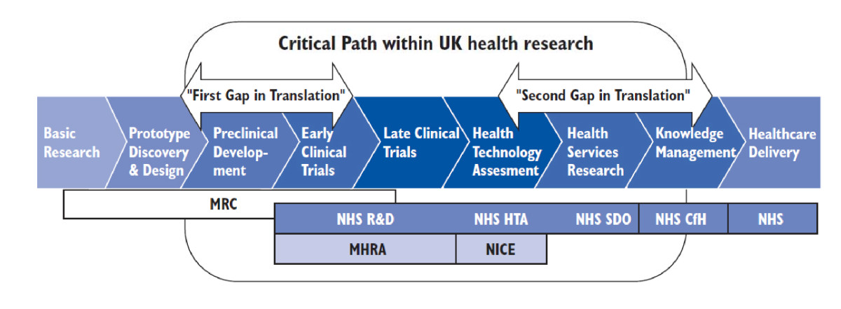
E
Cooksey HMSO 2005

Slide 18
Health Services Research (HSR)
Observational and Experimental designs
Quantitative and Qualitative methods
Mixed methods

Slide 19
HSRC: Aims
Initiating and coordinating large scale clinical audits
Methodological innovation in clinical measurement
Conducting and facilitating research to improve patient outcomes

Slide 20
HSRC: Initiatives
RCoA National Audit Program (NAPs)
Integrated Perioperative Outcomes Network (iPON)
  Hip Fracture Anaesthesia Network (HipFAN)
  Emergency Laparotomy Network (ELN)
Clinical Measures Development Program
UK Perioperative Clinical Research Forum (UKPCRF)
HSRC Fellowship Program

Slide 21
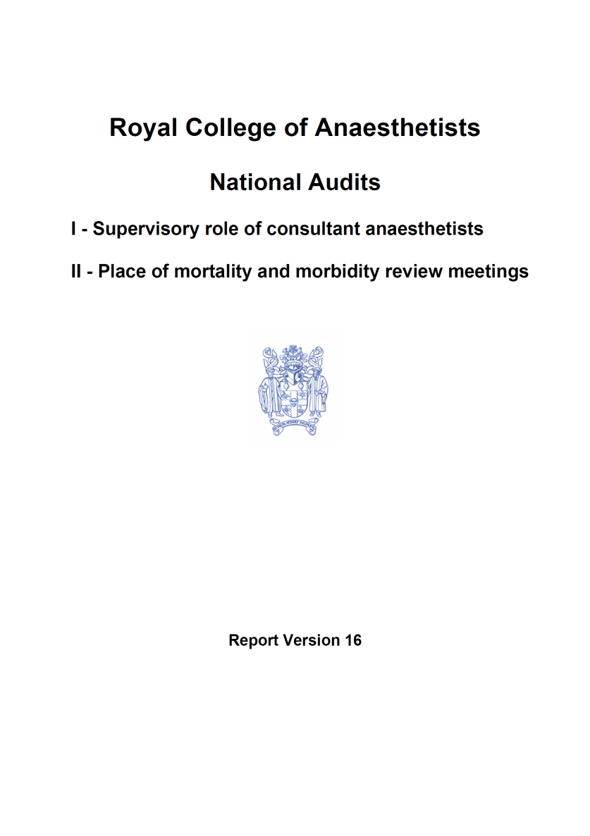
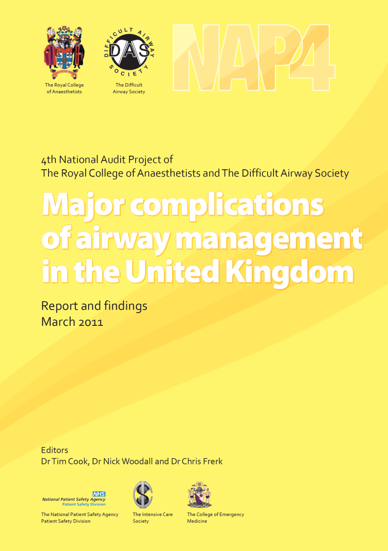
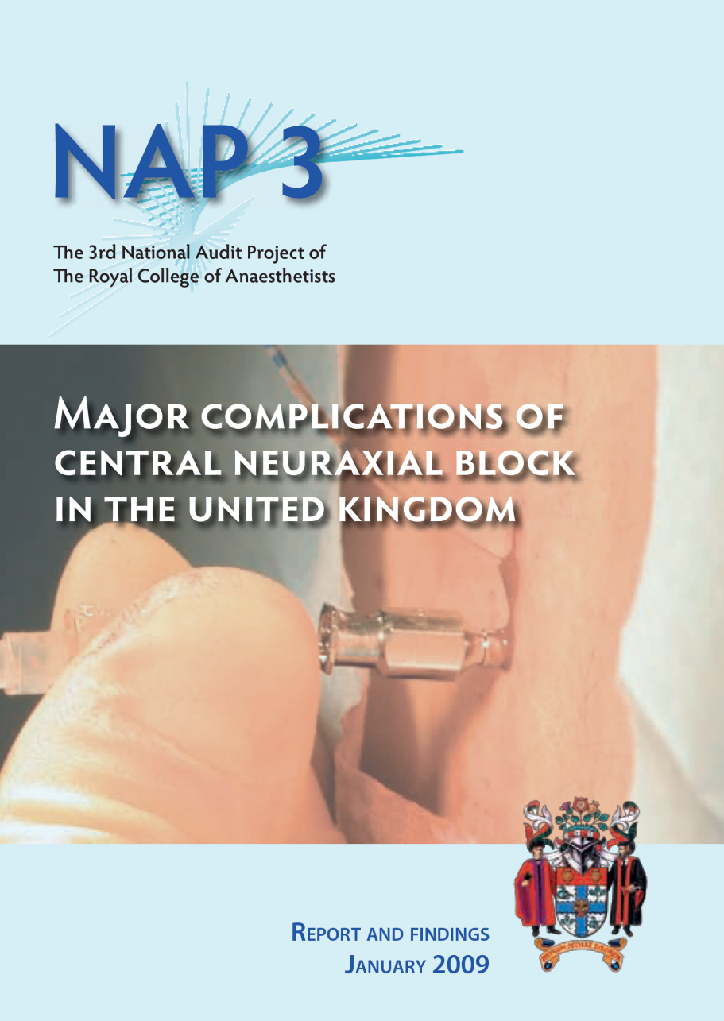

Slide 22
National Audit Projects
Discrete projects (fixed duration)
Rare events
Aims
  Incidence
  Consequences
  Lessons learned
+/- Specialist Society input

Slide 23
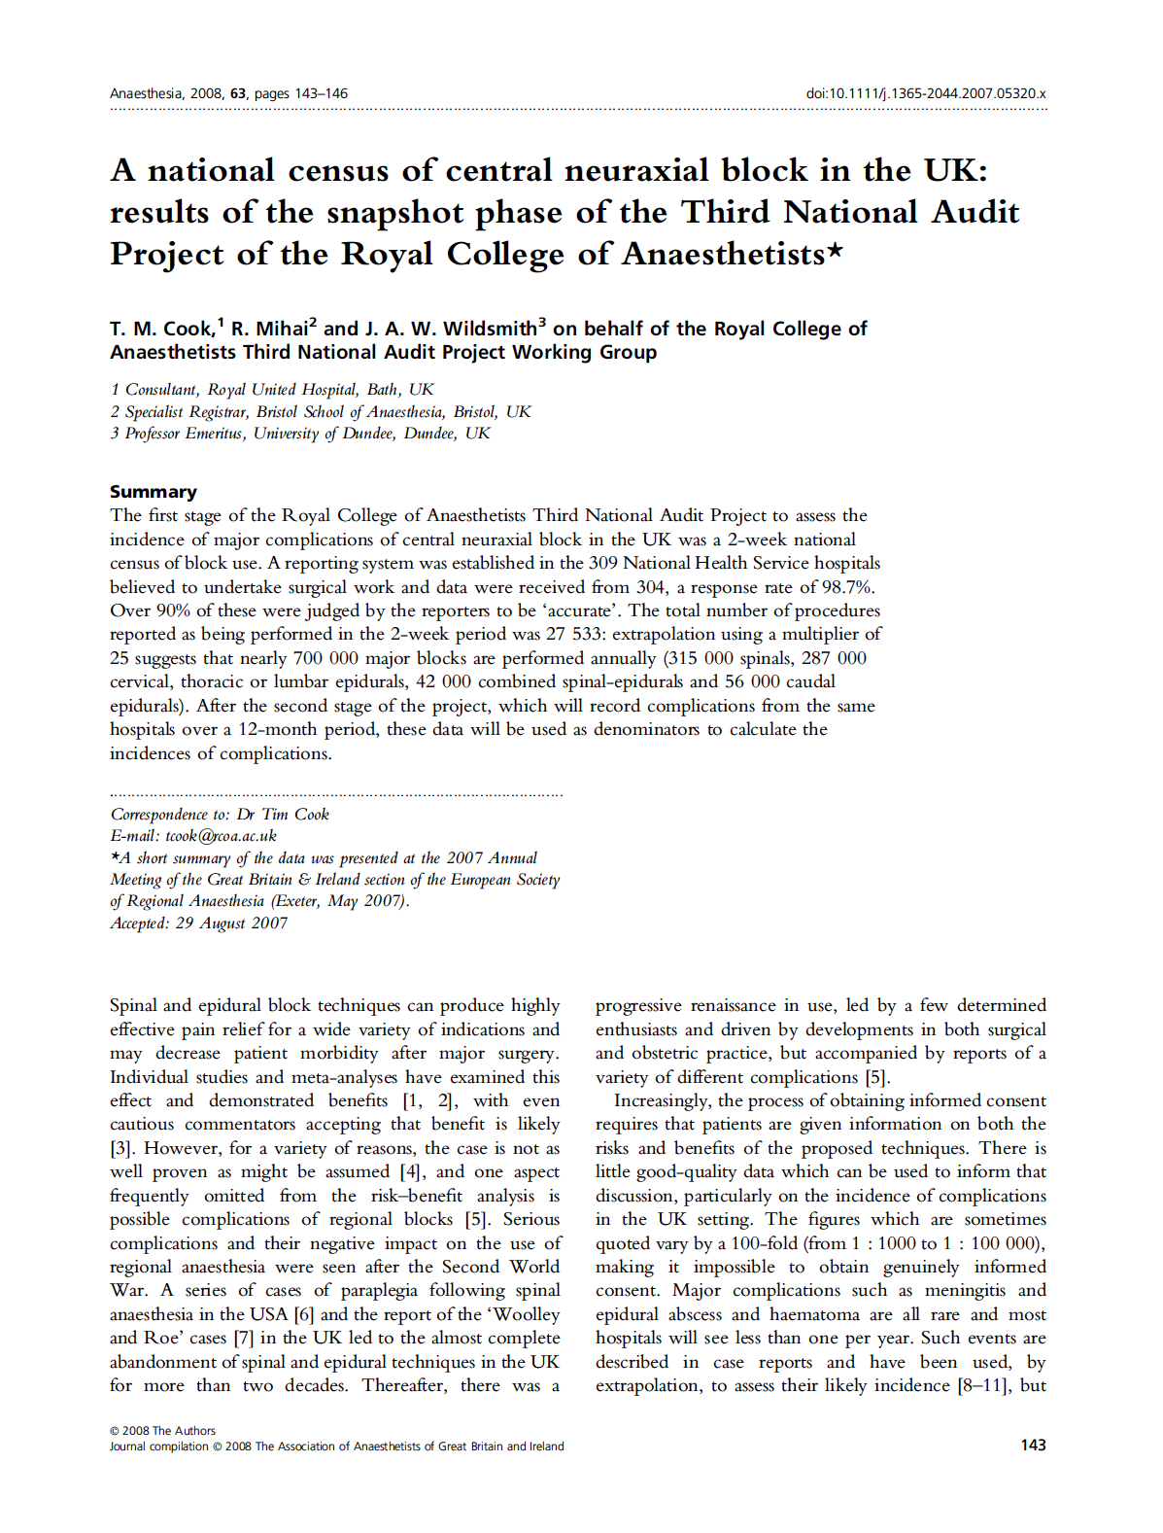
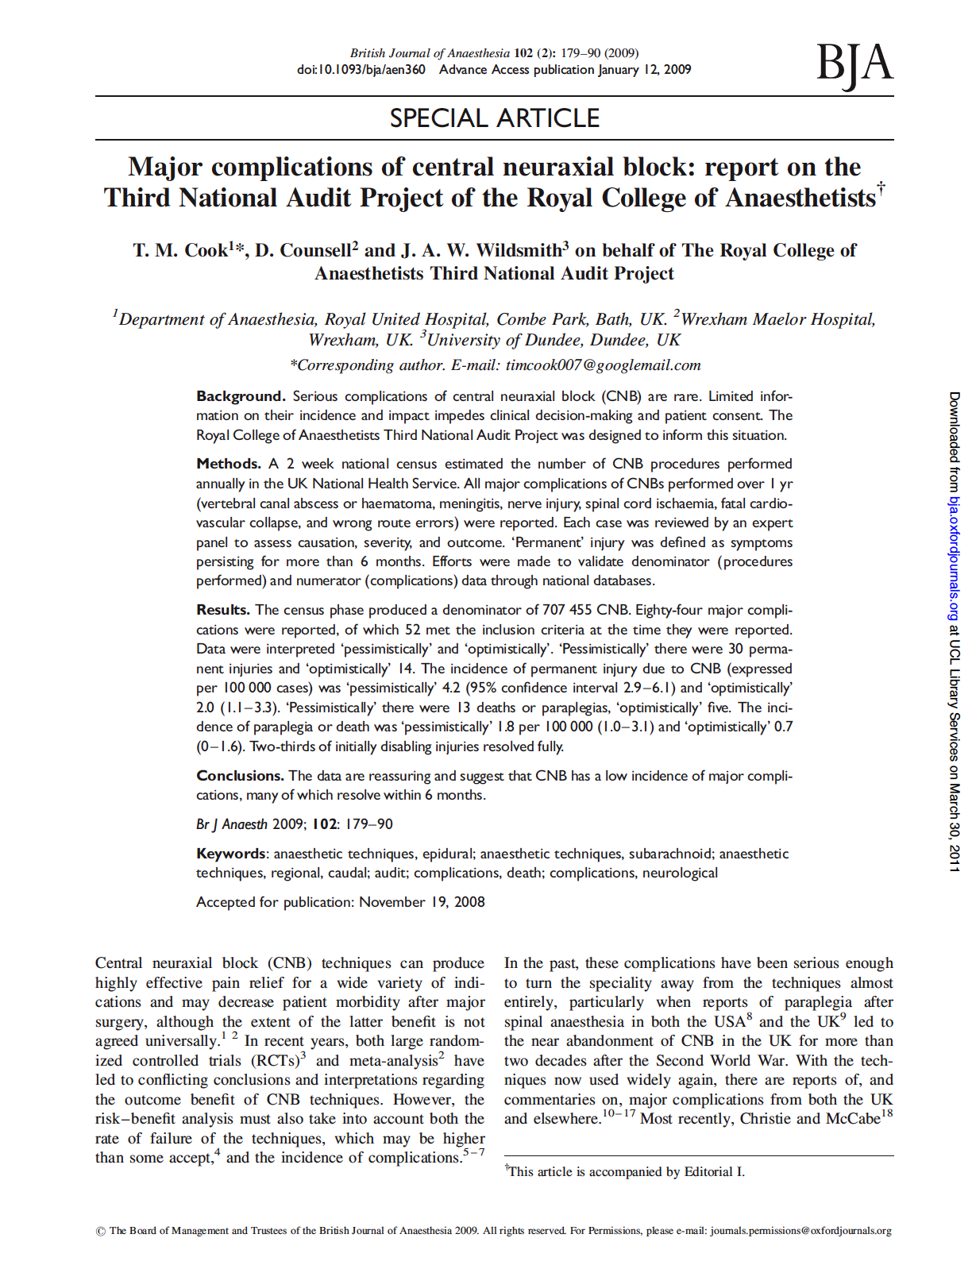
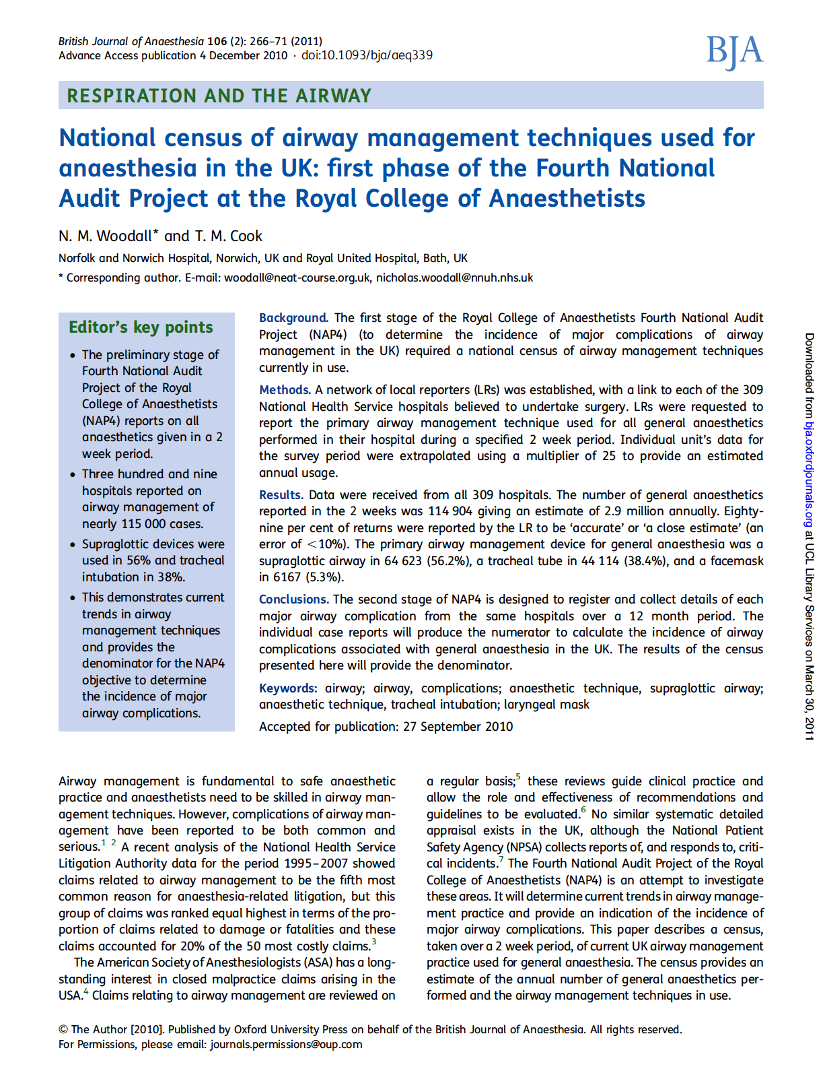
Notes:
50 citations for NAP3 report + 13 for snapshot

Slide 24
NAP5
Call for proposals (10th Feb 2011)
Review of proposals
Short list
Feasibility assessment

Slide 25
NAP6 and beyond
Open calls for proposals
Peer review
Feasibility assessment
Regular cycle
Parallel streams
Exploration of alternative methodologies

Slide 26
Summary
Congratulate NAP4 team
NAPs become part of HSRC activity
HSRC = NIAA body located at the RCoA
On-going cycle of NAPs with open calls for proposals

