Slide 1
Tracheal Tubes
David Bogod, Nottingham
March 2011

Slide 2
38%
Woodall NM, Cook TM. Br J Anaesth 2011;106:266–271

Slide 3



7%
17%
70 Theatre (73%)
96 cases overall (52%)
26 A&E / ICU (27%)

Slide 4

Theatre Cases

Slide 5
Failed Intubation

Slide 6
Failed Intubation

Slide 7
Failure Anticipated (31 cases)
Surgery for tumour or stridor
Strictures
Previous difficult intubation
Return to theatre after difficult intubation
Rescue with surgical tracheostomy or percutaneous CT

Slide 8

Case 1 - Return to theatre
Laparotomy after one week
Previous Grade III
RSI → No visible structures
Bag/mask, LMA unsuccessful
MiniTrach → awake FOI
8 min apnoea, SpO2 ↓44%

Slide 9
Failure Unanticipated
No assessment
False negative assessment
Three obstetric, one paediatric
Five CT or tracheostomy, seven non-surgical airways
No death or cerebral damage
Strong correlation with obesity (11/12)

Slide 10

Case 2 - Failed RA
BMI, diabetes, for day-case hand surgery
Normal pre-op assessment
Failed BPB
Three failed intubations, failed LMA
Peri-arrest
2nd anaesthetist successful with Mac/bougie
20 min - lowest SpO2 44%

Slide 11
Difficult Intubation - Recommendations
Airway assessment before anaesthetising a patient
Plans for failed intubation - different devices both for direct laryngoscopy and and for airway rescue
Explicit policy for management of difficult or failed intubation
Rescue techniques involving direct tracheal access should be included, and should be taught and practised
High index of suspicion for overweight and obese patients

Slide 12
Unrecognised Oesophageal Intubation
Two out of three mistaken for anaphylaxis
Problem of low output states and capnograph trace
OI may present as CV collpase
Clinical signs unreliable
Other tools, esp FOI, may be useful

Slide 13

Case 3 - Unrecognised OI
Hx of asthma and latex sensitivity
Assessment not recorded
No pre-oxygenation
BMV impossible after induction
Hypoxia and cardiac arrest
Grade III intubation
Flat trace
No action to exclude OI
CO restored but still flat trace → reintubated
Persistent vegetative state

Slide 14
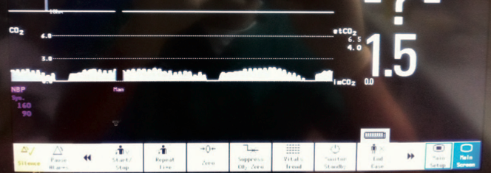

Slide 15
Unrecognised OI - Recommendations
Capnography should be used during all intubations, irrespective of location
Training in capnography interpretation, in particular abnormal but not flat trace during low cardiac output states and CPR

Slide 16
Airway Trauma
Multiple intubation attempts → swelling → ICU
Tube exchanges
Barotrauma from AEC and high pressure source
Bougie → tracheal tear, pneumothorax and mediastinum
Bougie → massive haemorrhage

Slide 17

Bougie-assisted Difficult Airway Management in a Manikin
Hodzovik I, Wilkes AR, Latto IP. Anaesthesia 2004; 59: 38

Slide 18
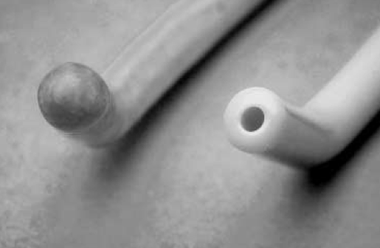
Bougie-assisted Difficult Airway Management in a Manikin
Hodzovik I, Wilkes AR, Latto IP. Anaesthesia 2004; 59: 38

Slide 19
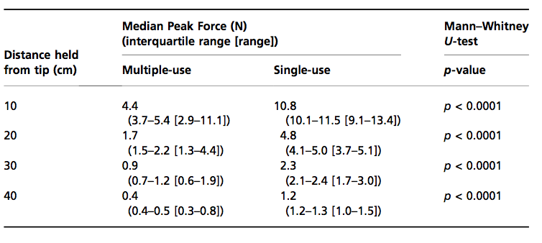
Bougie-assisted Difficult Airway Management in a Manikin
Hodzovik I, Wilkes AR, Latto IP. Anaesthesia 2004; 59: 38

Slide 20
Airway Trauma - Recommendations
Techniques that reduce the need for blind placement of a bougie or introducer probably lessen the risk of trauma. FOI and video-laryngoscopes may have a role
AECs - Depth of insertion should be limited to <26 cm; use with high pressure ventilation source should be reserved for necessity only

