Slide 1
NAP4
Introduction

Slide 2
Layout of day

Slide 3
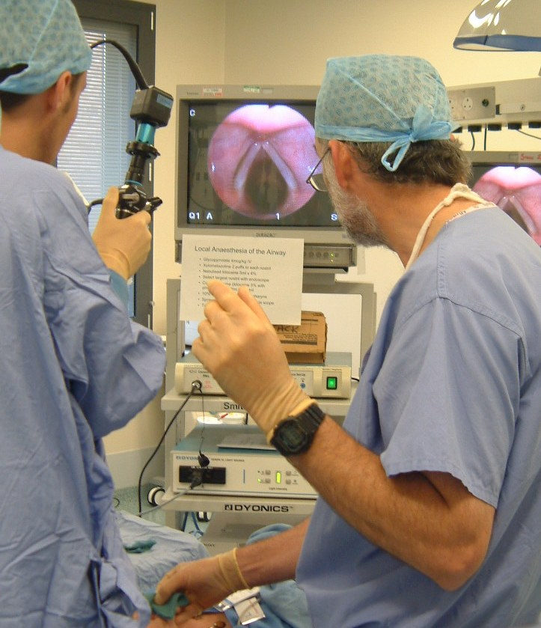
Acknowledgements
All NAP4 Local reporters
All who reported cases
All NAP4 reviewers
Nick Woodall/Chris Frerk

Slide 4
Thanks
College and council
DAS
Ralph Vaughan, John Henderson, Adrian Pearce, Mansukh Popat, Ian Calder, Chris Frerk.
Intensive Care Society
College of Emergency Medicine
National Patient Safety Agency

Slide 5
Thanks: partners
Association of Anaesthetists of Great Britain and Ireland,
Association for Peri-Operative Practice
Association of Paediatric Anaesthetists
College of Operating Department Practitioners
Intensive Care National Audit and Research Centre
Obstetric Anaesthetists Association
Paediatric Intensive Care Society
Paediatric Intensive Care network
Notes:
There was wide consultation before embarking on this project which has gained support from these bodies

Slide 6
Those who endorsed or supported
Chief Medical Officer England
Chief Medical Officer Scotland
Chief Medical Officer Wales
Chief Medical Officer Northern Ireland
Medical Protection Society
Medical Defence Union
[Patient Information Advisory Group of DH]

Slide 7
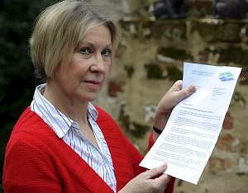

Hazel Blears's stolen laptop was not encrypted
18 JUNE 2008 JJ Robinson
Laptop stolen from communities secretary Hazel Blears contained restricted information
A computer containing information on extremism, defence and the housing market was stolen from the Salford office of communities and local government secretary Hazel Blears last weekend.
The restricted information was not encrypted, and government officials admitted breaching data security rules when sending Blears the files.
Peter Housden, chief civil servant from the department of Communities and Local Government, said that the computer was password protected and emphasised that “no damage had been done” because the documents were not classified.
Council loses data on 3,000 people
TOM POTTER
Last updated: 3/20/2009 9:25:00 AM
COUNCIL chiefs have today apologised to nearly 3,000 people in Suffolk following the theft of a laptop computer containing personal data.
Suffolk Coastal has suspended work with the contractor responsible for the potential loss of information, which was stored on a laptop stolen from the home of an employee last week.
The unencrypted data relates to licence applications submitted by pubs, taxi ranks, festivals and fete organisers and also includes details of those who had responded to consultations about licensed premises.
From The Times
August 22, 2008
Thousands of criminal files lost in data fiasco
Sean O’Neill and Richard Ford

Slide 8
Team at RCoA
Charlie McLaughlan
Mandie Kelly
Edwina Jones
Philip Fey
Bob Williams

Slide 9
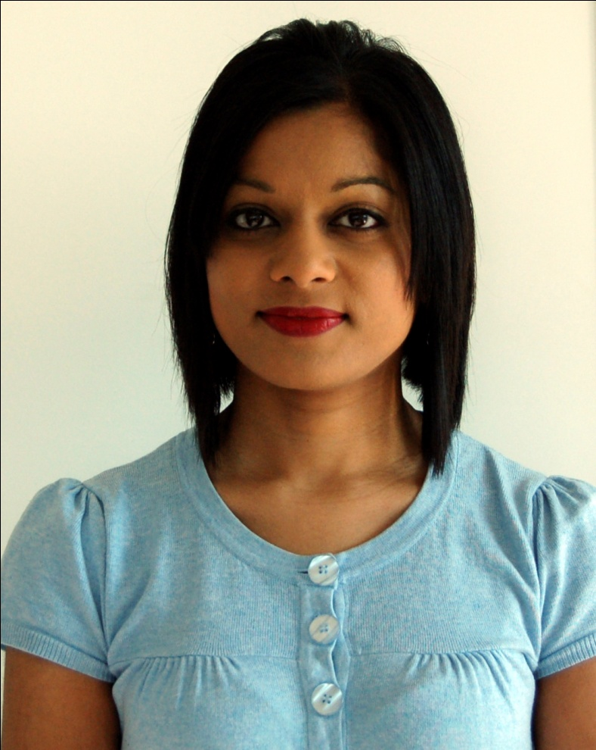
Shirani Nadarajah

Slide 10
NAP4
Why bother?

Slide 11
An e mail re NAP3 and NAP4
“Anaesthetists really were interested to know what the regional anaesthesia complication rate is.
I get the impression that they couldn't give a (monkey's) about the airway issue, since they don't envisage the same issues with consent as with regional anaesthesia.”

Slide 12
NAP4
Why bother?
Its what defines us as anaesthetists
“There is one skill above all else that an anaesthetist is expected to exhibit and that is to maintain the airway impeccably”
M Rosen, IP Latto 1984
“The most compelling educational effort for the anaesthesia community should be to reduce the frequency and severity
of complications related to managing the airway”
Jonathan Benumof 1995

Slide 13
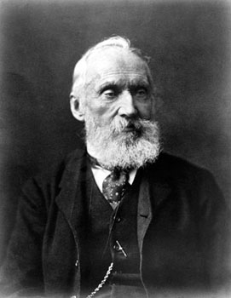
“When you can measure what you are speaking about, and express it in numbers, you know something about it; but when you cannot measure it, when you cannot express it in numbers, your knowledge is off a meager and unsatisfactory kind.”
William Thompson
(Lord Kelvin)
1824-1907

Slide 14
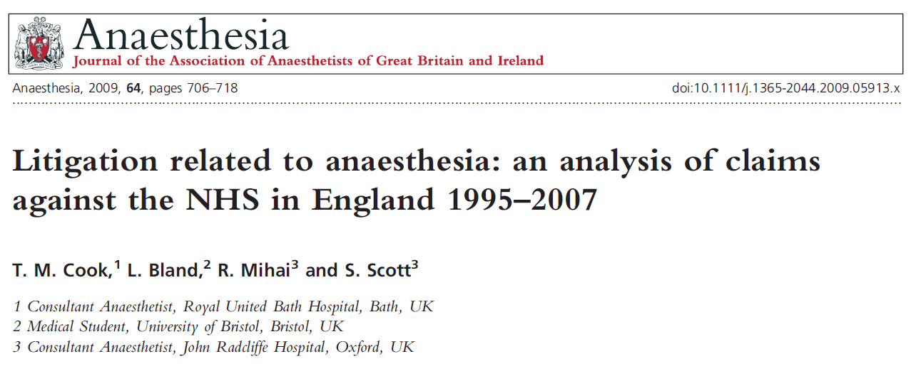
12 years claims to NHSLA in England
841 ‘anaesthesia claims’ reviewed
£31 million
Classified variously….

Slide 15
Top 5
Category | Cases | Total cost | Cost per case | Severity
Regional | 1 | 1 | 8 | 6
Obstetric | 2 | 2 | 6 | 8
Inadequate anaesthesia | 3 | 6 | 4 | 10
Dental | 4 | 12 | 13 | 11
Airway | 5 | 3 | 2 | 2
Drug error | 6 | 4 | 5 | 5
Drug allergy | 7 | 8 | 7 | 4
Respiratory | 9 | 5 | 3 | 3
CVC | 11 | 7 | 1 | 1

Slide 16
Top 5
Category | Cases 841 | Total cost £31M | Cost per case £6K | Severity 30%
Regional | 366 | £11M | 8 | 6
Obstetric | 245 | £7.5M | 6 | 8
Inadequate anaesthesia | 161 | 6 | £16K | 10
Dental | 95 | 12 | £0.1K | 11
Airway | 71 | £5.2 | £27K | 72%
Drug error | 6 | £4.3 | £13 | 24%
Drug allergy | 7 | 8 | 7 | 46%
Respiratory | 9 | £3.3 | £18K | 65%
CVC | 11 | 7 | £30K | 76%

Slide 17
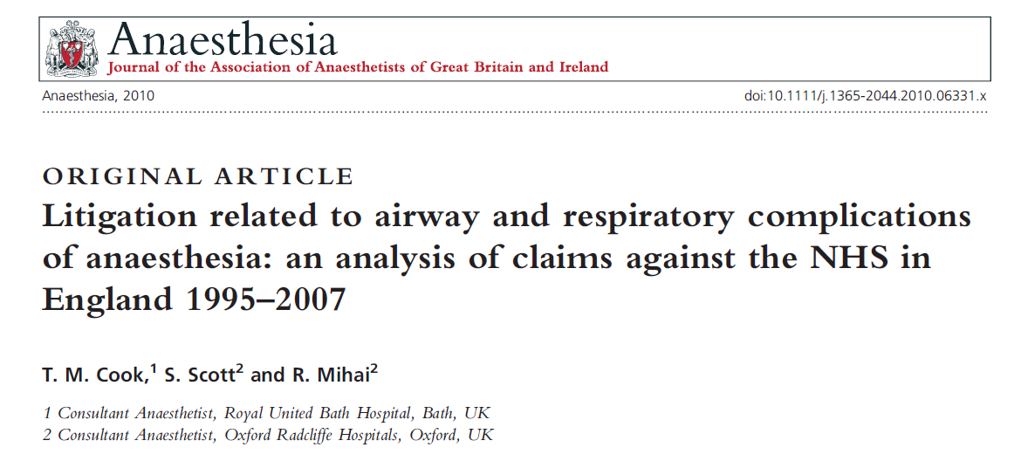
Airway
12% of all anaesthesia claims
53% of deaths in the dataset
27% of cost
10 of the 50 most expensive claims in the dataset.

Slide 18
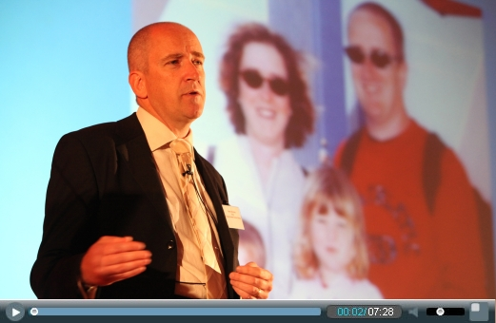

Slide 19
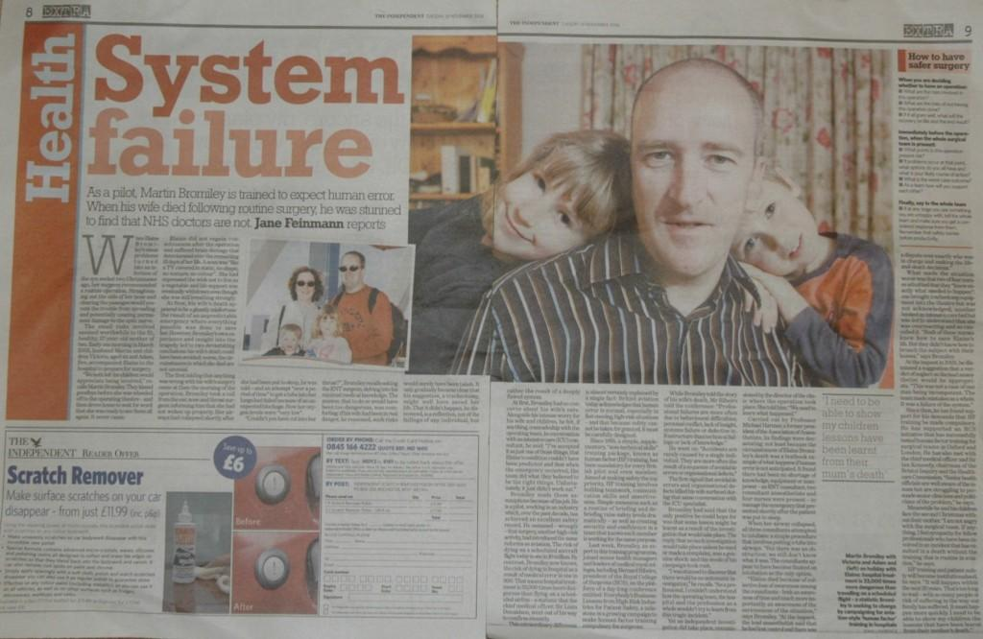

Slide 20


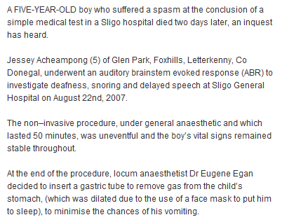
Fatal laryngospasm

Slide 21

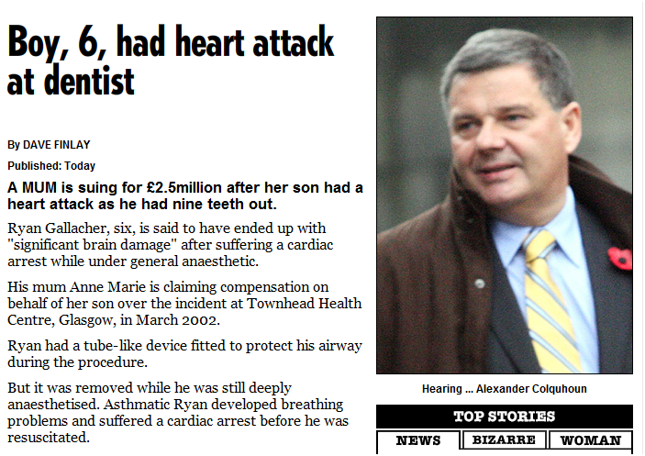
Fatal LMA problem

Slide 22


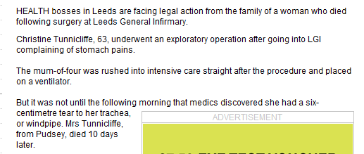

Fatal tracheal injury at intubation

Slide 23

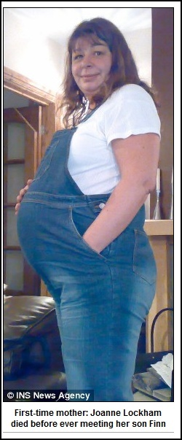
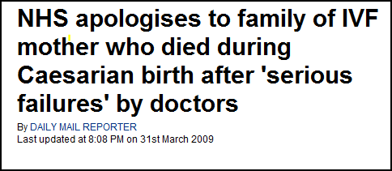
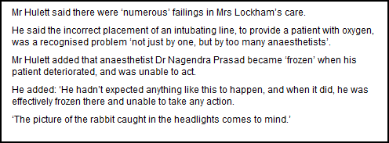
Obstetric death:
failed intubation

Slide 24
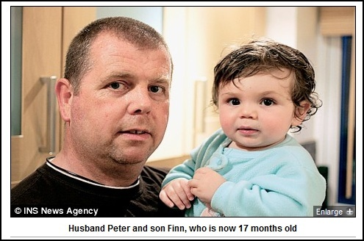
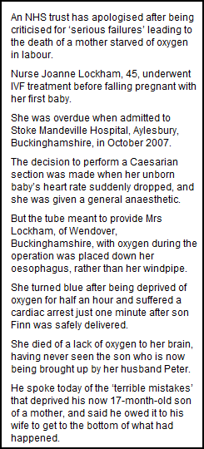
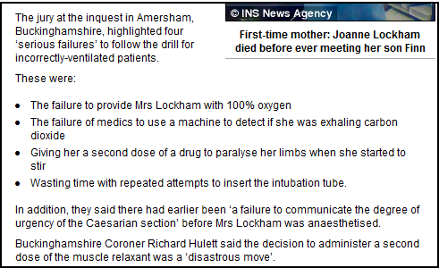

Slide 25

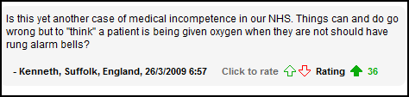
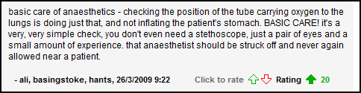


Slide 26

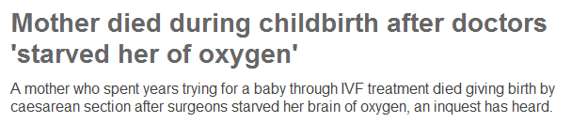
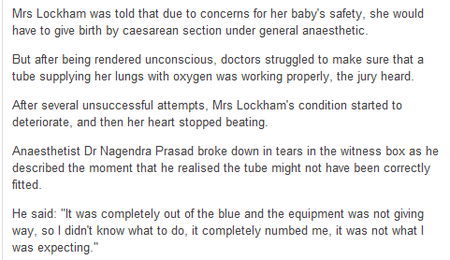
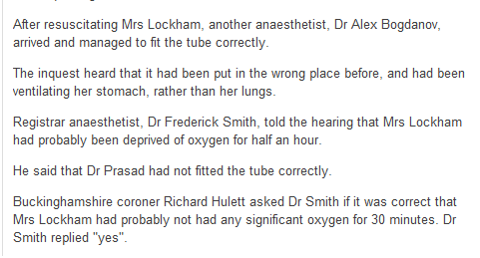

Slide 27

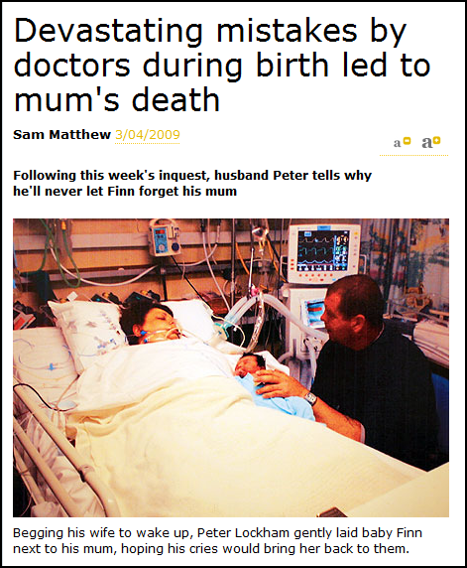
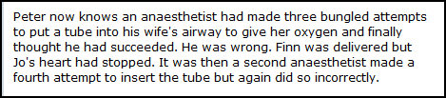

Slide 28

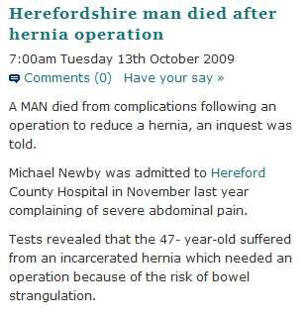
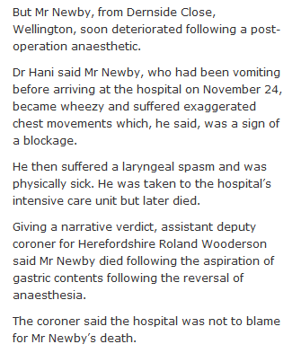
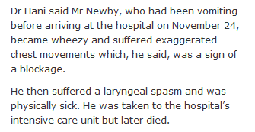
Fatal post-op laryngospasm and aspiration in recovery

Slide 29
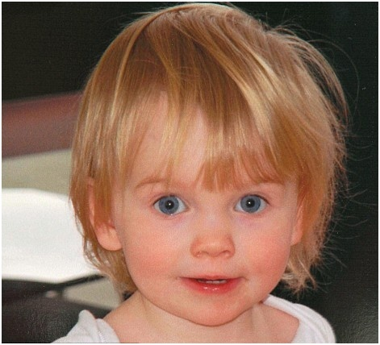
Indya Trevelyan

Slide 30
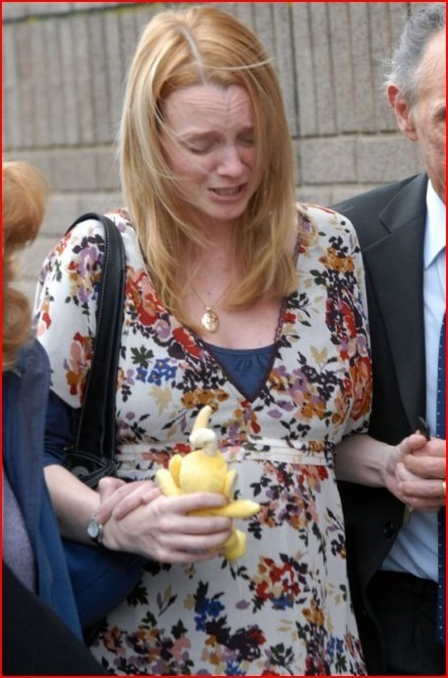

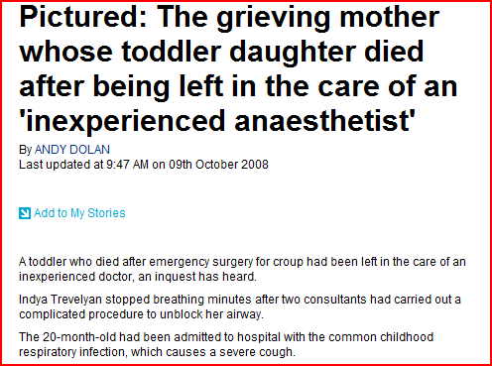

Slide 31

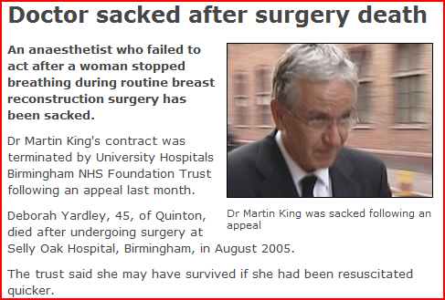
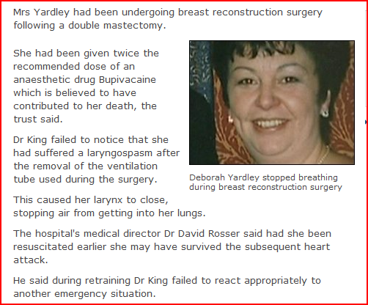
Fatal laryngospasm or obstruction

Slide 32
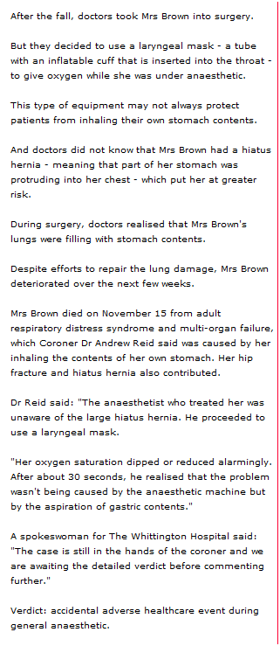

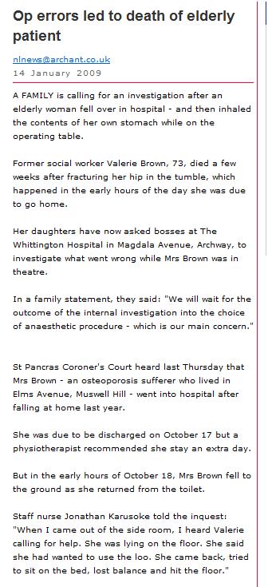
Fatal
LMA aspiration
Jan 2009

Slide 33

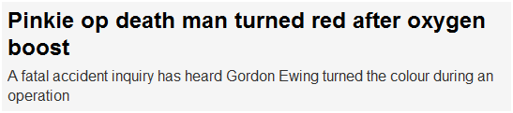

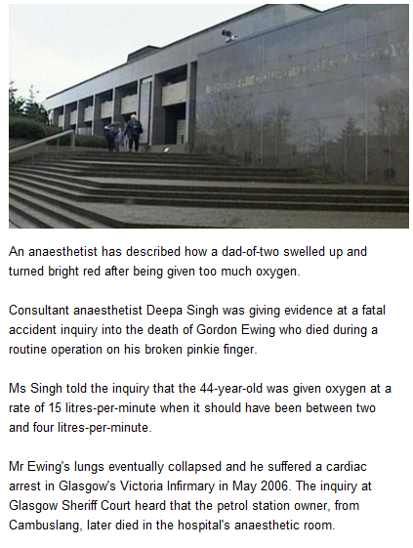
Failed intubation. Bilat pneumothorax after AEC insertion and ventilation

Slide 34
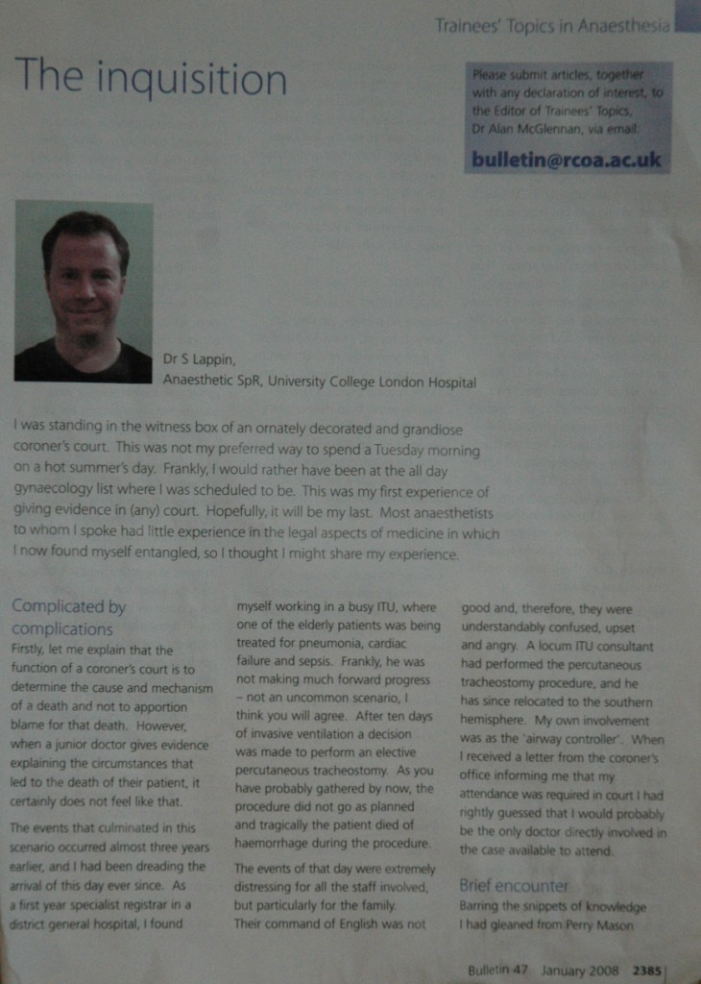
Death at PDT

Slide 35
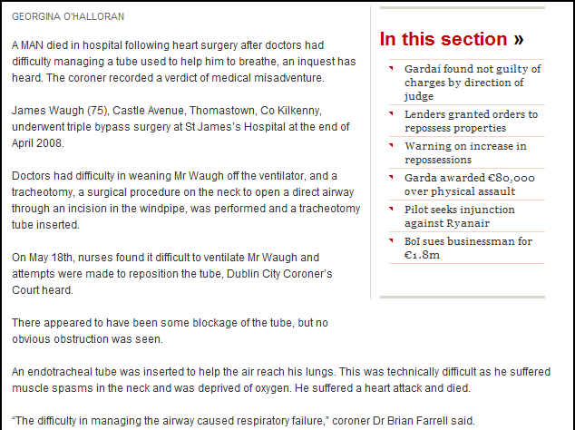
Tracheostomy blockage on ICU

Slide 36
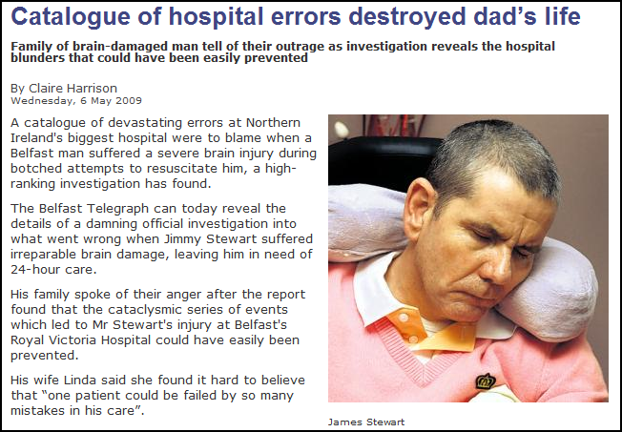
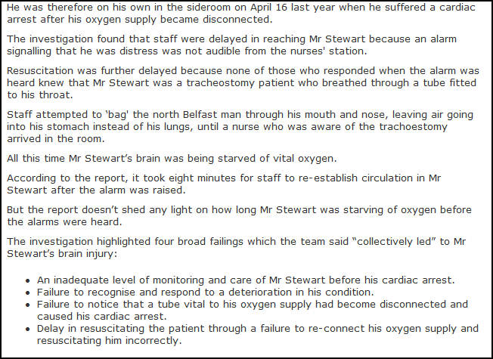

Cuffed TT disconnection on
Ventilation via BVM

Slide 37

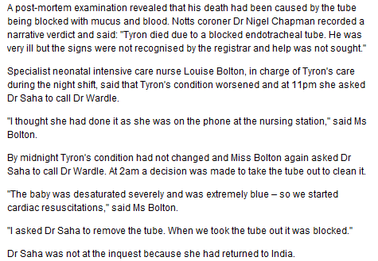
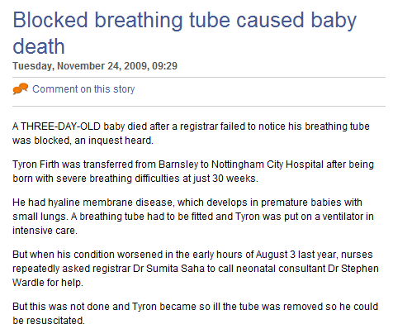
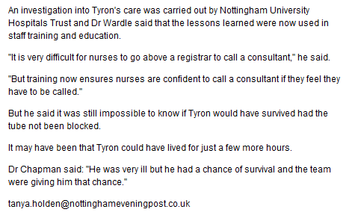
ICU blocked tube

Slide 38
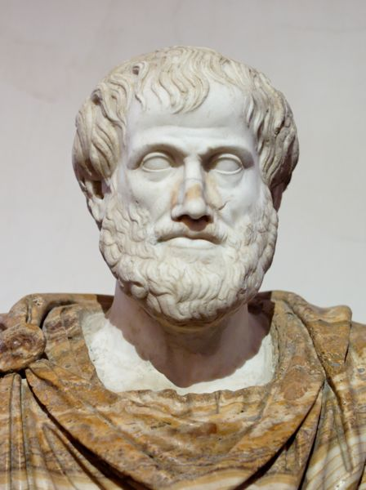
Excellence is an art won by training and habituation. We do not act rightly because we have virtue or excellence, but we rather have those because we have acted rightly. We are what we repeatedly do. Excellence, then, is not an act but a habit.
Aristotle

Slide 39
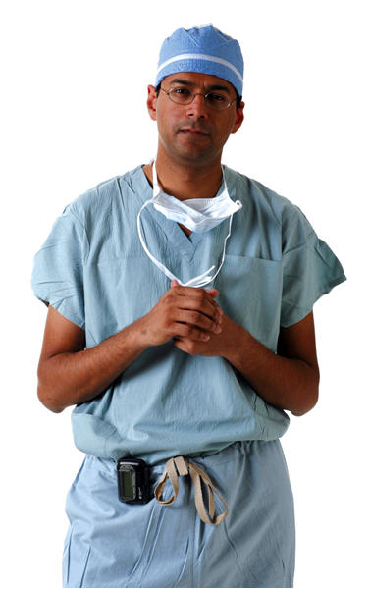
Atul Gawande
‘progress in medicine will not be made through improved technology but rather through improved application of current knowledge and activity: in short ‘doing it better’ (Gawande)

Slide 40

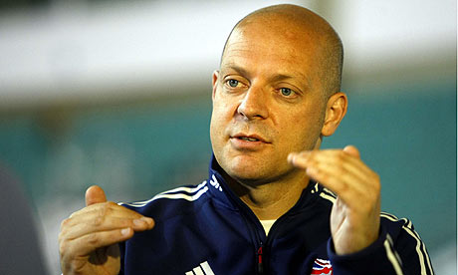
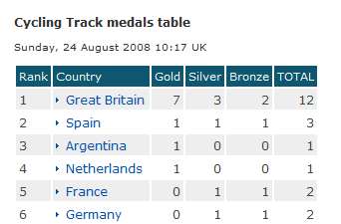
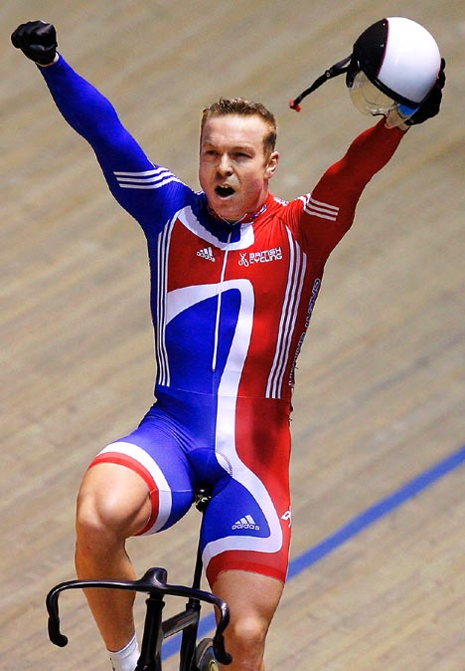
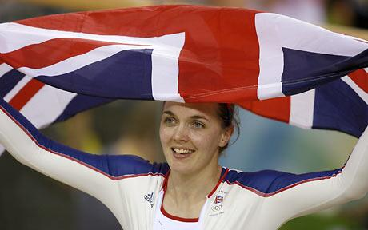
Dave Brailsford

