Slide 1

Curriculum 2021: An Introduction for Trainees
Provided by the Intercollegiate Committee for ACCS Training - ICACCST
Notes:
This presentation provides an overview of the new ACCS Curriculum for 2021. There is also a separately available set of more in-depth presentations with built-in audio/video narrative that cover the main parts of curriculum in greater detail.

Slide 2

Contents
  Rationale for new curriculum
  Background & key principles
            GPCs
            Learning Outcomes
            Entrustment
          Assessment & ARCP
          Supervision arrangements
          Transition & implementation

Slide 3


GMC: Standards and Processes
Notes:
The curriculum (along with all other training curricula) had to change to meet the new GMC standard for curricula, the latest iteration of which was published in May 2017 along with guidance on how to update curricula.

Slide 4
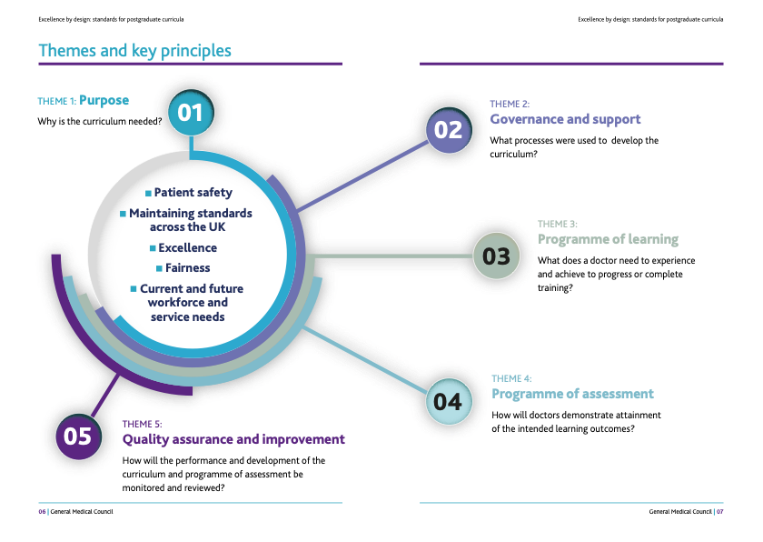
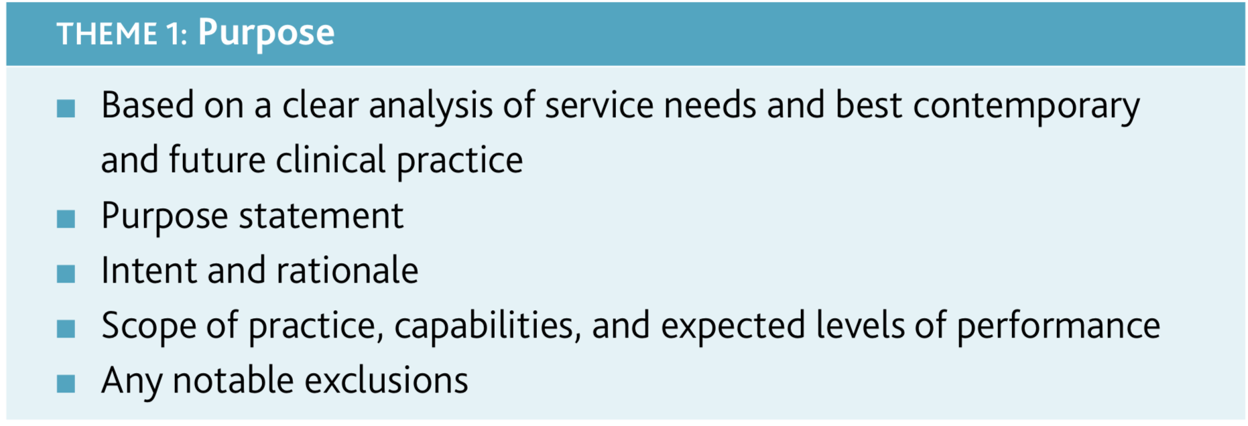
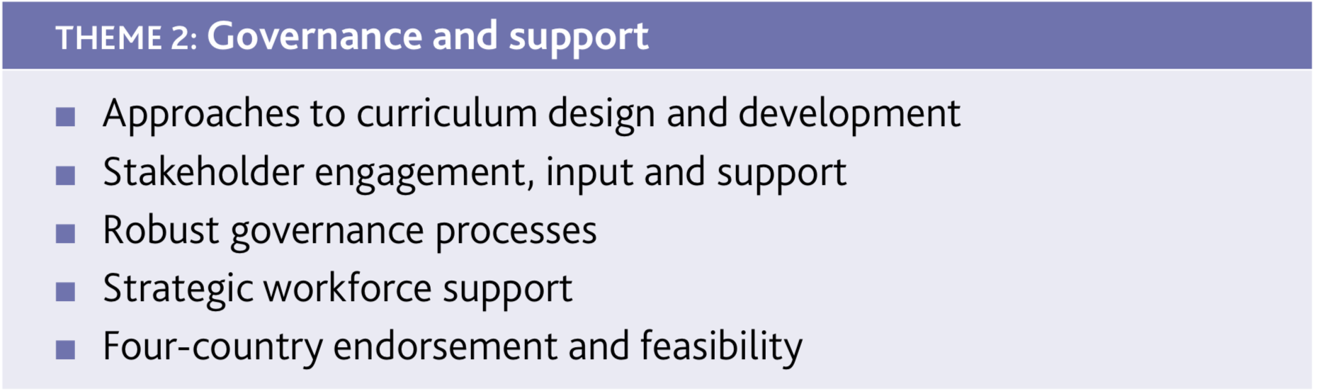
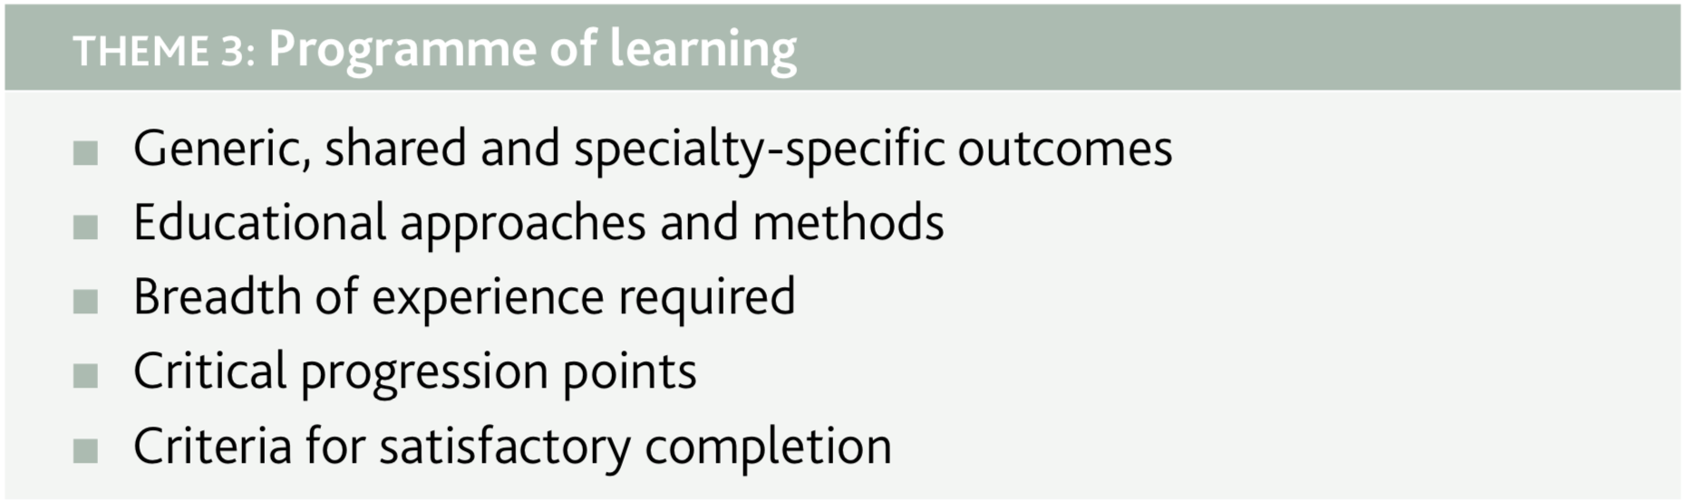
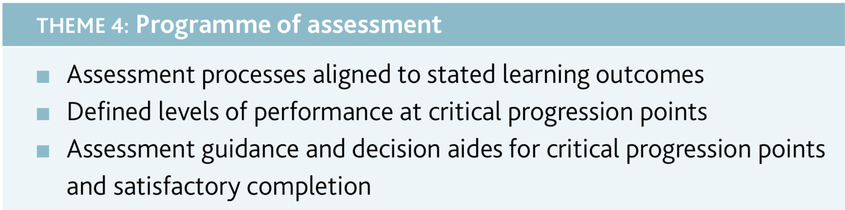

Notes:
This shows the five key themes upon which the ACCS curriculum is structured. These themes are mandatory for all curricula and essentially demonstrate what curricula are expected to deliver.

Slide 5

Generic Professional Capabilities
Matrix of educational outcomes and descriptors that states common core content required in
all postgraduate curricula
The GPC framework describes minimum GMC regulatory requirements which are essential
and critical capabilities underpinning core professional practice in the UK
Notes:
New for all curricula now are GPCs. These generic outcomes are common to all new curricula and must be explicitly included within, or referenced by, the specialty-specific educational outcomes.

Slide 6
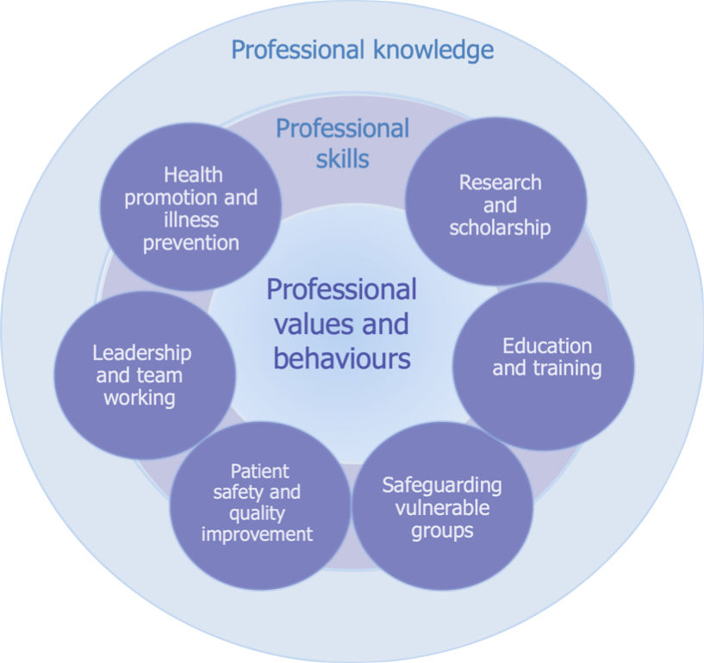
Generic Professional Capabilities
3 fundamental domains:
professional values and behaviours
professional skills
professional knowledge
6 further themed or targeted domains.
Notes:
The GPCs are set out as three fundamental domains and six themed domains within.

Slide 7
Learning Outcomes
The ACCS Learning Outcomes (ACCS LOs) describe overall, higher-level professional tasks or work within the scope of ACCS
Knowledge, skills, capabilities, behaviours and expected levels of performance a learner must acquire and demonstrate by the end of a period of education or training
Clinical ACCS LOs are based on the concept of ‘Entrustable Professional Activities’
Notes:
The ACCS curriculum has been designed around the concept of ACCS Learning Outcomes. These are common, higher-level outcomes that all ACCS trainees (irrespective of parent specialty) must achieve at the end of the two-year ACCS part of their training. The ACCS Colleges and Faculty have fully signed up to this concept, as have NHS employers and other key groups.

Slide 8
Entrustable Professional Activities
Way of translating the broad concepts of competency into everyday practice
EPAs should be thought of as the overall units of work of a physician, while competencies are abilities of individuals to carry out that work
EPAs are the clinical context for demonstrations of competences
Approach built around preparing trainees for thresholds in training – assessments are aligned to entrustment/independence
Knowing whether a trainee is ready to progress is complex, requires clear working knowledge of what the responsibilities involve, and the ability to predict how a trainee will respond when given responsibility
Notes:
These Learning Outcomes are underpinned by the concept of Entrustable Professional Activities.

Slide 9
 | ACCS Learning Outcomes | GPCs
1 | Care for a physiologically stable patient across the full range of complexity | 1,2,3,4,5,6,7
2 | Make safe clinical decisions, appropriate to level of experience, knowing when and how to seek effective support | 1,2,3,4,6,7
3 | Identify sick adult patients, be able to resuscitate and stabilise and know when it is appropriate to stop | 1,2,3,4,5,6,7,8,9
4 | Care for an injured patient across the full range of complexity | 1,2,3,4,6,7
5 | Deliver key ACCS procedural skills | 1,2,3,4,5,6,7,8,9
6 | Deal with complex and challenging situations in the workplace | 1,2,3,4,5,6,7,8
7 | Provide safe basic anaesthetic care including sedation | 1,2,3,5,6,7
8 | Manage patients with organ dysfunction and failure | 1,2,3,5,6,7
9 | Support, supervise and educate | 8
10 | Participate in research and manage data appropriately | 9
11 | Participate in and promote activity to improve the quality and safety of patient care | 6
Notes:
This illustrates the eight Clinical and three Generic ACCS Learning Outcomes.

Slide 10
ACCS Entrustment Scale
Entrustment Level | Descriptor
1 | Direct supervisor observation/involvement, able to provide immediate direction or assistance
2a | Supervisor on the ‘shop-floor’ (e.g. ED, theatres, AMU, ICU), monitoring at regular intervals
2b | Supervisor within hospital for queries, able to provide prompt direction or assistance and trainee knows reliably when to ask for help
3 | Supervisor ‘on call’ from home for queries, able to provide directions via phone and able to attend the bedside if required to provide direct supervision
4 | Would be able to manage with no supervisor involvement (all trainees practice with a consultant taking overall clinical responsibility)
Notes:
This is the entrustment scale used to rate trainees based on the concept of degree of independence. It was agreed in conjunction with the parent Colleges and Faculty to ensure consistency with their curricula to ensure a smooth transition from ACCS into the third year of training for all trainees.

Slide 11
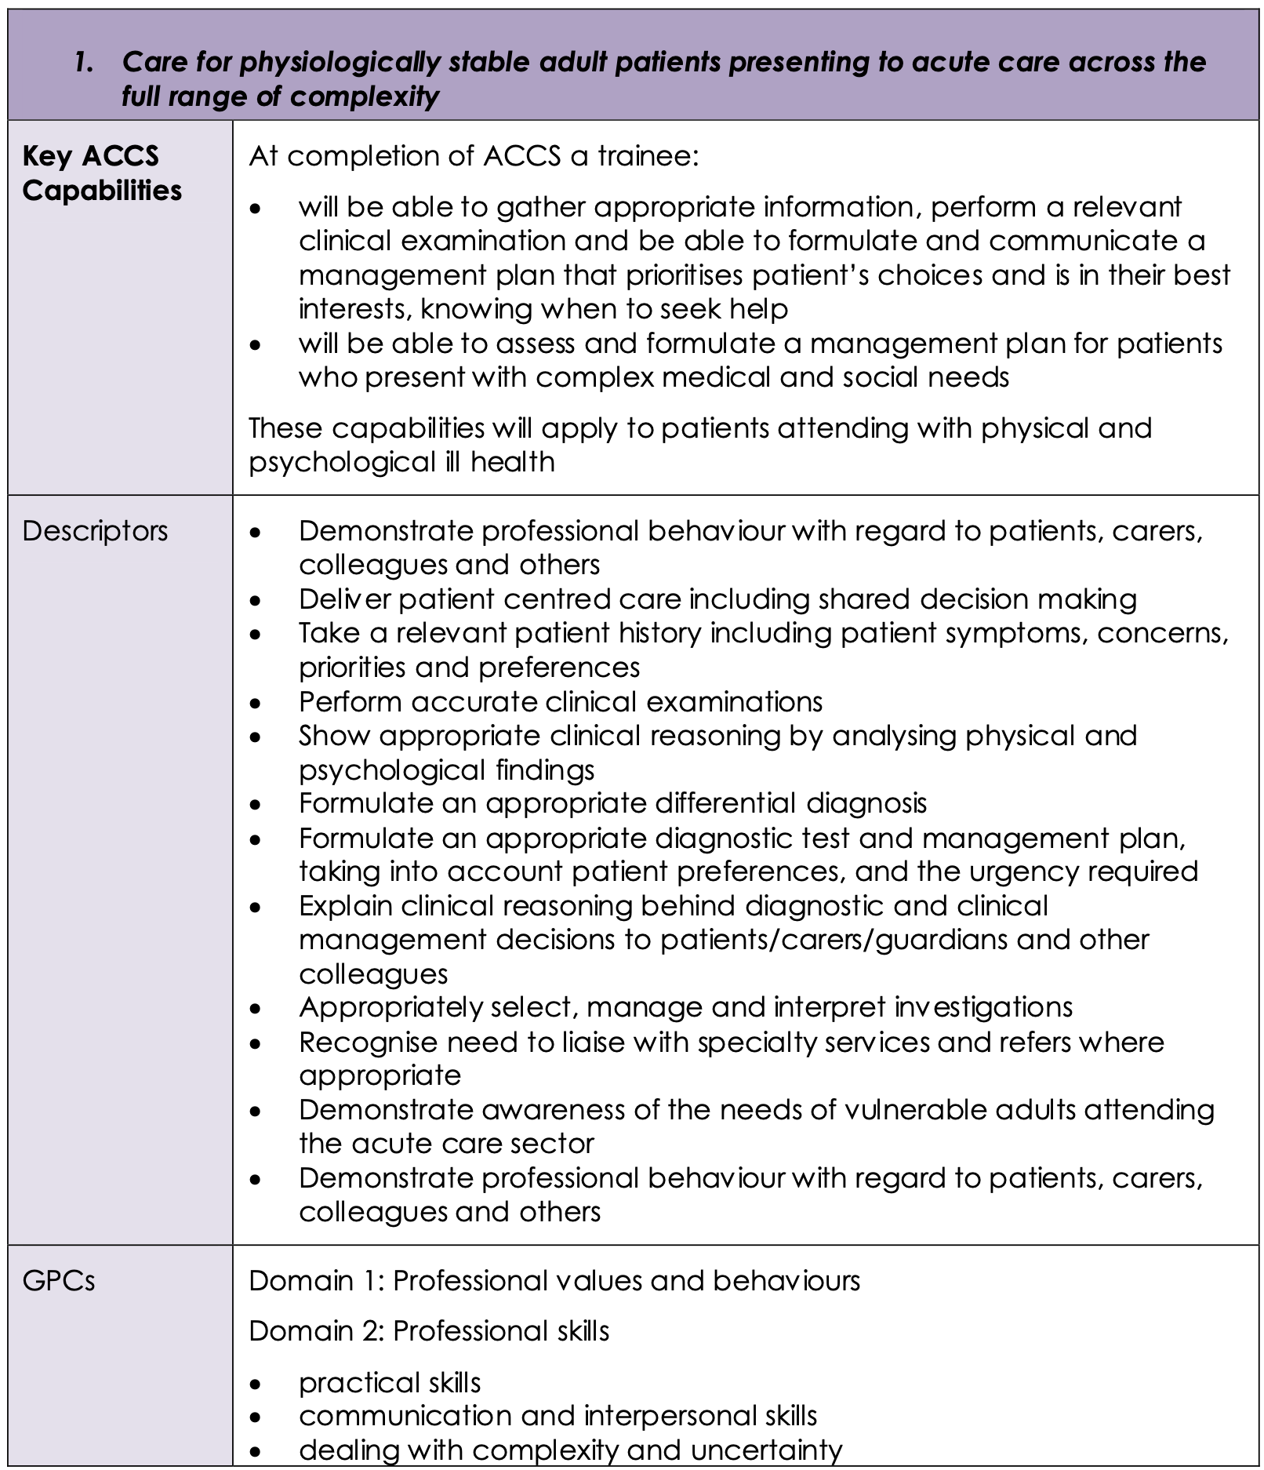
ACCS Clinical LOs
Notes:
The next few slides demonstrate how the curriculum is presented for each LO, with key capabilities, descriptors and GPCs.

Slide 12
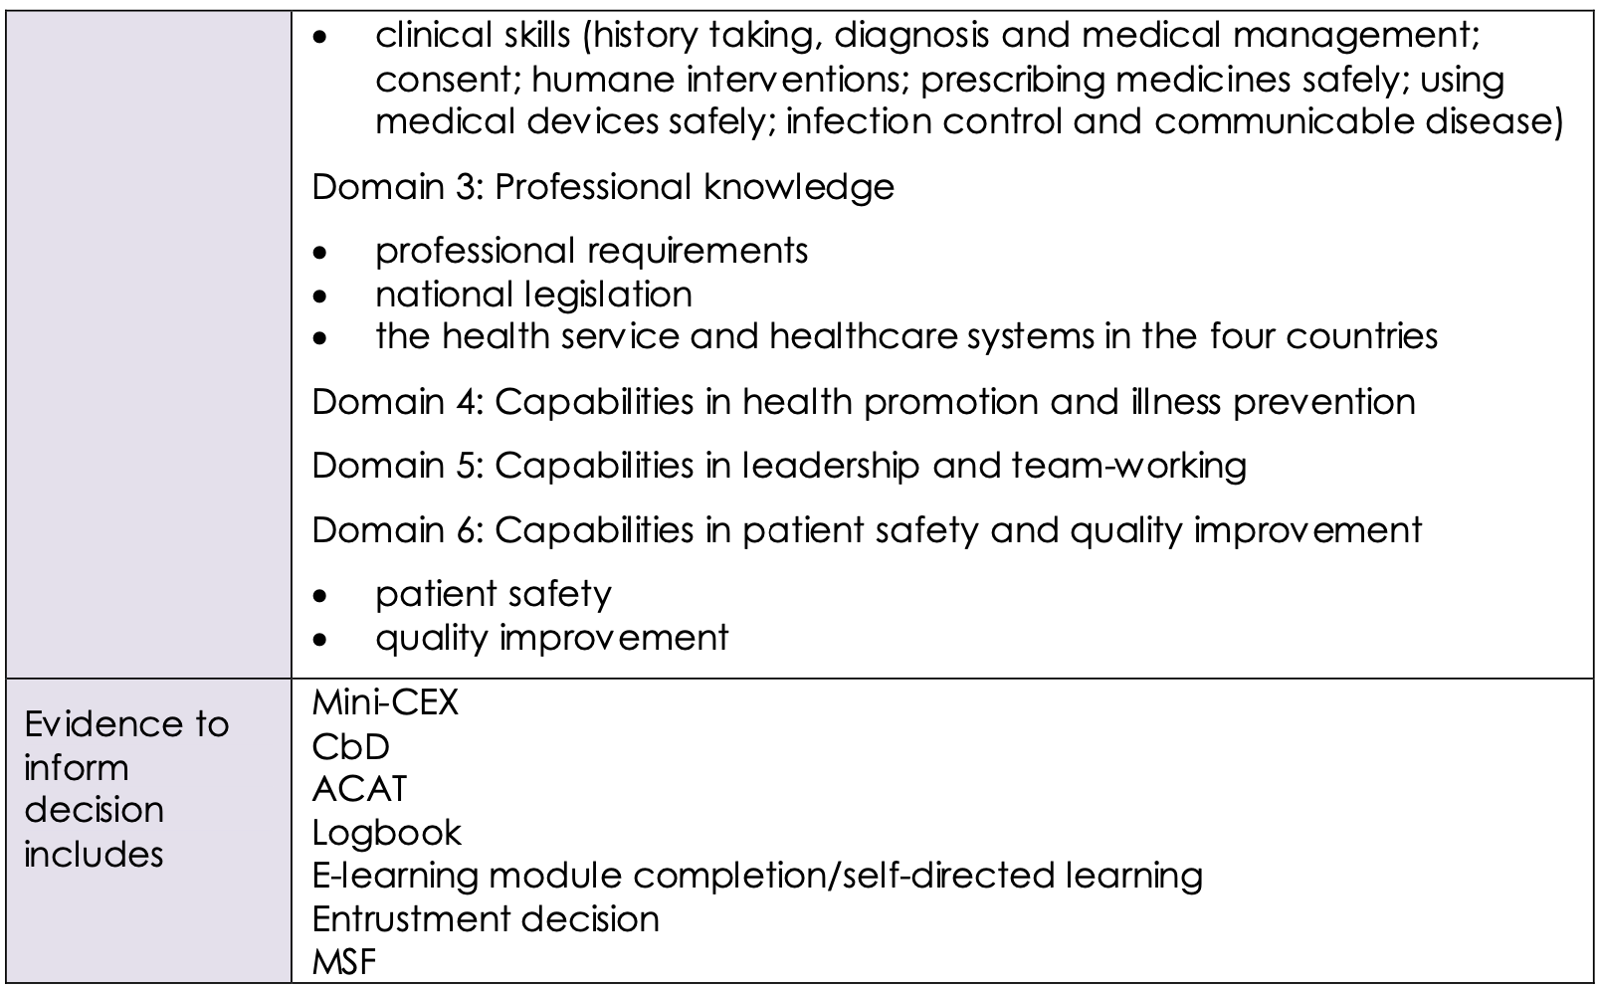
ACCS Clinical LOs
GPCs
(continued)
Notes:
It is also made very clear exactly how trainees can provide the necessary evidence.

Slide 13
ACCS Procedural Skills
5. Deliver key ACCS procedural skills
Key ACCS capabilities | At completion of ACCS a trainee: Will have the clinical knowledge to identify when key practical emergency skills are indicated Will have the knowledge and psychomotor skills to perform the skill safely and in a timely fashion
Descriptors | Pleural aspiration of air Chest drain: Seldinger and open technique Establish invasive monitoring (CVP and Art line) Vascular access in emergency- IO, femoral vein Lumbar puncture Fracture/dislocation manipulation External pacing Point of care ultrasound- Vascular access and Fascia iliaca block
GPCs | Domain 1: Professional values and behaviours Domain 2: Professional skills practical skills communication and interpersonal skills dealing with complexity and uncertainty
Evidence to inform decision includes | DOPs Logbook Entrustment decision MSF
Notes:
ACCS Learning Outcome 5 describes key practical skills relevant to ACCS training. Trainees must provide evidence of progress towards independence in these to a level appropriate for the completion of the core two years of ACCS training.
Additional practical skills of specific relevance to anaesthesia and intensive care medicine are described in ACCS Learning Outcomes 7 and 8 respectively.

Slide 14
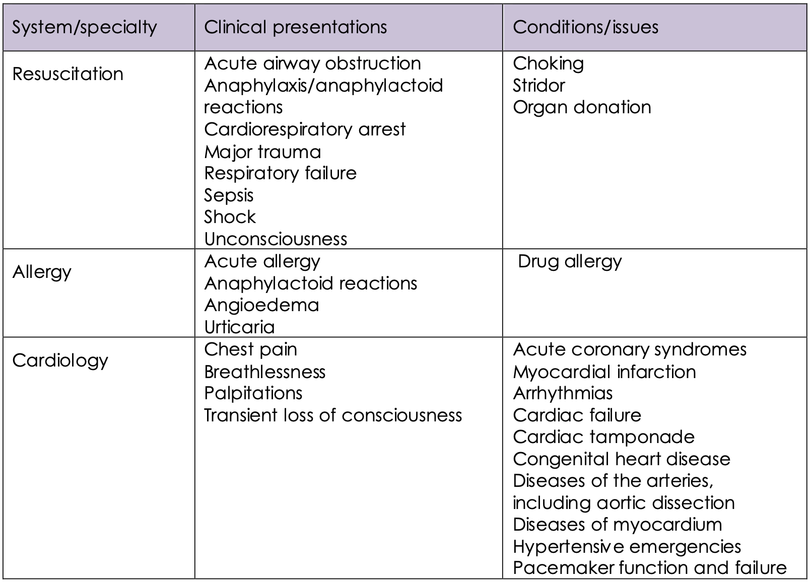
ACCS Clinical Presentations and Conditions
Notes:
The clinical content and syllabus are unchanged with the new curriculum. Clinical presentations and conditions are the same as in the old curriculum (including the old MPs and APs) but presented differently - listed by system/specialty, clinical presentation and underlying condition/issue.

Slide 15
ACCS Generic LOs
Notes:
The three Generic LOs are presented in the same clear way as the Clinical LOs to ensure trainees and trainers know what is expected.

Slide 16
Programme of assessment
Workplace-based Assessments
Panel-based Judgements
Notes:
The curriculum purposes have driven the design of the ACCS assessment strategy from start to finish. The has a fully integrated and complementary programme of assessment that recognises the strengths and limitations of its constituent parts.
The programme of assessment is made up of two major elements:
1. A programme of workplace based assessments (WPBAs)
2. A programme of regular, panel-based, information-rich, individualised judgements that regulate each trainee’s progression and remediation (where necessary)

Slide 17
Workplace-based Assessments
No minimum number – curriculum sampling
Move away from tick-box
Anchored to independence, formative
New format using entrustment scale
Developmental feedback
ACAT, CBD, mini-CEX, DOPS, MSF, PS, QIPAT and TO
Notes:
For the workplace-based assessments, there has been an explicit move away from an approach with minimum requirements that can promote a tick-box approach to one where trainees choose how to use WPBAs to evidence their progress against the high level ACCS Learning Outcomes. Trainees are given a clear description of the standard and advice on how that may be evidenced.
By providing feedback – now anchored to degree of independence - and encouraging reflection throughout training, the WPBA programme helps trainees develop self-regulated learning skills as well as identifying excellence and concerns.

Slide 18
Panel-based Judgements
Regular, individualised judgement
Regulate progression and remediation
Faculty provides summative recommendation for each LO
    Faculty Educational Governance statement (FEG) – EM
    Multi-Consultant Report (MCR) – IM, Anaes, ICM
    Holistic Assessment of Learning Outcome (HALO) - Anaes
Notes:
The second aspect to the programme of assessment is the use of panel-based judgements – specifically:
The Faculty Educational Governance (FEG) statements in Emergency Medicine
Multiple Consultant Reports (MCRs) in Internal Medicine and Anaesthesia and Intensive Care Medicine
Holistic Assessment of Learning Outcome (HALO) within Anaesthesia
These judgements work within the ARCP process to provide regular, feedback that regulates each trainee’s progression and remediation (where necessary).

Slide 19
Assessment Blueprint
Learning Outcome | Mini-CEX | CbD | ACAT | DOPS | Logbook | Teaching/presentation feedback tool | QIPAT | Portfolio/self-directed learning | Entrustment decision/FEG Statement/MCR | MSF | HALO | IAC
1. Care for physiologically stable adult patients presenting to acute care across the full range complexity | X | X | X |  | X |  |  | X | X | X
2. Make safe clinical decisions, appropriate to level of experience, knowing when and how to seek effective support | X | X | X |  | X |  |  |  | X | X
Notes:
The ACCS Curriculum provides clear guidance for trainees and trainers in the form of an assessment blueprint which sets out the possible methods of assessment for each of the Learning Outcomes.
Some ACCS LOs have a requirement for evidence of specific interaction with a particular learning element in the Programme of Learning, e.g. adult safeguarding or critical appraisal training for research. These aside however, a checklist approach has been minimised.

Slide 20
Learning Outcome | Mini-CEX | CbD | ACAT | DOPS | Logbook | Teaching/presentation feedback tool | QIPAT | Portfolio/self-directed learning | Entrustment decision/FEG Statement/MCR | MSF | HALO | IAC
3. Identify sick adult patients, be able to resuscitate and stabilise and know when it is appropriate to stop | X | X | X | X | X |  |  |  | X | X
4. Care for acutely injured patients across the full range of complexity | X | X | X | X | X |  |  |  | X | X
5. Deliver key ACCS procedural skills |  |  |  | X | X |  |  |  | X | X
Notes:
It is not expected that every method will be used for each LO.

Slide 21
Learning Outcome | Mini-CEX | CbD | ACAT | DOPS | Logbook | Teaching/presentation feedback tool | QIPAT | Portfolio/self-directed learning | Entrustment decision/FEG Statement/MCR | MSF | HALO | IAC
6. Deal with complex and challenging situations in the workplace | X |  |  |  | X |  |  |  | X | X
7. Deliver safe anaesthesia and sedation | X | X |  | X | X |  |  |  | X | X | X | X
8. Manage patients with organ dysfunction and failure | X | X |  | X | X |  |  |  | X | X
Notes:
Also, additional evidence may be used to help make a judgement on capability.

Slide 22
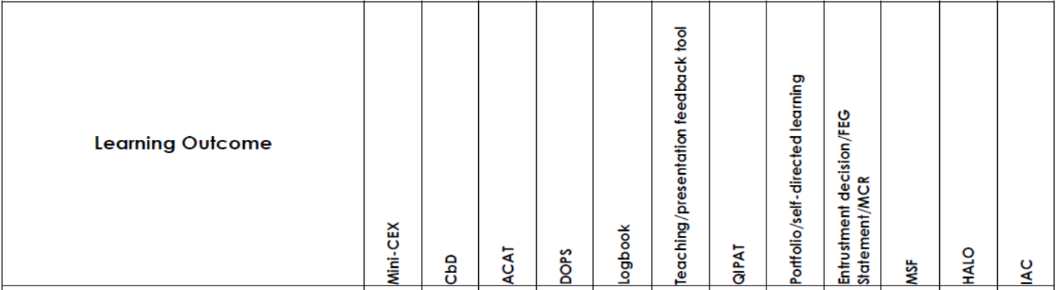
Notes:
Assessment of the 3 Generic LOs is be underpinned by the descriptors from the relevant GPC domains and evidenced against the performance and behaviour expected at that stage of training.
The ACCS entrustment scale is thus not applicable to the generic LOs, instead the Educational Supervisor reviews the evidence put forward by the trainee for each generic LO and assesses whether progress is below, at or above expectations.
Satisfactory sign off will indicate that there are no concerns before the trainee can progress to the next part of the assessment of clinical capabilities.

Slide 23
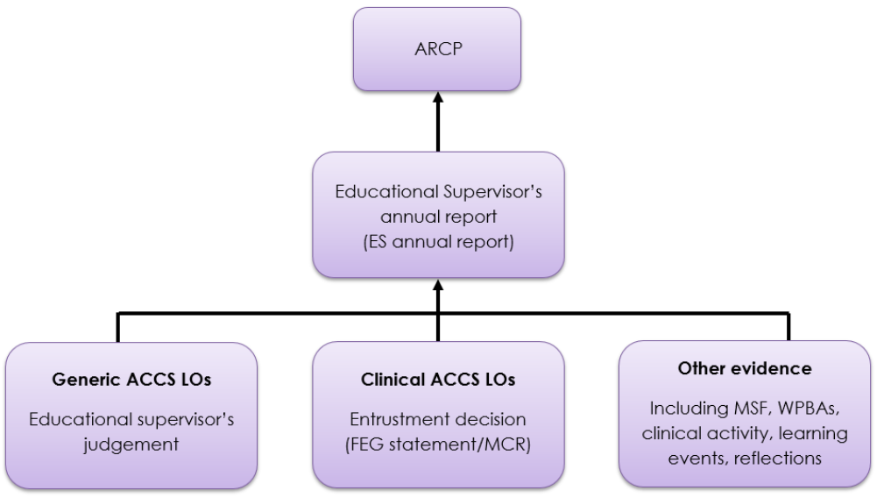
ARCP
Notes:
This diagram illustrates in overview how evidence for each of the learning outcomes is pulled together to inform ARCP.
Overall, ACCS trainees will be expected to seek opportunities to learn in each of the ACCS LOs from the outset of training and to build a body of evidence that reflects their growing clinical ability and confidence.
The information from WPBAs and the panel-based judgements is combined with other evidence provided by the trainee in an Educational Supervisor’s annual report that is completed at the end of a block of training. This, in turn, is reviewed by the ARCP panel who will make the final decision regarding progression.

Slide 24

Clinician with Foundation Competencies
ACCS
Clinician who can be relied upon to assess and manage acutely ill and injured adults, knowing when and who to ask for help
IMT
Training
EM
Training
Anaesthesia
Training
ICM
Training
CCT
Notes:
By the end of training and in order to be recommended to the GMC for the award of CCT and entry to the specialist register, trainees must demonstrate that they are capable of unsupervised practice in all generic and clinical Learning Outcomes.
The ACCS training programme, as the first stage of training for the constituent specialties, gives a sound footing for trainees to achieve this with expected performance levels for the clinical LOs commensurate with this stage of training.

Slide 25
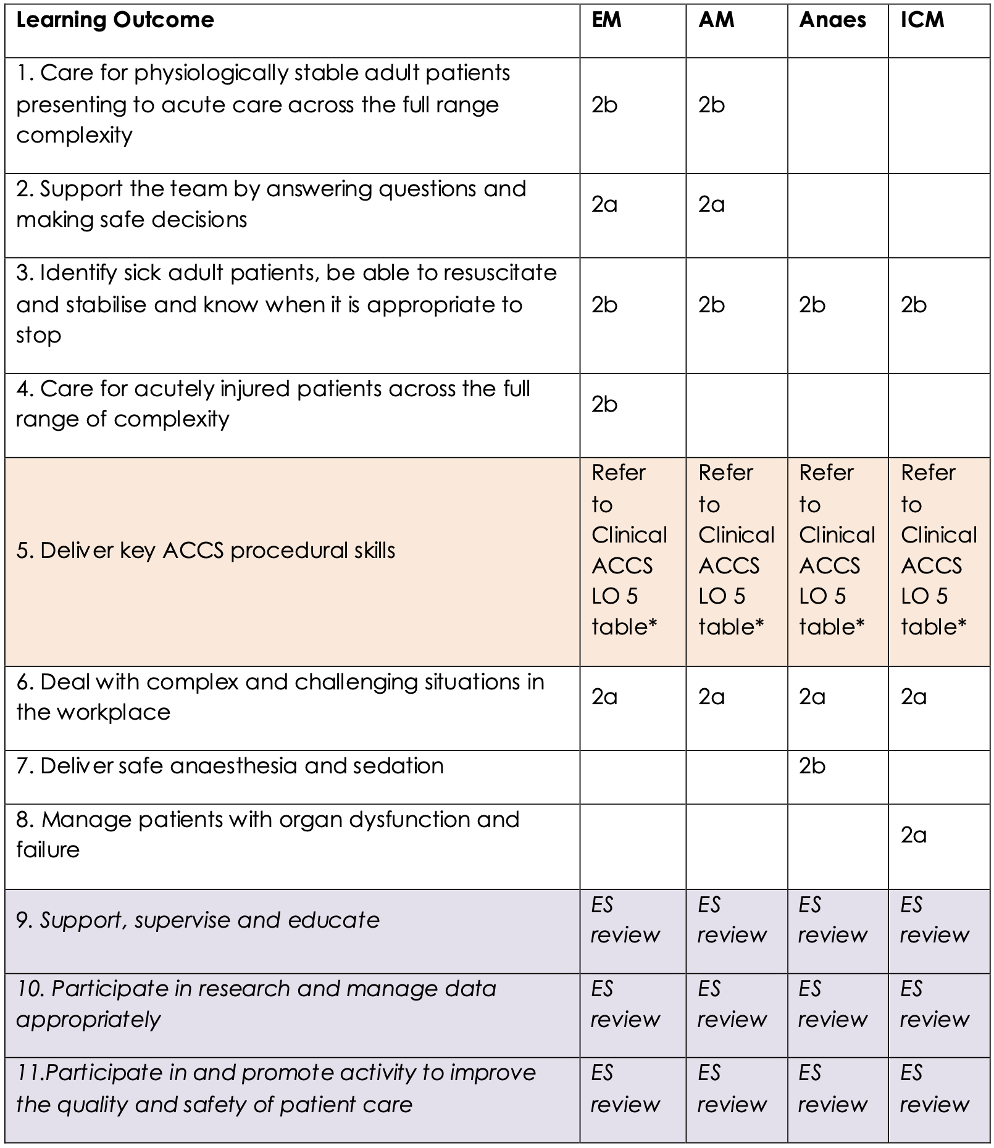
ACCS LOs:
Entrustment Requirements
Notes:
This key table sets out for each of the ACCS LOs the required entrustment level that must be achieved for each placement. Satisfactory completion to these levels is mandatory for completion of the two core ACCS years.

Slide 26
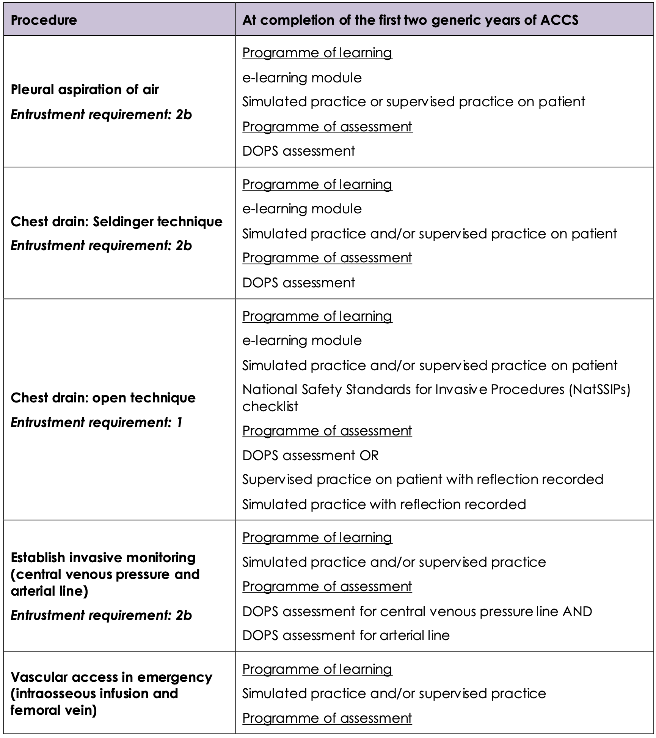
ACCS Procedural Skills:
Entrustment Requirements
Notes:
Similarly this table sets out the entrustment levels for some of the ACCS procedural skills.

Slide 27
Transition Arrangements
As uncomplicated as possible
Ideally only 1 curriculum at any one time
Aug 2021: All ACCS trainees about to start a module/placement should transition to the new curriculum irrespective how far through ACCS
LTFT, sick leave, OOP & and out-of-sync’: transition at end of current placement, start new module on new curriculum
Room for bespoke local arrangement e.g. transition part-way
Notes:
ACCS is very well placed for maximum simplicity of transition since it is divided into 6-month blocks.
All trainees starting a new placement in August 2021 should transition over to the 2021 curriculum – even if it is for the final 6 months of ACCS. This is in order to minimise the incidence of having the old and the new curricula running simultaneously.
The only trainees on the old curriculum after Aug 2021 should therefore be those who are part way through a placement - namely LTFT trainees or those returning from sick leave/time out of programme.

Slide 28
Supervision, appraisal and feedback
Each trainee must be allocated a named
  Educational supervisor: overall responsibility for supervision and management of educational progress; this person should be from their own specialty and may remain the same over the 2 years
  Clinical supervisor: leads on reviewing clinical practice throughout a placement and contributes to the ES’s report
Notes:
Trainees should be allocated named Educational Supervisor as well as a Clinical supervisor prior to each clinical attachment. These roles have distinct and complementary responsibilities, though in some instances these roles may be filled by the same individual.

Slide 29
Implementation
For the Educational Supervisor:
Familiarise self with new curriculum – using resources via website and/or attending national / local events
Make contact with trainees shortly before or as soon as possible after start of Aug 2021 to review their e-portfolio / what LOs need to be addressed in the remainder of their training
Notes:
Educational Supervisors must meet with their trainee(s) prior to, or very shortly after, August 2021.
For new CT1s this should involve:
Clarification of roles/responsibilities
Overview of the curriculum as a whole – LOs, entrustment, assessments, ARCP etc.
Review of expectations for each placement (LOs and entrustment levels/progress as per table in curriculum)
Review of e-portfolio, agreeing a PDP/educational plan
For existing trainees entering CT2 in this will involved the above as well as mapping coverage of the old curriculum to date across to the new one. Details of how to do this are provided elsewhere including ACCS and College websites and podcasts/videos.
In simple terms, whatever placements have been signed off do not need to be revisited. Additionally, the new curriculum is more generic and so there is greater flexibility for making entrustment decisions of most LOs in more than one placement.

Slide 30
Implementation
For the Clinical Supervisor:
Establish clear plan for how the trainee’s placement will be supervised / date for next review
Review LO matrix with trainee
Regular meetings with the trainee to review progress
Initiate of FEGs / MCRs and collation of feedback
Complete ‘end-of-placement’ report at the end of the placement including the recommended LO entrustment decisions
Notes:
During the placement, the named Clinical Supervisor is responsible for:
Ensuring regular meetings with the trainee take place,
Initiating the FEG/MCRs - the results of these are collated and fed back to the trainee to optimize their educational benefit
Completing an end-of-placement report including the recommended entrustment decisions for the relevant LOs
The Clinical Supervisor make a plan with the trainee covering objectives for that placement. The objectives for the placement should be established by reviewing the trainee’s e-portfolio to date and the LO entrustment matrix.

Slide 31
Implementation
For the trainee:
Establish contact with Educational Supervisor ASAP
Establish early contact with clinical supervisor for first and subsequent placements
Review LOs to obtain overview of all requirements
Placements that have been ‘signed off’ on old curriculum do not need to be revisited
Use entrustment matrix to establish which LOs require entrustment decisions for that placement
Notes:
Trainees will need to take the initiative in ensuring they meet with their Educational and Clinical Supervisors promptly around the August changeover.
As part of these meetings, for existing trainees entering CT2 in August 2021 this will involve mapping coverage of the old curriculum to date across to the new one.
In simple terms, whatever placements have been signed off do not need to be revisited. Additionally, the new curriculum is more generic and so there is greater flexibility for making entrustment decisions of most LOs in more than one placement.
The LO entrustment matrix provides the structure summary for what gets covered where and the requirements for each placement.

Slide 32
Resources
Trainees event and Q&As from Spring 2021
Curriculum rough guide
Podcasts and videos
All available on ACCS and parent specialty websites
Notes:
There is a range of resources both available now and in development to support the introduction of this new curriculum:
There will be live Q&As and a Trainees event starting in Spring 2021.
There will be a curriculum rough guide that gives an overview and summary of the key aspects.
There will also be podcasts and/short videos covering key aspects of the curriculum.
All events and resources are/will be advertised on the ACCS website, parent College websites, in the ICACCST newsletter and via the ACCS training leads.

Slide 33
Summary
  GMC standards for postgraduate curricula
  GPCs
  Learning Outcomes
  Entrustment
  Assessment & ARCP
  Supervision arrangements
          Transition & implementation
Notes:
This summarises what has been covered in this overview presentation.

