Slide 1
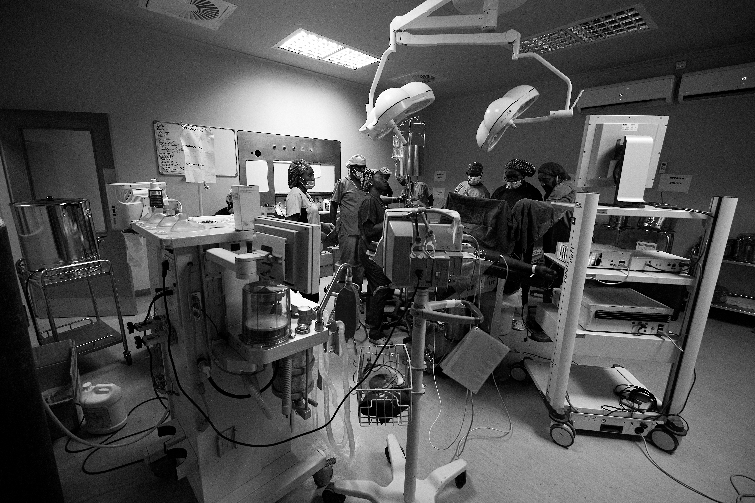
GADP VIRTUAL CONFERENCE
2021
Continuing to build essential surgical services during a pandemic
29 January 2021
09:50 – 16:00 GMT
Free to attend
Donations welcome
CPD points TBC
Book your place here:
Donate here:
GADP 2021
JUSTGIVING CAMPAIGN
Contact us : infogadp@gmail.com

